Slide 1
Wildfire Season Forecast 2023
Richard Carr, Wildland Fire Research Analyst, Natural Resources Canada, Canadian Forest Service
Forecast 2023
June 6, 2023

Slide 2
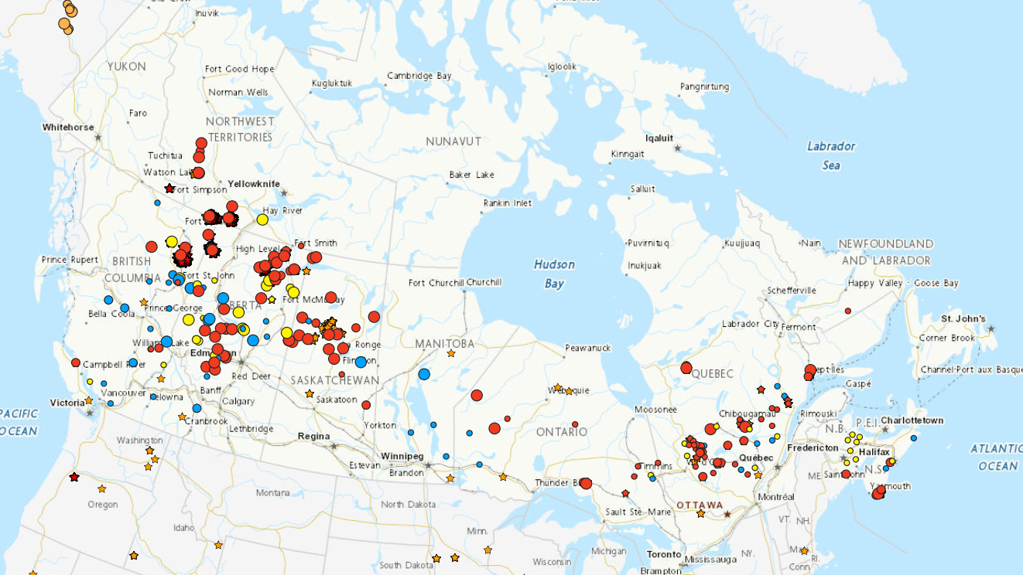
Whoa! What’s going on this year?!!
CWFIS interactive map, June 2, 2023
Already at/above mean area burned for an entire year
Notes:
2

Slide 3
Statistics to date
“I don’t want to comment on that since the numbers are changing so fast they are quickly outdated.”
Numbers from the June 5, 2023 CIFFC Situation Report:
Fires: 2266
Area burned: 3,571,727 ha
10-year averages for early June: (~1700 fires, 270,000 ha)
CIFFC National Preparedness Level (NPL) at 5 since May 11 (earliest on record) 1 2 3 4 5
International crews in from USA, AUS, NZ, ZA,
CIFFC situation report web page has been reworked

Slide 4
1989 vs 2023
1989 featured most area burned in our modern records
~7.5 million hectares burned; about 43% in Manitoba
Were 1989 weather patterns similar to 2023?
Both years featured fading La Nina; 1989 persisted later
1989-early 1991 had long extended ENSO-neutral period
Drought prevalent
Add 30 years of climate warming
Better detection and suppression methods in 2023
Notes:
4

Slide 5
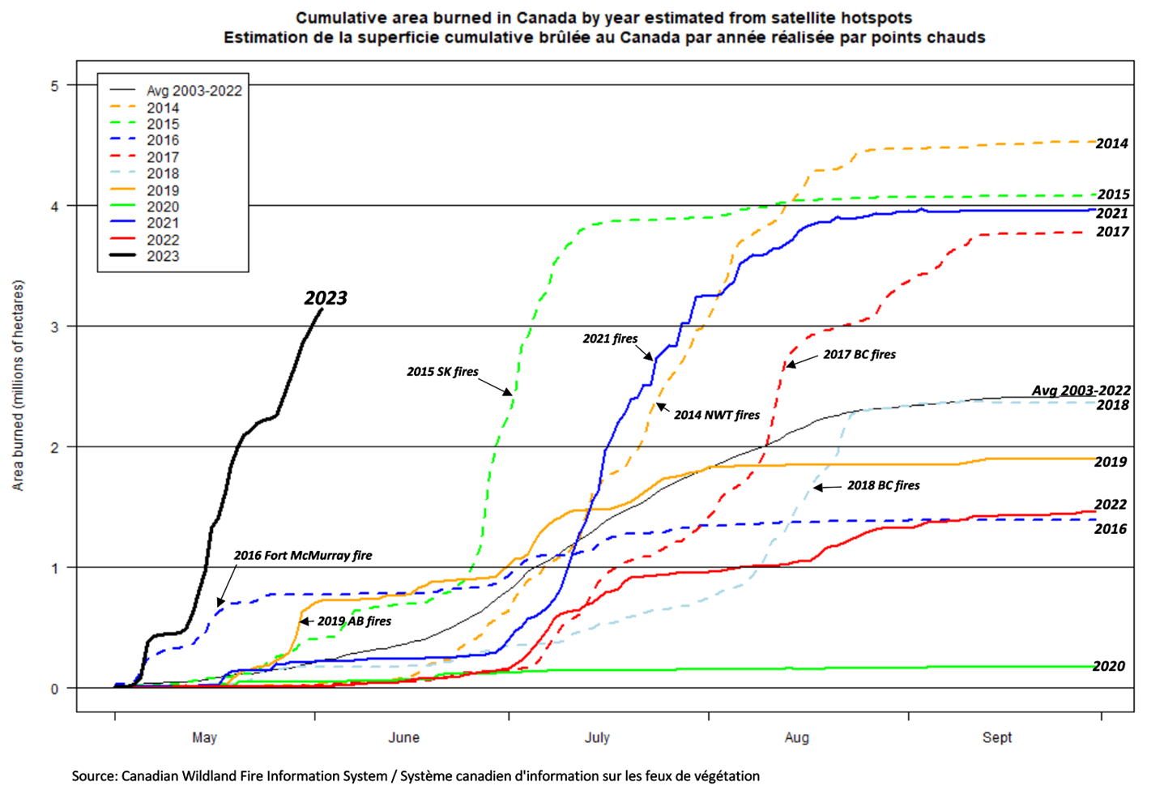
Unprecedented area burned increase
Notes:
5

Slide 6
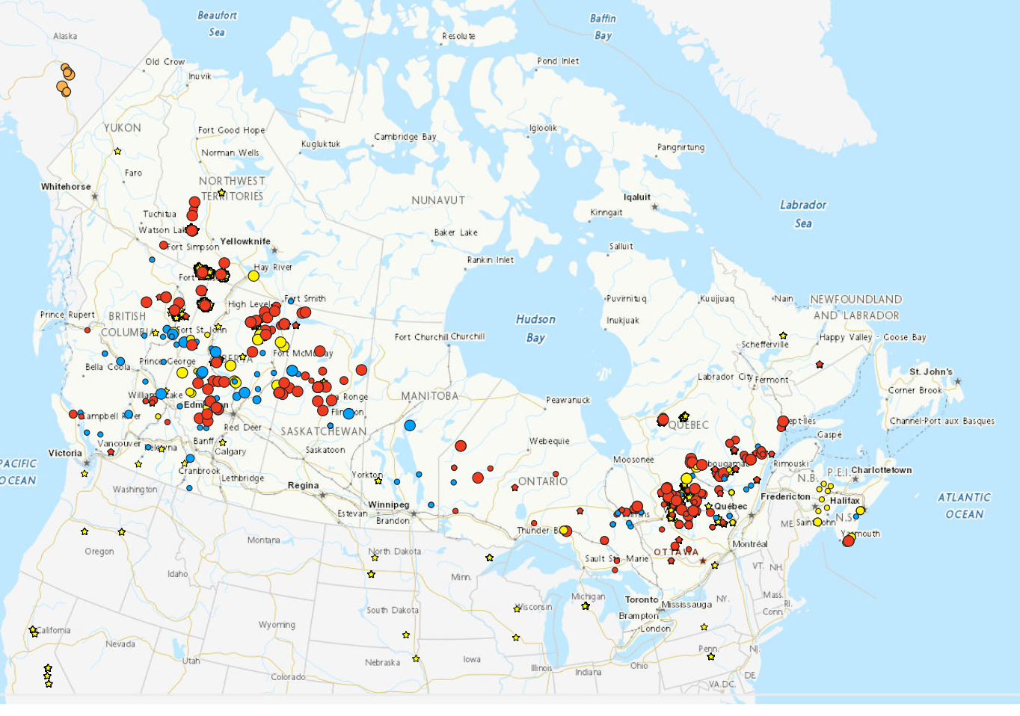
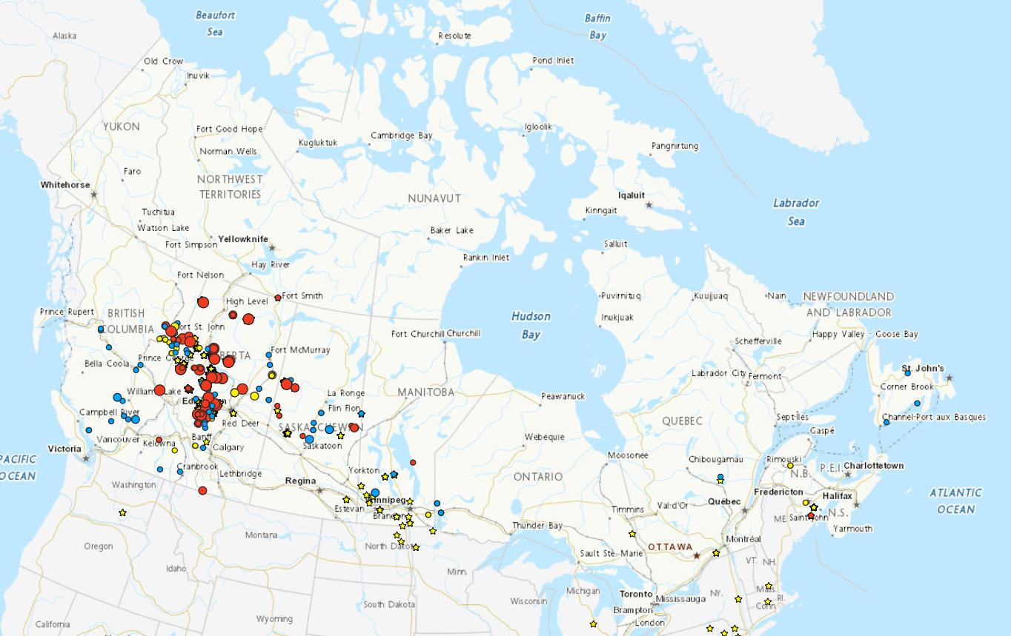
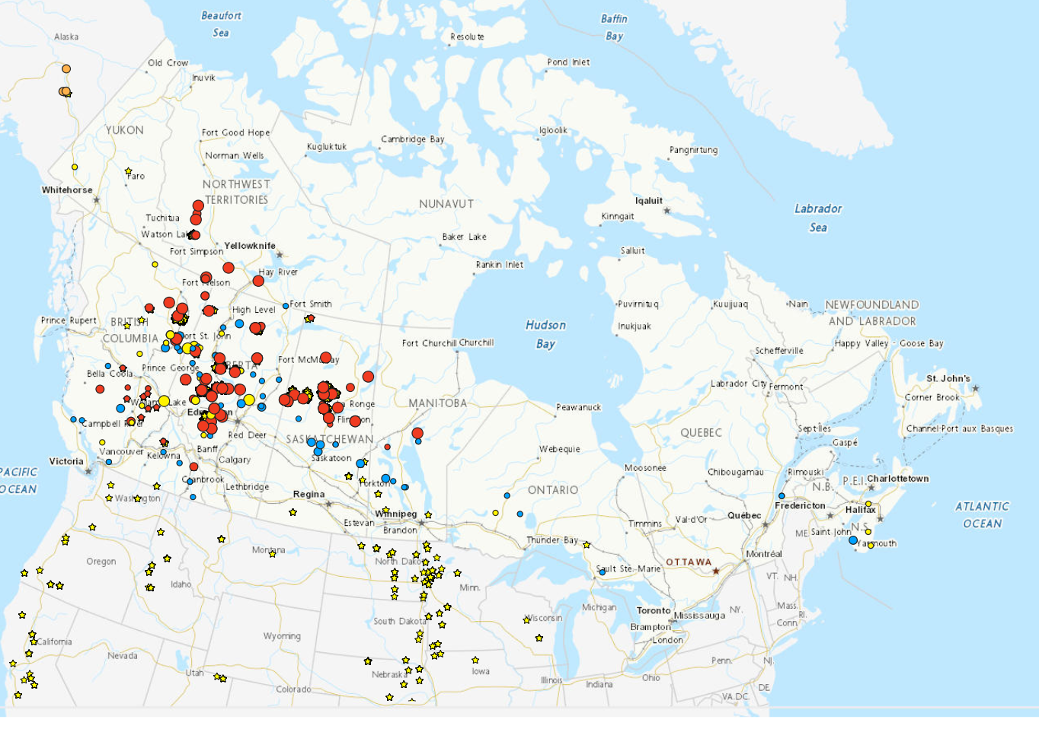
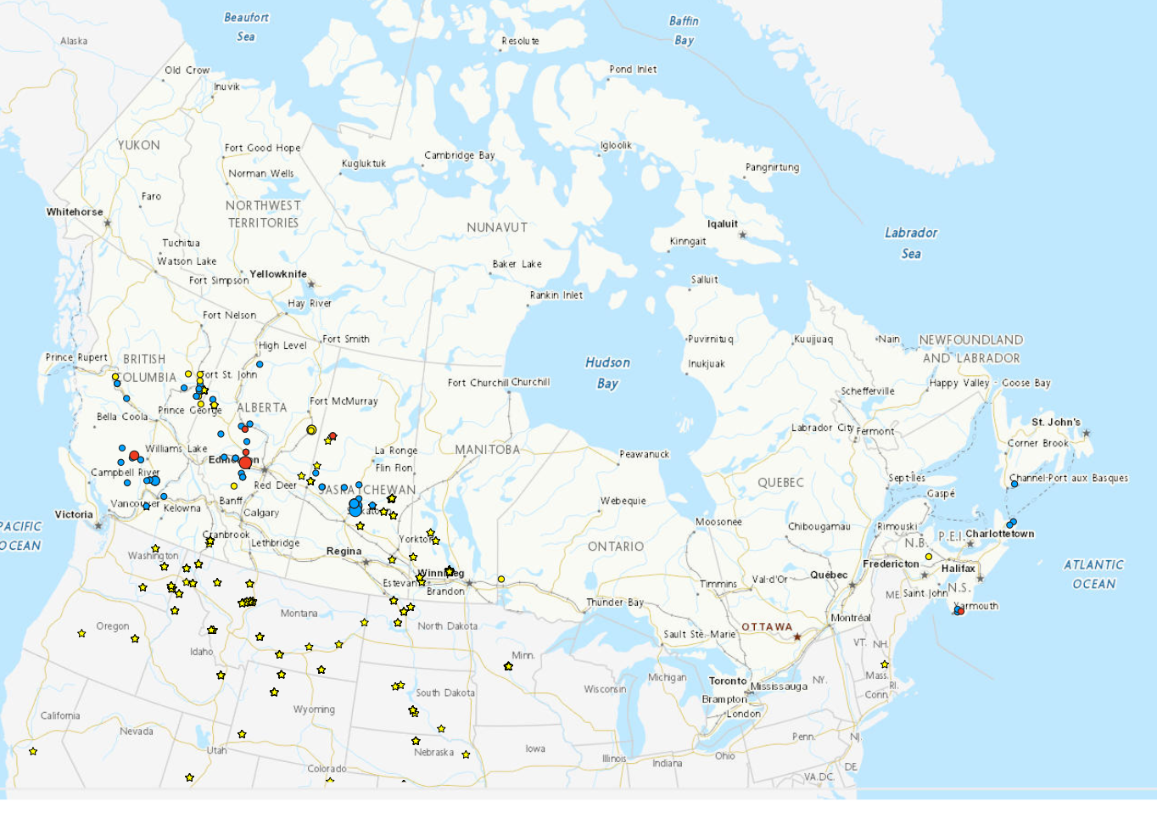
Hotspot and Fire Progression
May 1, 2023
May 6, 2023
May 20, 2023
June 3, 2023
Notes:
6

Slide 7
Why might this have happened?
Notes:
7

Slide 8
Facts and Anecdotes
Transition speeds of ocean/atmosphere indexes may be more important than phase maxima/minima
Warmest May on record in Washington state
Similar in western Canada? Numbers not assessed yet
Notes:
8

Slide 9
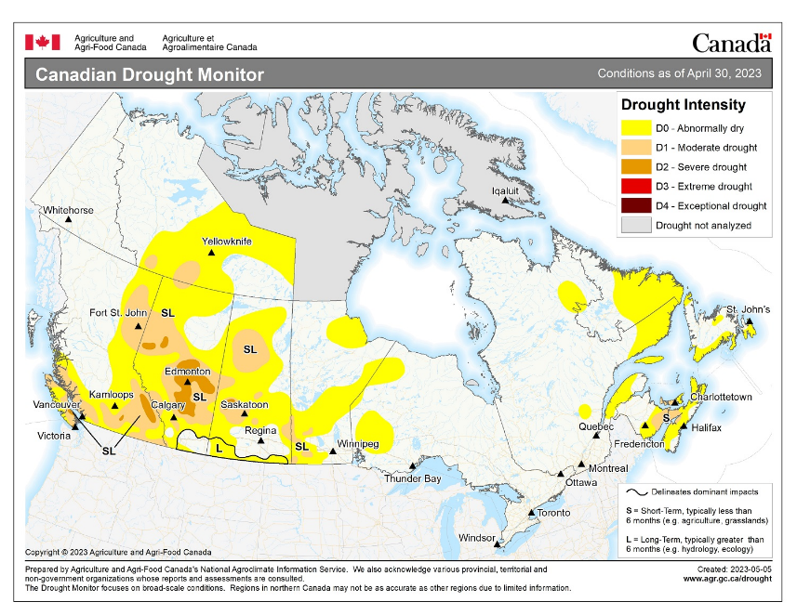
Drought Progression
Drought intensified in late 2022; few areas of improvement
Notes:
9

Slide 10
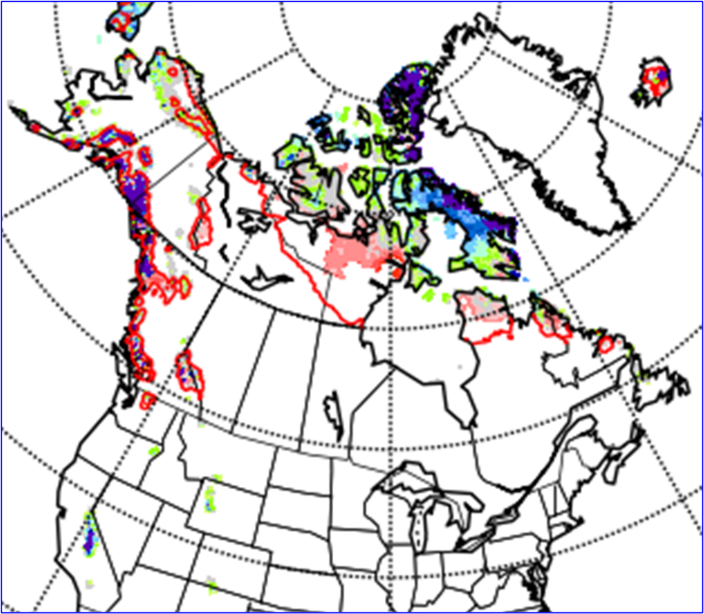
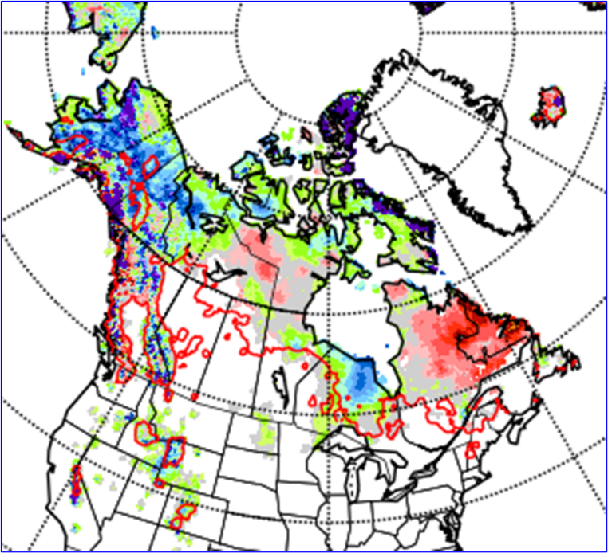
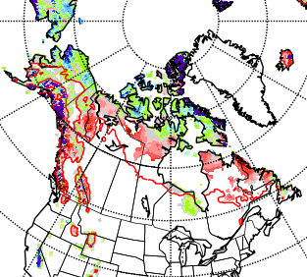
2022 Spring start-up conditions
Snow depths
Affects spring more than summer
May 17, 2023
April 26, 2023
May 10, 2023
Notes:
Past 6 months precipitation (percent of average) map from Agriculture and Agri-Food Canada. Few stations in northern regions with the correct history for comparison.
Canadian Drought Monitor map (top right) from Agriculture and Agri-Food Canada. Conditions are derived from a variety of indexes with user feedback to finalize areas and intensities.
Snow depth anomaly map (bottom right) is from the Canadian Cryospheric Information Network. The red line encloses the area that has at least a 2-cm mean depth for the time of year. Figure shows snow cover gone in west except mountain areas; deep snow remaining in eastern Quebec and Labrador.

Slide 11
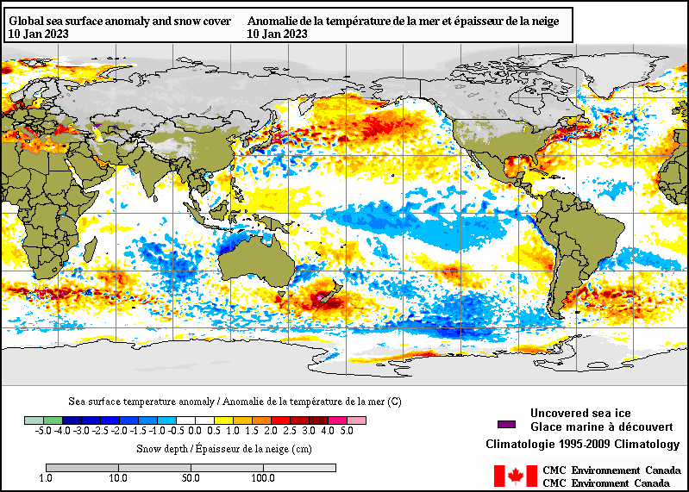
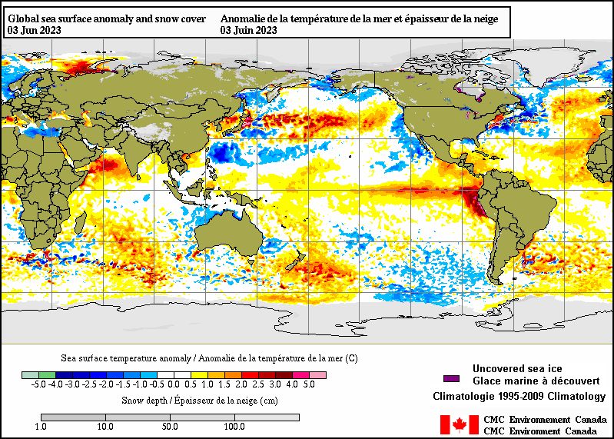
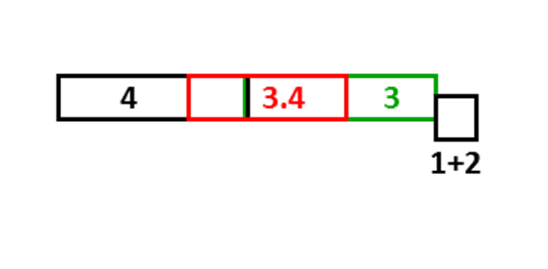
ENSO, PDO – Current SST
La Nina faded
El Nino developing
Are we getting the “worst” of each???
Cold north Atlantic favoring high pressure in east?
Notes:
Sea surface temperatures (SST): blue = below normal, orange--red = above normal.
Blue plume in the boxes along the equator indicate La Nina is still active (ENSO SST indexes are measured in the red box).
SST in the red ellipse can indicate status of the Pacific Decadal Oscillation (PDO). Cold water along the BC coast with warm water in the central north Pacific indicate the PDO is in the negative phase. Some of the big fire years in northern parts of the provinces and Territories have occurred with a positive PDO, opposite phase from what we currently see.
11

Slide 12
Fire problems in ENSO Springs
El Niño:
Warm, windy, dry in western Canada
La Niña:
Arctic surface highs bring dry air, strong wind around edges
Temperature may be cool
Summer fire problems may depend on other influences
Year | DJF | JFM | FMA | MAM | AMJ | MJJ | JJA | JAS | ASO | SON | OND | NDJ
1995 | 1.0 | 0.7 | 0.5 | 0.3 | 0.1 | 0.0 | -0.2 | -0.5 | -0.8 | -1.0 | -1.0 | -1.0
1996 | -0.9 | -0.8 | -0.6 | -0.4 | -0.3 | -0.3 | -0.3 | -0.3 | -0.4 | -0.4 | -0.4 | -0.5
1997 | -0.5 | -0.4 | -0.1 | 0.3 | 0.8 | 1.2 | 1.6 | 1.9 | 2.1 | 2.3 | 2.4 | 2.4
1998 | 2.2 | 1.9 | 1.4 | 1.0 | 0.5 | -0.1 | -0.8 | -1.1 | -1.3 | -1.4 | -1.5 | -1.6
1999 | -1.5 | -1.3 | -1.1 | -1.0 | -1.0 | -1.0 | -1.1 | -1.1 | -1.2 | -1.3 | -1.5 | -1.7
2000 | -1.7 | -1.4 | -1.1 | -0.8 | -0.7 | -0.6 | -0.6 | -0.5 | -0.5 | -0.6 | -0.7 | -0.7
2001 | -0.7 | -0.5 | -0.4 | -0.3 | -0.3 | -0.1 | -0.1 | -0.1 | -0.2 | -0.3 | -0.3 | -0.3
2002 | -0.1 | 0.0 | 0.1 | 0.2 | 0.4 | 0.7 | 0.8 | 0.9 | 1.0 | 1.2 | 1.3 | 1.1
2003 | 0.9 | 0.6 | 0.4 | 0.0 | -0.3 | -0.2 | 0.1 | 0.2 | 0.3 | 0.3 | 0.4 | 0.4
2004 | 0.4 | 0.3 | 0.2 | 0.2 | 0.2 | 0.3 | 0.5 | 0.6 | 0.7 | 0.7 | 0.7 | 0.7
2005 | 0.6 | 0.6 | 0.4 | 0.4 | 0.3 | 0.1 | -0.1 | -0.1 | -0.1 | -0.3 | -0.6 | -0.8
2006 | -0.8 | -0.7 | -0.5 | -0.3 | 0.0 | 0.0 | 0.1 | 0.3 | 0.5 | 0.7 | 0.9 | 0.9
2007 | 0.7 | 0.3 | 0.0 | -0.2 | -0.3 | -0.4 | -0.5 | -0.8 | -1.1 | -1.4 | -1.5 | -1.6
2008 | -1.6 | -1.4 | -1.2 | -0.9 | -0.8 | -0.5 | -0.4 | -0.3 | -0.3 | -0.4 | -0.6 | -0.7
2009 | -0.8 | -0.7 | -0.5 | -0.2 | 0.1 | 0.4 | 0.5 | 0.5 | 0.7 | 1.0 | 1.3 | 1.6
2010 | 1.5 | 1.3 | 0.9 | 0.4 | -0.1 | -0.6 | -1.0 | -1.4 | -1.6 | -1.7 | -1.7 | -1.6
2011 | -1.4 | -1.1 | -0.8 | -0.6 | -0.5 | -0.4 | -0.5 | -0.7 | -0.9 | -1.1 | -1.1 | -1.0
2012 | -0.8 | -0.6 | -0.5 | -0.4 | -0.2 | 0.1 | 0.3 | 0.3 | 0.3 | 0.2 | 0.0 | -0.2
2013 | -0.4 | -0.3 | -0.2 | -0.2 | -0.3 | -0.3 | -0.4 | -0.4 | -0.3 | -0.2 | -0.2 | -0.3
2014 | -0.4 | -0.4 | -0.2 | 0.1 | 0.3 | 0.2 | 0.1 | 0.0 | 0.2 | 0.4 | 0.6 | 0.7
2015 | 0.6 | 0.6 | 0.6 | 0.8 | 1.0 | 1.2 | 1.5 | 1.8 | 2.1 | 2.4 | 2.5 | 2.6
2016 | 2.5 | 2.2 | 1.7 | 1.0 | 0.5 | 0.0 | -0.3 | -0.6 | -0.7 | -0.7 | -0.7 | -0.6
2017 | -0.3 | -0.1 | 0.1 | 0.3 | 0.4 | 0.4 | 0.2 | -0.1 | -0.4 | -0.7 | -0.9 | -1.0
2018 | -0.9 | -0.8 | -0.6 | -0.4 | -0.1 | 0.1 | 0.1 | 0.2 | 0.4 | 0.7 | 0.9 | 0.8
2019 | 0.7 | 0.7 | 0.7 | 0.7 | 0.5 | 0.5 | 0.3 | 0.1 | 0.2 | 0.3 | 0.5 | 0.5
2020 | 0.5 | 0.5 | 0.4 | 0.2 | -0.1 | -0.3 | -0.4 | -0.6 | -0.9 | -1.2 | -1.3 | -1.2
2021 | -1.0 | -0.9 | -0.8 | -0.7 | -0.5 | -0.4 | -0.4 | -0.5 | -0.7 | -0.8 | -1.0 | -1.0
2022 | -1.0 | -0.9 | -1.0 | -1.1 | -1.0 | -0.9 | -0.8 | -0.9 | -1.0 | -1.0 | -0.9 | -0.8
2023 | -0.7 | -0.4 | -0.1 | 0.1
Large area burned
Virginia Hills, AB
Chisholm, AB
Kelowna, BC
Slave Lake, AB
PDO positive phase
Fort McMurray, AB
Big years in BC
Western half

Slide 13
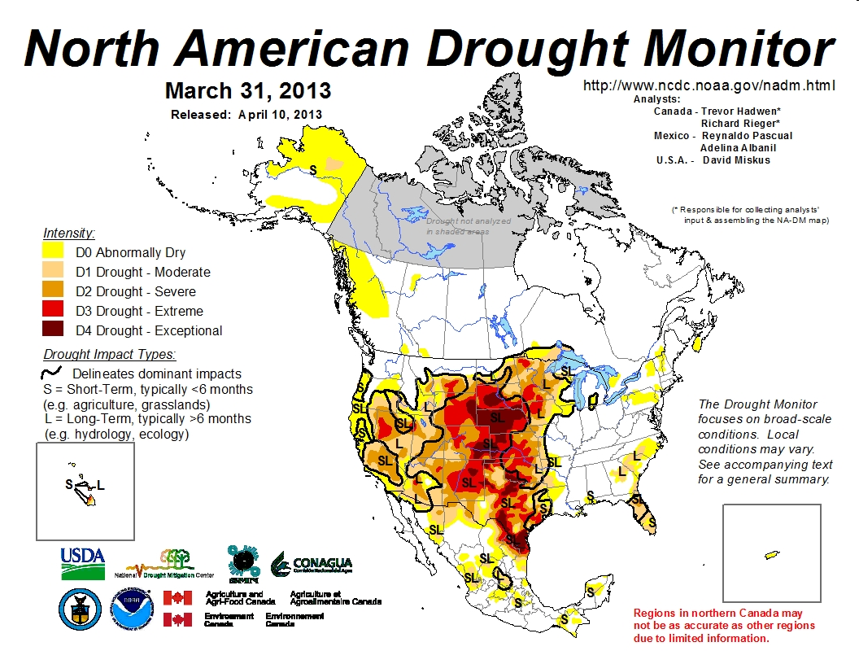
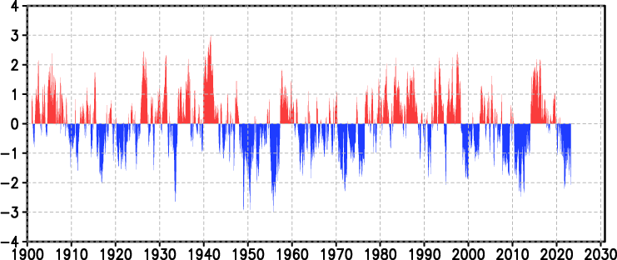
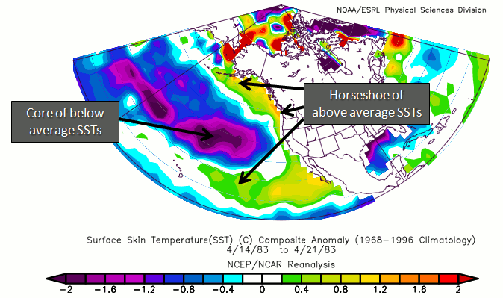
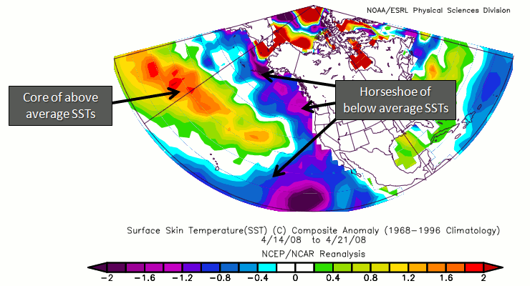
Pacific Decadal Oscillation
https://ds.data.jma.go.jp/tcc/tcc/products/elnino/decadal/pdo_month.html
Warm phase
Cold phase
http://climate.ncsu.edu/climate/patterns/PDO.html
Notes:
13

Slide 14
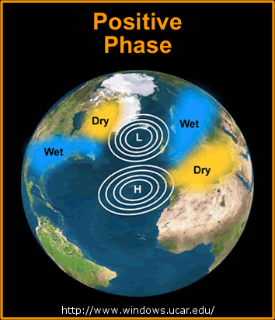
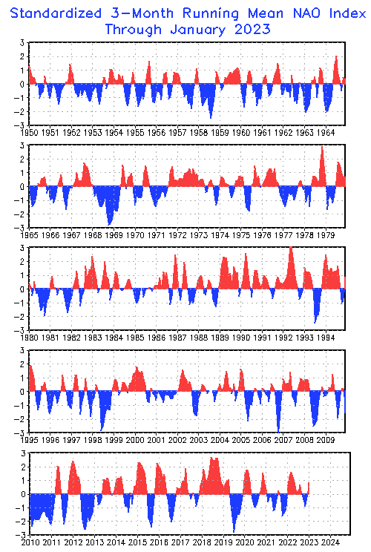
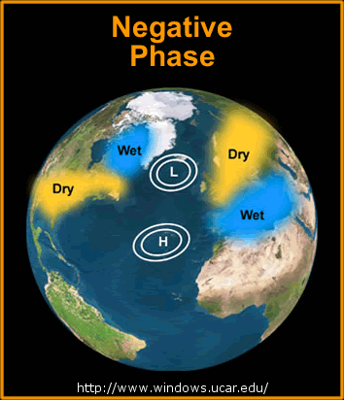
North Atlantic Oscillation
http://www.cpc.ncep.noaa.gov/products/precip/CWlink/pna/nao.timeseries.gif
Quebec Area Burned
(NFDB, ha*1000)
2020 69
2019 10
2018 86
2017 38
2016 33
2015 5
2014 64
2013 1900
2012 64
2011 12
2010 315
2009 94
2008 1
2007 343
2006 136
2005 800
2004 3
2003 88
2002 1000
2001 33
2000 39
+
-
-
+
Notes:
Years with high burned area in Quebec are indicated with the black arrows. Perhaps the degree to which the NAO is positive influences fire occurrence, which depends on the correct dryness (high atmospheric pressure) coupled with enough atmospheric instability to generate thundershowers, or increased human activity in the absence of rain. This may occur during years where the NAO transitions between negative and positive or vice versa.
A study ongoing at Universite du Quebec a Montreal will likely provide more insight into oceanic/atmospheric oscillations that influence fire in eastern Canada. One finding may link a Baffin/West Atlantic (BWA) oscillation with increased severity rating (I have not read outcomes from this study so can’t comment on this any more at this time).
14

Slide 15
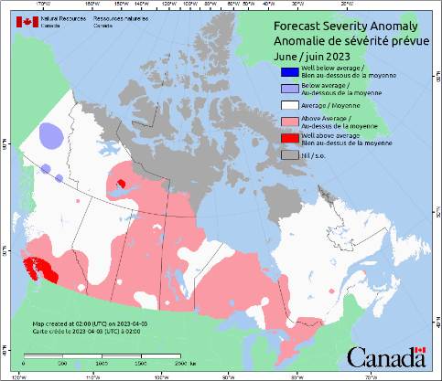
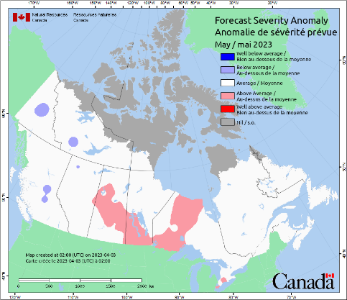
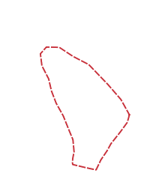
NRCan-CFS Prediction: April run, for May and June
This is not the most recent forecast
Wind influence?
Anomaly
Predicted values normalized against average weather
Notes:
The patchy red pattern likely indicates anomaly values lie close to the division between normal and above normal.
Much above normal values begin to appear in central Canada in July (bright red). Fire activity normally increases for its
summer peak beginning in mid-July, so this area may be a precursor for expected escalation of August activity (next slide).
15

Slide 16
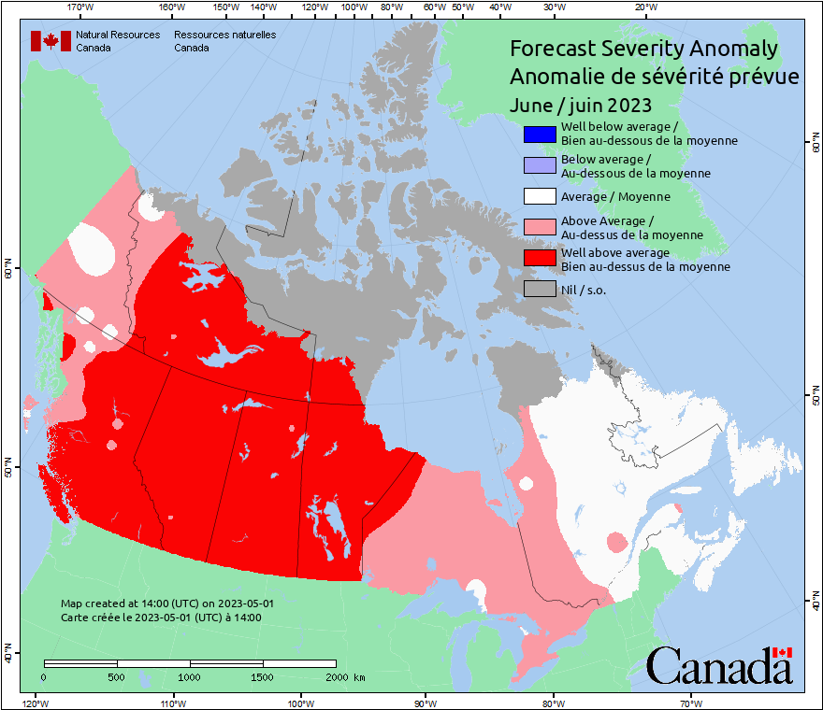
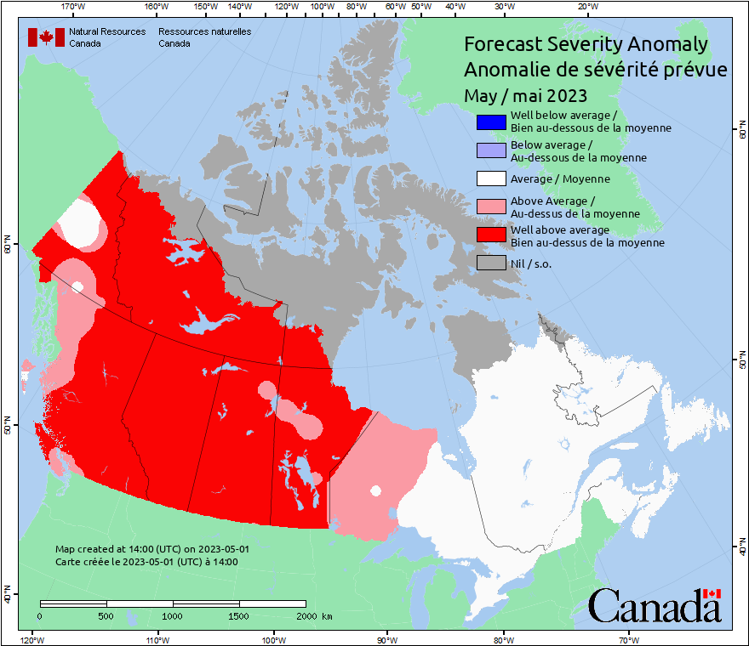
NRCan-CFS Prediction: May run, for May and June
This is not the most recent forecast
Anomaly
Predicted values normalized against average weather
Notes:
August shows the peak intensity for 2022. Active fire in August can carry on through September or longer, but in September, we begin to see fire activity wane in the north due to cooler days, longer nights, better moisture retention, less lightning, and possible snow events.
16

Slide 17
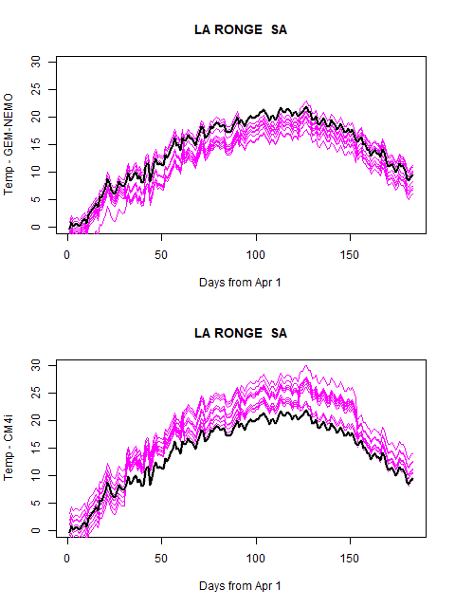
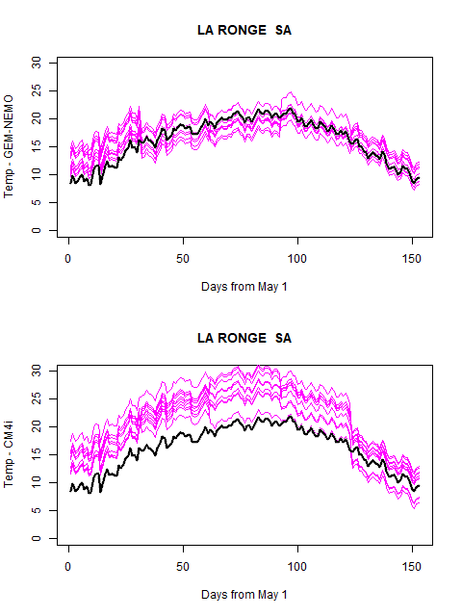
Why did April and May Forecasts Differ?
Canadian Seasonal to Interannual Prediction System:
CanCM4i + GEM5-NEMO
Notes:
August shows the peak intensity for 2022. Active fire in August can carry on through September or longer, but in September, we begin to see fire activity wane in the north due to cooler days, longer nights, better moisture retention, less lightning, and possible snow events.
17

Slide 18
Climate Ensemble Data: CanSIPS
Models developed by Canadian Centre for Climate Modeling and Analysis
CanCM4i
GEM-NEMO: Global Environmental Multiscale – Nucleus for European Modeling of the Ocean
10-member ensembles producing 12-month forecasts
NRCan uses temperature and precipitation data
Skill of climate forecasts often best in coastal areas, poorer in lee of mountain ranges
Notes:
18

Slide 19
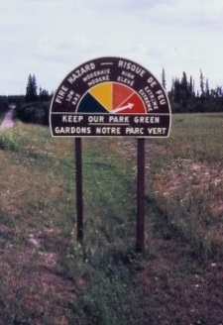
Canadian Forest Fire Weather Index (FWI) System
Seasonal forecasts use the severity rating anomaly
Fire Weather
Observations
Temperature
Humidity,
Wind, Rain
Temperature,
Humidity,
Rain
Snow depth
Barometric Pressure
Horizontal Visibility
Cloud cover and type
Upper air data
Wind
Temperature,
Rain
Fuel Moisture
Codes
FFMC
Fine Fuel Moisture Code
DMC
Duff Moisture Code
DC
Drought Code
Fire Behavior
Indexes
ISI
Initial Spread Index
BUI
Buildup Index
FWI
Fire Weather Index
DSR/MSR/SSR
Severity Rating
Notes:
19

Slide 20
2023 Seasonal Predictions
What happens now???
Notes:
20

Slide 21
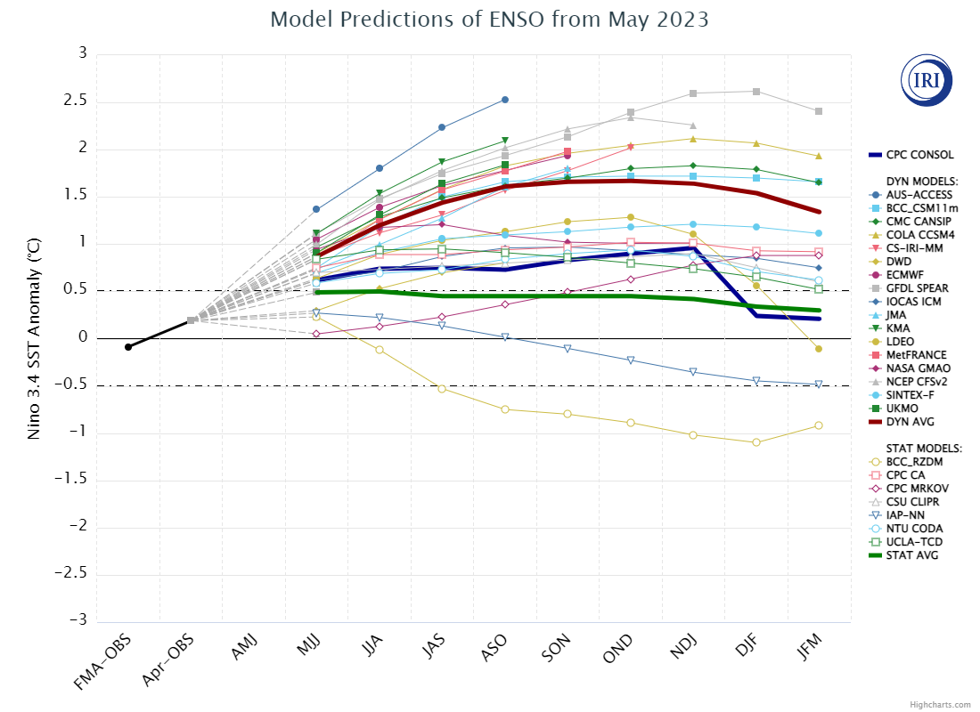
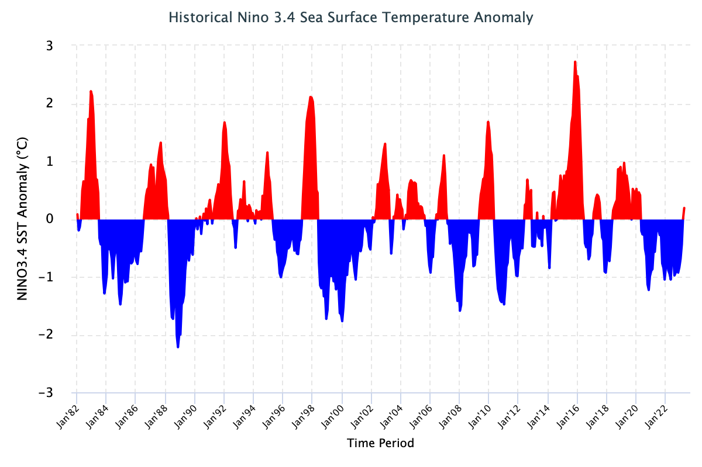
ENSO Forecasts
Moderate/strong El Nino looking likely by late summer
May 19, 2023
Notes:
21

Slide 22
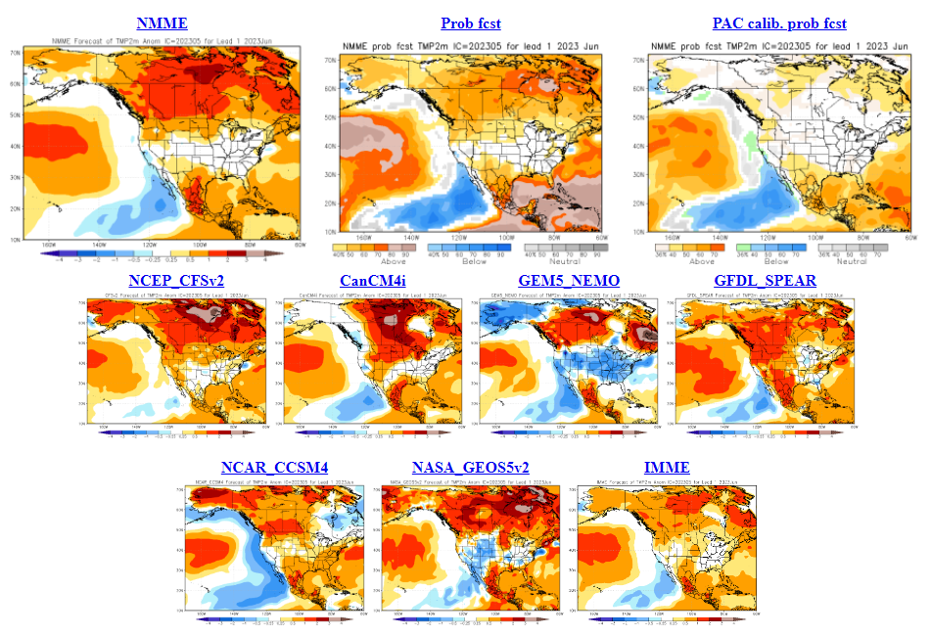
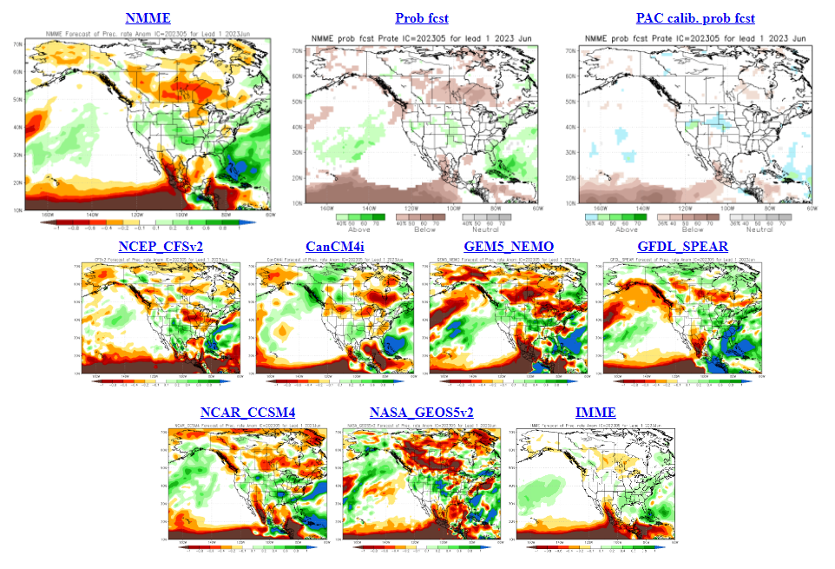
North American Multi-model Ensemble
NMME
June Temp
GEM-NEMO often predicts cool
June Precip
Dry central regions?
Notes:
Temperature maps: blue = below normal, orange--red = above normal
Precipitation maps: orange--red = below normal, green = above normal
Seasonal forecasts produced by NRCan use temperature and precipitation from the two 10-member CanSIPS ensembles (green boxes in centre).
GEM-NEMO translates to Global Environmental Multiscale – Nucleus for European Modeling of the Oceans.
Wind data from these models have not been tested yet.
The remainder of the boxes show various models used in the NMME, with combined outputs condensed into the top left box, while
the bottom right box includes European models – the International Multi-Model Ensemble (IMME).

Slide 23
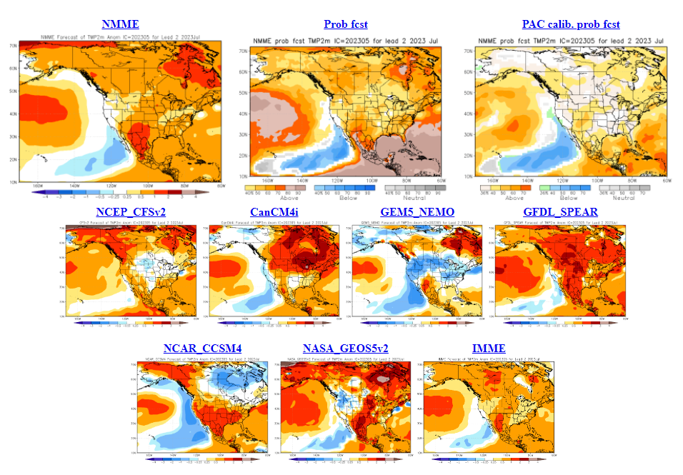
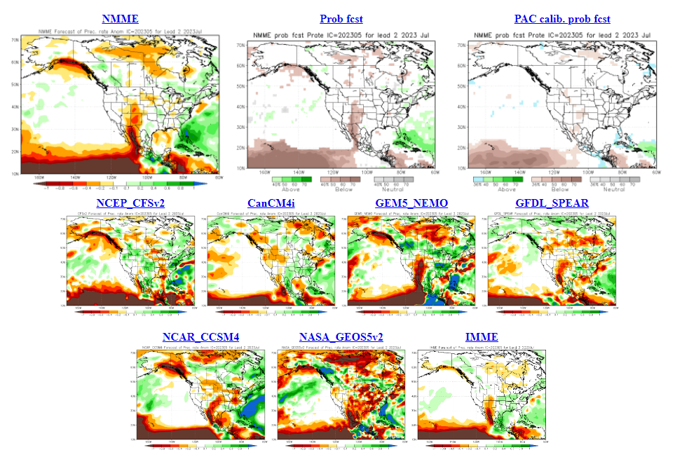
North American Multi-model Ensemble
NMME
July Temp
Ambiguous trends
July Precip
Rainfall increases in July?
Notes:
Temperature maps: blue = below normal, orange--red = above normal
Precipitation maps: orange--red = below normal, green = above normal
Seasonal forecasts produced by NRCan use temperature and precipitation from the two 10-member CanSIPS ensembles (green boxes in centre).
GEM-NEMO translates to Global Environmental Multiscale – Nucleus for European Modeling of the Oceans.
Wind data from these models have not been tested yet.
The remainder of the boxes show various models used in the NMME, with combined outputs condensed into the top left box, while
the bottom right box includes European models – the International Multi-Model Ensemble (IMME).

Slide 24
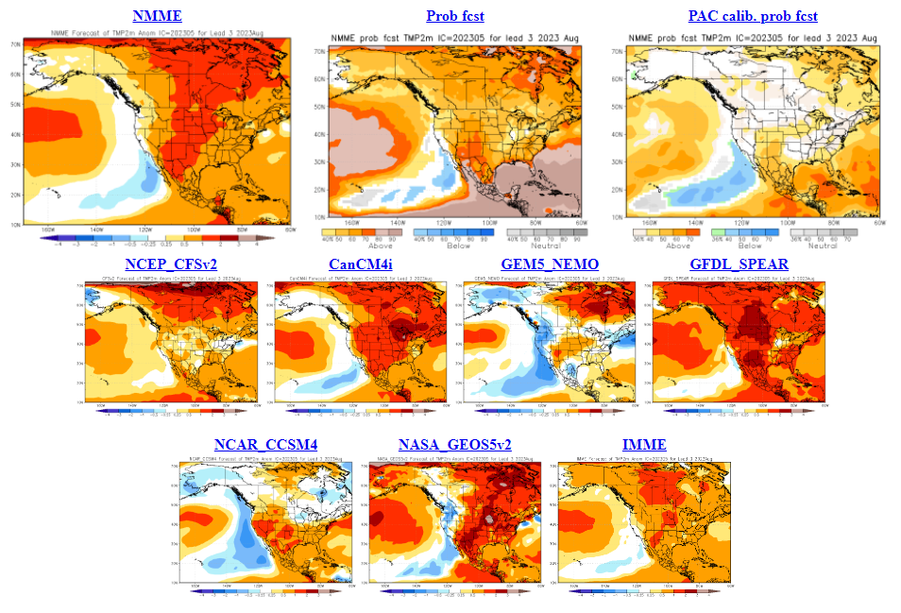
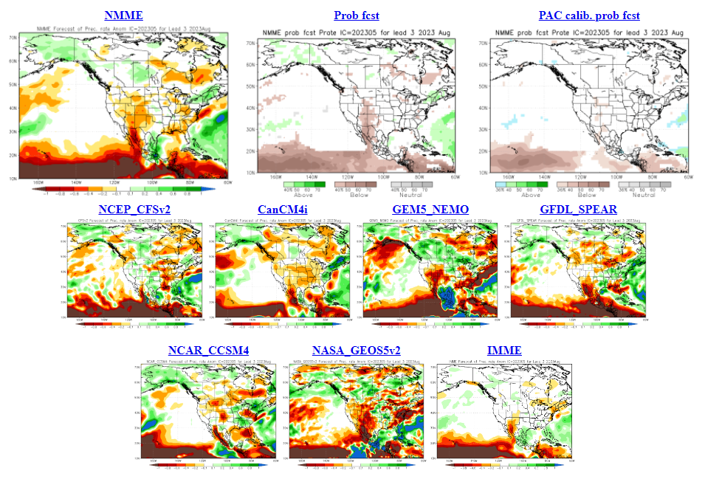
North American Multi-model Ensemble
NMME
August Temp
Warm signal
August Precip
Dry signal strongest in central-eastern
Canada
Notes:
Temperature maps: blue = below normal, orange--red = above normal
Precipitation maps: orange--red = below normal, green = above normal
Seasonal forecasts produced by NRCan use temperature and precipitation from the two 10-member CanSIPS ensembles (green boxes in centre).
GEM-NEMO translates to Global Environmental Multiscale – Nucleus for European Modeling of the Oceans.
Wind data from these models have not been tested yet.
The remainder of the boxes show various models used in the NMME, with combined outputs condensed into the top left box, while
the bottom right box includes European models – the International Multi-Model Ensemble (IMME).

Slide 25
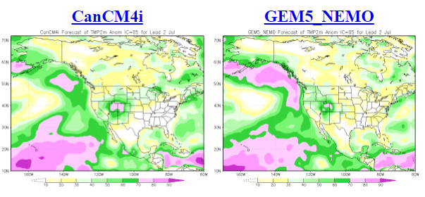
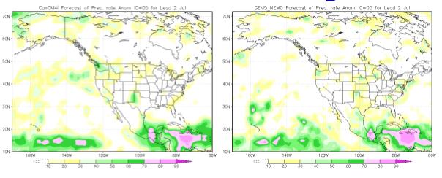
NMME Skills Maps
Two month lead (July forecast)
Temperature
Precipitation
Notes:
Temperature maps: blue = below normal, orange--red = above normal
Precipitation maps: orange--red = below normal, green = above normal
Seasonal forecasts produced by NRCan use temperature and precipitation from the two 10-member CanSIPS ensembles (green boxes in centre).
GEM-NEMO translates to Global Environmental Multiscale – Nucleus for European Modeling of the Oceans.
Wind data from these models have not been tested yet.
The remainder of the boxes show various models used in the NMME, with combined outputs condensed into the top left box, while
the bottom right box includes European models – the International Multi-Model Ensemble (IMME).

Slide 26
2023 NRCan-CFS Seasonal Prediction
Notes:
26

Slide 27
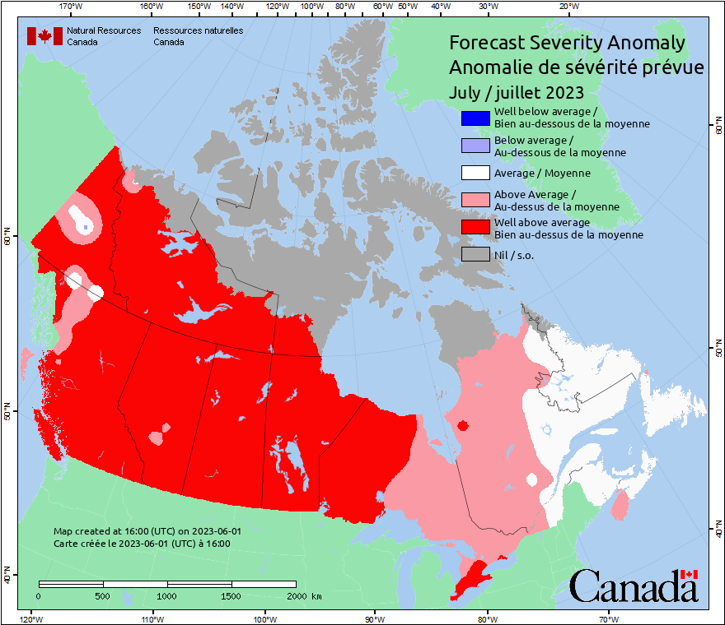
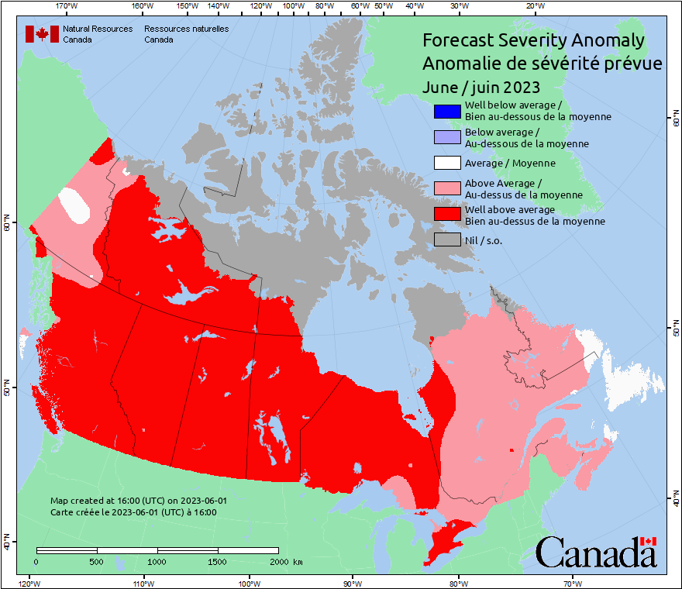
NRCan-CFS Prediction: June run, for June and July
Anomaly
Predicted values normalized against average weather
Notes:
The patchy red pattern likely indicates anomaly values lie close to the division between normal and above normal.
Much above normal values begin to appear in central Canada in July (bright red). Fire activity normally increases for its
summer peak beginning in mid-July, so this area may be a precursor for expected escalation of August activity (next slide).
27

Slide 28
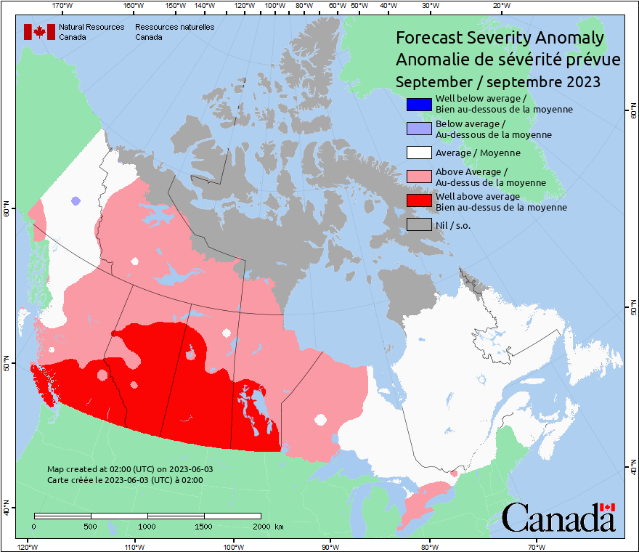
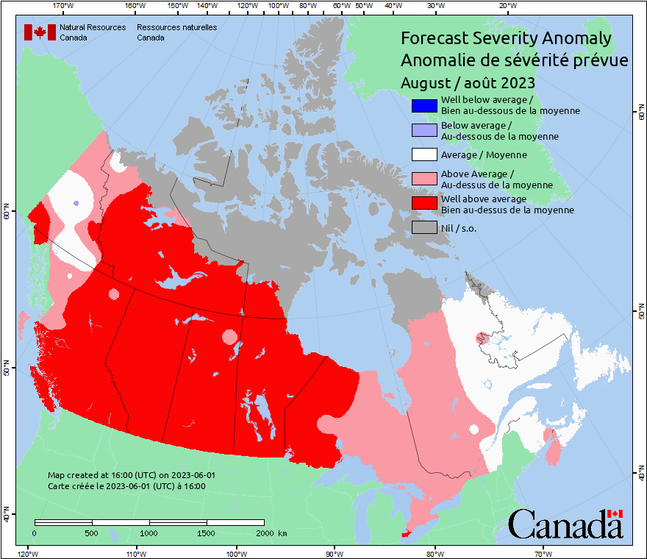
NRCan-CFS Prediction: June run, for August and September
Anomaly
Predicted values normalized against average weather
Notes:
August shows the peak intensity for 2022. Active fire in August can carry on through September or longer, but in September, we begin to see fire activity wane in the north due to cooler days, longer nights, better moisture retention, less lightning, and possible snow events.
28

Slide 29
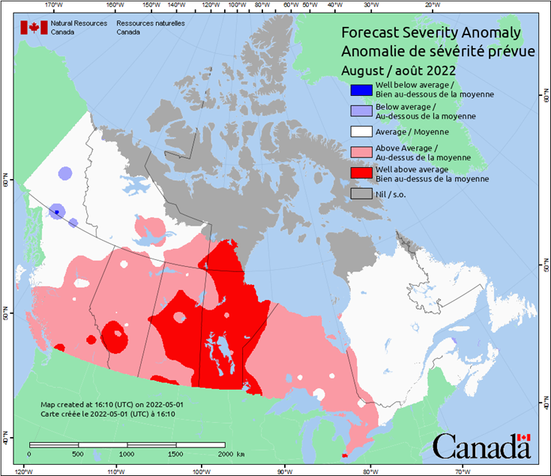
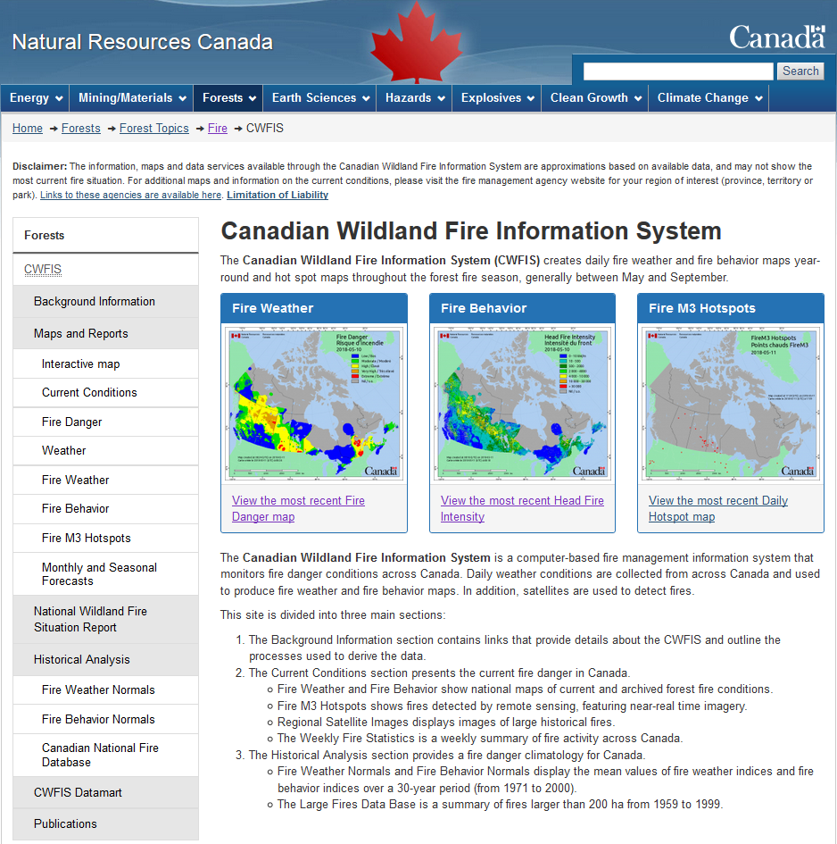
Canadian Wildland Fire Information System (CWFIS)
Note: CWFIS web site will change, likely in 2023-24
Notes:
Animation highlights the Monthly and Seasonal Forecasts link on the CWFIS web page and the weekly sit rep.

Slide 30
Conclusions and Reminders
Model consensus points to warm summer with many dry areas, but possible respite in July with better rainfall
Serious fires can occur in any year
Fire activity depends on ignitions; our forecast only predicts where potential exists

Slide 31
Remember to check updates …
Seasonal forecast: first working day each month on CWFIS
Daily conditions: provincial and/or CWFIS web sites
Government of Ontario

Slide 32
Questions?
Contact:
Richard Carr
Fire Research Analyst
Natural Resources Canada – Canadian Forest Service
Richard.Carr@NRCan-RNCan.gc.ca
5320 122 Street NW
Edmonton, AB, Canada
T6H 3S5
825-510-1265
?
?
?
?
?
Notes:
32

