Slide 1
Fire Season Severity Anomaly Forecast
for the Institute for Catastrophic Loss Reduction
June 12, 2025
Richard Carr Natural Resources Canada – Canadian Forest Service

Slide 2
Agenda
2023-25 early season factors
Climate model predictions
2025 CWFIS Fire Season Forecast (June 1)

Slide 3
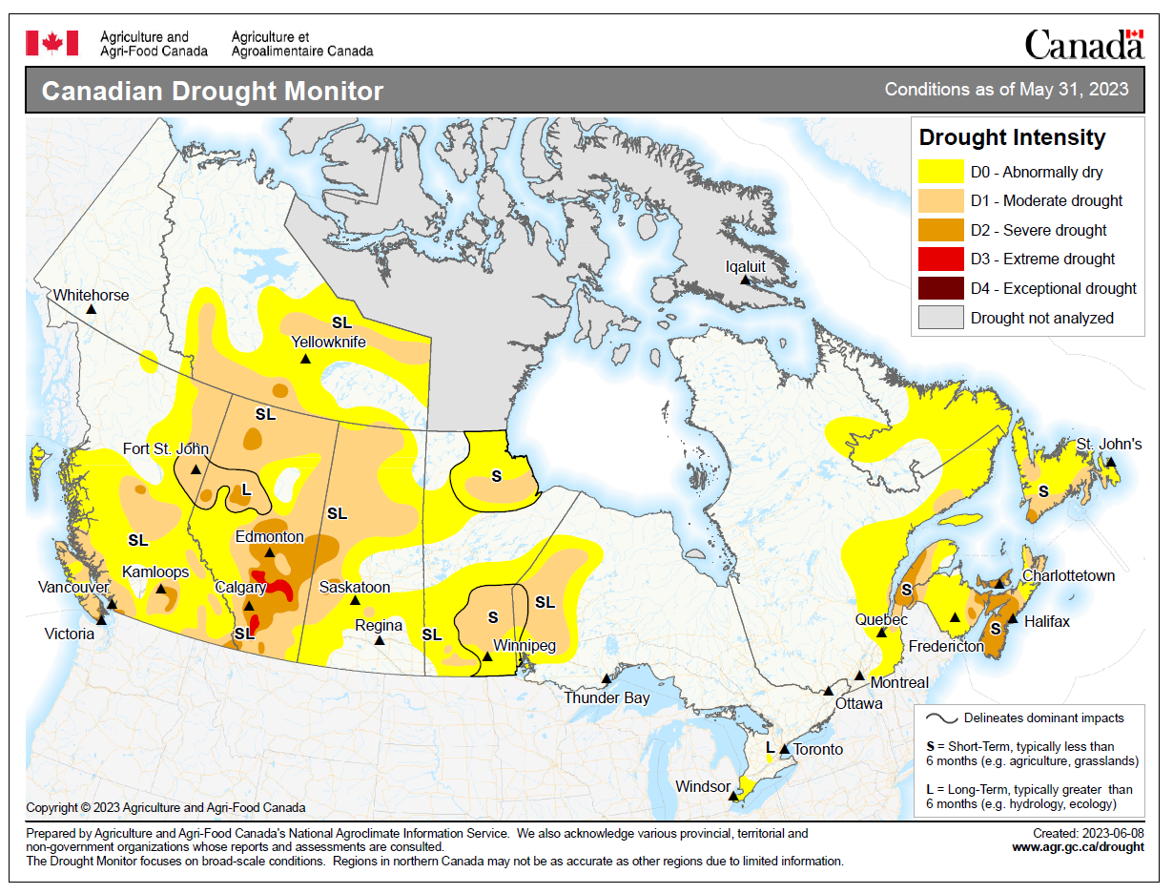
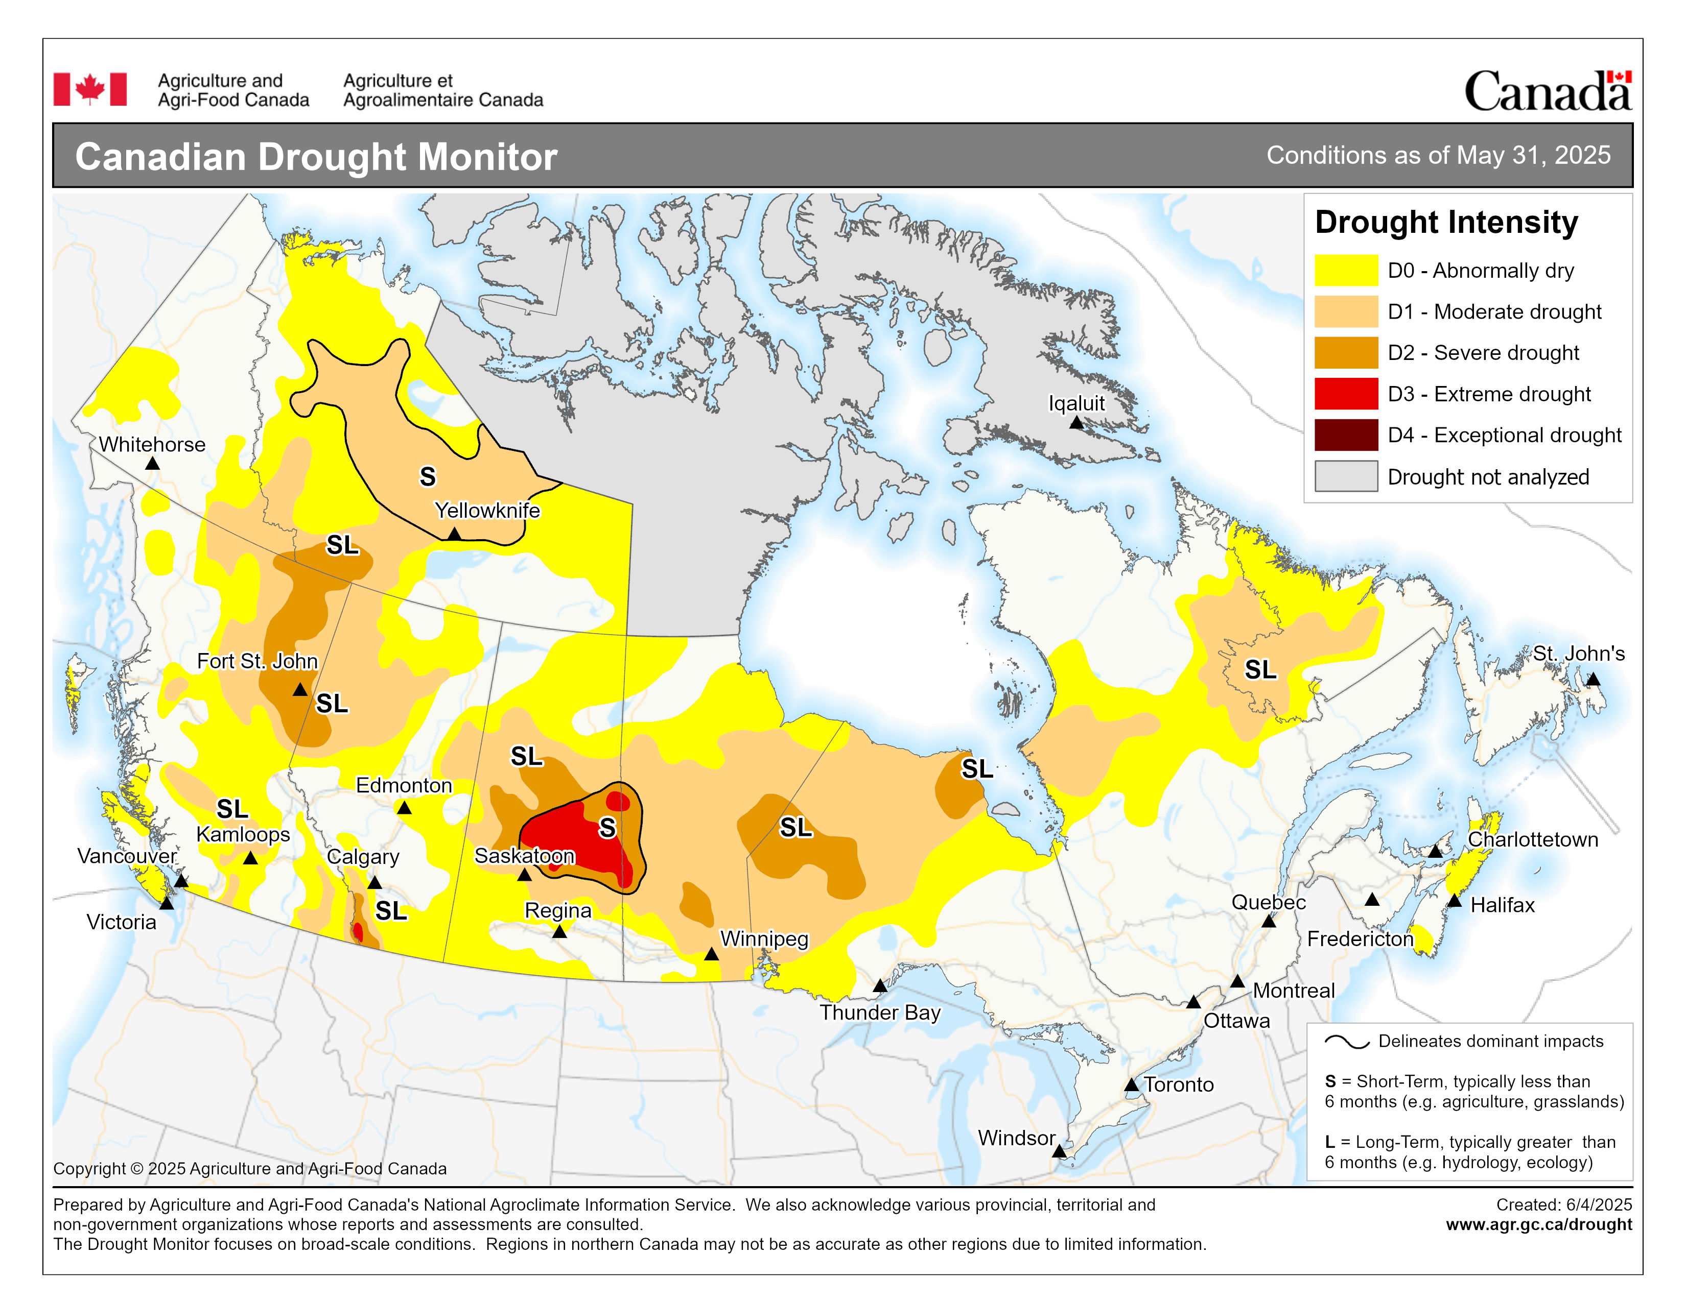
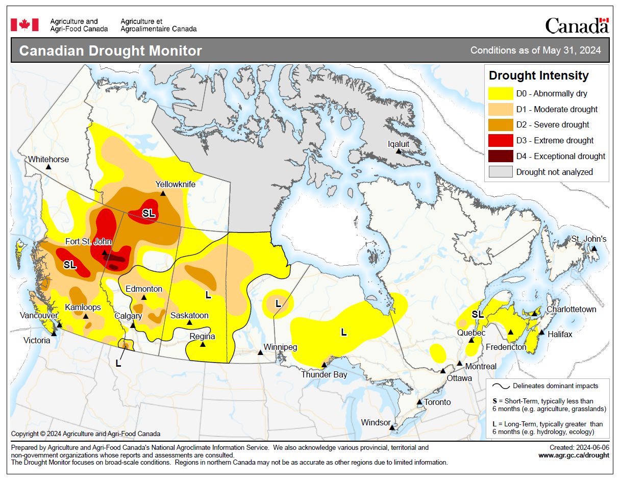
Drought Progression: May 31, 2023-25
Drought was less intense than in spring 2023 and 2024
Intensification during 2023; reduction in mid to late 2024
Notes:
Drought reporting is done by Agriculture and Agri-Food Canada.
3

Slide 4
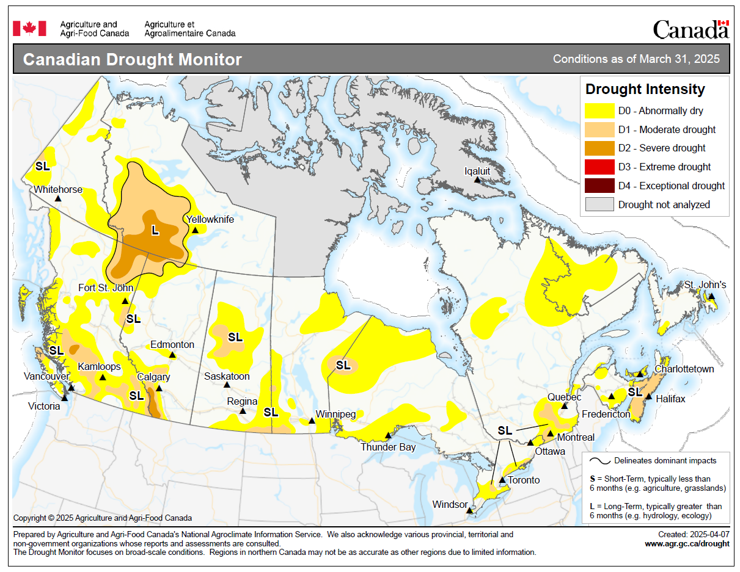
Drought Progression: Spring 2025
Not too dramatic at March 31, April 30
Rapid intensification during May
Some reduction in southwestern NT, southern BC
Notes:
4

Slide 5
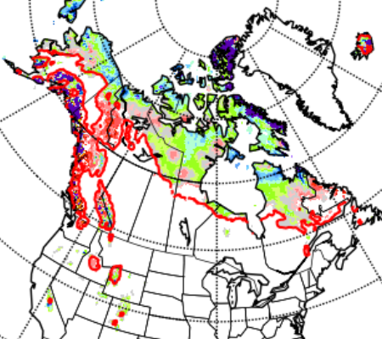
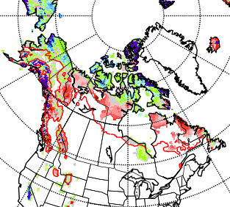
Snow Cover
Snow melted quickly in southern BC in February-March
Snow loss in other regions was normal during spring
May 10, 2023
May 8, 2024
May 14, 2025
Notes:
Snow cover maps are from the Canadian Cryospheric Information Network (ccin.ca). The red line give the locations of the historical mean 2-cm snow depth for the particular date. Regions showing white north of (above) the red line have early snow loss; regions with color south of (below) the red line have snow lingering later than usual. Sometimes, snowfalls in the spring/autumn may give temporary snow cover where snow is usually gone.
5

Slide 6
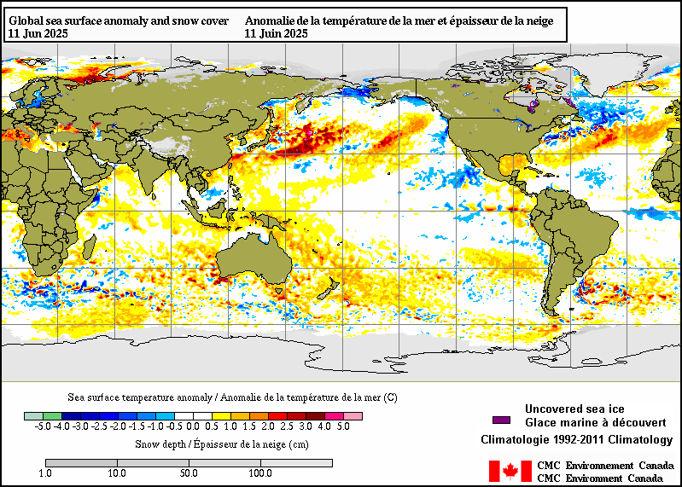
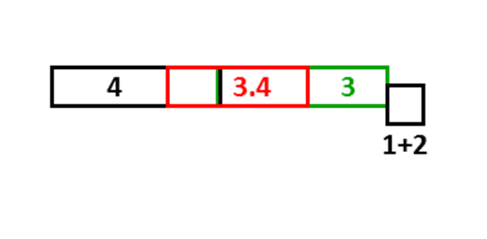
ENSO – Current SST
North Pacific SST (PDO) negative; closer to neutral than past few years
La Niña-ish condition faded … was winter 2024-25 ever a true La Niña? ENSO is neutral now.
Notes:
Sea surface temperatures (SST): blue = below normal, orange--red = above normal.
Boxes along the equator represent ENSO regions (ENSO SST indexes are measured in 3.4, the red box).
SST in the red ellipse can indicate status of the Pacific Decadal Oscillation (PDO). Cold water along the BC coast with warm water in the central north Pacific indicate the PDO is in the negative phase. Some of the big fire years in northern parts of the provinces and Territories have occurred with a positive PDO, opposite phase from what we currently see.
North Atlantic waters have cooled from late 2023. Note this may not indicate phase of the North Atlantic Oscillation, which is determined by the strength of the Icelandic low
pressure and the Azores high pressure systems.
6

Slide 7
Fire Problems in ENSO Springs
El Niño:
Warm, windy, dry in western Canada
La Niña:
Arctic surface highs bring dry air, strong wind around edges
Temperature may be cool
Summer fire problems may depend on other influences
Year | DJF | JFM | FMA | MAM | AMJ | MJJ | JJA | JAS | ASO | SON | OND | NDJ
1995 | 1.0 | 0.7 | 0.5 | 0.3 | 0.1 | 0.0 | -0.2 | -0.5 | -0.8 | -1.0 | -1.0 | -1.0
1998 | 2.2 | 1.9 | 1.4 | 1.0 | 0.5 | -0.1 | -0.8 | -1.1 | -1.3 | -1.4 | -1.5 | -1.6
1999 | -1.5 | -1.3 | -1.1 | -1.0 | -1.0 | -1.0 | -1.1 | -1.1 | -1.2 | -1.3 | -1.5 | -1.7
2000 | -1.7 | -1.4 | -1.1 | -0.8 | -0.7 | -0.6 | -0.6 | -0.5 | -0.5 | -0.6 | -0.7 | -0.7
2001 | -0.7 | -0.5 | -0.4 | -0.3 | -0.3 | -0.1 | -0.1 | -0.1 | -0.2 | -0.3 | -0.3 | -0.3
2002 | -0.1 | 0.0 | 0.1 | 0.2 | 0.4 | 0.7 | 0.8 | 0.9 | 1.0 | 1.2 | 1.3 | 1.1
2003 | 0.9 | 0.6 | 0.4 | 0.0 | -0.3 | -0.2 | 0.1 | 0.2 | 0.3 | 0.3 | 0.4 | 0.4
2004 | 0.4 | 0.3 | 0.2 | 0.2 | 0.2 | 0.3 | 0.5 | 0.6 | 0.7 | 0.7 | 0.7 | 0.7
2005 | 0.6 | 0.6 | 0.4 | 0.4 | 0.3 | 0.1 | -0.1 | -0.1 | -0.1 | -0.3 | -0.6 | -0.8
2006 | -0.8 | -0.7 | -0.5 | -0.3 | 0.0 | 0.0 | 0.1 | 0.3 | 0.5 | 0.7 | 0.9 | 0.9
2007 | 0.7 | 0.3 | 0.0 | -0.2 | -0.3 | -0.4 | -0.5 | -0.8 | -1.1 | -1.4 | -1.5 | -1.6
2008 | -1.6 | -1.4 | -1.2 | -0.9 | -0.8 | -0.5 | -0.4 | -0.3 | -0.3 | -0.4 | -0.6 | -0.7
2009 | -0.8 | -0.7 | -0.5 | -0.2 | 0.1 | 0.4 | 0.5 | 0.5 | 0.7 | 1.0 | 1.3 | 1.6
2010 | 1.5 | 1.3 | 0.9 | 0.4 | -0.1 | -0.6 | -1.0 | -1.4 | -1.6 | -1.7 | -1.7 | -1.6
2011 | -1.4 | -1.1 | -0.8 | -0.6 | -0.5 | -0.4 | -0.5 | -0.7 | -0.9 | -1.1 | -1.1 | -1.0
2012 | -0.8 | -0.6 | -0.5 | -0.4 | -0.2 | 0.1 | 0.3 | 0.3 | 0.3 | 0.2 | 0.0 | -0.2
2013 | -0.4 | -0.3 | -0.2 | -0.2 | -0.3 | -0.3 | -0.4 | -0.4 | -0.3 | -0.2 | -0.2 | -0.3
2014 | -0.4 | -0.4 | -0.2 | 0.1 | 0.3 | 0.2 | 0.1 | 0.0 | 0.2 | 0.4 | 0.6 | 0.7
2015 | 0.6 | 0.6 | 0.6 | 0.8 | 1.0 | 1.2 | 1.5 | 1.8 | 2.1 | 2.4 | 2.5 | 2.6
2016 | 2.5 | 2.2 | 1.7 | 1.0 | 0.5 | 0.0 | -0.3 | -0.6 | -0.7 | -0.7 | -0.7 | -0.6
2017 | -0.3 | -0.1 | 0.1 | 0.3 | 0.4 | 0.4 | 0.2 | -0.1 | -0.4 | -0.7 | -0.9 | -1.0
2018 | -0.9 | -0.8 | -0.6 | -0.4 | -0.1 | 0.1 | 0.1 | 0.2 | 0.4 | 0.7 | 0.9 | 0.8
2019 | 0.7 | 0.7 | 0.7 | 0.7 | 0.5 | 0.5 | 0.3 | 0.1 | 0.2 | 0.3 | 0.5 | 0.5
2020 | 0.5 | 0.5 | 0.4 | 0.2 | -0.1 | -0.3 | -0.4 | -0.6 | -0.9 | -1.2 | -1.3 | -1.2
2021 | -1.0 | -0.9 | -0.8 | -0.7 | -0.5 | -0.4 | -0.4 | -0.5 | -0.7 | -0.8 | -1.0 | -1.0
2022 | -1.0 | -0.9 | -1.0 | -1.1 | -1.0 | -0.9 | -0.8 | -0.9 | -1.0 | -1.0 | -0.9 | -0.8
2023 | -0.7 | -0.4 | -0.1 | 0.2 | 0.5 | 0.8 | 1.1 | 1.3 | 1.6 | 1.8 | 1.9 | 2.0
2024 | 1.8 | 1.5 | 1.1 | 0.7 | 0.4 | 0.2 | 0.0 | -0.1 | -0.2 | -0.3 | -0.4 | -0.5
2025 | -0.6 | -0.4 | -0.2 | -0.1
Large area burned
Virginia Hills, AB
Chisholm, AB
Kelowna, BC
Slave Lake, AB
PDO positive phase
Fort McMurray, AB
Big years in BC
Western half
Most of Canada!
Busy summer
Notes:
Blue text indicates La Nina periods, and corresponding notable fire events.
Red text indicated El Nino periods, and corresponding notable fire events.
Months (May) that notable spring fires occurred in are highlighted by yellow boxes.
Orange boxes indicate neutral ENSO summer period where fire was very active, usually in western Canada.

Slide 8
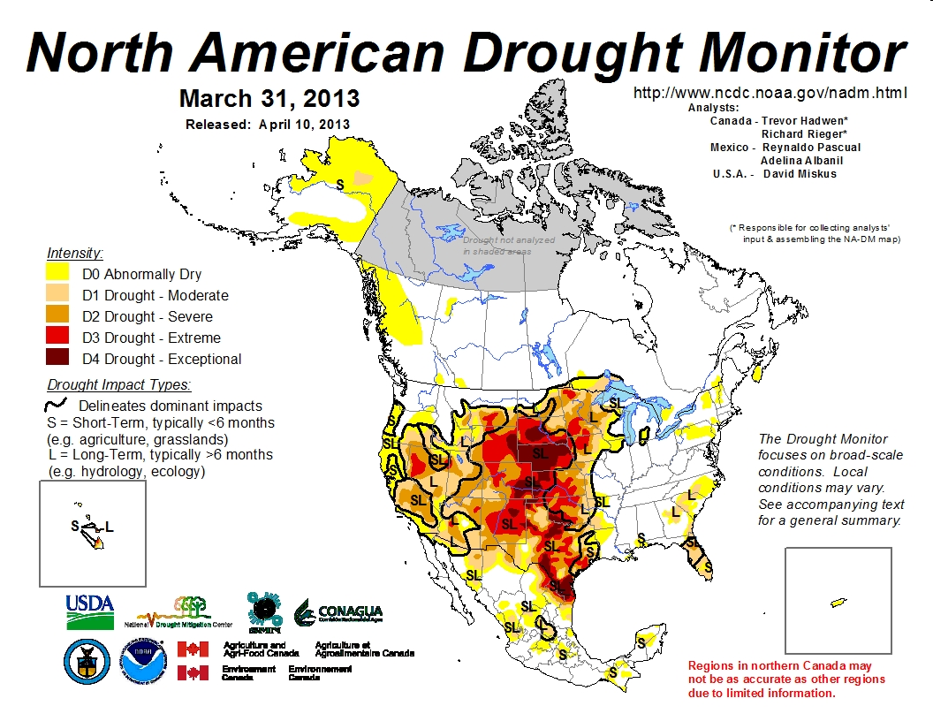
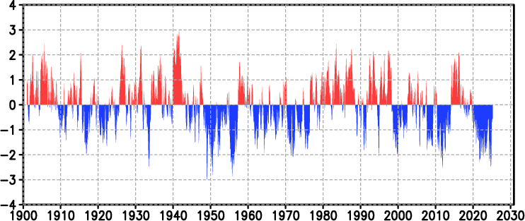
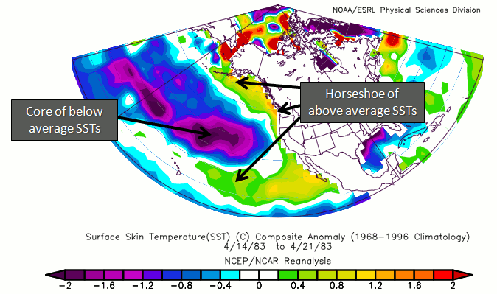
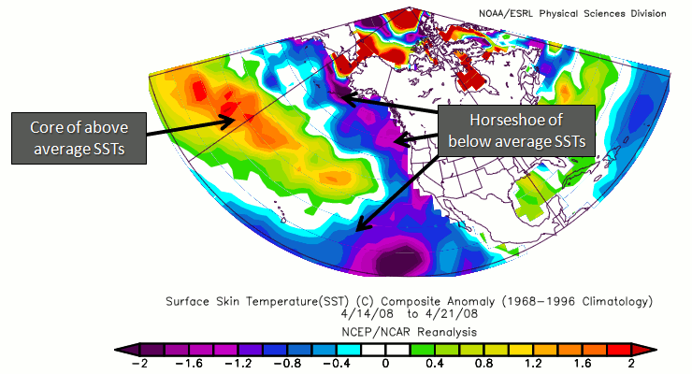
Pacific Decadal Oscillation (as of Apr 2025)
https://ds.data.jma.go.jp/tcc/tcc/products/elnino/decadal/pdo_month.html
Warm phase
Cold phase
http://climate.ncsu.edu/climate/patterns/PDO.html
Notes:
PDO is still negative but closer to neutral than most of the past few years.
8

Slide 9
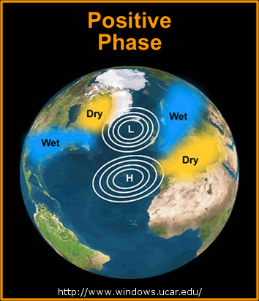
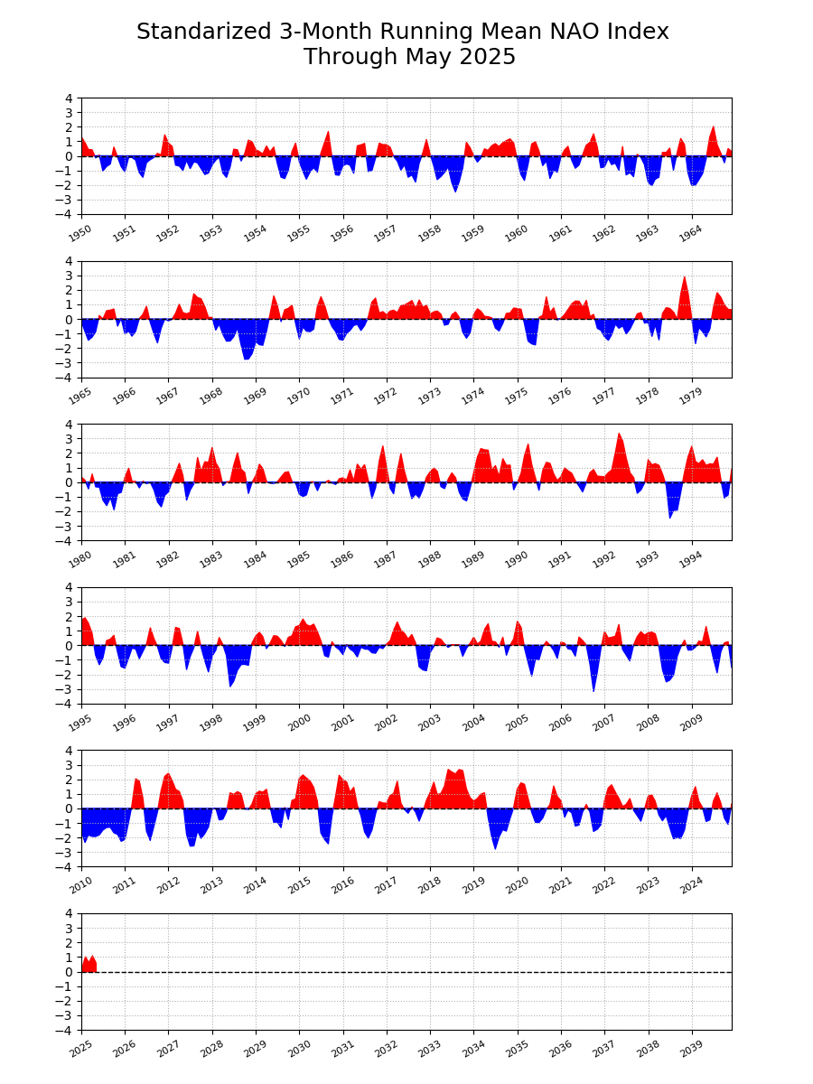
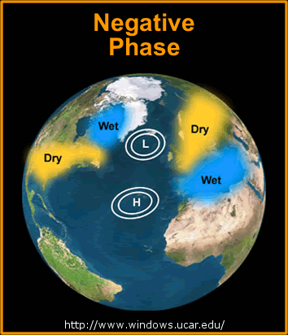
North Atlantic Oscillation (to May 2025)
https://www.ncei.noaa.gov/access/monitoring/nao
+
Quebec Area Burned
(NFDB, ha*1000)
2023 5000*
2015 5
2013 1900
2010 315
2008 1
2007 343
2005 800
2004 3
2002 1000
-
Early years may not include area burned in northern (unmanaged) region
-
+
Notes:
Years with high burned area in Quebec are indicated in black text, moderate years in orange, and low in green. Perhaps the degree to which the NAO is positive influences fire occurrence, which depends on the correct dryness (high atmospheric pressure) coupled with enough atmospheric instability to generate thundershowers, or increased human activity in the absence of rain. This may occur during years where the NAO transitions between negative and positive or vice versa. The Baffin Island/Western Atlantic (BWA) Oscillation is the western portion of the NAO and may provide a better indicator of fire activity in eastern North America.
A study ongoing at Universite du Quebec a Montreal will likely provide more insight into oceanic/atmospheric oscillations that influence fire in eastern Canada. One finding may link a Baffin/West Atlantic (BWA) oscillation with increased severity rating (I have not read outcomes from this study so can’t comment on this any more at this time).
9

Slide 10
Climate Model Predictions
Notes:
10

Slide 11
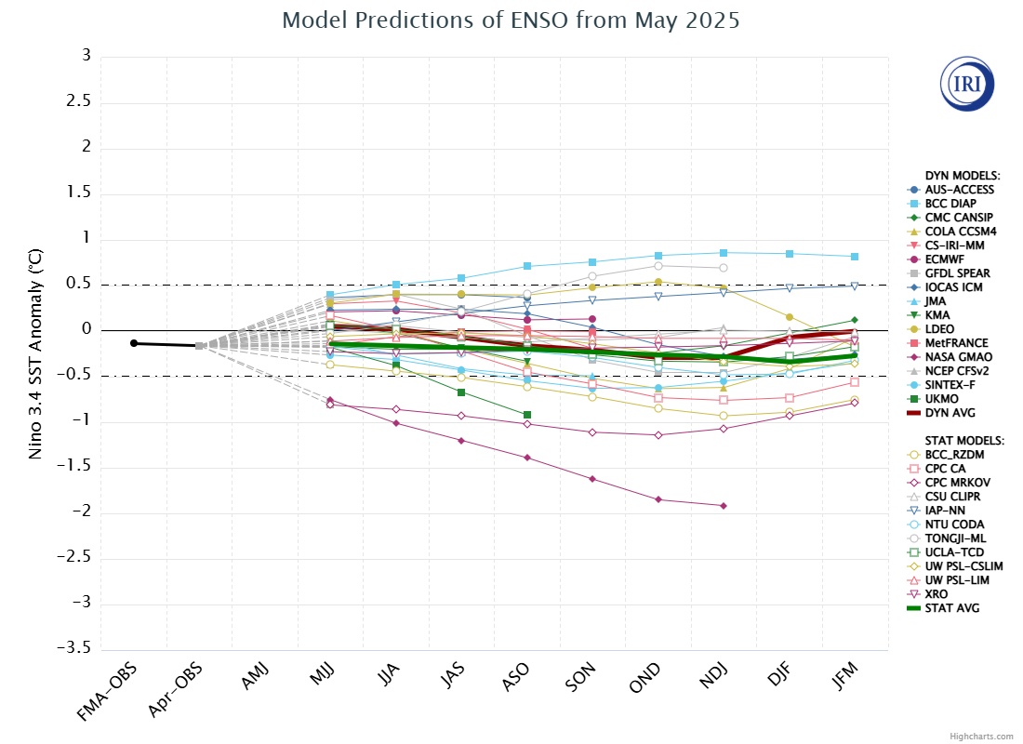
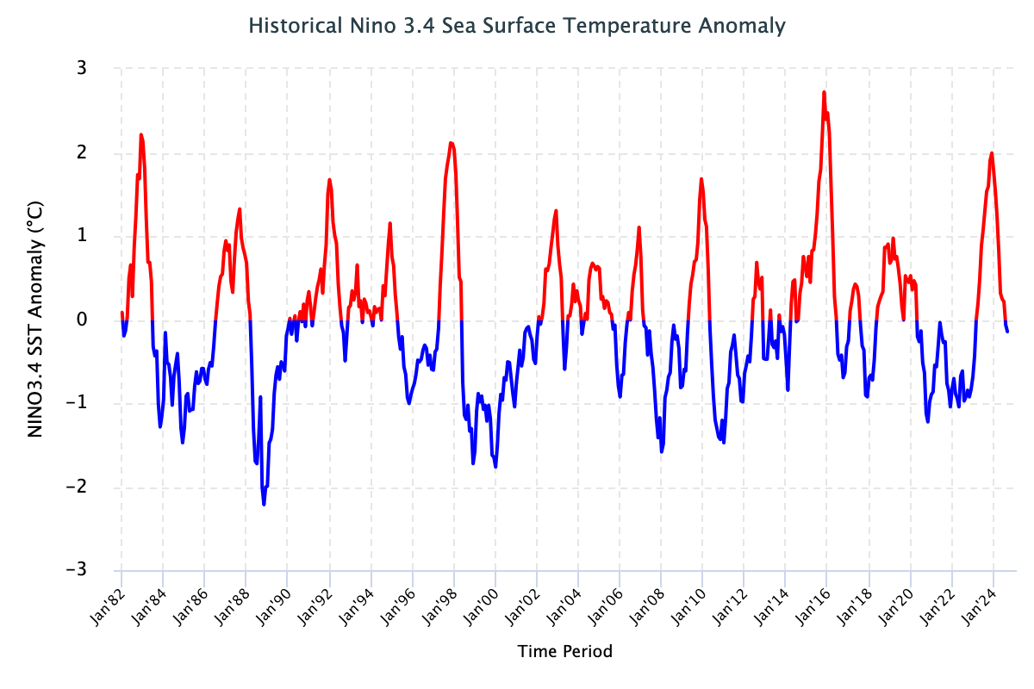
IRI ENSO Forecast
https://iri.columbia.edu/our-expertise/climate/forecasts/enso/current/?enso_tab=enso-sst_table
https://iri.columbia.edu/our-expertise/climate/forecasts/enso/2024-october-quick-look/?enso_tab=enso-sst_image
Neutral conditions likely continuing to winter 2025-26
May, 2025
Time series to October 2024
Notes:
Neutral ENSO is when indexes remain between the horizontal red lines on the plume chart and the black lines on the time series.
El Nino occurs when the indexes are above the top line (+0.5 sea surface temperature anomaly in the 3.4 region) for over 3 consecutive months.
La Nina occurs when the indexes are below the bottom line (-0.5 sea surface temperature anomaly in the 3.4 region) for over 3 consecutive months.
11

Slide 12
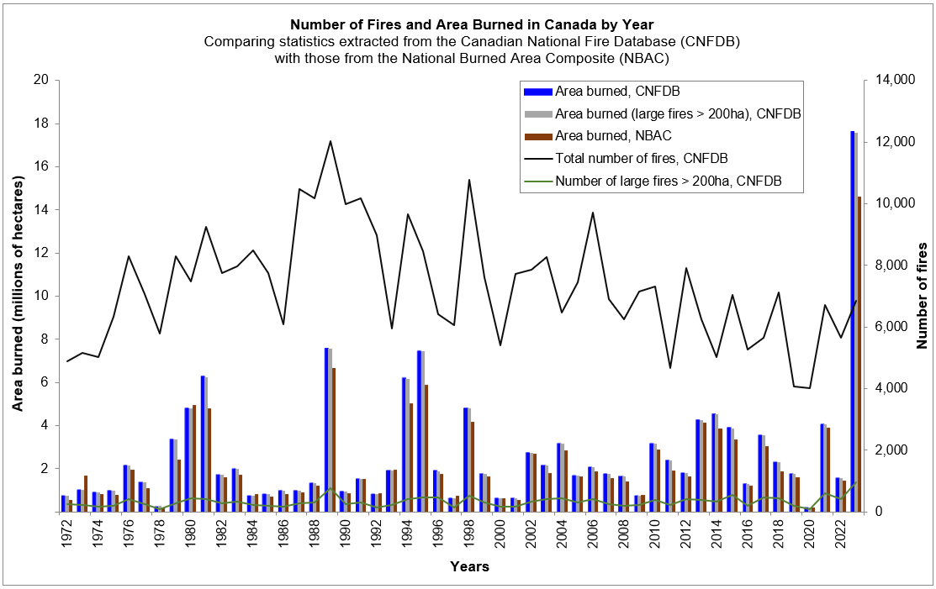
Neutral ENSO: Recent Analog Years
Arrows to area burned: 2012 (orange), 2013—2014, 2017 (black), 2020 (green), 2024 (black)
2024
Notes:
Dominant neutral: greater than 6 months in neutral phase
Other years featured short neutral summer periods (2016, 2018, 2021)
Neutral ENSO may have erratic weather patterns; this may cause some years to have high/low fire activity
12

Slide 13
CanSIPS
Ensemble has increased from 2x10 to 2x20 members
Models developed by Canadian Centre for Climate Modeling and Analysis
CanCM4i (CanESM5)
GEM5.2-NEMO: Global Environmental Multiscale – Nucleus for European Modeling of the Ocean
NRCan uses temperature and precipitation data, plus fuel moisture initialization from CWFIS
Skill of climate forecasts often best in coastal areas, poorer in lee of mountain ranges
Notes:
Temperature maps: blue = below normal, orange--red = above normal
Precipitation maps: orange--red = below normal, green = above normal
Seasonal forecasts produced by NRCan use temperature and precipitation from the two 10-member CanSIPS ensembles (green boxes in centre).
GEM-NEMO translates to Global Environmental Multiscale – Nucleus for European Modeling of the Oceans.
Wind data from these models have not been tested yet.
The remainder of the boxes show various models used in the NMME, with combined outputs condensed into the top left box, while
the bottom right box includes European models – the International Multi-Model Ensemble (IMME).

Slide 14
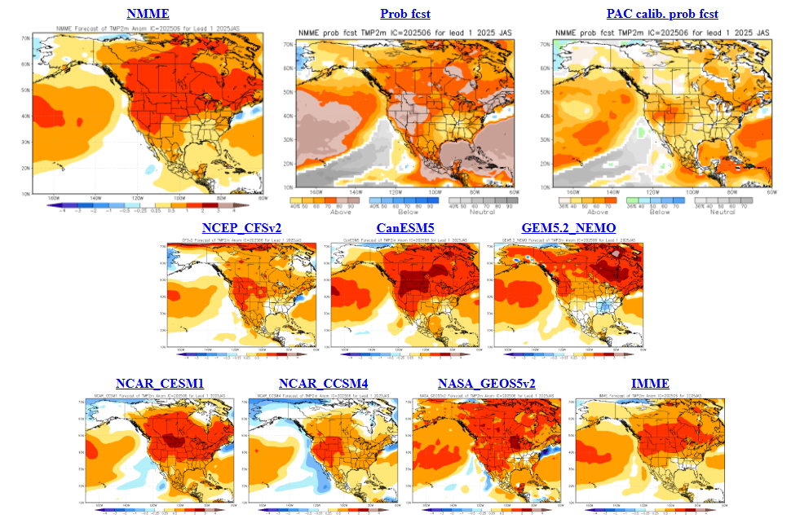
North American Multi-model Ensemble
NMME – April run
JJA Temp
Looks warm …
Subtract a bit of drama to get truer picture!
Notes:
Temperature maps: blue = below normal, orange--red = above normal
Precipitation maps: orange--red = below normal, green = above normal
Seasonal forecasts produced by NRCan use temperature and precipitation from the two 10-member CanSIPS ensembles (green boxes in centre).
GEM-NEMO translates to Global Environmental Multiscale – Nucleus for European Modeling of the Oceans.
Wind data from these models have not been tested yet.
The remainder of the boxes show various models used in the NMME, with combined outputs condensed into the top left box, while
the bottom right box includes European models – the International Multi-Model Ensemble (IMME).

Slide 15
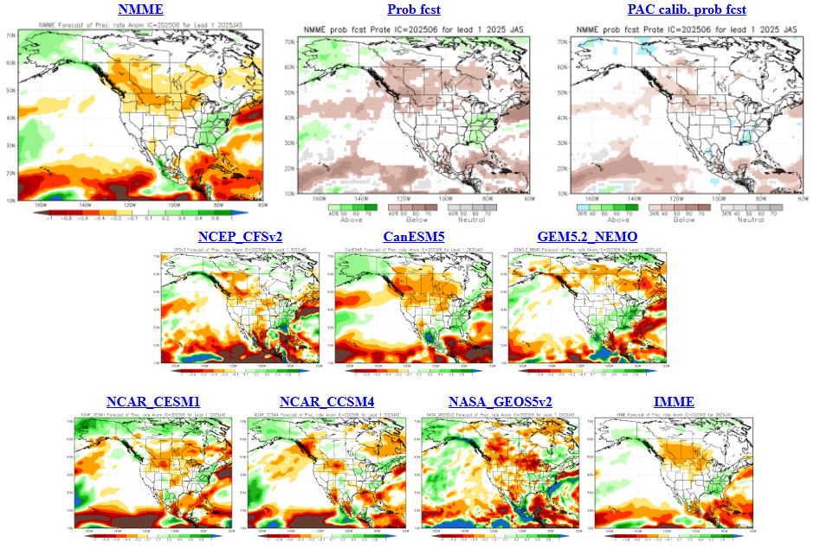
North American Multi-model Ensemble
JJA Precip
Many dry regions?
NMME – April run
Notes:
Temperature maps: blue = below normal, orange--red = above normal
Precipitation maps: orange--red = below normal, green = above normal
Seasonal forecasts produced by NRCan use temperature and precipitation from the two 10-member CanSIPS ensembles (green boxes in centre).
GEM-NEMO translates to Global Environmental Multiscale – Nucleus for European Modeling of the Oceans.
Wind data from these models have not been tested yet.
The remainder of the boxes show various models used in the NMME, with combined outputs condensed into the top left box, while
the bottom right box includes European models – the International Multi-Model Ensemble (IMME).

Slide 16
2025 NRCan-CFS Seasonal Prediction
Notes:
16

Slide 17
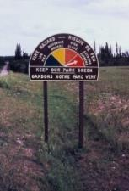
Canadian Forest Fire Weather Index (FWI) System
Seasonal forecasts use the severity rating anomaly
Fire Weather
Observations
Temperature
Humidity,
Wind, Rain
Temperature,
Humidity,
Rain
Snow depth
Barometric Pressure
Horizontal Visibility
Cloud cover and type
Upper air data
Wind
Temperature,
Rain
Fuel Moisture
Codes
FFMC
Fine Fuel Moisture Code
DMC
Duff Moisture Code
DC
Drought Code
Fire Behavior
Indexes
ISI
Initial Spread Index
BUI
Buildup Index
Fire Danger
FWI
Fire Weather Index
DSR/MSR/SSR
Severity Rating
Notes:
For the seasonal forecast maps, Monthly Severity Rating (MSR) forecasts are compared with a 30-year hindcast for respective months and locations to arrive at the anomalies. Seasonal forecast verification can be done by comparing forecast MSRs with observed values. Fire events can be used as a verification tool but this assumes ignitions have occurred where forecasts suggest high potential.
17

Slide 18
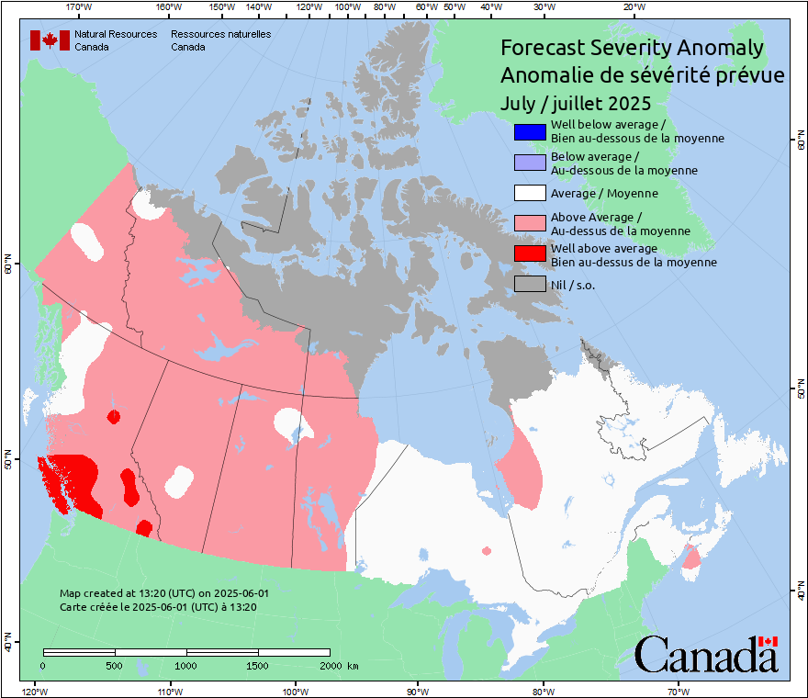
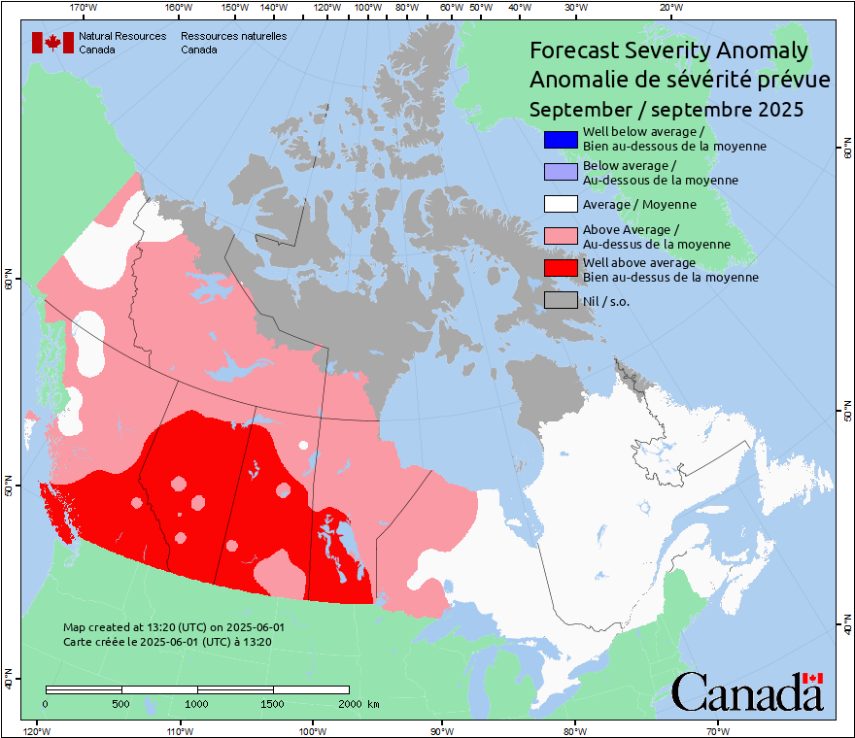
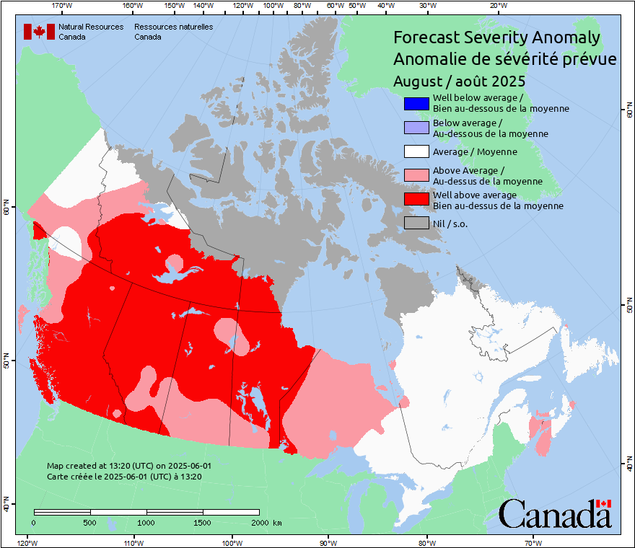
NRCan-CFS Prediction: June run, for July -- Sept
Anomaly
Predicted values normalized against average weather
Notes:
A patchy pattern likely indicates anomaly values lie close to the category bounds.
Although the southern Prairies are often red in the spring, little burning occurs due to greening of grass, so this area can often be ignored in mid-spring to early summer.
18

Slide 19
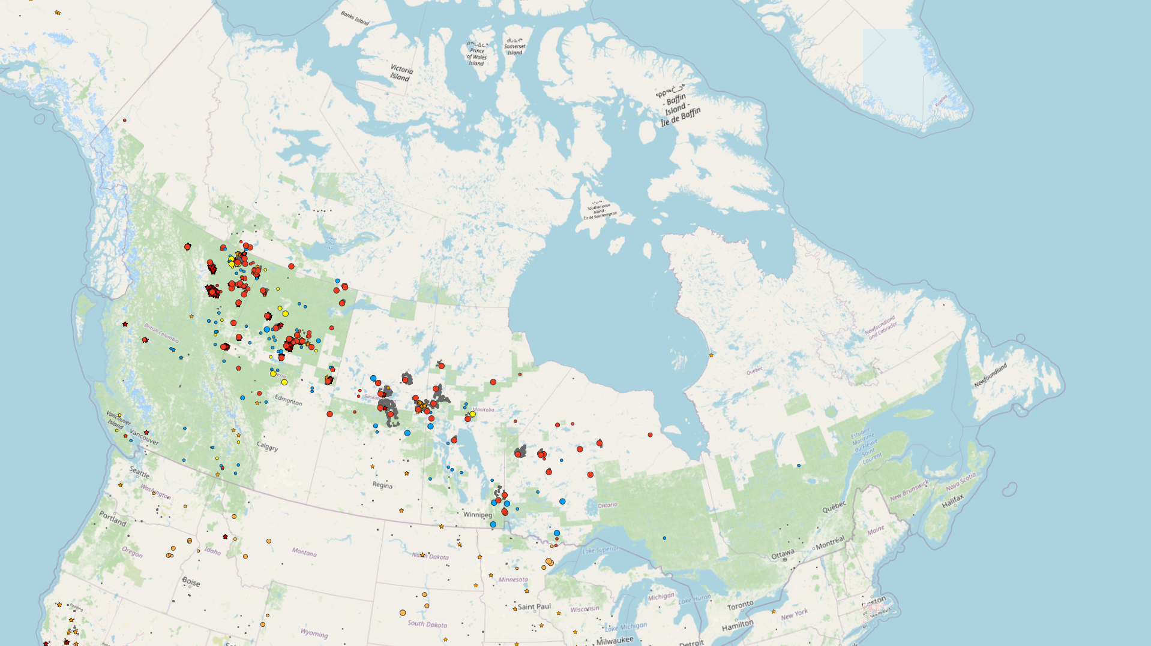
CWFIS Current Season Snapshot
CWFIS: Canadian Wildland Fire Information System: https://cwfis.cfs.nrcan.gc.ca
Large fires BC to western Ontario
Largest complexes are 25LF-SHOE, central SK:
~650,000 ha
Flin Flon MB / Creighton SK:
~500,000 ha
Notes:
This map is from the CWFIS internal viewer. A similar map can be viewed on the public web site interactive map, but with a different base layer.
19

Slide 20
Windy spring?
Many periods of rapid growth
No wind comparisons with normals, but in discussion
Current burned area passed annual average by ~June 7
Area burned at about 3.5 million ha as of June 11
CIFFC National Preparedness Level at 5 since May 29, Level 3 since May 15
1 2 3 4 5
Crews from USA, Australia
Notes:
Hotspot map is from June 3, 2025. Much growth June 3-7.
The National Preparedness Level is driven by P/T needs for firefighting resources. At Level 3, CIFFC/NRCan begin 4-week weather outlooks in evaluating need for international resource acquisition. At Level 5, all Canadian resources may be in use.
20

Slide 21
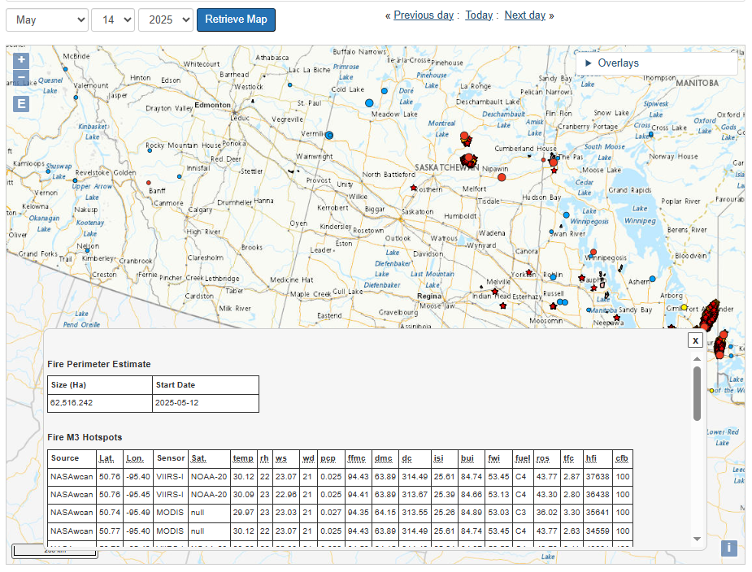
CWFIS Interactive Map Information
Dates can be chosen from the drop-down menu
On the CWFIS interactive map, click features to open an information box
https://cwfis.cfs.nrcan.gc.ca/interactive-map
Notes:
21

Slide 22
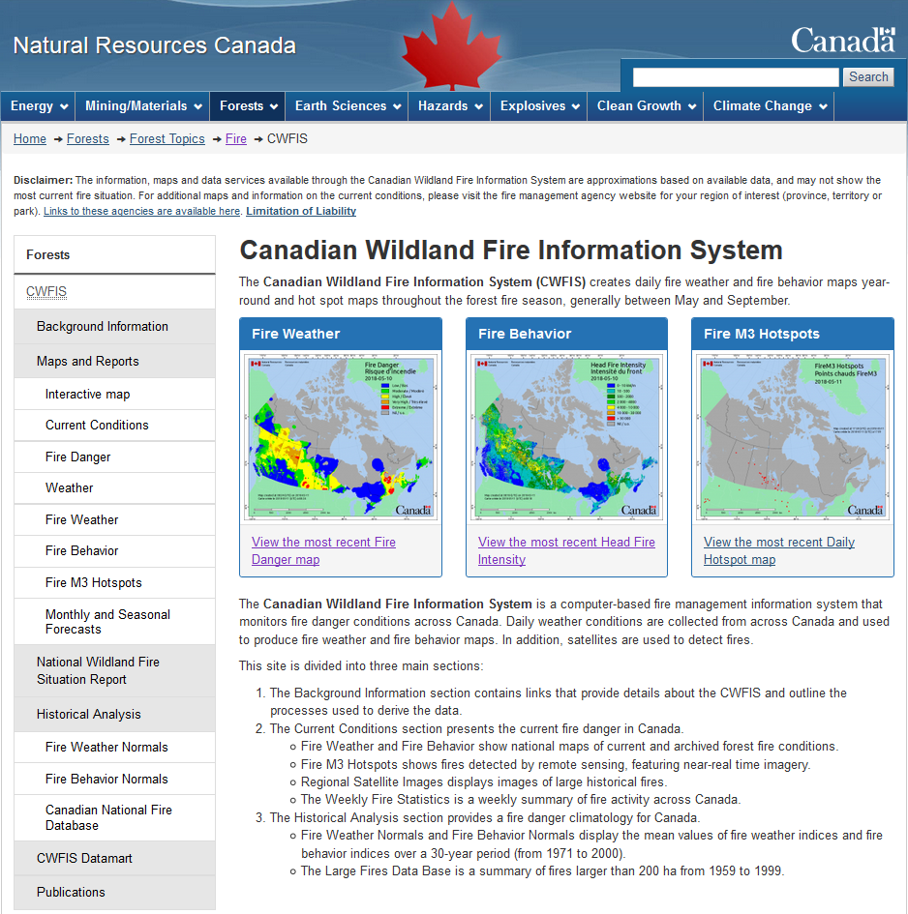
Canadian Wildland Fire Information System (CWFIS)
Note: updated CWFIS web site rollout 2025-26
Notes:
Highlights the Monthly and Seasonal Forecasts link on the CWFIS web page. This will eventually look different when the web site revisions are done! The new interactive map will feature a much larger choice of overlays. Many other new features will be introduced.

Slide 23
Conclusions and Reminders
Warm summer (may be common with warming climate)
Potentially dry, especially southern BC to central Canada
Neutral ENSO: higher activity in west?
Serious fires can occur in any year
Fire activity depends on ignitions; our forecast only predicts where potential exists
This year’s forecast runs have been produced using cleaned code on Azure (thank you, Robert Jagodzinski!)
In 2026 a new method will be introduced (Piyush Jain)

Slide 24
Remember to check updates …
Seasonal forecast: first working day each month on CWFIS: March-September
Daily conditions: provincial and/or CWFIS web sites
Government of Ontario

Slide 25
Questions?
Contact:
Richard Carr
Fire Research Analyst
Natural Resources Canada – Canadian Forest Service
Richard.Carr@NRCan-RNCan.gc.ca
5320 122 Street NW
Edmonton, AB, Canada
T6H 3S5
825-510-1265
?
?
?
?
?
Notes:
25

