Slide 1
Fire Season Severity Anomaly Forecast
May 16, 2024
Richard Carr Natural Resources Canada – Canadian Forest Service

Slide 2
2023 in Review
Notes:
2

Slide 3
Some Records set in 2023
Record area burned: BC, NT, AB, QC, NS
Largest fires on record: BC, NS, QC
CIFFC National Preparedness Level (NPL) at 5 May 11 to September 7 (earliest 5, longest on record at 120 days)
International crews from 11 nations over season
Smoke alerts (ECCC)
Evacuations (282) and evacuees (232,359)
Notes:
Likely more records of various kinds set …

Slide 4
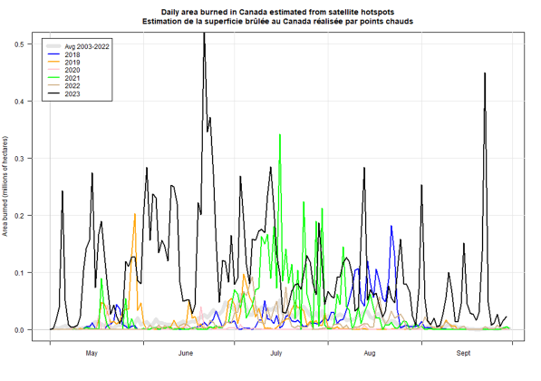
2023 Fire Season Summary
Area burned estimates based on hotspots
Big spike in June and again Sept 22
Area burned is often small in early spring and late summer (low amplitude of colored lines in these periods)
Notes:
The burned area chart shows the progression during 2023, with the black 2023 line dwarfing the burned area from
the previous few years. Colored lines show area burned estimates from the previous 6 years. The 20-year normal is in grey.
The colored lines are largely absent in early spring and late summer, indicating little area burned during those times
of year. In 2023, large area was burned in the summer and the spring/fall (“shoulder seasons”).
Actual amounts of area burned will differ somewhat from these estimates with some inaccuracy in hotspot representation
of actual fire and cloud cover or heavy smoke obscuring active fire.

Slide 5
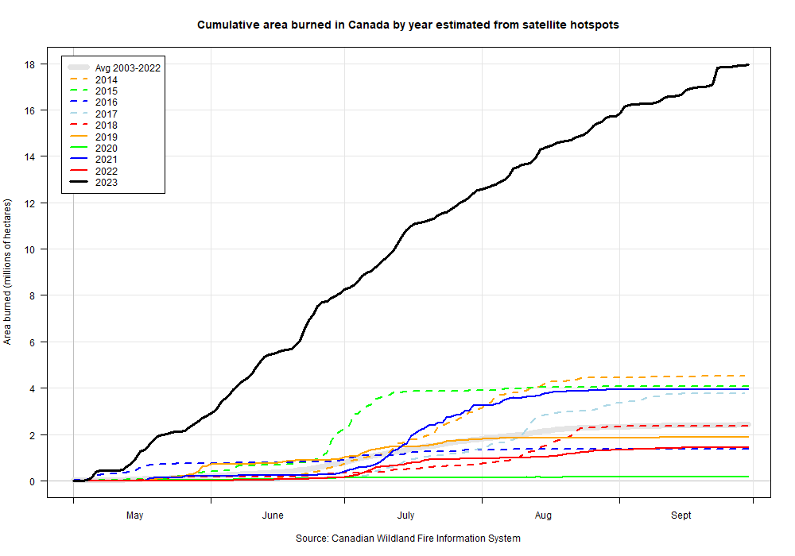
2023 Fire Season Summary
August-Sept: Wind events in northern BC/AB/NT. Much area burned end of August/start of September and September 22
July: NT/YT
June: ON/QC
June 27: Breaks previous national record area burned
April-May: west central AB, northeast BC, central SK, NT, NS
Notes:
The burned area chart shows the progression during 2023, with the black 2023 line dwarfing the burned area from
the previous few years. At the moment, let us focus on the circled areas in the chart:
-Fires started in late April and early May in the Parkland area (mixed forest/cropland/grazing land) in Alberta
and were most likely human-caused with little lightning at the time. Southeast winds drove rapid fire growth.
Fires starting after the first couple days of May in the Swan Hills, northwestern Alberta, northeastern BC, and
western SK may be lightning-caused, with numerous weak thundershowers present in the first half of May.
-By mid-May, fires in northern Alberta, northeastern BC, and western Saskatchewan were growing fast.
-Barrington and Tantallon fires in NS
-West central AB began receiving good rainfall in about the 3rd week of May, and was good through most of the summer (see the Drought map).
<Advance slide>
-During June, Ontario and Quebec had numerous fires, although the Quebec fires became larger. This is the area that contributed most of the
dense smoke into the eastern USA.
<Advance slide>
-Burning in Yukon and the Northwest Territories accelerated in July
<Advance slide>
-Wind events near the end of August and early September, plus late in September continued to drive rapid fire growth in northeastern British Columbia,
northwestern Alberta, and the southern Northwest Territories. The amount of area burned during this period was astounding, especially for northern regions.

Slide 6
Quote and Media Response: May-Sept, 2023
“I don’t want to comment on that since the numbers are changing so fast they are quickly outdated.”
- Richard Carr, comment on area burned during an unnamed media request
Print media articles quoting NRCan-CFS researchers:
Total number of media requests: 450+
Total number of media articles: 5,500+
Daily record-high of media articles published: 545+
Daily average of media articles: 40
Number of countries with outlets: 34
Languages interviewed in or translated to: 22
Notes:
Media Reports (from Nicole Simmons):
All stats are from May-September 2023:
Total number of media requests: 450+
Total number of media articles quoting CFS wildfire researchers: 5,500+
Daily record-high of media articles published citing CFS wildfire researchers: 545+
Daily average of media articles quoting CFS wildfire researcher: 40
Number of countries with outlets citing CFS wildfire researchers: 34
Number of languages CFS wildfire researchers were interviewed in or translated to: 22
**Note: These numbers do not include the majority of broadcast media (TV and Radio) as we’re unable to include transcripts from these sources in our scan (we’ve added the ‘+’ in some instances to account for this). Although we have confidence in this software, some instances of articles irrelevant to the topic have appeared in the scan and omissions have been established. We’ve reduced the total number of articles down from 6,000 to reflect this. A separate social media scan exists and is not included in these numbers.

Slide 7
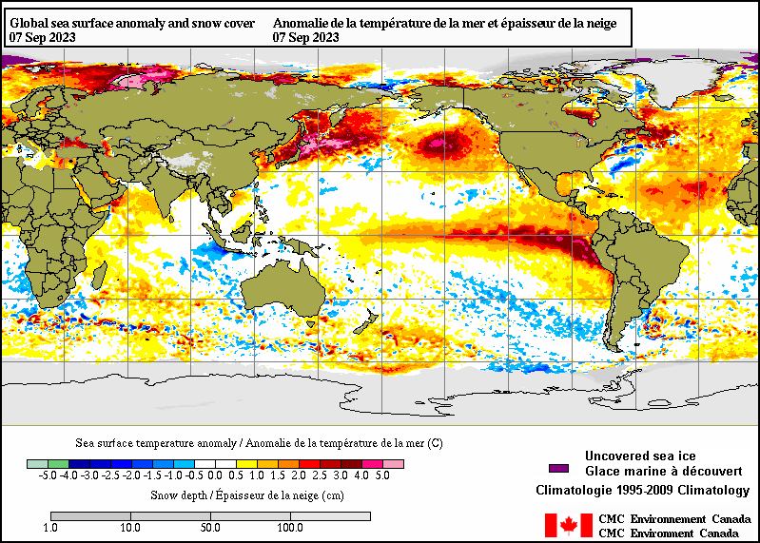
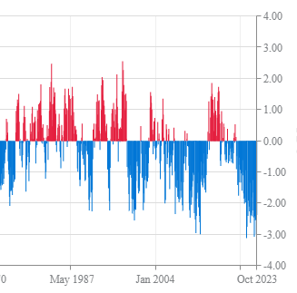
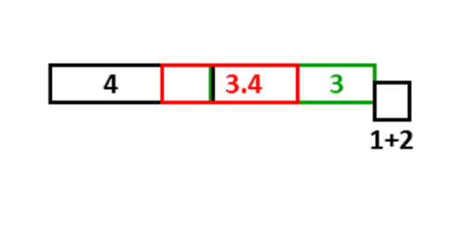
2023 Lead-up/factors: Ocean/atmosphere
Quick transition to El Niño after extended La Niña
“Warm negative” Pacific Decadal Oscillation (PDO)?
Warm sea surface temperatures during 2023
September 7, 2023
https://www.ncei.noaa.gov/access/monitoring/pdo/
Notes:
El Nino is evident with the plume of warm water extending west from the west coast of South America. Sea Surface Temperatures in the Nino 3.4 region (red rectangle)
provide the oceanic temperature index used to help determine the state of ENSO.
The impact of the Pacific Decadal Oscillation (PDO) on the 2023 fire season in Canada may be one
of many contributing factors. The warm ocean temperatures shown in orange or red along the west coast of North
America often indicate the PDO is in the positive phase, which often coincides with a well-established El Nino.
In 2023 the mid-Pacific SSTs were even higher though, resulting in a negative PDO.
Some big fire years occurred in the 2013-15 period in northern parts of western Canada with a positive PDO.
In this case, the temperatures in the central Pacific are even warmer than the coastal temperatures, indicating the PDO is
actually in the negative phase, which is indicated in the time series graph on the left. What effect does a “warm negative”
PDO have, such as during 2023?

Slide 8
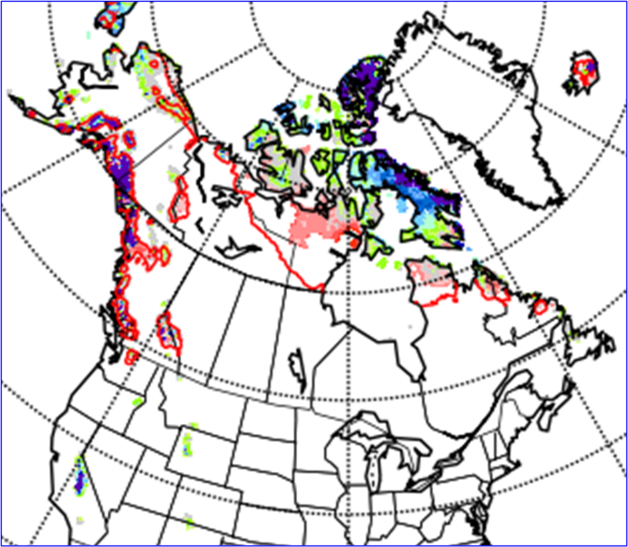
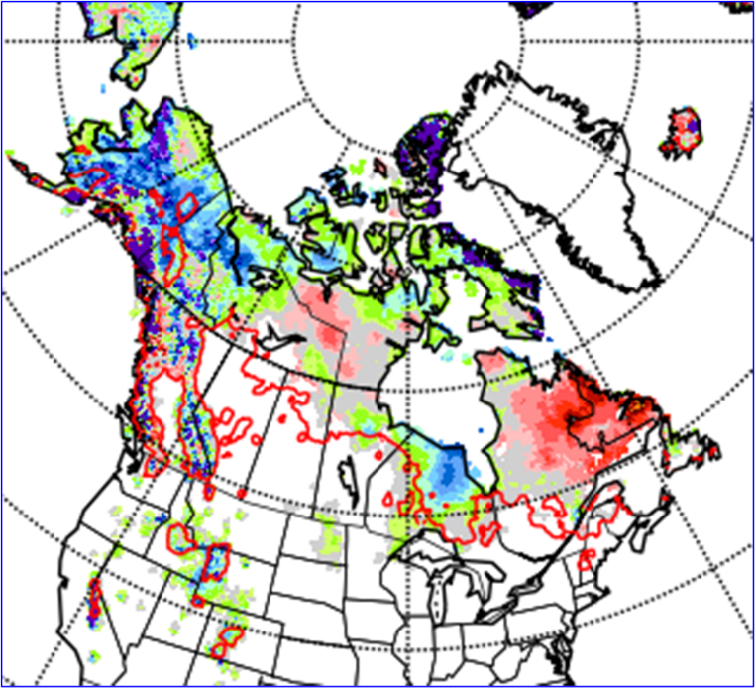
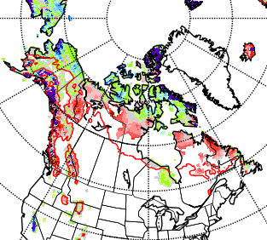
2023 Spring start-up conditions: Snow Cover
Snow loss affects spring fire more than summer …but lengthens/intensifies spring season
May 17, 2023
April 26, 2023
May 10, 2023
Notes:
Snow depth anomaly maps are from the Canadian Cryospheric Information Network. The red line encloses the area that has at least a 2-cm mean depth for the time of year.
White to the north of (above) the red line indicates snow loss earlier than normal; color to the south of (below) the red line indicate snow lingering longer than usual.
Snow vanished quickly and early in 2023.
The black circle indicates the area where the first large fires in 2023 started in west central Alberta, where snow cover usually lingers close to the end of April.
This area is mixed agriculture and forest with some hills/low mountains to about 1300m (4300 ft).

Slide 9
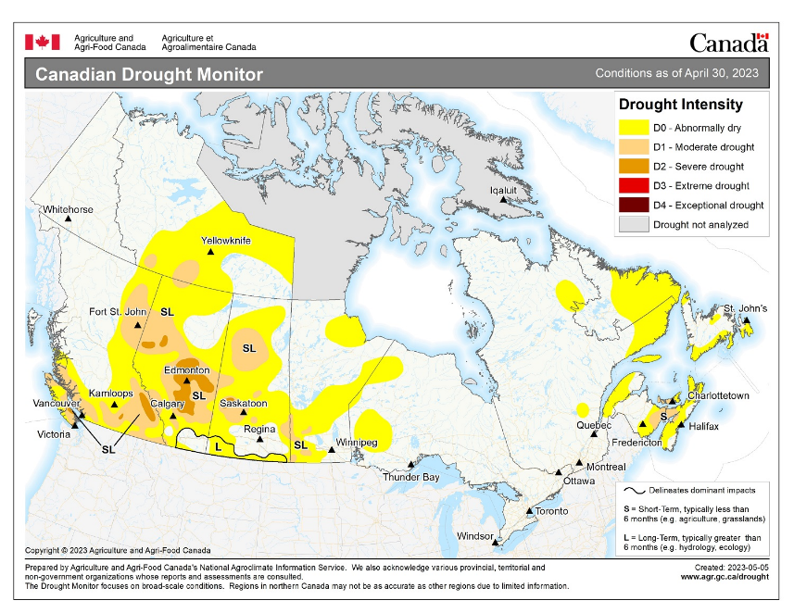
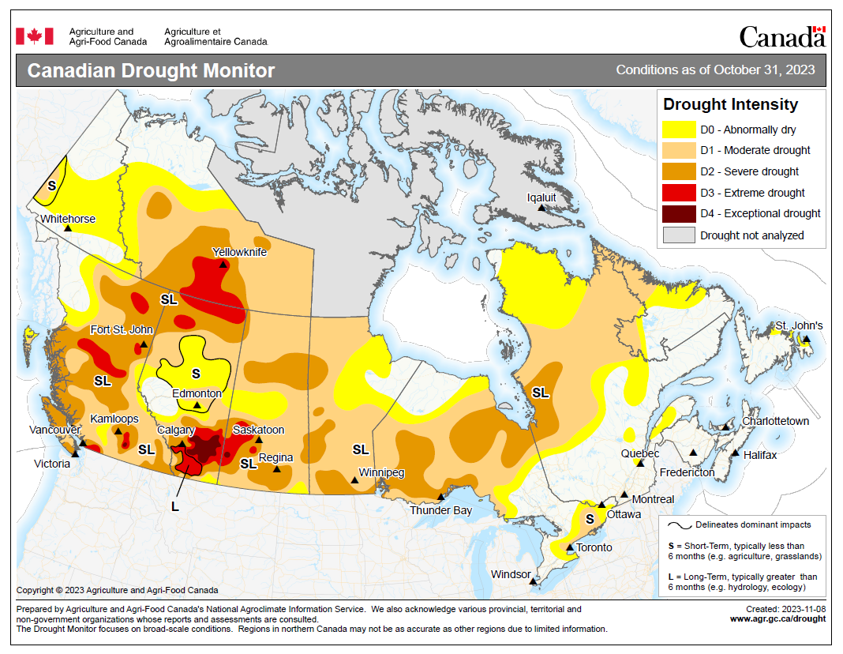
Drought Progression
Drought intensified in late 2022
Widespread intensification over summer
Some improvement over winter
Notes:
9

Slide 10
2024 Season to Date
Notes:
10

Slide 11
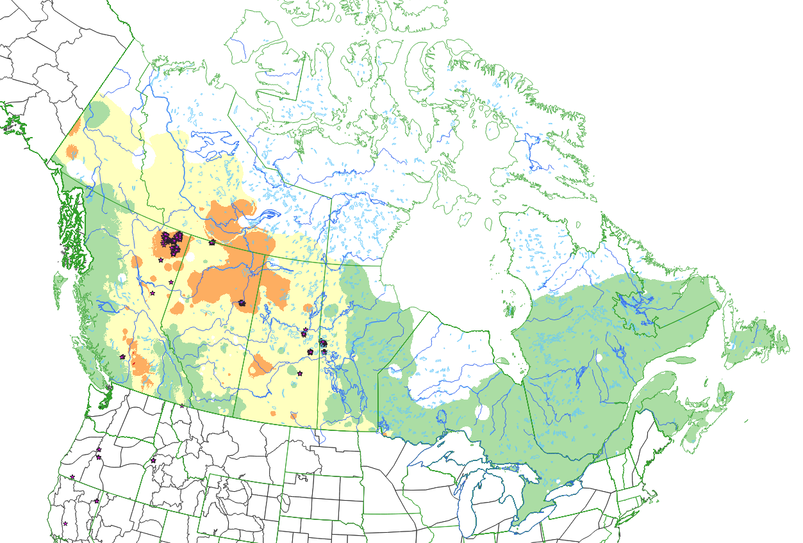
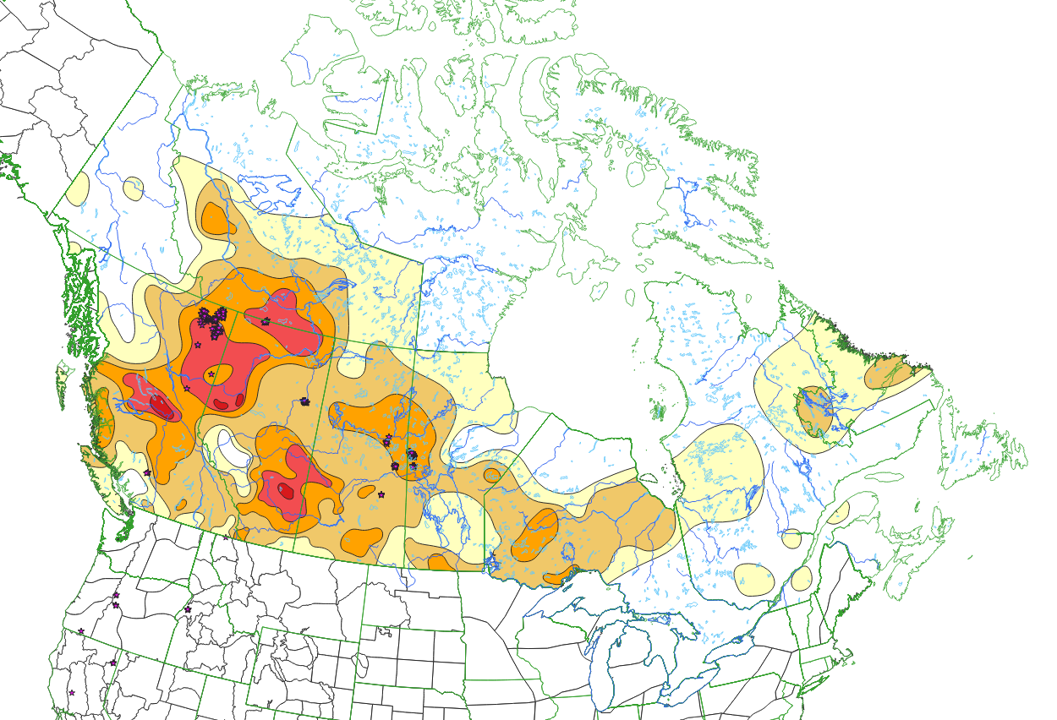
Drought
Some improvement since March 31 in east, southern Prairies
DC: May 14, 2024
Canadian Drought Monitor, April 30
Notes:
11

Slide 12
Snow Cover
Snow melt in far north appears slower than in 2023
May 17, 2023
May 16, 2024
Notes:
12

Slide 13
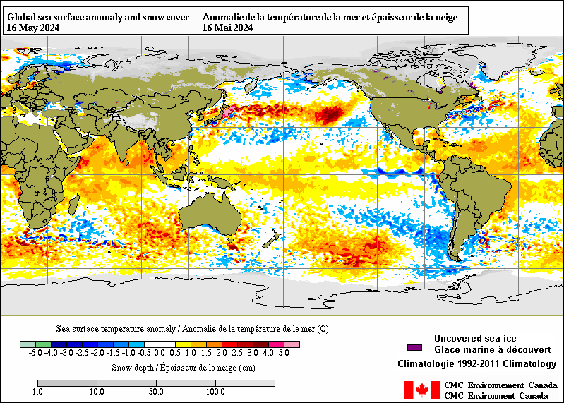
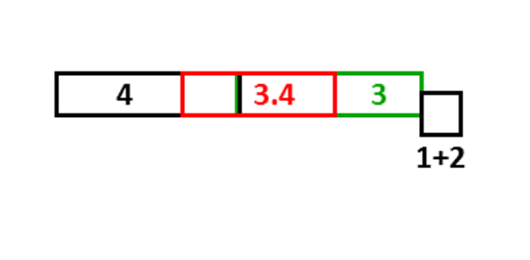
ENSO – Current SST
El Niño fading
Cold water in eastern Pacific typical of a developing La Niña
North Pacific and Atlantic started cold in 2023 but 2024 La Niña may help cool north Pacific
Notes:
Sea surface temperatures (SST): blue = below normal, orange--red = above normal.
Blue in the boxes along the equator indicate La Nina is likely developing (ENSO SST indexes are measured in the red box).
SST in the red ellipse can indicate status of the Pacific Decadal Oscillation (PDO). Cold water along the BC coast with warm water in the central north Pacific indicate the PDO is in the negative phase. Some of the big fire years in northern parts of the provinces and Territories have occurred with a positive PDO, opposite phase from what we currently see.
North Atlantic waters have cooled from late 2023. Note this may not indicate phase of the North Atlantic Oscillation, which is determined by the strength of the Icelandic low
pressure and the Azores high pressure systems.
13

Slide 14
Fire problems in ENSO Springs
El Niño:
Warm, windy, dry in western Canada
La Niña:
Arctic surface highs bring dry air, strong wind around edges
Temperature may be cool
Summer fire problems may depend on other influences
Year | DJF | JFM | FMA | MAM | AMJ | MJJ | JJA | JAS | ASO | SON | OND | NDJ
1995 | 1.0 | 0.7 | 0.5 | 0.3 | 0.1 | 0.0 | -0.2 | -0.5 | -0.8 | -1.0 | -1.0 | -1.0
1998 | 2.2 | 1.9 | 1.4 | 1.0 | 0.5 | -0.1 | -0.8 | -1.1 | -1.3 | -1.4 | -1.5 | -1.6
1999 | -1.5 | -1.3 | -1.1 | -1.0 | -1.0 | -1.0 | -1.1 | -1.1 | -1.2 | -1.3 | -1.5 | -1.7
2000 | -1.7 | -1.4 | -1.1 | -0.8 | -0.7 | -0.6 | -0.6 | -0.5 | -0.5 | -0.6 | -0.7 | -0.7
2001 | -0.7 | -0.5 | -0.4 | -0.3 | -0.3 | -0.1 | -0.1 | -0.1 | -0.2 | -0.3 | -0.3 | -0.3
2002 | -0.1 | 0.0 | 0.1 | 0.2 | 0.4 | 0.7 | 0.8 | 0.9 | 1.0 | 1.2 | 1.3 | 1.1
2003 | 0.9 | 0.6 | 0.4 | 0.0 | -0.3 | -0.2 | 0.1 | 0.2 | 0.3 | 0.3 | 0.4 | 0.4
2004 | 0.4 | 0.3 | 0.2 | 0.2 | 0.2 | 0.3 | 0.5 | 0.6 | 0.7 | 0.7 | 0.7 | 0.7
2005 | 0.6 | 0.6 | 0.4 | 0.4 | 0.3 | 0.1 | -0.1 | -0.1 | -0.1 | -0.3 | -0.6 | -0.8
2006 | -0.8 | -0.7 | -0.5 | -0.3 | 0.0 | 0.0 | 0.1 | 0.3 | 0.5 | 0.7 | 0.9 | 0.9
2007 | 0.7 | 0.3 | 0.0 | -0.2 | -0.3 | -0.4 | -0.5 | -0.8 | -1.1 | -1.4 | -1.5 | -1.6
2008 | -1.6 | -1.4 | -1.2 | -0.9 | -0.8 | -0.5 | -0.4 | -0.3 | -0.3 | -0.4 | -0.6 | -0.7
2009 | -0.8 | -0.7 | -0.5 | -0.2 | 0.1 | 0.4 | 0.5 | 0.5 | 0.7 | 1.0 | 1.3 | 1.6
2010 | 1.5 | 1.3 | 0.9 | 0.4 | -0.1 | -0.6 | -1.0 | -1.4 | -1.6 | -1.7 | -1.7 | -1.6
2011 | -1.4 | -1.1 | -0.8 | -0.6 | -0.5 | -0.4 | -0.5 | -0.7 | -0.9 | -1.1 | -1.1 | -1.0
2012 | -0.8 | -0.6 | -0.5 | -0.4 | -0.2 | 0.1 | 0.3 | 0.3 | 0.3 | 0.2 | 0.0 | -0.2
2013 | -0.4 | -0.3 | -0.2 | -0.2 | -0.3 | -0.3 | -0.4 | -0.4 | -0.3 | -0.2 | -0.2 | -0.3
2014 | -0.4 | -0.4 | -0.2 | 0.1 | 0.3 | 0.2 | 0.1 | 0.0 | 0.2 | 0.4 | 0.6 | 0.7
2015 | 0.6 | 0.6 | 0.6 | 0.8 | 1.0 | 1.2 | 1.5 | 1.8 | 2.1 | 2.4 | 2.5 | 2.6
2016 | 2.5 | 2.2 | 1.7 | 1.0 | 0.5 | 0.0 | -0.3 | -0.6 | -0.7 | -0.7 | -0.7 | -0.6
2017 | -0.3 | -0.1 | 0.1 | 0.3 | 0.4 | 0.4 | 0.2 | -0.1 | -0.4 | -0.7 | -0.9 | -1.0
2018 | -0.9 | -0.8 | -0.6 | -0.4 | -0.1 | 0.1 | 0.1 | 0.2 | 0.4 | 0.7 | 0.9 | 0.8
2019 | 0.7 | 0.7 | 0.7 | 0.7 | 0.5 | 0.5 | 0.3 | 0.1 | 0.2 | 0.3 | 0.5 | 0.5
2020 | 0.5 | 0.5 | 0.4 | 0.2 | -0.1 | -0.3 | -0.4 | -0.6 | -0.9 | -1.2 | -1.3 | -1.2
2021 | -1.0 | -0.9 | -0.8 | -0.7 | -0.5 | -0.4 | -0.4 | -0.5 | -0.7 | -0.8 | -1.0 | -1.0
2022 | -1.0 | -0.9 | -1.0 | -1.1 | -1.0 | -0.9 | -0.8 | -0.9 | -1.0 | -1.0 | -0.9 | -0.8
2023 | -0.7 | -0.4 | -0.1 | 0.2 | 0.5 | 0.8 | 1.1 | 1.3 | 1.6 | 1.8 | 1.9 | 2.0
2024 | 1.8 | 1.5 | 1.1
Large area burned
Virginia Hills, AB
Chisholm, AB
Kelowna, BC
Slave Lake, AB
PDO positive phase
Fort McMurray, AB
Big years in BC
Western half
Most of Canada!

Slide 15
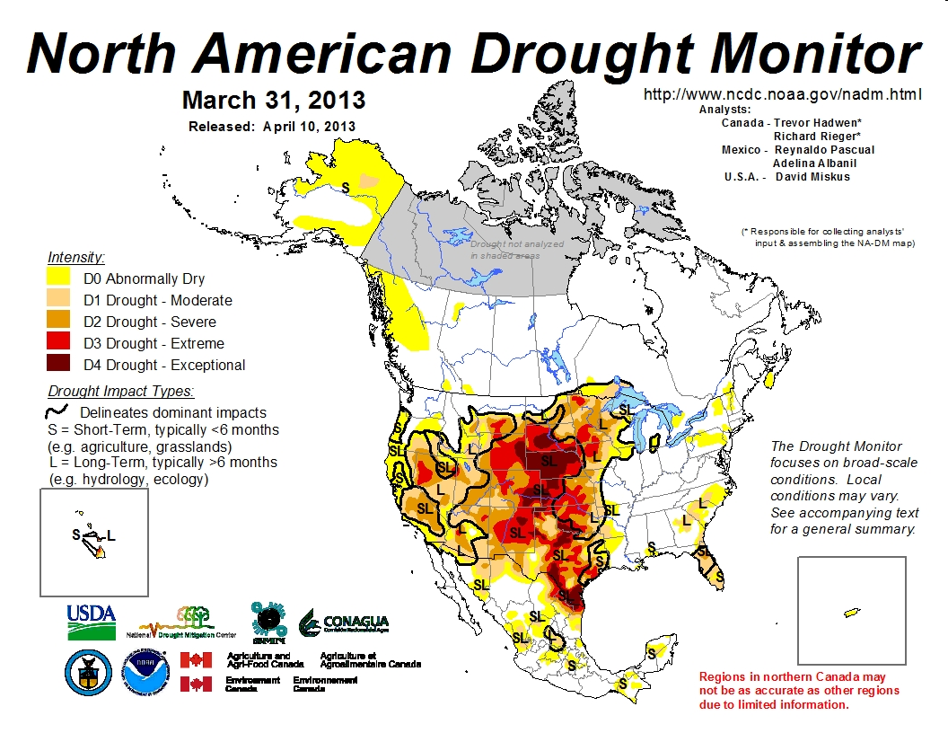
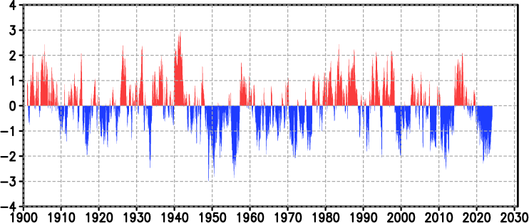
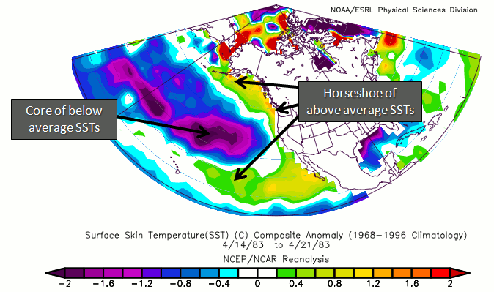
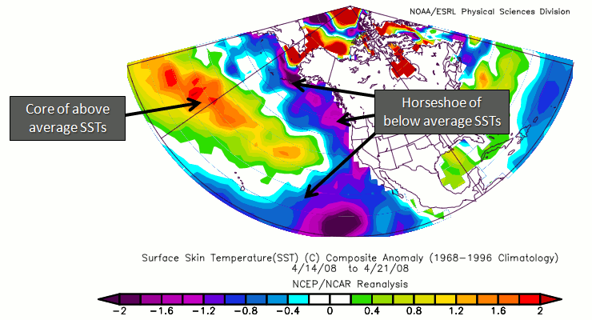
Pacific Decadal Oscillation (as of Mar 2024)
https://ds.data.jma.go.jp/tcc/tcc/products/elnino/decadal/pdo_month.html
Warm phase
Cold phase
http://climate.ncsu.edu/climate/patterns/PDO.html
Notes:
15

Slide 16
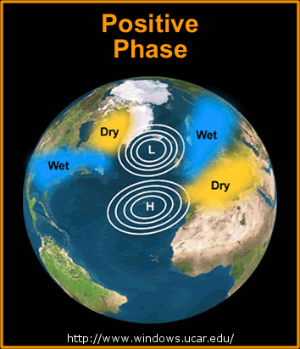
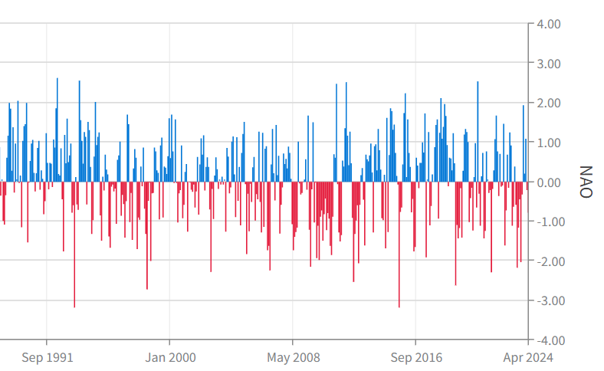
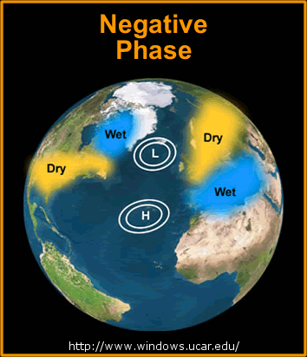
North Atlantic Oscillation
https://www.ncei.noaa.gov/access/monitoring/nao
+
-
Quebec Area Burned
(NFDB, ha*1000)
2023 5000*
2015 5
2013 1900
2010 315
2008 1
2007 343
2006 136
2005 800
2004 3
2002 1000
-
Early years may not include area burned in northern (unmanaged) region
+
Notes:
Years with high burned area in Quebec are indicated in red text, moderate years in orange, and low in black. Perhaps the degree to which the NAO is positive influences fire occurrence,
which depends on the correct dryness (high atmospheric pressure) coupled with enough atmospheric instability to generate thundershowers, or increased human activity in the absence of rain. This may occur during years where the NAO transitions between negative and positive or vice versa.
A study ongoing at Universite du Quebec a Montreal will likely provide more insight into oceanic/atmospheric oscillations that influence fire in eastern Canada. One finding may link a Baffin/West Atlantic (BWA) oscillation with increased severity rating (I have not read outcomes from this study so can’t comment on this any more at this time).
16

Slide 17
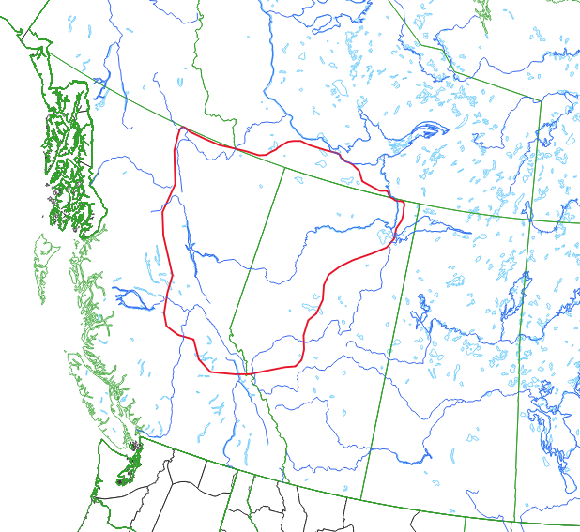
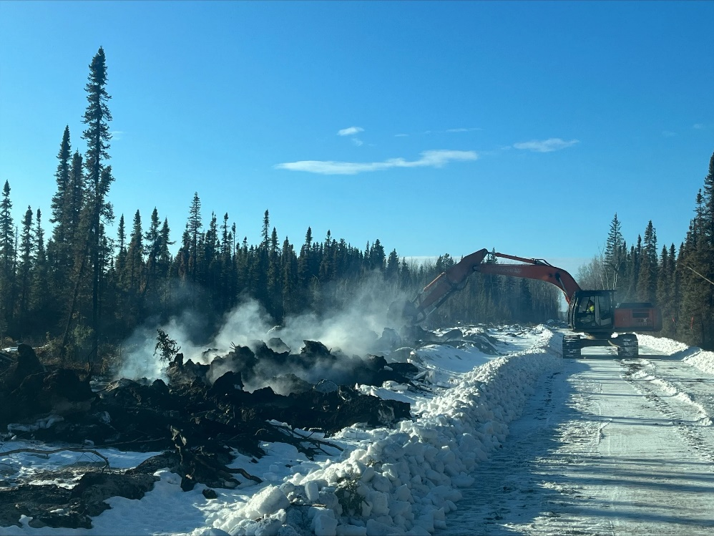
2023 Activity Continues: Holdover Fires
BC: 90+ AB: 55-60 NT: 2+ Others?
BC/AB average 5-10 per year
Heavy equipment working on hotspots on the southwest perimeter of the Basset fire (HWF058). February 12, 2024. https://srd.web.alberta.ca/high-level-area-update/february-12; accessed April 22, 2024
Notes:
Area outlined in red indicates where known holdover fires occurred in the 2023-24 winter.

Slide 18
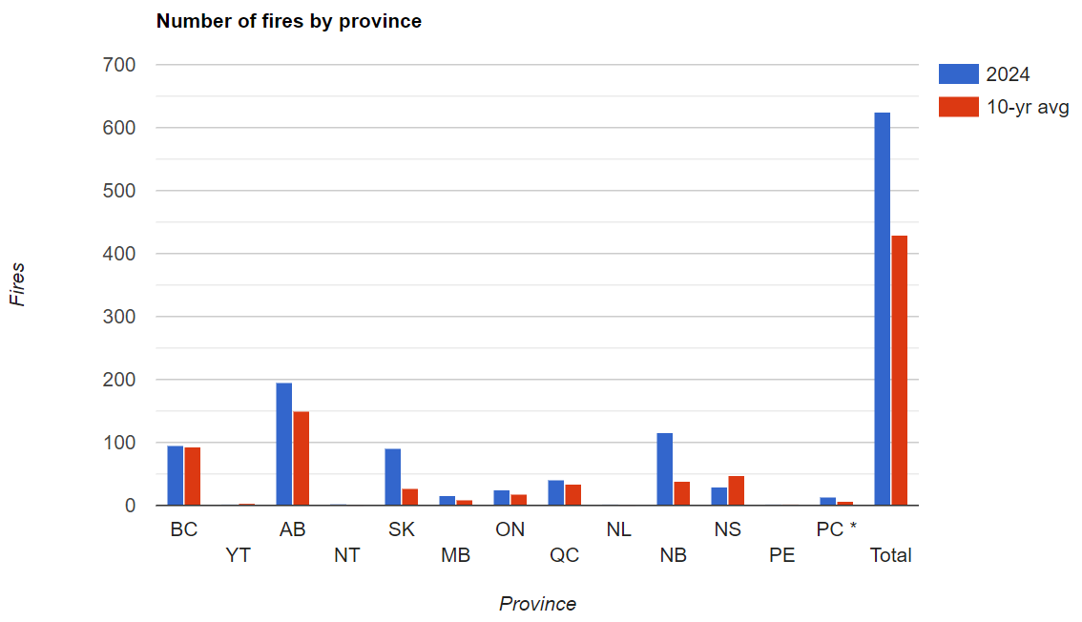
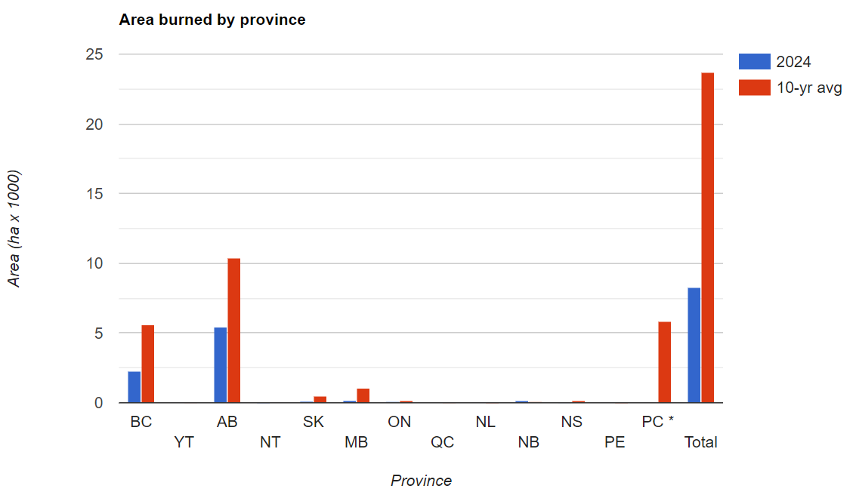
Fire numbers and area burned by region
Some regions with more fires but less area burned than average
Still early in the fire season! (May 1 data)
May want to produce custom graphs from
May 15 sitrep data
Notes:
From the weekly CWFIS situation report.
18

Slide 19
Climate Model Predictions
Notes:
19

Slide 20
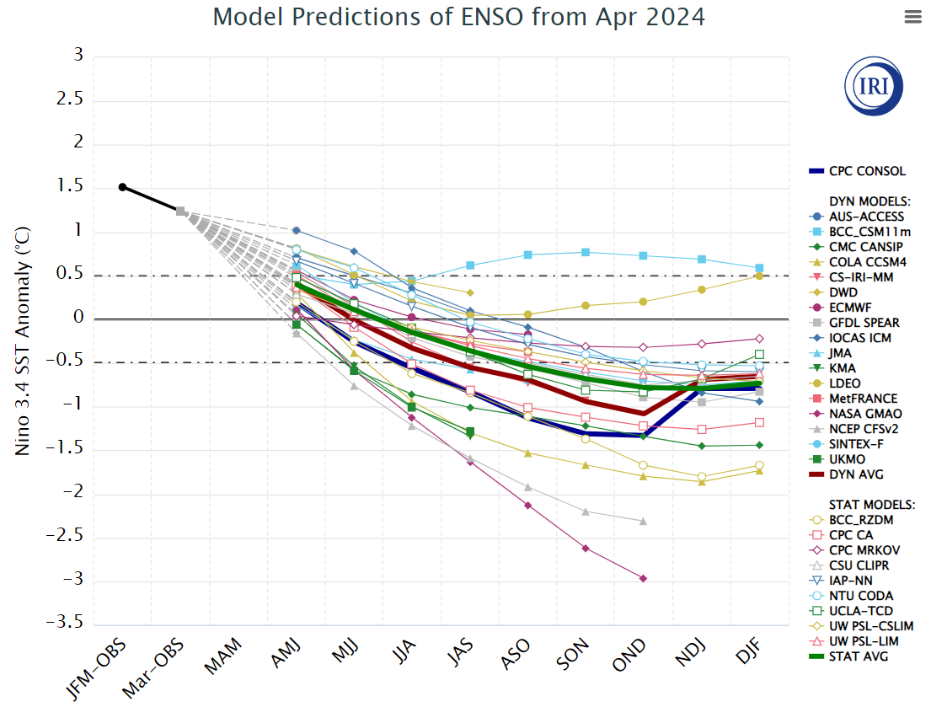
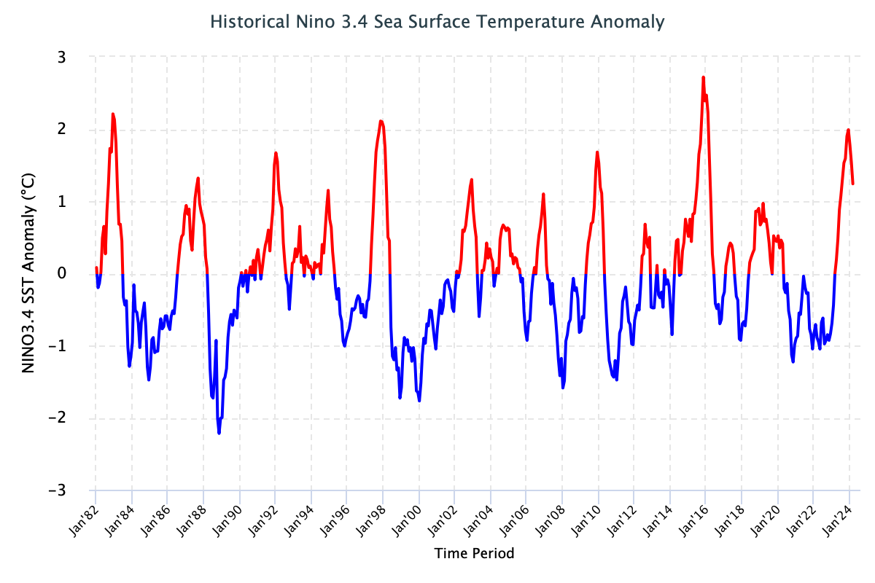
IRI ENSO Forecast
https://iri.columbia.edu/our-expertise/climate/forecasts/enso/current/?enso_tab=enso-sst_table
La Niña likely developing 0ver summer
April, 2024
Time series to January 2024
Notes:
Neutral ENSO is when indexes remain between the horizontal red lines on the plume chart and the black lines on the time series.
El Nino occurs when the indexes are above the top line (+0.5 sea surface temperature anomaly in the 3.4 region) for over 3 consecutive months.
La Nina occurs when the indexes are below the bottom line (-0.5 sea surface temperature anomaly in the 3.4 region) for over 3 consecutive months.
20

Slide 21
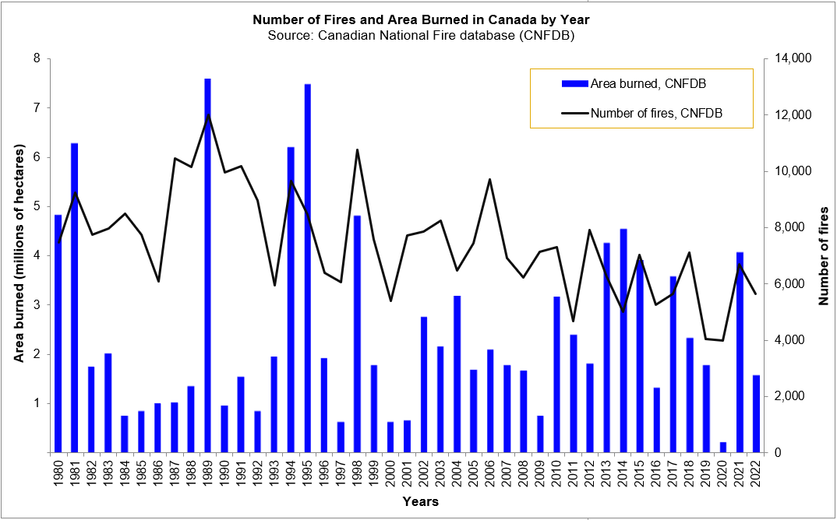
Fading El Niño: Recent analog years
Area burned in 2010, 2016, 2017, 2019, 2020 (red, orange arrows)
Notes:
We could look at analog years before 2016 but climate warming may make good comparisons more difficult.
In 2017, a large area burned occurred mainly in British Columbia. The difference in the ENSO index is a later onset of La Nina – in the winter of 2017-18.
Neutral ENSO may favor larger area burned in that province.
21

Slide 22
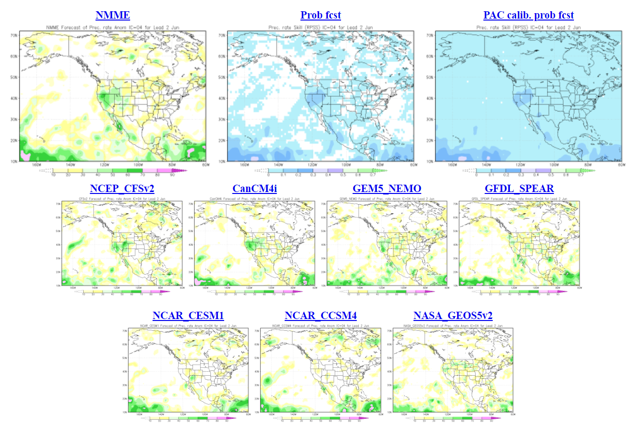
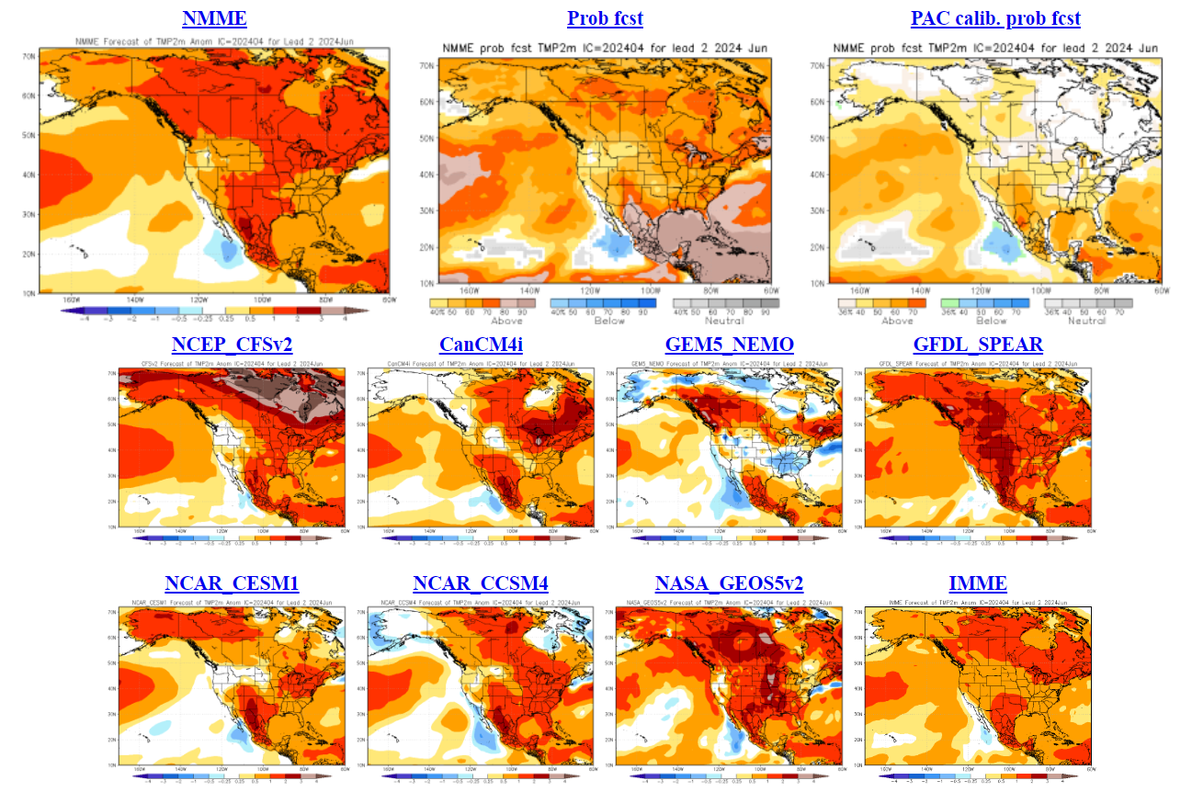
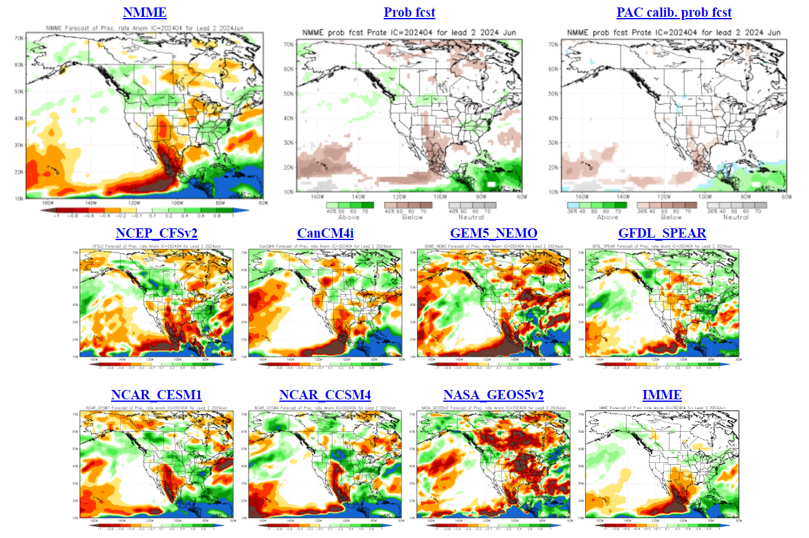
North American Multi-model Ensemble
NMME
June Temp
GEM-NEMO often predicts cool
Precip skills
Little skill and variation
June Precip
Dry central regions?
Notes:
Temperature maps: blue = below normal, orange--red = above normal
Precipitation maps: orange--red = below normal, green = above normal
Seasonal forecasts produced by NRCan use temperature and precipitation from the two 10-member CanSIPS ensembles (green boxes in centre).
GEM-NEMO translates to Global Environmental Multiscale – Nucleus for European Modeling of the Oceans.
Wind data from these models have not been tested yet.
The remainder of the boxes show various models used in the NMME, with combined outputs condensed into the top left box, while
the bottom right box includes European models – the International Multi-Model Ensemble (IMME).

Slide 23
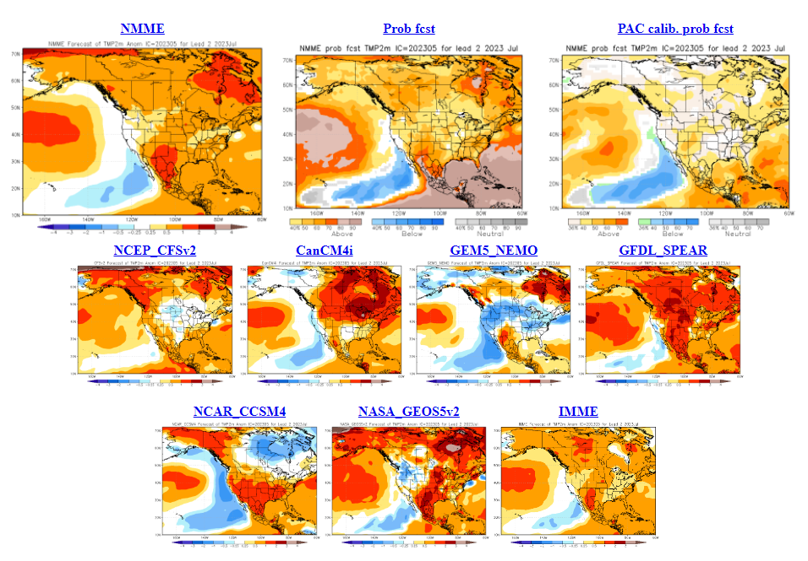
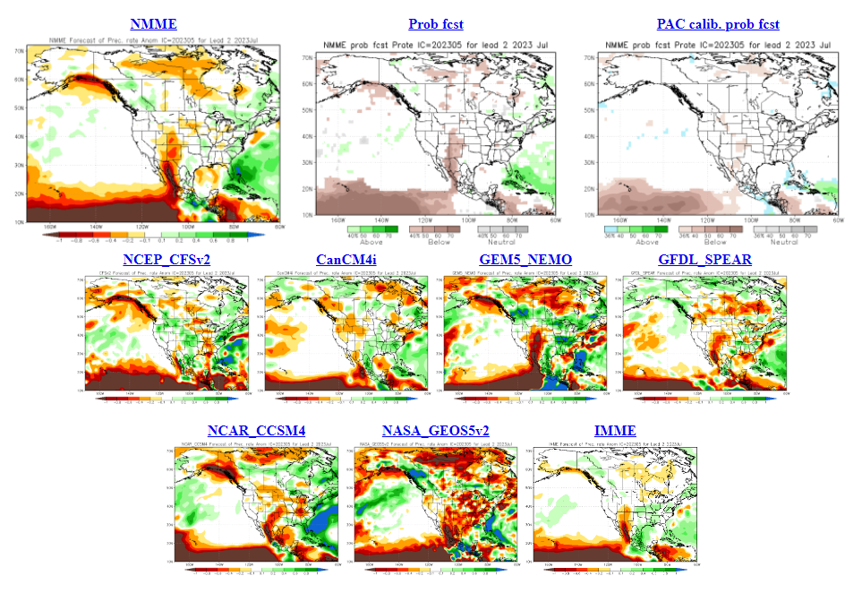
North American Multi-model Ensemble
NMME – April run
July Temp
Ambiguous trends
July Precip
Rainfall increases in July?
Notes:
Temperature maps: blue = below normal, orange--red = above normal
Precipitation maps: orange--red = below normal, green = above normal
Seasonal forecasts produced by NRCan use temperature and precipitation from the two 10-member CanSIPS ensembles (green boxes in centre).
GEM-NEMO translates to Global Environmental Multiscale – Nucleus for European Modeling of the Oceans.
Wind data from these models have not been tested yet.
The remainder of the boxes show various models used in the NMME, with combined outputs condensed into the top left box, while
the bottom right box includes European models – the International Multi-Model Ensemble (IMME).

Slide 24
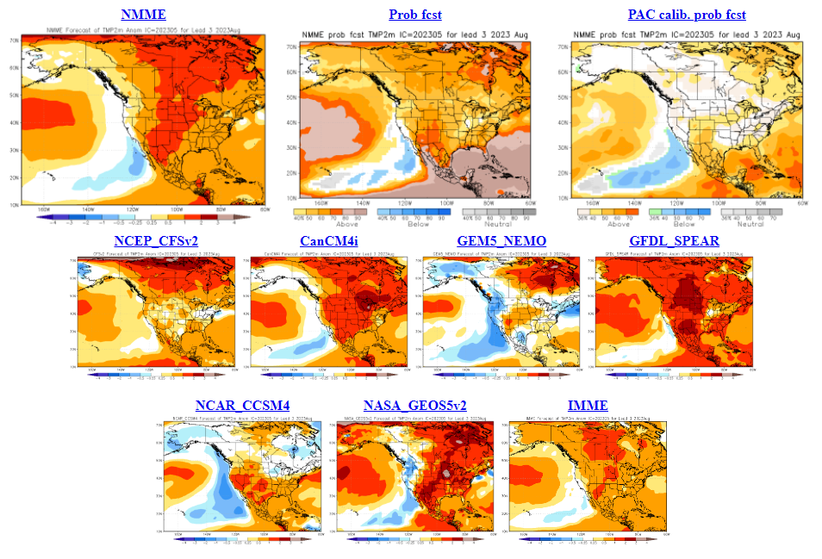
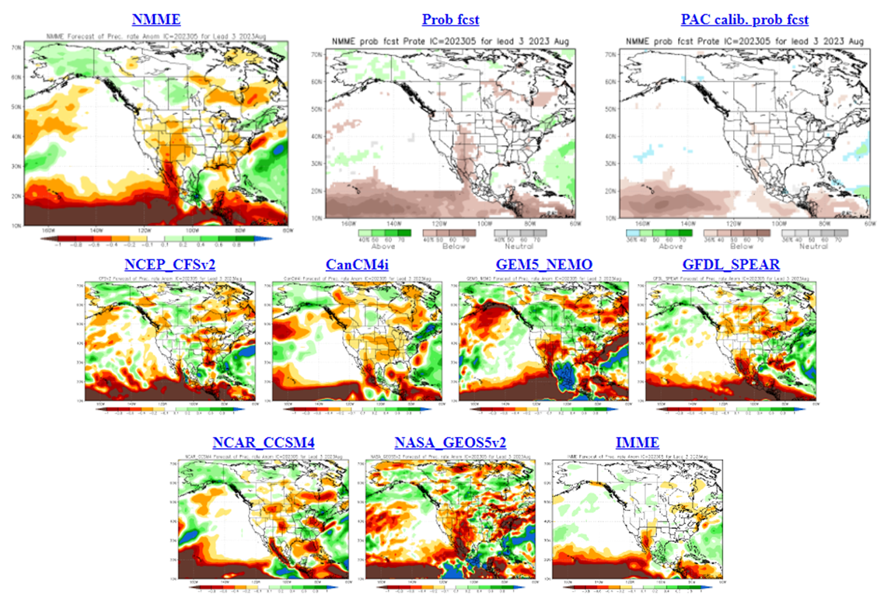
North American Multi-model Ensemble
NMME – April run
August Temp
Warm signal
August Precip
Dry signal strongest in central-eastern
Canada
Notes:
Temperature maps: blue = below normal, orange--red = above normal
Precipitation maps: orange--red = below normal, green = above normal
Seasonal forecasts produced by NRCan use temperature and precipitation from the two 10-member CanSIPS ensembles (green boxes in centre).
GEM-NEMO translates to Global Environmental Multiscale – Nucleus for European Modeling of the Oceans.
Wind data from these models have not been tested yet.
The remainder of the boxes show various models used in the NMME, with combined outputs condensed into the top left box, while
the bottom right box includes European models – the International Multi-Model Ensemble (IMME).

Slide 25
2024 NRCan-CFS Seasonal Prediction
Will 2024 be as bad as 2023??
Notes:
25

Slide 26
Some notes …
Fire seasons often change dramatically year to year
Different set of climate features in 2024 should produce a different outcome
This does not mean all regions will be quieter
One region can be active more than one year at a time
Notes:
26

Slide 27
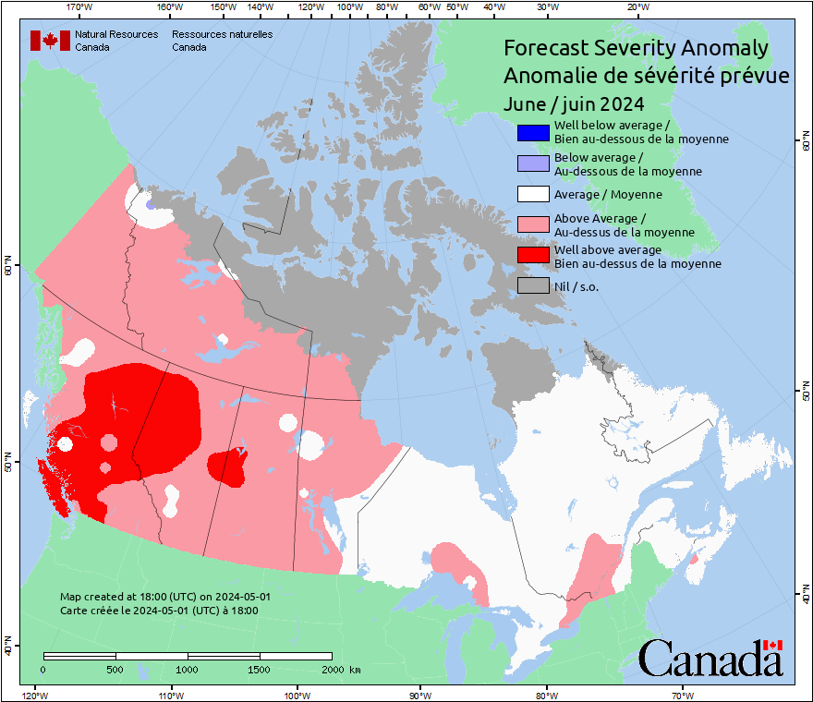
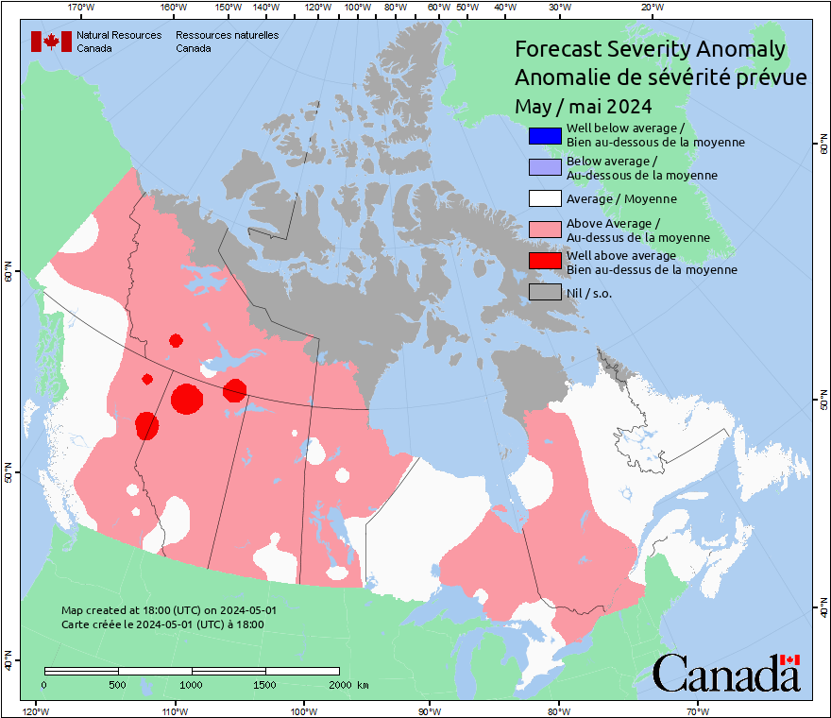
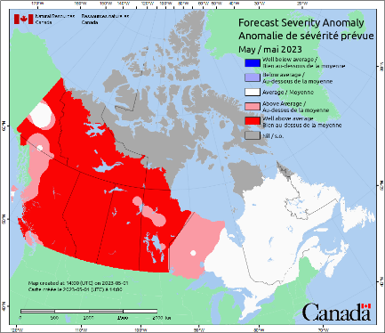
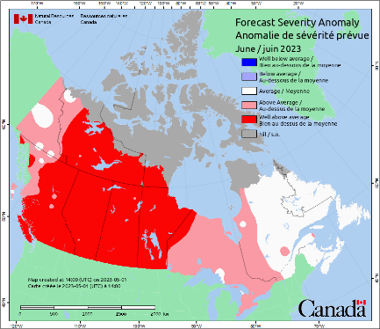
NRCan-CFS Prediction: May run, for May/June
Anomaly
Predicted values normalized against average weather
Notes:
A patchy pattern likely indicates anomaly values lie close to the category bounds.
Although the southern Prairies are often red in the spring, little burning occurs due to greening of grass, so this area can often be ignored in mid to late spring.
27

Slide 28
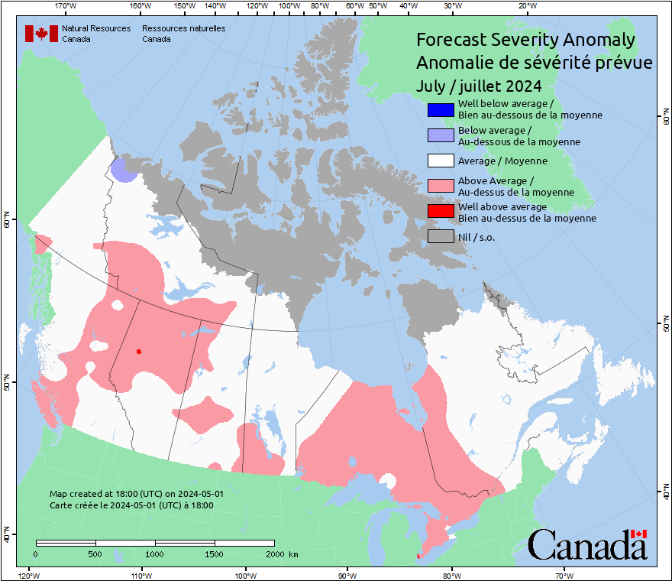
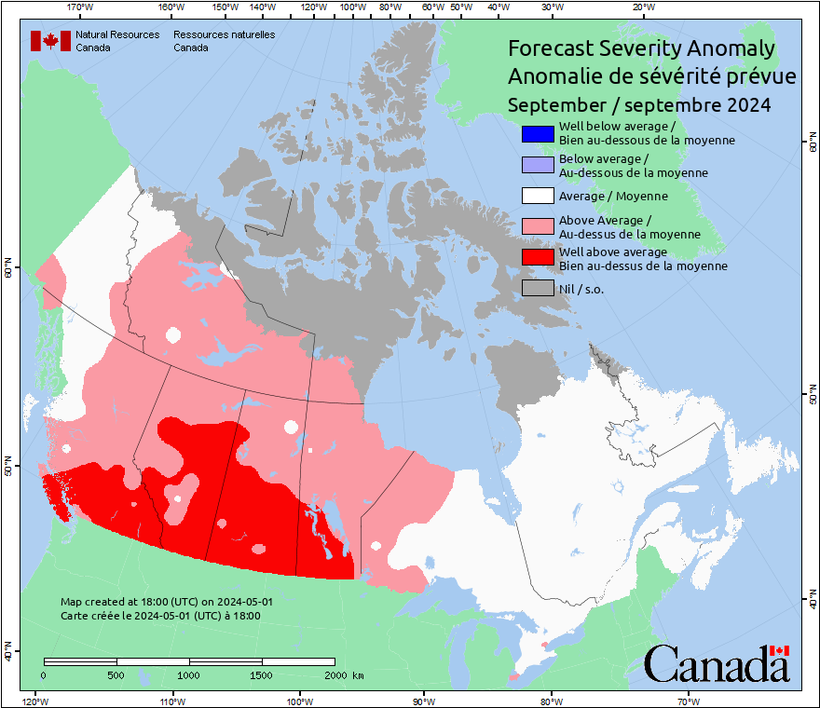
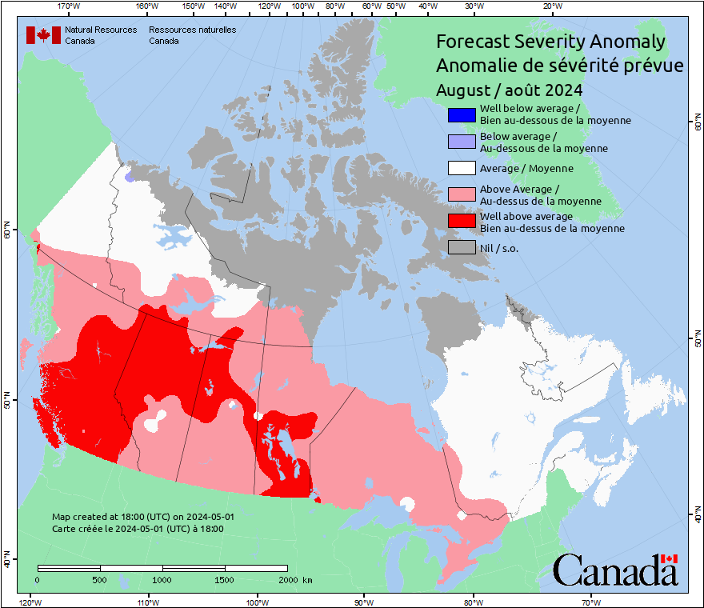
NRCan-CFS Prediction: May run, for July-Sept
Anomaly
Predicted values normalized against average weather
Notes:
A patchy pattern likely indicates anomaly values lie close to the category bounds.
28

Slide 29
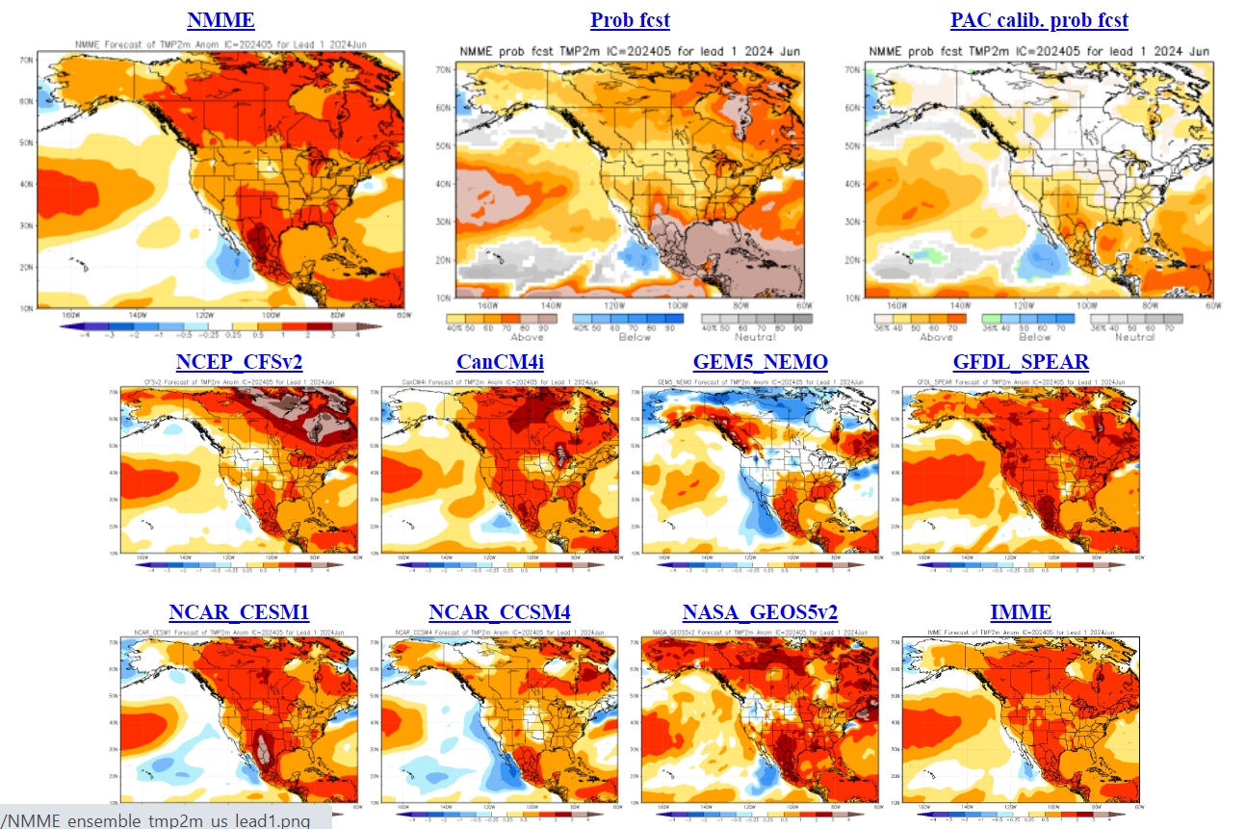
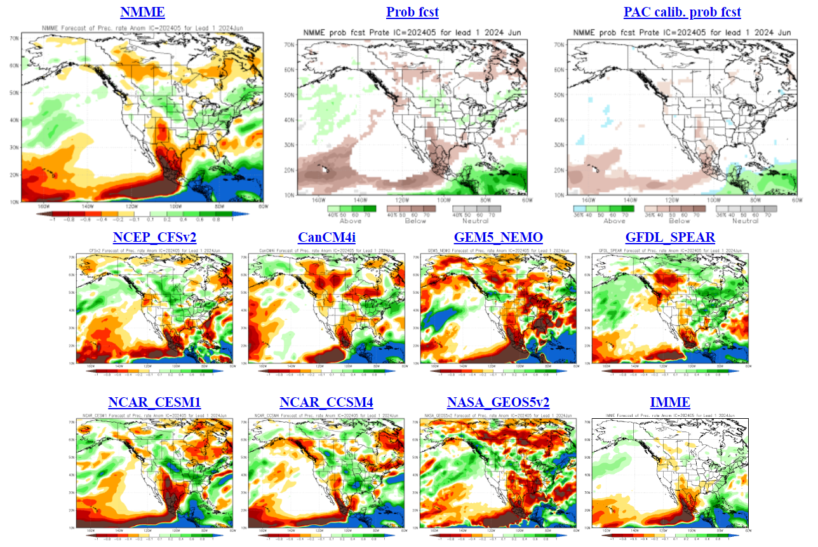
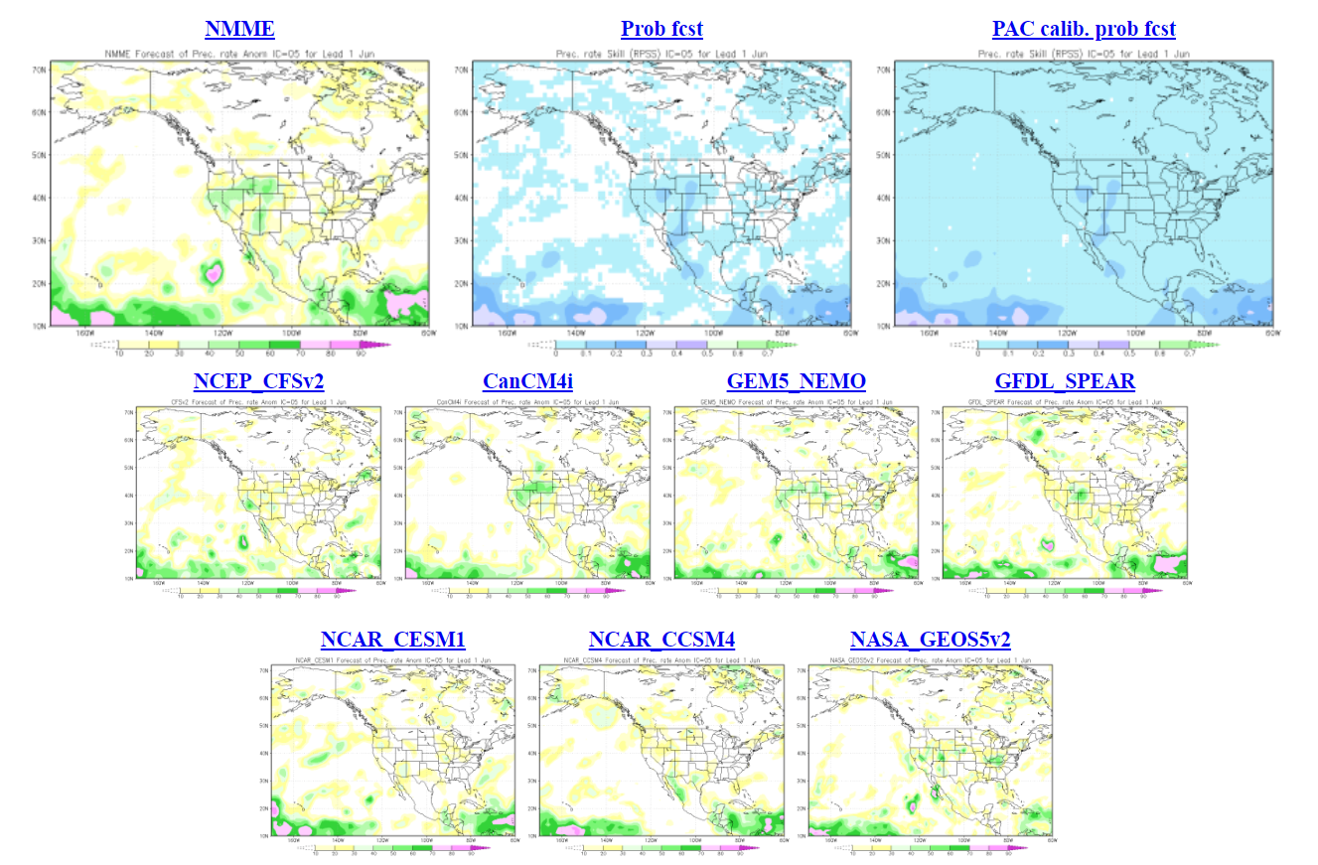
North American Multi-model Ensemble
NMME – May run
June Temp
GEM-NEMO often predicts cool
Precip skills
Little skill and variation
June Precip
Dry central regions?
Notes:
Temperature maps: blue = below normal, orange--red = above normal
Precipitation maps: orange--red = below normal, green = above normal
Seasonal forecasts produced by NRCan use temperature and precipitation from the two 10-member CanSIPS ensembles (green boxes in centre).
GEM-NEMO translates to Global Environmental Multiscale – Nucleus for European Modeling of the Oceans.
Wind data from these models have not been tested yet.
The remainder of the boxes show various models used in the NMME, with combined outputs condensed into the top left box, while
the bottom right box includes European models – the International Multi-Model Ensemble (IMME).
The precipitation “lack of skills” map is shown here to illuminate the difficulty in precipitation prediction.

Slide 30
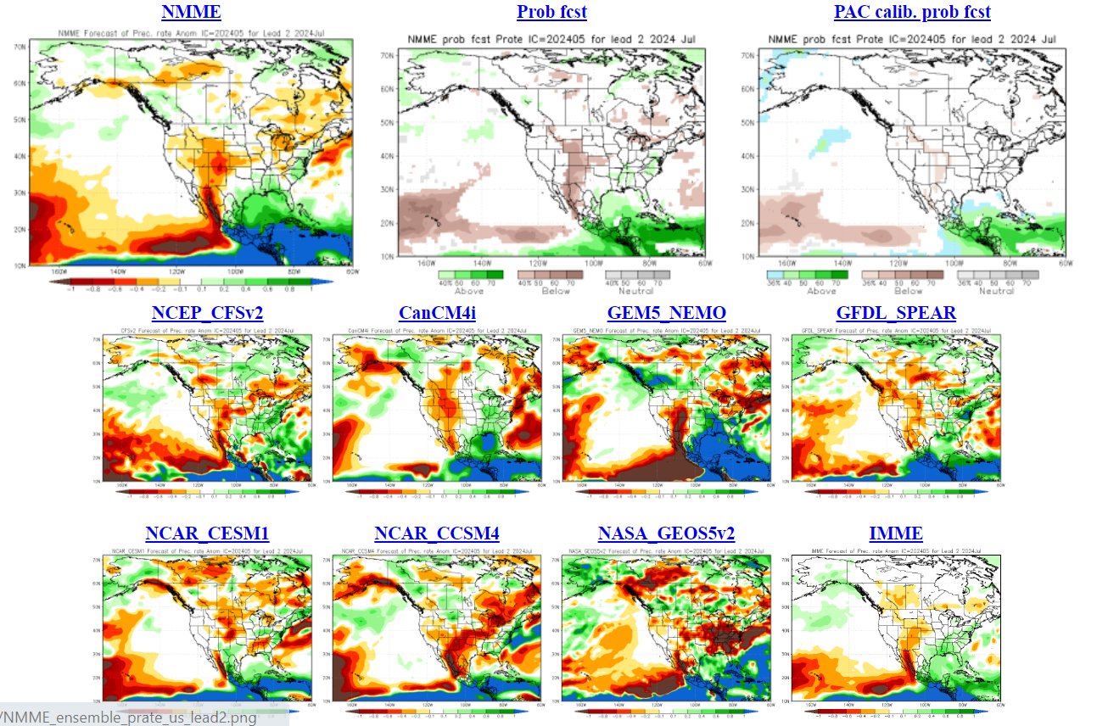
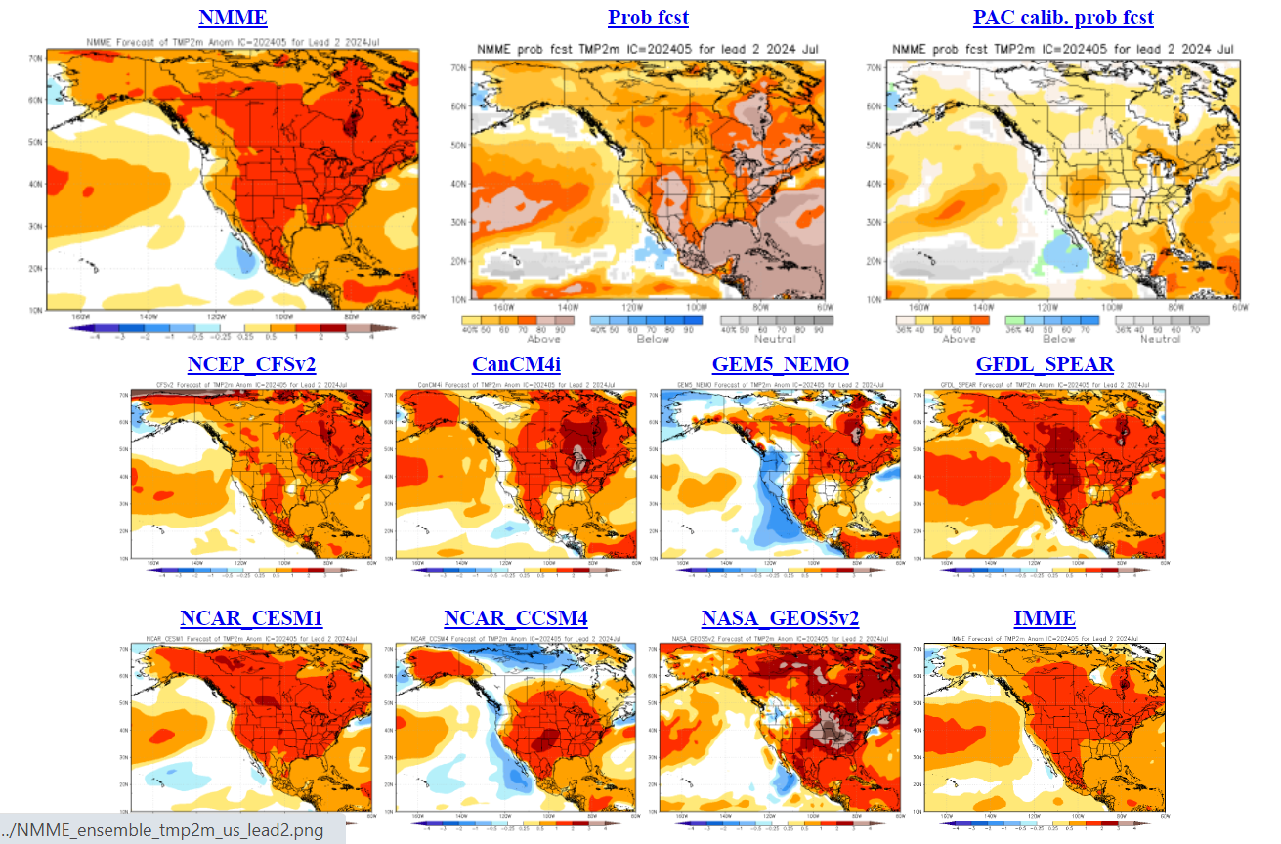
North American Multi-model Ensemble
NMME – May run
July Temp
Good agreement for normal to above normal
July Precip
Ambiguous results. Many models continue dryness along 60N
Notes:
Temperature maps: blue = below normal, orange--red = above normal
Precipitation maps: orange--red = below normal, green = above normal
Seasonal forecasts produced by NRCan use temperature and precipitation from the two 10-member CanSIPS ensembles (green boxes in centre).
GEM-NEMO translates to Global Environmental Multiscale – Nucleus for European Modeling of the Oceans.
Wind data from these models have not been tested yet.
The remainder of the boxes show various models used in the NMME, with combined outputs condensed into the top left box, while
the bottom right box includes European models – the International Multi-Model Ensemble (IMME).

Slide 31
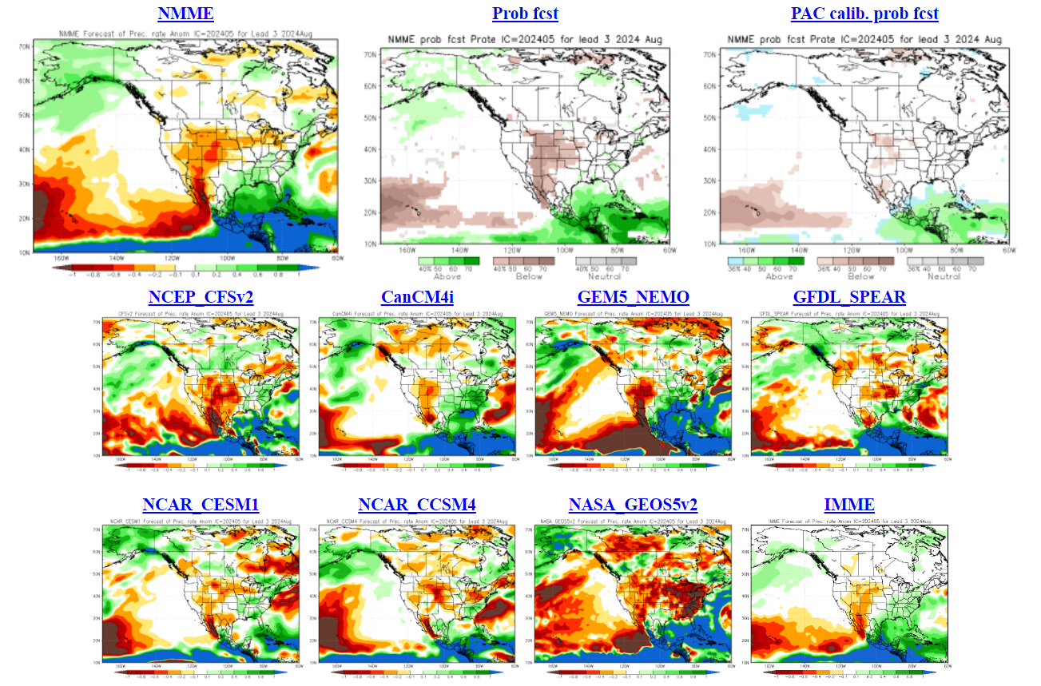
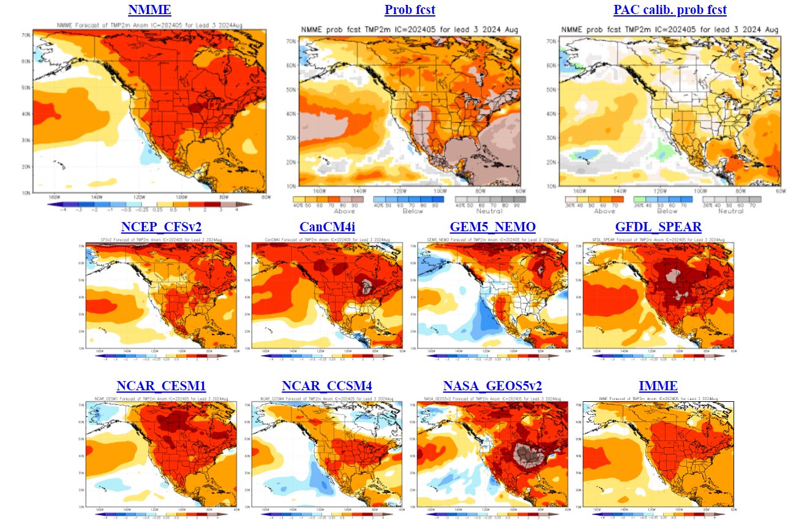
North American Multi-model Ensemble
NMME – May run
August Precip
Mixed results but dry near 60N?
August Temp
Mostly normal to above normal signal
Notes:
Temperature maps: blue = below normal, orange--red = above normal
Precipitation maps: orange--red = below normal, green = above normal
Seasonal forecasts produced by NRCan use temperature and precipitation from the two 10-member CanSIPS ensembles (green boxes in centre).
GEM-NEMO translates to Global Environmental Multiscale – Nucleus for European Modeling of the Oceans.
Wind data from these models have not been tested yet.
The remainder of the boxes show various models used in the NMME, with combined outputs condensed into the top left box, while
the bottom right box includes European models – the International Multi-Model Ensemble (IMME).

Slide 32
Differences from April runs
June:
CM4i warms northwest Canada along 60N, GEM-NEMO shrinks warm area
Both models increase dryness in west; CM4i dries Labrador
July:
Both models expand warmth in central Canada
CM4i dries western Prairies; east
August:
CM4i brings highest heat anomaly southward from northeast BC to Great Lakes (patchy areas)
CM4i dries west along 60N, GEM-NEMO dries central QC and Labrador

Slide 33
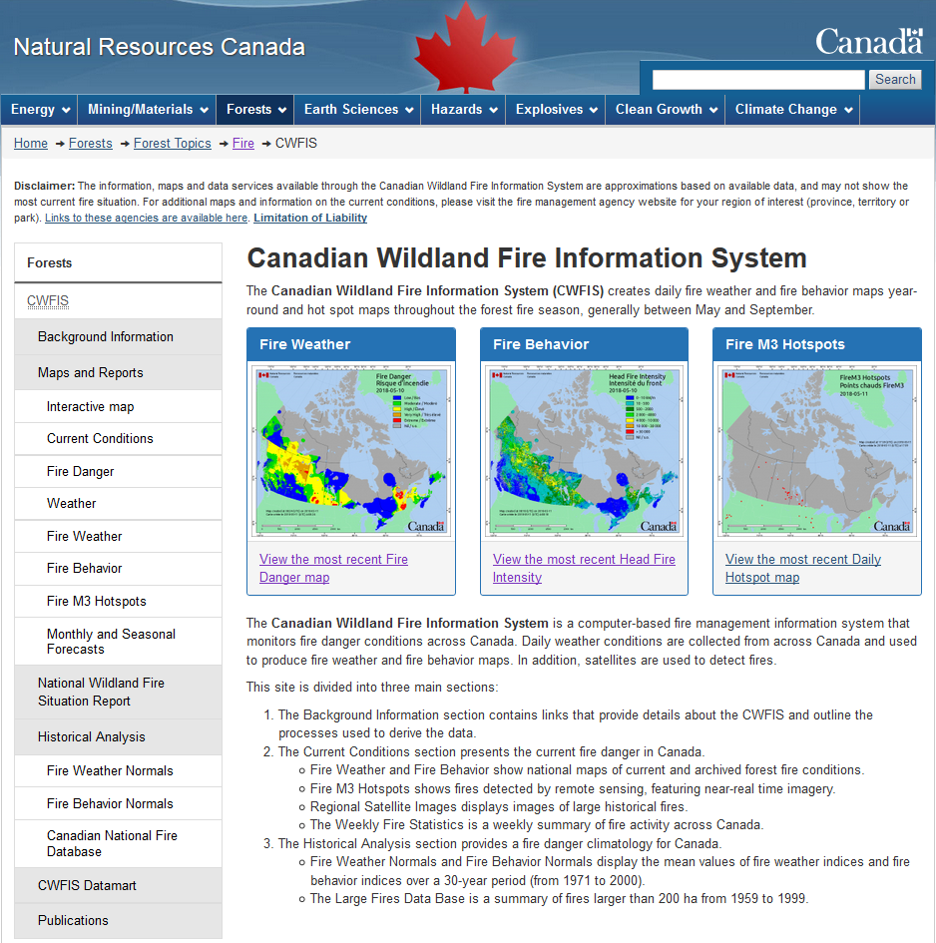
Canadian Wildland Fire Information System (CWFIS)
Note: CWFIS web site will change, likely in 2024-25
Notes:
Highlights the Monthly and Seasonal Forecasts link on the CWFIS web page. This will eventually look different when the web site revisions are done!

Slide 34
Conclusions and Reminders
2023 was likely an outlier statistically (2020’s opposite)
Model synthesis indicates
Warm summer (may be common with warming climate)
Rainfall uncertain but La Niña may help boost amounts
Possible quieter July but active late summer
Serious fires can occur in any year
Fire activity depends on ignitions; our forecast only predicts where potential exists

Slide 35
Remember to check updates …
Seasonal forecast: first working day each month on CWFIS
Daily conditions: provincial and/or CWFIS web sites
Government of Ontario

Slide 36
Questions?
Contact:
Richard Carr
Fire Research Analyst
Natural Resources Canada – Canadian Forest Service
Richard.Carr@NRCan-RNCan.gc.ca
5320 122 Street NW
Edmonton, AB, Canada
T6H 3S5
825-510-1265
?
?
?
?
?
Notes:
36

Slide 37
Holdover Fires
Winter remediation includes searching for heat signatures, turning over soil, applying water
As of early 2024:
BC: ~90
AB: 55-60
NT: 2+
BC and AB averages are probably <10 per year
Notes:
The two blue boxes northwest of Fort Smith indicate he NWT holdover fires in the 2023-24 winter.

Slide 38
Climate Ensemble Data: CanSIPS
Models developed by Canadian Centre for Climate Modeling and Analysis
CanCM4i
GEM-NEMO: Global Environmental Multiscale – Nucleus for European Modeling of the Ocean
10-member ensembles producing 12-month forecasts
NRCan uses temperature and precipitation data
Skill of climate forecasts often best in coastal areas, poorer in lee of mountain ranges
Notes:
38

Slide 39
Canadian Forest Fire Weather Index (FWI) System
Seasonal forecasts use the severity rating anomaly
Fire Weather
Observations
Temperature
Humidity,
Wind, Rain
Temperature,
Humidity,
Rain
Snow depth
Barometric Pressure
Horizontal Visibility
Cloud cover and type
Upper air data
Wind
Temperature,
Rain
Fuel Moisture
Codes
FFMC
Fine Fuel Moisture Code
DMC
Duff Moisture Code
DC
Drought Code
Fire Behavior
Indexes
ISI
Initial Spread Index
BUI
Buildup Index
Fire Danger
FWI
Fire Weather Index
DSR/MSR/SSR
Severity Rating
Notes:
39

