Slide 1
Seasonal Fire Weather Preview
CIFFC All Staff Meeting
March 31, 2026
Richard Carr
Natural Resources Canada – Canadian Forest Service

Slide 2
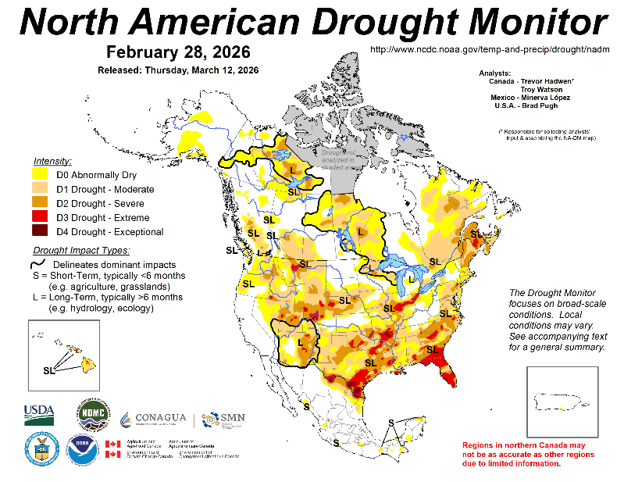
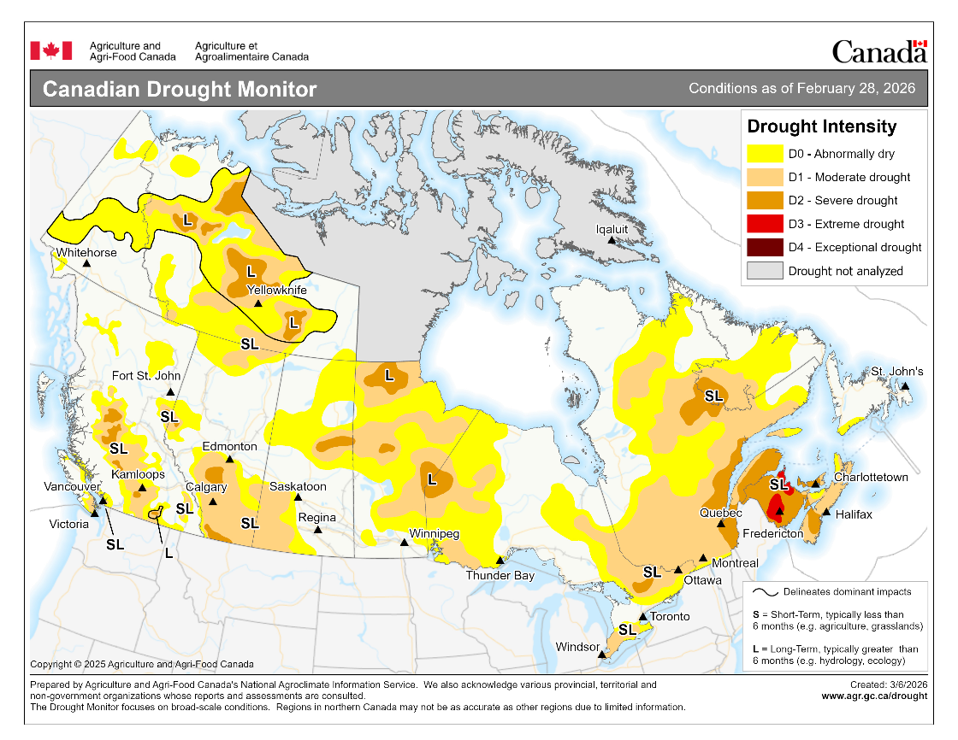
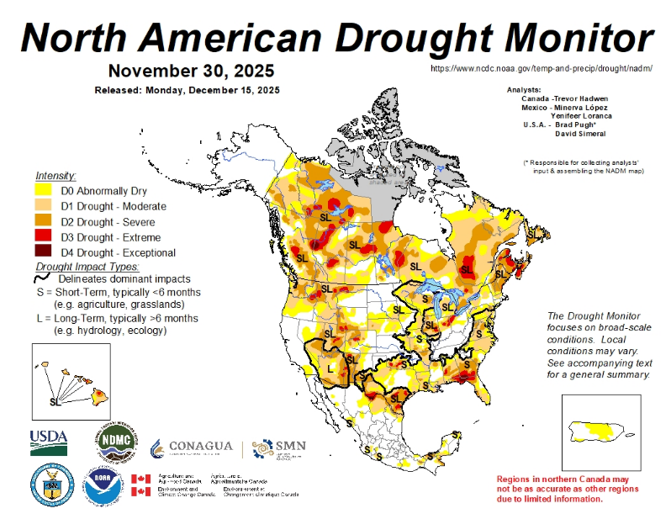
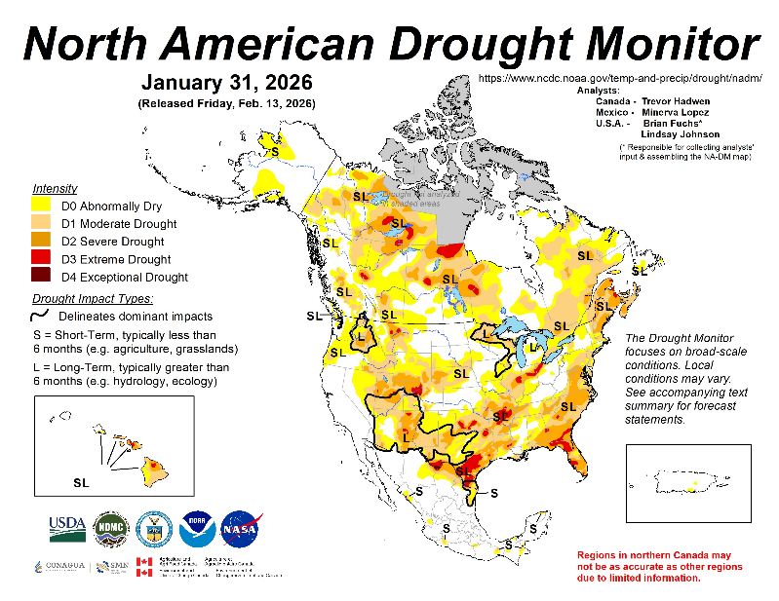
Drought Progression
General improvement over winter 2025-26
Some areas intensified
Notes:
2

Slide 3
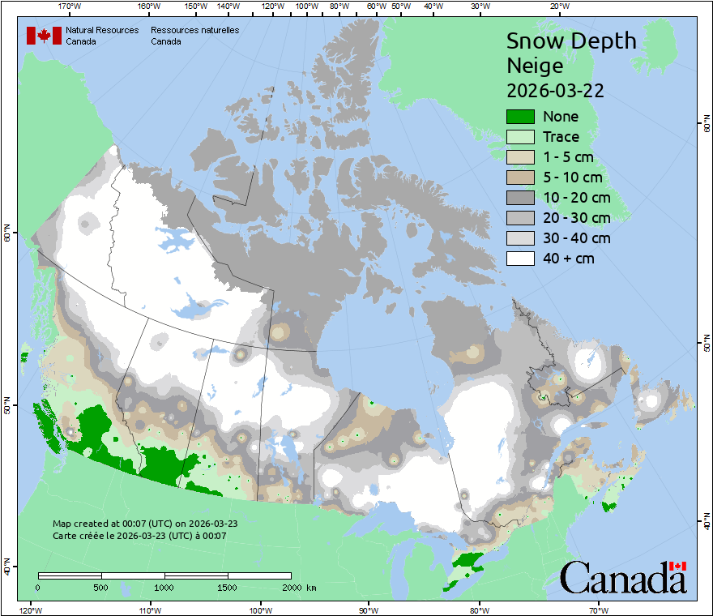
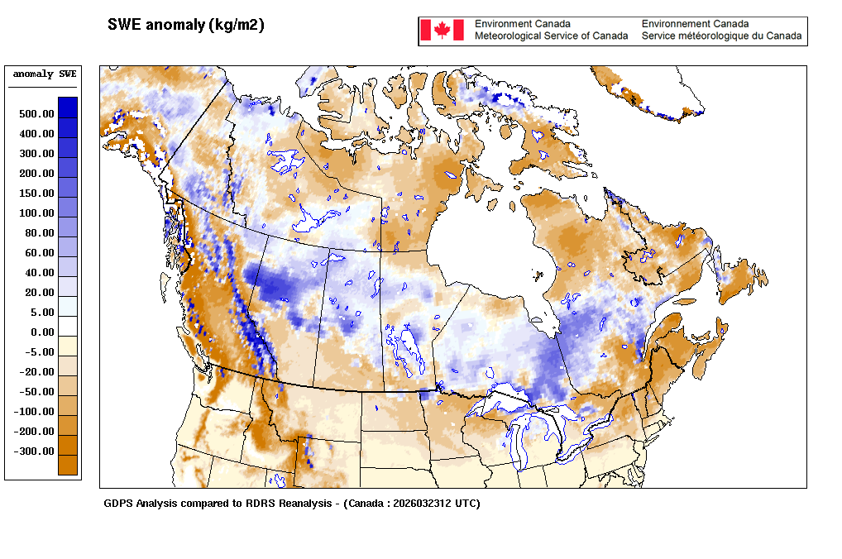
Snow Cover – CCIN maps gone!
Good snowpack in boreal region
Snow cover sporadic in southwest
CWFIS – March 30
SWE: /cmc/ensemble/VIGI/data_RDPS_CALDAS/202603
1 kg /m2 SWE ~ 1 cm snow cover
CaLDAS – March 29
Notes:
We have had a stormy northern hemisphere winter in many regions. Southwestern Canada and much of the western USA were exceptions.
3

Slide 4
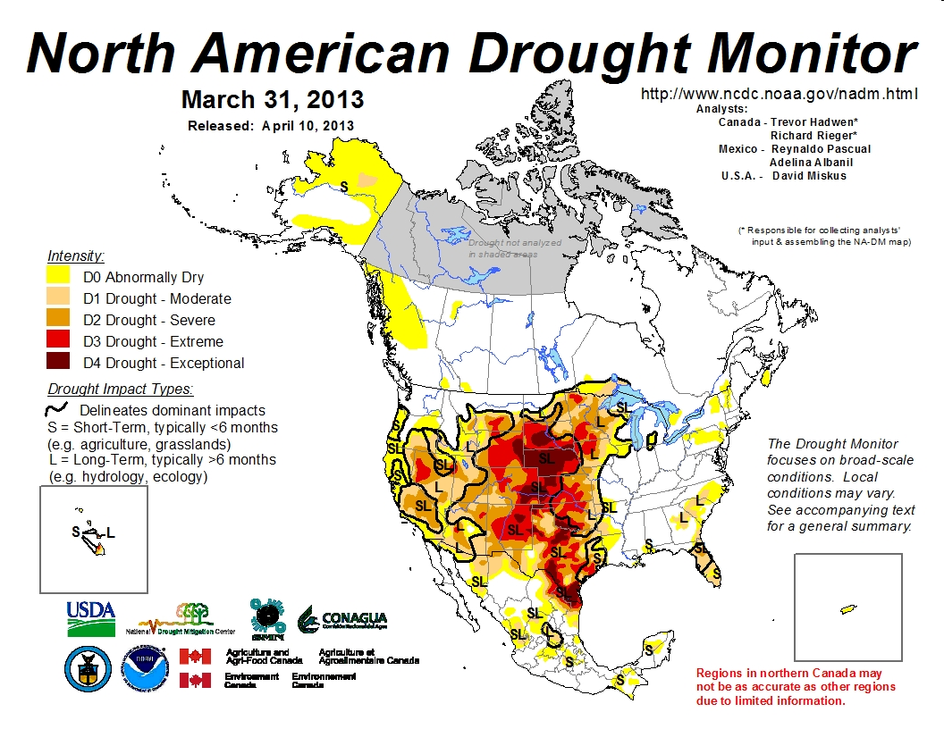
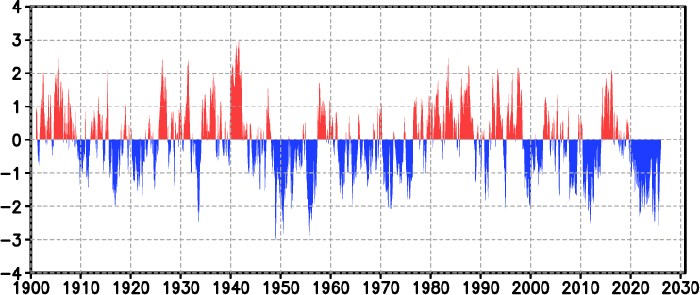
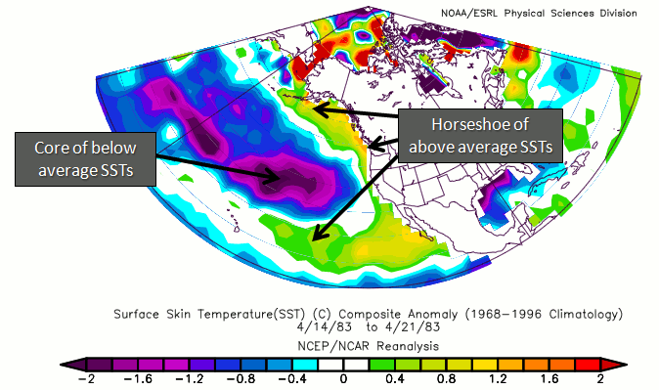
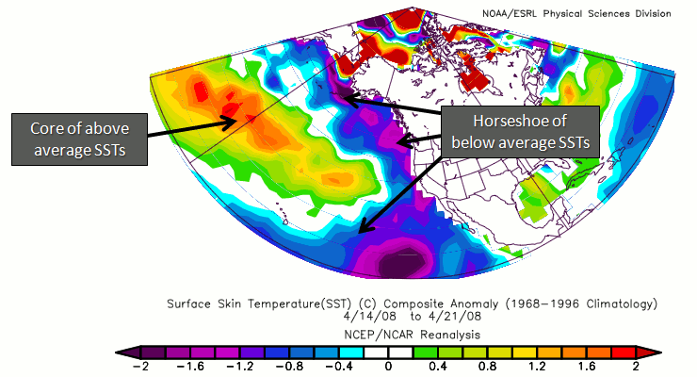
Pacific Decadal Oscillation (as of Mar 2026)
https://ds.data.jma.go.jp/tcc/tcc/products/elnino/decadal/pdo_month.html
Warm phase
Cold phase
http://climate.ncsu.edu/climate/patterns/PDO.html
Notes:
Still in a broad negative PDO phase but SST in the northern Pacific have cooled a bit. During 2023-25 SST were very high
across the northern Pacific with warmest temperatures in mid-ocean. Ocean temperatures can change rapidly so we want to monitor them as the season progresses.
4

Slide 5
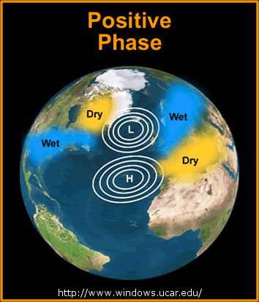
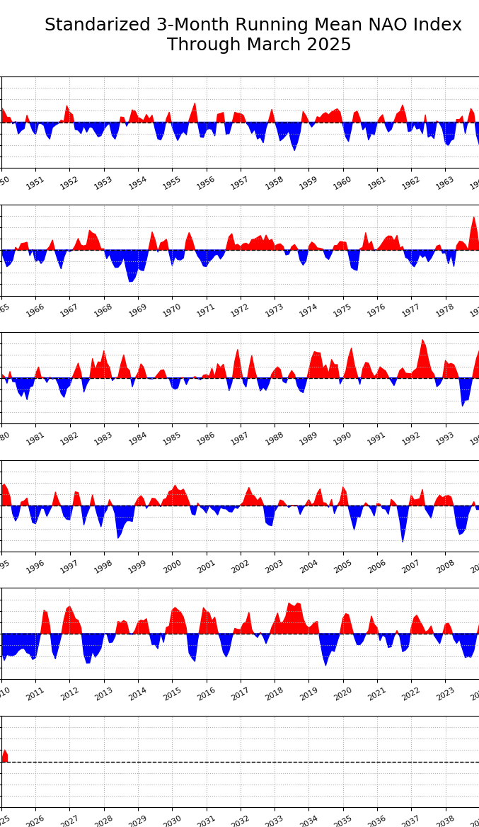
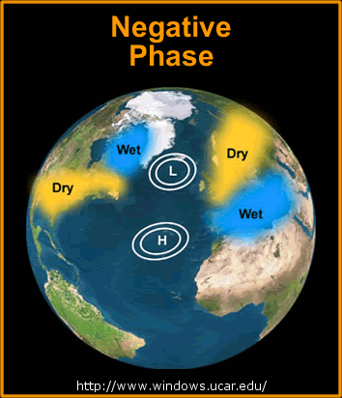
North Atlantic Oscillation (to Mar 2025)
https://www.ncei.noaa.gov/access/monitoring/nao
+
Quebec Area Burned
(NFDB, ha*1000)
2023 5000*
2015 5
2013 1900
2010 315
2008 1
2007 343
2005 800
2004 3
2002 1000
-
Early years may not include area burned in northern (unmanaged) region
-
+
Notes:
Years with high burned area in Quebec are indicated in black text, moderate years in orange, and low in green. Perhaps the degree to which the NAO is positive influences fire occurrence,
which depends on the correct dryness (high atmospheric pressure) coupled with enough atmospheric instability to generate thundershowers, or increased human activity in the absence of rain. This may occur during years where the NAO transitions between negative and positive or vice versa.
A study ongoing at Universite du Quebec a Montreal will likely provide more insight into oceanic/atmospheric oscillations that influence fire in eastern Canada. One finding may link a Baffin/West Atlantic (BWA) oscillation with increased severity rating (I have not read outcomes from this study so can’t comment on this any more at this time).
5

Slide 6
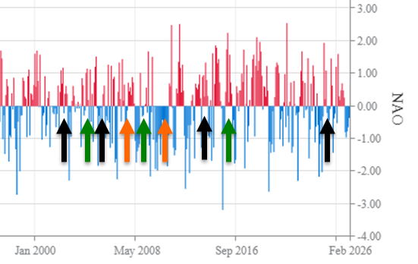
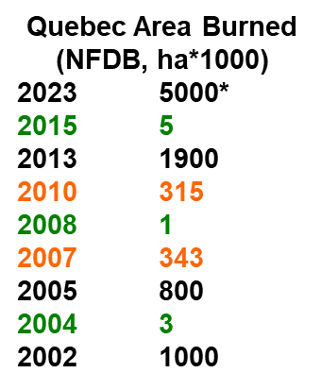
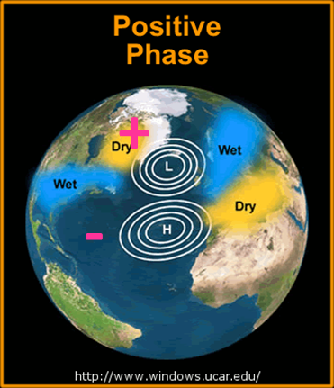

North Atlantic Oscillation (to Feb 2026)
https://www.ncei.noaa.gov/access/monitoring/nao
Early years may not include area burned in northern (unmanaged) region
Notes:
Years with high burned area in Quebec are indicated in black text, moderate years in orange, and low in green. Perhaps the degree to which the NAO is positive influences fire occurrence,
which depends on the correct dryness (high atmospheric pressure) coupled with enough atmospheric instability to generate thundershowers, or increased human activity in the absence of rain. This may occur during years where the NAO transitions between negative and positive or vice versa.
A study ongoing at Universite du Quebec a Montreal will likely provide more insight into oceanic/atmospheric oscillations that influence fire in eastern Canada. One finding may link a Baffin/West Atlantic (BWA) oscillation with increased severity rating (I have not read outcomes from this study so can’t comment on this any more at this time).
6

Slide 7
Fire problems in ENSO Springs
El Niño:
Warm, windy, dry in western Canada
La Niña:
Arctic surface highs bring dry air, strong wind around edges
Temperature may be cool
Summer fire problems may depend on other influences
Year | DJF | JFM | FMA | MAM | AMJ | MJJ | JJA | JAS | ASO | SON | OND | NDJ
2000 | -1.7 | -1.4 | -1.1 | -0.8 | -0.6 | -0.5 | -0.4 | -0.4 | -0.4 | -0.6 | -0.7 | -0.7
2001 | -0.6 | -0.5 | -0.5 | -0.5 | -0.3 | -0.1 | 0.0 | 0.0 | 0.0 | -0.2 | -0.2 | -0.3
2002 | -0.1 | 0.0 | 0.0 | 0.1 | 0.4 | 0.7 | 0.9 | 1.1 | 1.3 | 1.4 | 1.5 | 1.2
2003 | 0.9 | 0.5 | 0.2 | -0.2 | -0.4 | -0.3 | 0.0 | 0.2 | 0.2 | 0.2 | 0.3 | 0.3
2004 | 0.3 | 0.1 | 0.1 | 0.2 | 0.3 | 0.5 | 0.7 | 0.8 | 0.9 | 0.8 | 0.7 | 0.7
2005 | 0.6 | 0.4 | 0.3 | 0.3 | 0.2 | 0.0 | -0.1 | -0.1 | 0.0 | -0.2 | -0.5 | -0.8
2006 | -0.9 | -0.9 | -0.6 | -0.4 | -0.1 | 0.0 | 0.1 | 0.3 | 0.5 | 0.8 | 0.9 | 0.9
2007 | 0.6 | 0.2 | -0.2 | -0.4 | -0.4 | -0.5 | -0.6 | -0.8 | -1.0 | -1.3 | -1.4 | -1.5
2008 | -1.6 | -1.5 | -1.3 | -0.9 | -0.8 | -0.5 | -0.3 | -0.2 | -0.3 | -0.4 | -0.6 | -0.8
2009 | -0.9 | -0.8 | -0.7 | -0.4 | -0.1 | 0.1 | 0.3 | 0.4 | 0.6 | 0.9 | 1.3 | 1.6
Year | DJF | JFM | FMA | MAM | AMJ | MJJ | JJA | JAS | ASO | SON | OND | NDJ
2010 | 1.5 | 1.1 | 0.6 | 0.1 | -0.5 | -1.0 | -1.3 | -1.5 | -1.7 | -1.7 | -1.7 | -1.6
2011 | -1.4 | -1.2 | -0.9 | -0.7 | -0.5 | -0.3 | -0.4 | -0.5 | -0.7 | -0.9 | -1.0 | -1.0
2012 | -0.8 | -0.6 | -0.6 | -0.5 | -0.3 | 0.0 | 0.3 | 0.4 | 0.4 | 0.2 | -0.1 | -0.4
2013 | -0.6 | -0.6 | -0.5 | -0.4 | -0.4 | -0.4 | -0.4 | -0.3 | -0.3 | -0.2 | -0.2 | -0.3
2014 | -0.5 | -0.5 | -0.3 | 0.0 | 0.1 | 0.0 | -0.1 | -0.1 | 0.1 | 0.4 | 0.5 | 0.6
2015 | 0.5 | 0.4 | 0.5 | 0.6 | 0.8 | 1.0 | 1.3 | 1.6 | 1.9 | 2.2 | 2.3 | 2.4
2016 | 2.2 | 1.8 | 1.3 | 0.5 | -0.1 | -0.6 | -0.9 | -1.0 | -1.1 | -1.1 | -1.1 | -1.0
2017 | -0.7 | -0.5 | -0.3 | -0.1 | 0.1 | 0.1 | -0.2 | -0.5 | -0.7 | -1.0 | -1.1 | -1.3
2018 | -1.1 | -1.0 | -0.9 | -0.7 | -0.3 | 0.0 | 0.1 | 0.2 | 0.4 | 0.7 | 0.8 | 0.7
2019 | 0.6 | 0.6 | 0.6 | 0.5 | 0.3 | 0.2 | 0.0 | -0.1 | 0.0 | 0.1 | 0.2 | 0.2
Year | DJF | JFM | FMA | MAM | AMJ | MJJ | JJA | JAS | ASO | SON | OND | NDJ
2020 | 0.1 | 0.1 | 0.0 | -0.3 | -0.6 | -0.8 | -0.8 | -0.9 | -1.2 | -1.5 | -1.5 | -1.4
2021 | -1.2 | -1.0 | -1.0 | -0.8 | -0.6 | -0.5 | -0.6 | -0.7 | -0.9 | -1.1 | -1.2 | -1.2
2022 | -1.2 | -1.2 | -1.3 | -1.3 | -1.2 | -1.0 | -0.9 | -1.0 | -1.1 | -1.1 | -1.0 | -1.0
2023 | -0.8 | -0.6 | -0.4 | -0.2 | 0.1 | 0.4 | 0.6 | 0.9 | 1.1 | 1.4 | 1.5 | 1.5
2024 | 1.2 | 0.9 | 0.5 | 0.1 | -0.3 | -0.5 | -0.5 | -0.6 | -0.8 | -0.8 | -0.9 | -1.1
2025 | -1.1 | -0.9 | -0.7 | -0.5 | -0.5 | -0.4 | -0.5 | -0.6 | -0.8 | -0.9 | -0.9 | -1.0
2026 | -0.9
Chisholm, AB
Kelowna, BC
Slave Lake, AB
PDO positive phase
Fort McMurray, AB
Big years in BC
Western half
Most of Canada!
Busy summer
Notes:
Starting in September 2025, Oceanic Nino Index (ONI) calculations changed by removing the ocean’s warming trend by comparing Nino 3.4 region SST with the SST averaged over
the whole ocean between -20 and +20 latitude, with a monthly scaling factor applied. This relative index, called the Relative Oceanic Nino Index (RONI), has resulted in
some changes to the index values, which are reflected in the table above. Reference: DOI: https://doi.org/10.1175/JCLI-D-23-0406.1

Slide 8
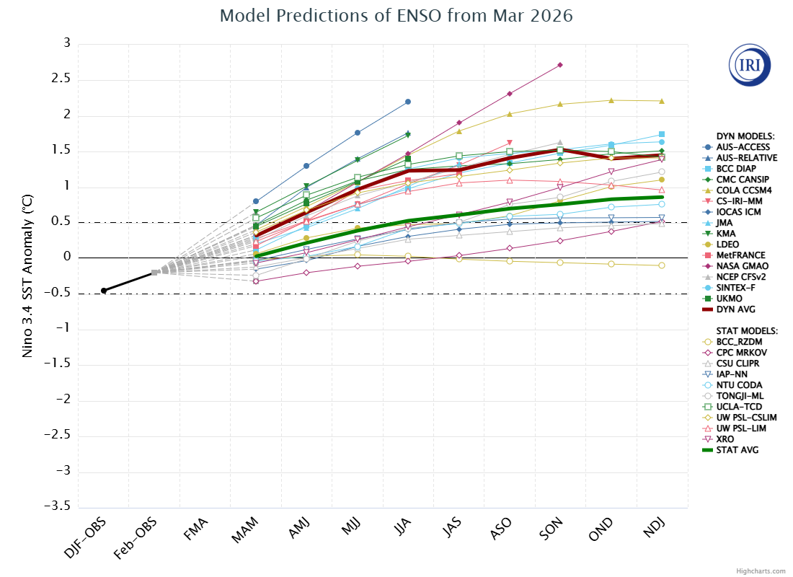
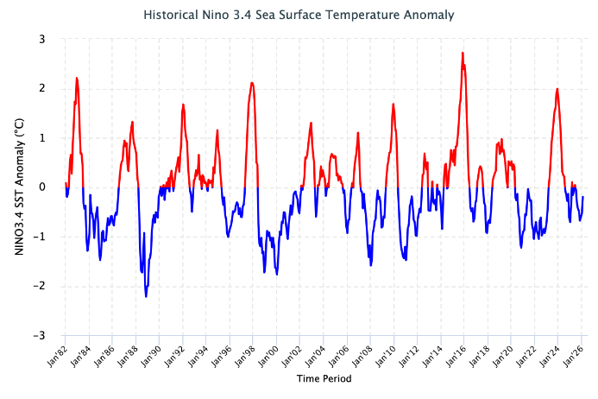
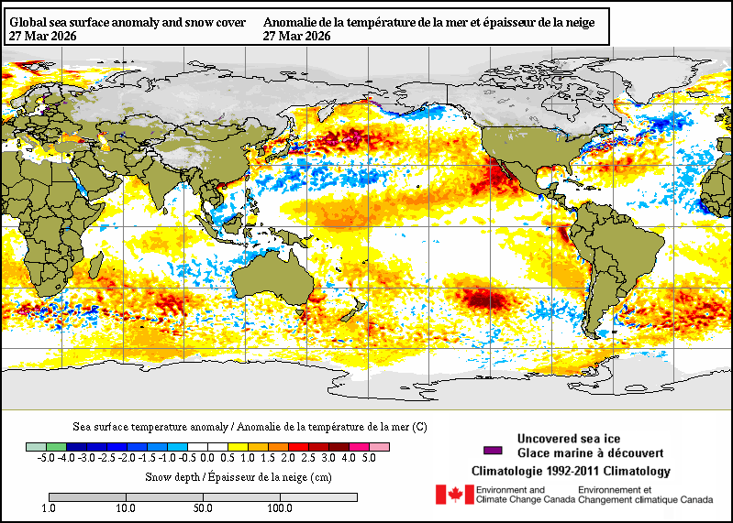
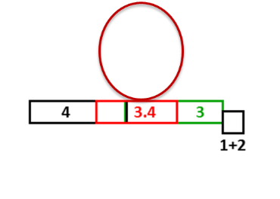
IRI ENSO Forecast
https://iri.columbia.edu/our-expertise/climate/forecasts/enso/current/?enso_tab=enso-sst_table
https://iri.columbia.edu/our-expertise/climate/forecasts/enso/2024-october-quick-look/?enso_tab=enso-sst_image
March 2026
Time series to January 2026
El Niño likely develops over summer
Notes:
Neutral ENSO is when indexes remain between the horizontal red lines on the plume chart and the black lines on the time series.
El Nino occurs when the indexes are above the top line (+0.5 sea surface temperature anomaly in the 3.4 region) for over 3 consecutive months.
La Nina occurs when the indexes are below the bottom line (-0.5 sea surface temperature anomaly in the 3.4 region) for over 3 consecutive months.
8

Slide 9
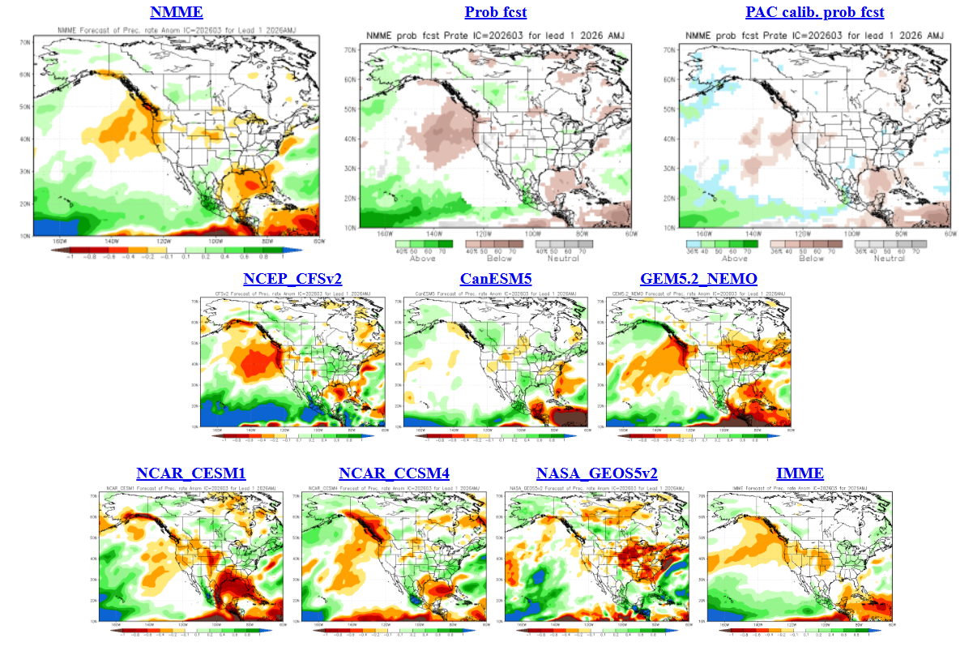
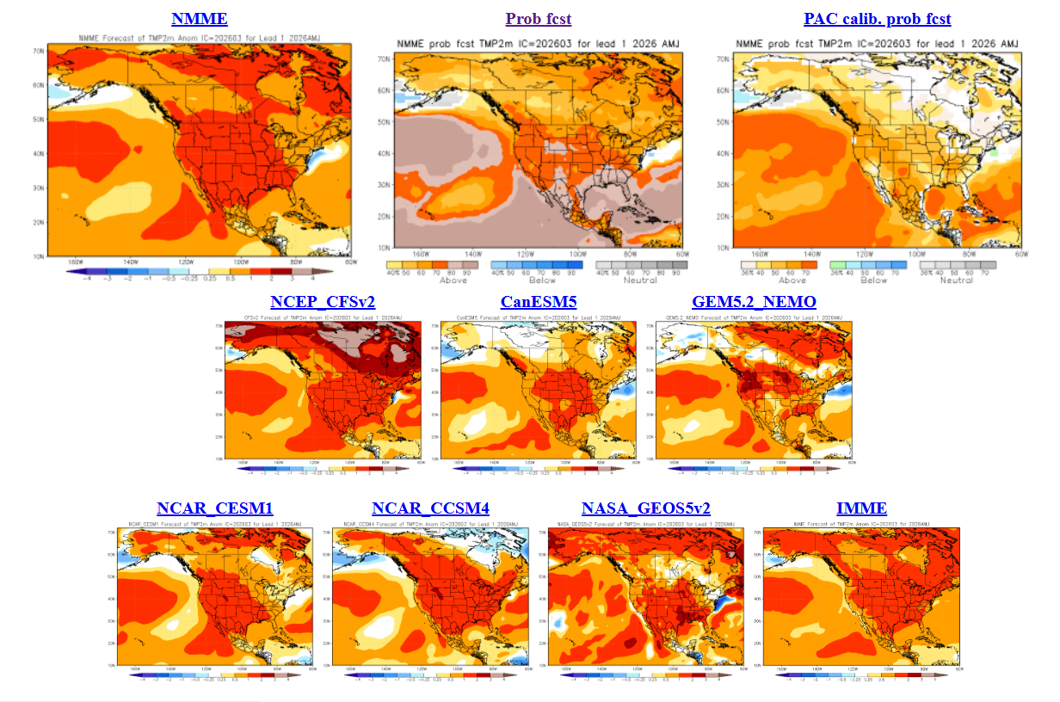
North American Multi-model Ensemble
NMME – March run
AMJ Temp
Looks warm …
Subtract a bit of drama to get truer picture!
Canadian models may show cool in NW
AMJ Precip
No dominant trends seen
Notes:
Temperature maps: blue = below normal, orange--red = above normal
Precipitation maps: orange--red = below normal, green = above normal
Seasonal forecasts produced by NRCan use temperature and precipitation from the two 10-member CanSIPS ensembles (green boxes in centre).
GEM-NEMO translates to Global Environmental Multiscale – Nucleus for European Modeling of the Oceans.
Wind data from these models have not been tested yet.
The remainder of the boxes show various models used in the NMME, with combined outputs condensed into the top left box, while
the bottom right box includes European models – the International Multi-Model Ensemble (IMME).

Slide 10
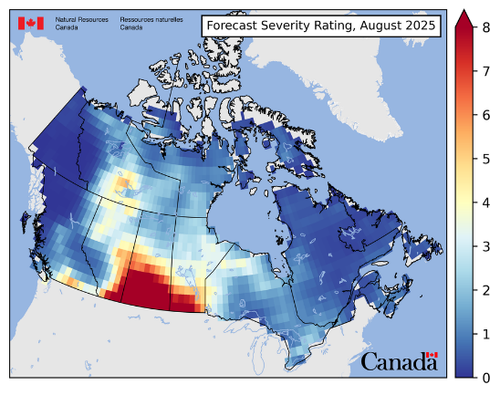
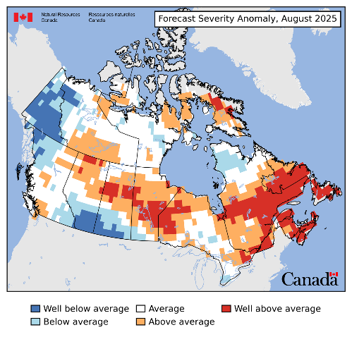
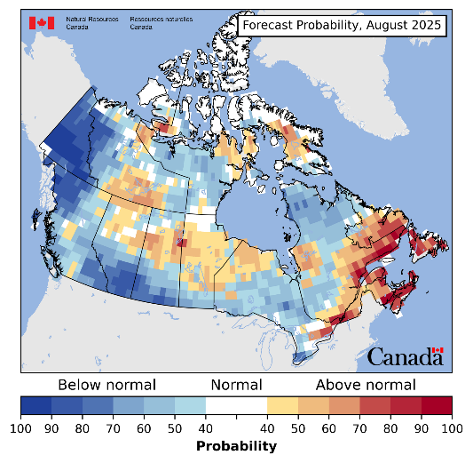
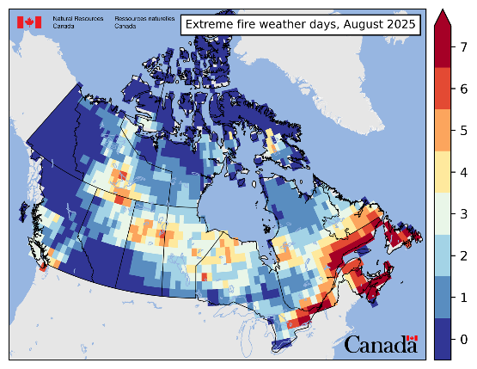
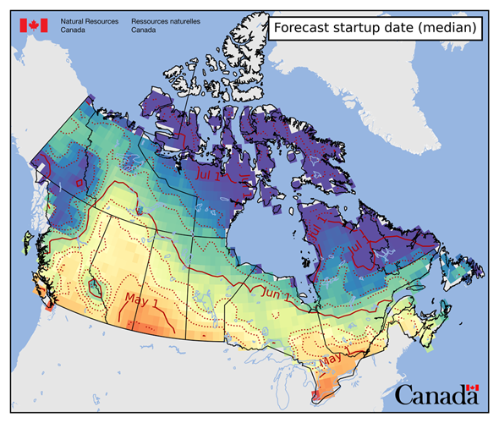
New CWFIS Seasonal Maps
  FWI calculated at each 1x1 deg grid cell over North America
  Examples for August 2025
  1. Forecast Severity Rating
  2.Forecast Severity Anomaly
  3. Forecast Probability
  Overwinter and startup conditions from near-real-time ERA5 reanalysis model
  Fire season startup directly forecasted
  4. Extreme Days
Notes:
After the new CWFIS goes live, we will display four maps related to the seasonal forecast. These are:
1. Forecast Severity Rating
2. Forecast Severity Anomaly
3. Forecast probability
4. Extreme fire weather days.
The first two of these maps are similar to those produced by version 1, although the underlying calculation is different. The other two maps are new.
The examples shown correspond to the August 2025 forecast.
Maps on CWFIS may have a different appearance.

Slide 11
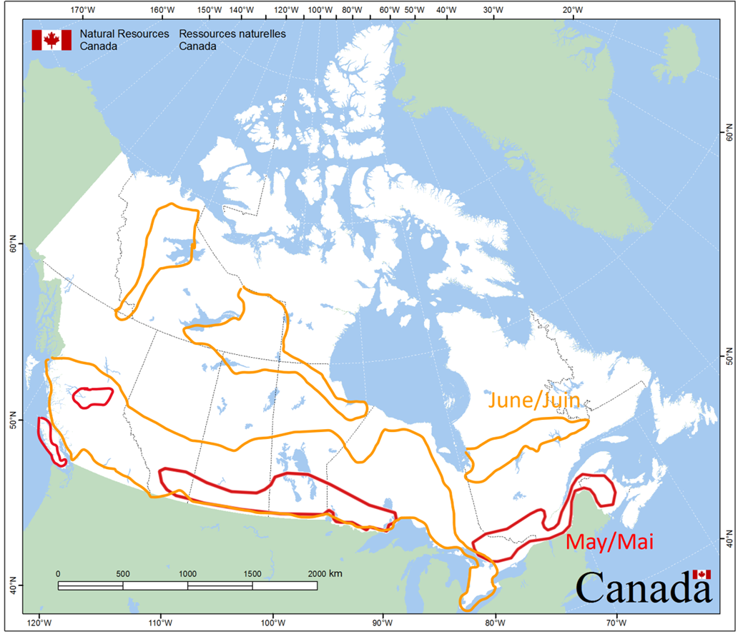
Current Areas to Watch
Skill of climate forecasts often best in coastal areas, poorer in lee of mountain ranges
Notes:
We do not expect above normal fire severity in April and thus do not show any polygons on this map. Stormy conditions are likely to continue
with precipitation tracks variable through the month.
Areas in the southern Prairies may not experience fire activity in later May or June as this area will likely be green.
Many of the areas had below normal precipitation over winter 2025-26 (e.g. southern BC/AB/SK, northern MB, NB).
11

Slide 12
Questions?
Contact:
Richard Carr
Fire Research Analyst
Natural Resources Canada – Canadian Forest Service
Richard.Carr@NRCan-RNCan.gc.ca
5320 122 Street NW
Edmonton, AB, Canada
T6H 3S5
825-510-1265
?
?
?
?
?
Notes:
12

