Slide 1
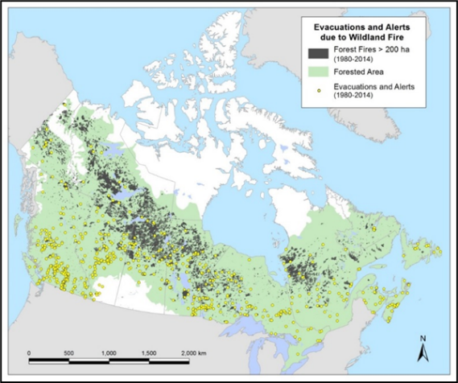
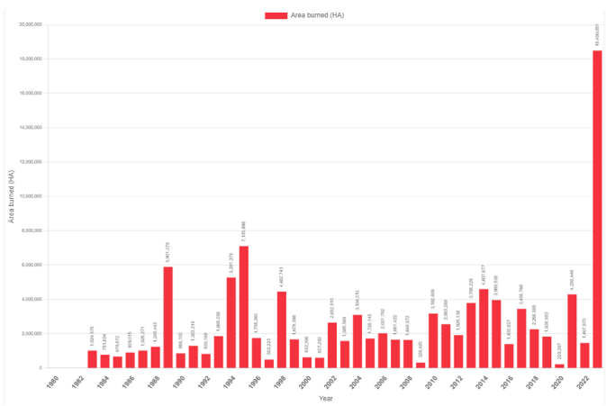
Fire!
Most fire is in the boreal forest
1 ha = 2.47 acres
Total forest area ~362 million ha (890 million acres)
40% of Canada’s land area
~33% of Canada is boreal forest
Revised mapping indicates ~15.x million hectares burned
Great variety in annual number of fires and area burned
Annual averages (1990-2016) are 7500 fires and 2.5 million ha (6.2 million acres) burned
Notes:
The location and year of the fire in the background photo is unknown to the author; however, this landscape is typical for
northern parts of the provinces or southern parts of the Territories.
Each year Canada has about:
7,500 forest fires (NFDB 1990-2016)
2.5 million ha burned (NFDB 1990-2016
The 2023 burned area will skew the historical statistic. The number of fires was not very big, so Canada had a
lot of fires that burned very large areas.

Slide 2
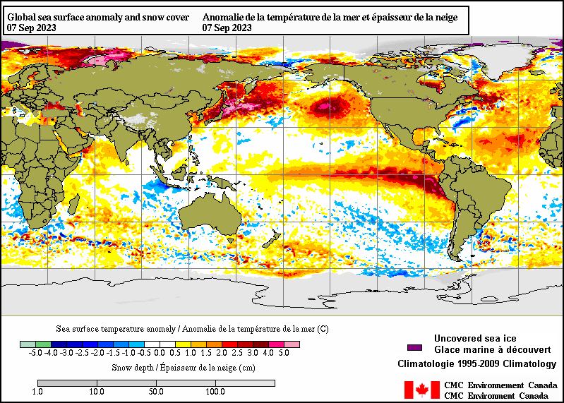
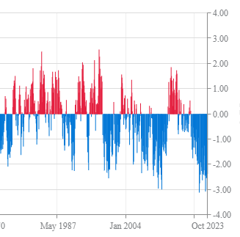
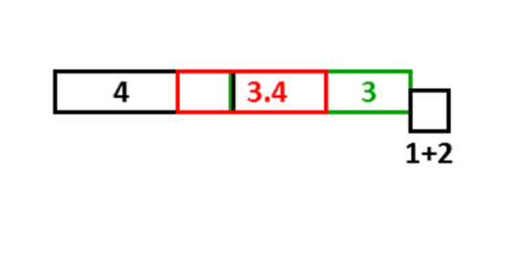
2023 Lead-up/factors: Ocean/atmosphere
Quick transition to El Niño after extended La Niña
“Warm negative” Pacific Decadal Oscillation (PDO)?
Warm sea surface temperatures during 2023
September 7, 2023
https://www.ncei.noaa.gov/access/monitoring/pdo/
Notes:
El Nino is evident with the plume of warm water extending west from the west coast of South America. Sea Surface Temperatures in the Nino 3.4 region (red rectangle)
provide the oceanic temperature index used to help determine the state of ENSO.
The impact of the Pacific Decadal Oscillation (PDO) on the 2023 fire season in Canada may be one
of many contributing factors. The warm ocean temperatures shown in orange or red along the west coast of North
America often indicate the PDO is in the positive phase, which often coincides with a well-established El Nino.
In 2023 the mid-Pacific SSTs were even higher though, resulting in a negative PDO.
Some big fire years occurred in the 2013-15 period in northern parts of western Canada with a positive PDO.
In this case, the temperatures in the central Pacific are even warmer than the coastal temperatures, indicating the PDO is
actually in the negative phase, which is indicated in the time series graph on the left. What effect does a “warm negative”
PDO have, such as during 2023?

Slide 3
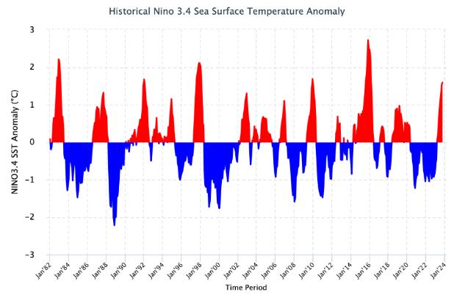
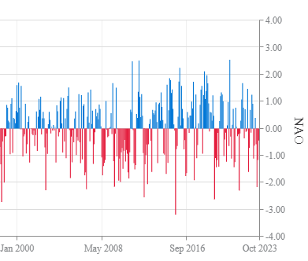
2023 Lead-up/factors: ENSO and NAO
Rapid transition from La Niña to El Niño
North Atlantic Oscillation (NAO): Positive to negative transition in summer?
https://iri.columbia.edu/our-expertise/climate/forecasts/enso/current/?enso_tab=enso-sst_image
https://www.ncei.noaa.gov/access/monitoring/nao/
Notes:
Both La Nina and El Nino years can lead to major fire spring events in western Canada. During La Nina springs, surface arctic
high pressure areas often drift southward into the Prairies, creating moderate to strong southeast winds in very dry air masses
along the western edge of the features. During El Nino springs, Pacific high pressure areas often move across western Canada,
generating warm, dry, and windy periods, but with westerly prevailing winds. The spring of 2023 featured both scenarios --
more on that later in the presentation.
Positive North Atlantic Oscillation (NAO) events often bring dry air to eastern North America. The NAO fluctuated during
2023, with positive values in the spring and negative values later in the summer. This may have contributed to early fire
activity in the east, with subsequent rain later in the summer. Work undertaken at Universite Quebec a Montreal is focusing
on the Baffin Island-West Atlantic Oscillation – the western edge of the NAO – where 500 hectopascal height differences
along 60W between 30N and 65N may help define Quebec fire seasons. Implications for the 2023 fire season are speculative
at this time.

Slide 4
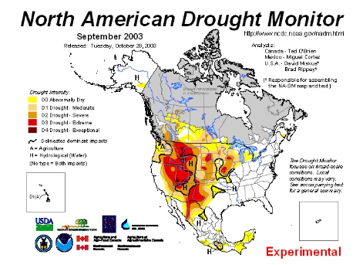
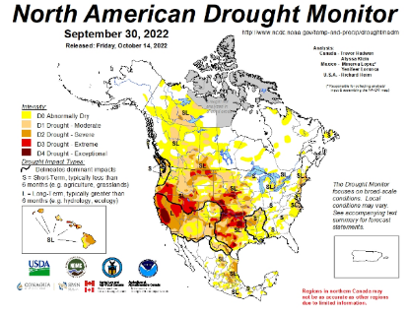
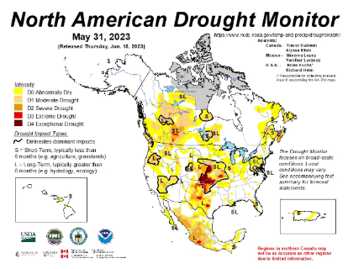
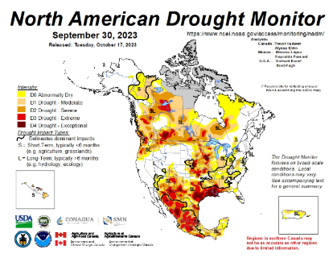
2023 Lead-up/factors: Drought
Drought: Summer 2022 onward
“Triple-dip” La Niña a factor?
Widespread drought followed the extended 1998-2001 La Niña
Notes:
A prolonged and severe drought affected parts of western Canada in the early 2000s following a “triple dip” La Nina event.
In Canada, the most intense drought was likely in 2002, before monthly North American Drought Monitor map
Production began. The map at the top left is from September 2003 and shows extreme drought in the western USA but
less intense values in the portion of Canada analyzed at the time.
Is Canadian drought in 2022-23 related to the recent prolonged La Nina? We don’t have a very big sample size
in the coinciding period of drought and ENSO monitoring.
September 2022 (far left): Drought leading to Canada’s 2023 fire problems started in the summer of 2022.
May 2023: map shows drought worsening in western Canada and appearing along the Atlantic coast.
September 2023: Over the 2023 summer, drought continued to intensify in much of Canada, although the spot within
the blue circle had plentiful summer rain, eliminating drought. Autumn precipitation, however, has been close to zero.
Heading into autumn 2023, Agriculture and Agri-Food Canada estimated about 72% of Canada was in some stage of
drought, not including Nunavut, where drought is currently not assessed.

Slide 5
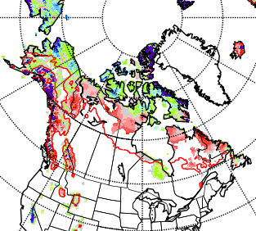
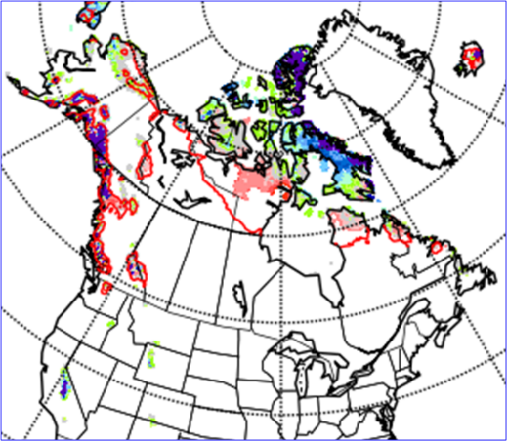
2023 Spring start-up conditions
Snow depths affect spring fires more than summer
Red line indicates the daily location of the 2cm depth
Rapid and early snow melt in many regions
May 10, 2023
May 17, 2023
Notes:
Snow cover left rapidly in the spring of 2023. The red line gives the mean daily 2-cm snow depth location, so white
areas north of the line have lost snow cover early, while colored areas south of the line are holding snow later
than usual.
By May 10, much of the Northwest Territories and northern Quebec had lost snow cover.
By mid-May, all forested regions of Canada outside high mountain ranges were snow-free. An early
departure of snow has more effect on spring fire activity when deciduous trees are still leafless, than on summer
fire activity, but if summer rainfall is lacking this spring activity can carry on into the summer.

Slide 6
Simplified 2023 fire season summary

Slide 7
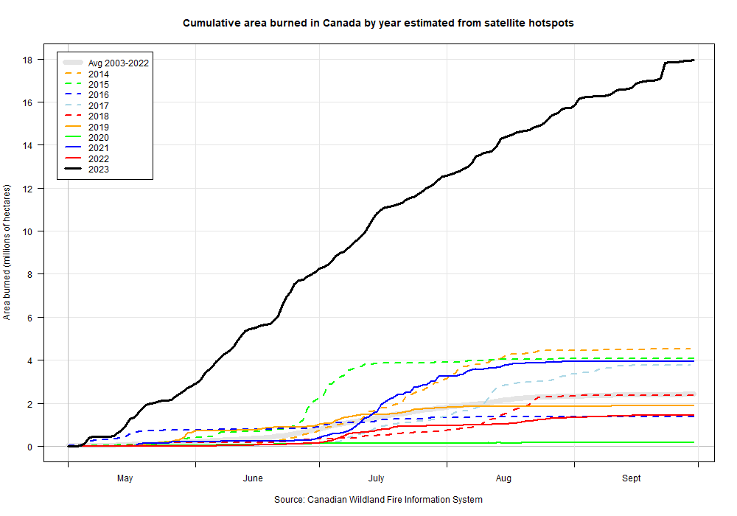
2023 Fire Season Summary
August-Sept: Wind events in northern BC/AB/NT. Much area burned end of August/start of September and September 22
July: NT/YT
June: ON/QC
April-May: west central AB, northeast BC, central SK, NT
June 27: Breaks previous national record area burned
Notes:
The burned area chart shows the progression during 2023, with the black 2023 line dwarfing the burned area from
the previous few years. At the moment, let us focus on the circled areas in the chart:
-Fires started in late April and early May in the Parkland area (mixed forest/cropland/grazing land) in Alberta
and were most likely human-caused with little lightning at the time. Southeast winds drove rapid fire growth.
Fires starting after the first couple days of May in the Swan Hills, northwestern Alberta, northeastern BC, and
western SK may be lightning-caused, with numerous weak thundershowers present in the first half of May.
-By mid-May, fires in northern Alberta, northeastern BC, and western Saskatchewan were growing fast.
-Barrington and Tantallon fires in NS
-West central AB began receiving good rainfall in about the 3rd week of May, and was good through most of the summer (see the Drought map).
<Advance slide>
-During June, Ontario and Quebec had numerous fires, although the Quebec fires became larger. This is the area that contributed most of the
dense smoke into the eastern USA.
<Advance slide>
-Burning in Yukon and the Northwest Territories accelerated in July
<Advance slide>
-Wind events near the end of August and early September, plus late in September continued to drive rapid fire growth in northeastern British Columbia,
northwestern Alberta, and the southern Northwest Territories. The amount of area burned during this period was astounding, especially for northern regions.

Slide 8
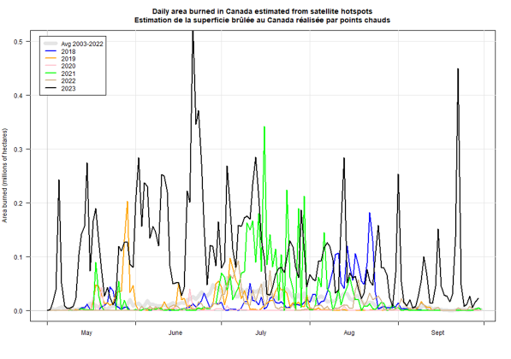
2023 Fire Season Summary
Area burned estimates based on hotspots
Big spike in June and again Sept 22
Area burned is often small in early spring and late summer (low amplitude of colored lines in these periods)
Notes:
The burned area chart shows the progression during 2023, with the black 2023 line dwarfing the burned area from
the previous few years. Colored lines show area burned estimates from the previous few years.
The colored lines are largely absent in early spring and late summer, indicating little area burned during those times
of year. In 2023, large area was burned in the summer and the spring/fall (“shoulder seasons”).
Actual amounts of area burned will differ somewhat from these estimates with some inaccuracy in hotspot representation
of actual fire and cloud cover or heavy smoke obscuring active fire.

Slide 9
Detailed 2023 fire season summary
Notes:
Snow cover left rapidly in the spring of 2023. The red line gives the mean daily 2-cm snow depth location, so white
areas north of the line have lost snow cover early, while colored areas south of the line are holding snow later
than usual.
<Advance slide>
By May 10, much of the Northwest Territories and northern Quebec had lost snow cover.
<Advance slide>
By mid-May, all forested regions of Canada outside high mountain ranges were snow-free. An early
departure of snow has more effect on spring fire activity when deciduous trees are still leafless, than on summer
fire activity, but if summer rainfall is lacking this spring activity can carry on into the summer.

Slide 10
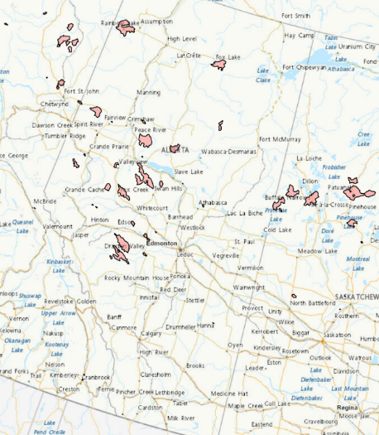
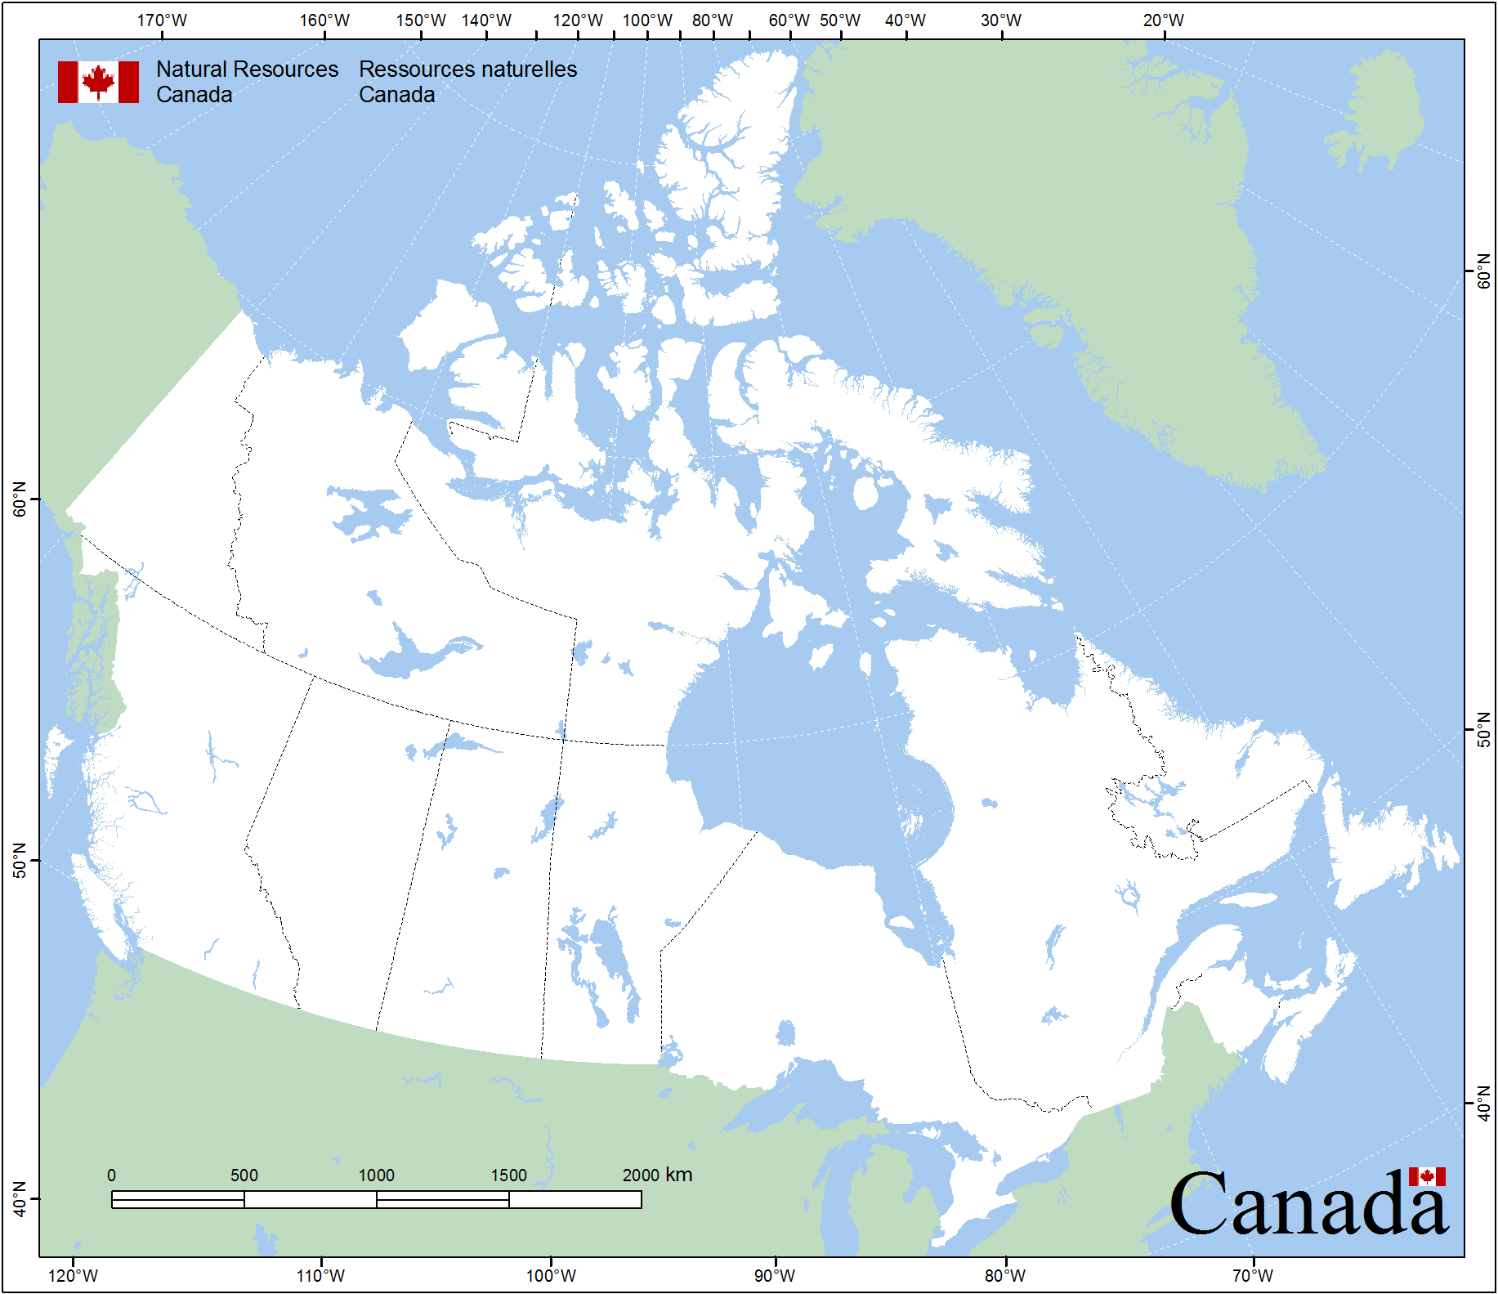
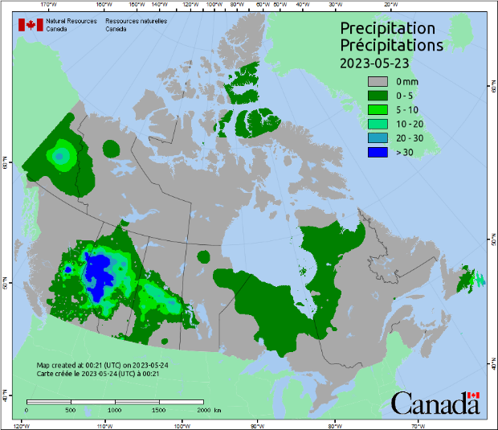
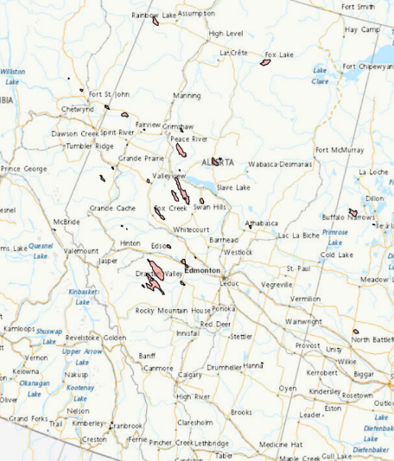
2023 Fire Season: May
Central Alberta: Likely human-caused fires then …
Possible lightning starts in Swan Hills and other regions
Wind-driven … a La Niña-ish spring feature
May 17
May 6
Notes:
The burned area chart shows the progression during 2023, with the black 2023 line dwarfing the burned area from
the previous few years. At the moment, let us focus on the circled areas in the chart:
-Fires started in late April and early May in the Parkland area (mixed forest/cropland/grazing land) in Alberta
and were most likely human-caused with little lightning at the time. Southeast winds drove rapid fire growth.
Edmonton, where the author and the Northern Forestry Centre are located, are near the tip of the pink arrow.
Fires starting after the first couple days of May in the Swan Hills, northwestern Alberta, northeastern BC, and
western SK may be lightning-caused, with numerous weak thundershowers present in the first half of May.
<Advance slide>
-By mid-May, fires in northern Alberta, northeastern BC, and western Saskatchewan were growing fast.
<Advance slide>
-Area in the blue oval began receiving good rainfall in about the 3rd week of May. Daily precipitation from the CWFIS
for May 23 is shown at left. Fires outside this area remained active, while the most intense fires within the oval
were reduced in intensity but not completely extinguished. Frequent rainfall over the rest of the summer within
the oval area kept these fires from re-intensifying.

Slide 11
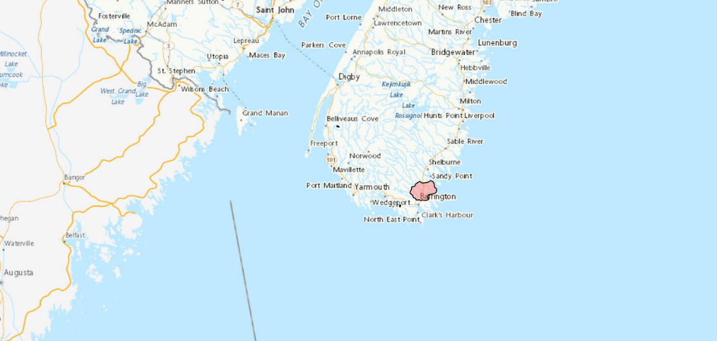
2023 Fire Season: May
Activity in New Brunswick and Nova Scotia in late May
Largest NS fire on record begins: ~25,000 ha (62,000 acres)
Mid-May to mid-June: same 500 hPa ridge crossed Canada west-east, east-west, west-east, then flattened
Warm, dry, windy west typical of El Niño springs
Notes:
The Tantallon fire near Halifax (off the top of this map) resulted in evacuations during the same period.
During mid-May to mid-June, a 500 hectopascal ridge of high pressure moved east across Canada, then was forced
westward (retrogression) across the country, after which it moved east across Canada again before flattening in eastern regions.
The author has never seen a ridge traverse the country three times in opposite directions. Some ridge retrogression
often occurs in winter where intruding Arctic air pushes a ridge from western Canada over the eastern Pacific Ocean,
after which the ridge may move east again. The amount of movement of this one ridge in 2023 was very unusual though.

Slide 12
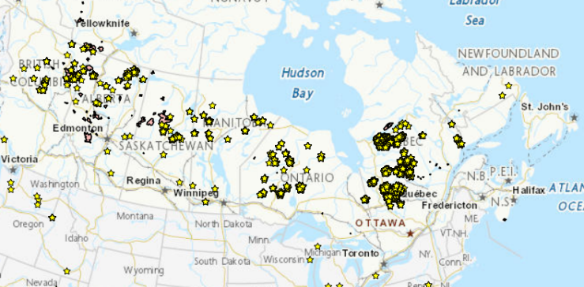
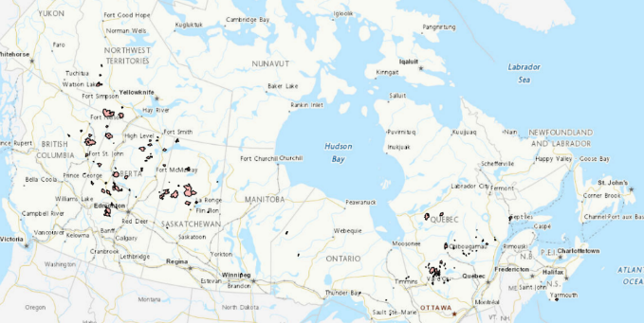
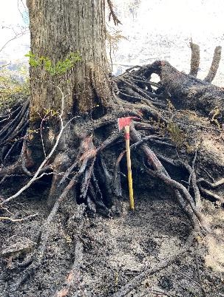
2023 Fire Season: June
NT fires growing … May starts are early!
Quebec starts ~June 1-3; La Grande: rapid growth in late June
Growth along 60N
June 24
~June 6
June 27: Breaks previous national record area burned
Photo supplied by BCWS
Newcastle Creek (V80527) June 3, 2023
Notes:
Some Northwest Territories fires started in May (recall the early snow departure), which is early for this region.
During June, many western Canadian fires showed vigorous activity, and many Quebec fires started in the first few
days of June. Hot and dry conditions followed by scattered thundershowers appeared to start the majority of these fires.
<Advance slide>
By June 27, Canada had broken the previous area burned records set in 1995 and/or 1989 (close to 7.5 million hectares).
This necessitated extending the chart’s y-axis to about 12 million hectares. This wasn’t enough though, as the y-axis
had to be extended a second time later in the summer.
<Advance slide>
The photo at the left shows fire activity on Vancouver Island was intense early in the season, as the axe
shows the depth of burn – close to 1 metre – exposed mineral soil.

Slide 13
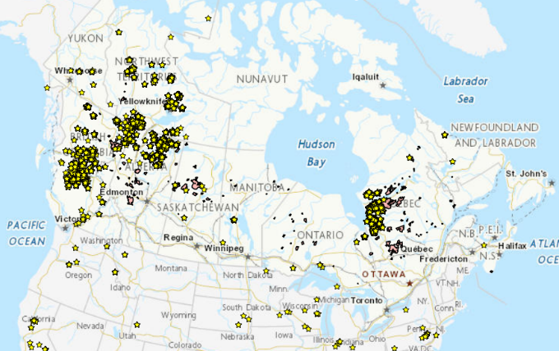
2023 Fire Season: July
Active fires across Canada except southern QC, Atlantic, and Yukon
Mid-month: MB/ON quiet but YT starts
Late July: QC quiet
July 14
Notes:
As July progressed, fires in southern Quebec began receiving rain, but those further north along James Bay
remained very active until late in the month. Extreme activity developed in western Canada.

Slide 14
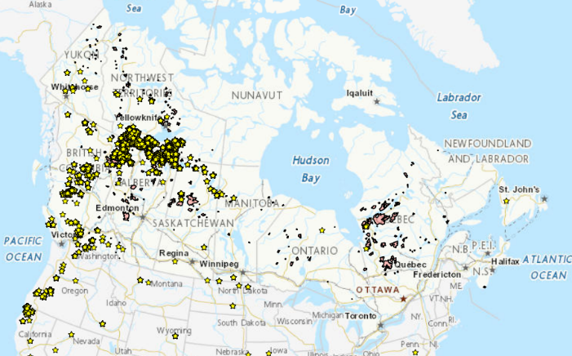
2023 Fire Season: August
James Bay area flares up; se BC, n AB, NT, Yukon
Mid-August: central/south BC, n AB; north NT slows
Late August wind events carry over into September
Aug 26
Notes:
During August, Quebec fires flared occasionally, and activity continued to increase in western areas through much
of the month. Many new starts occurred in southern and central BC, and Yukon (left circle). By late in the month,
cool and wet conditions in the northern Northwest Territories slowed fire activity there, but the responsible pressure
patterns led to warm, dry, and windy conditions along the 60th parallel. One such wind event led to rapid growth
at the end of August and start of September (right circle).

Slide 15
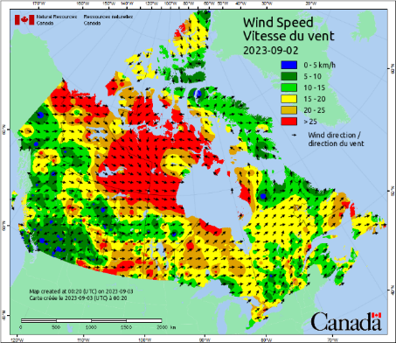
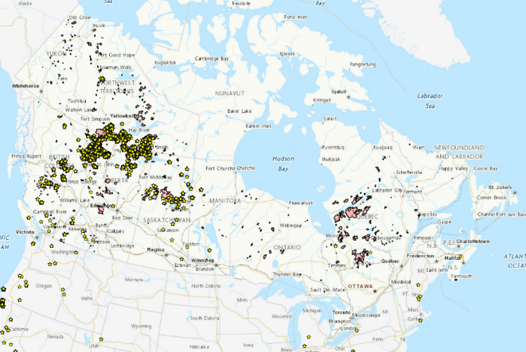
2023 Fire Season: September-October
Wind events along 60N ...
Sept 22
~3rd week: Large 1-day area burned increase
Late September burning around James Bay
Sporadic activity in October
Notes:
The CWFIS wind map shows noon conditions for September 2, which contributed to rapid fire growth. Red areas
indicate speeds of 25 km/h or higher. Since this map indicates noon local time observations, high winds could have
occurred in other areas earlier or later in the day.
<Advance slide>
A wind event may have led to a further large increase in area burned in late September. Remember this chart is
derived from hotspots, so this apparent large increase in area burned could also be an artifact of clear skies,
which may have allowed more hotspots to be visible than on previous days. Regardless, wind did drive fire growth
close to 60N between September 21 and 22.
Sporadic fire continued through September around James Bay, and the intense activity in the west carried on into
October. This gradually settled down, but did not entirely disappear, over the month. Some new fires have been
recorded in Alberta and British Columbia in November, but these are likely managed easily by suppression crews.

Slide 16
2023 Fire Season: September-October
Area burned estimates from hotspots
Largest 1-day increase appears to be in mid-June
2nd place: September 22 (previous years had minimal area burned in late August onward)
Sept 22
Notes:
A large increase in area burned was possible on September 22. Reminder to consider whether clear skies on a particular day
could allow a larger number of hotspots to be visible.
<Advance slide>
Maybe the largest one-day increase in area burned was in mid-June, as shown by the tallest black spire on this chart.
Other colored lines represent counts from the past few years. Note that very little burning had occurred in the previous few years in
Late August and September, while a large amount of burning occurred during this period in 2023.

Slide 17
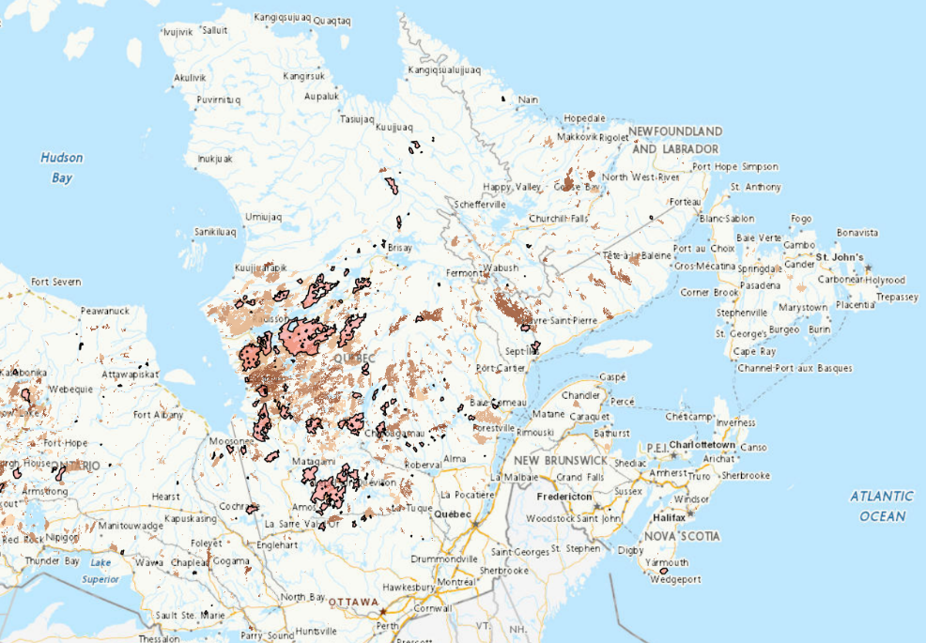
Quebec Fire History and 2023 Fires
2023 numbers from Société de prevention des forêts contre le Feux (SOPFEU):
Intensive zone: 566 fires, 1.3 million ha (3.2 million acres)
Northern zone: 147 fires, 3.7 million ha (9.1 million acres)
Fire 218
Notes:
Quebec’s intensive fire management zone roughly stretches east from the bottom of James Bay to the Labrador border.
While more fires occurred in this zone, the area burned was less than in the northern zone, where fires are often not
suppressed to the same degree as in the intensive zone.
Of note, the large fire (Fire 344) in the intensive zone below James Bay is the largest recorded in that area at about
483,000 ha.
Fire 218, on the south side of La Grande Riviere, became Quebec’s largest recorded fire at about 1.2 million hectares.
The gap in the fire history (brown shades) north of Fire 218 marks La Grande Riviere, and large river with several
hydroelectric plants, a small number of scattered communities, and large water bodies that break up the fire history pattern.

Slide 18
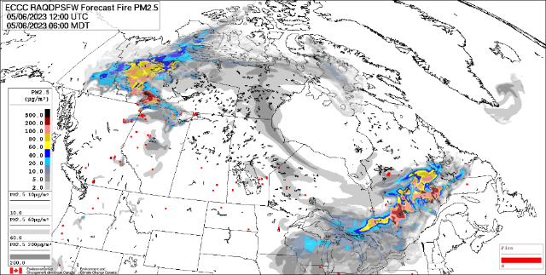
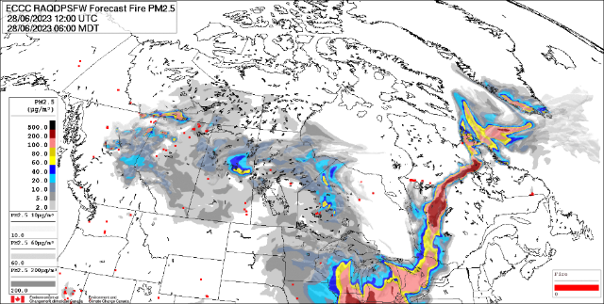
2023 Smoke/FireWork Model
Record numbers of smoke days in some locations
Notable days with smoke affecting the eastern USA:
June 5, 2023 12Z
June 28, 2023 12Z
FireWork on public web site covers Lower 48 states and most of Alaska
https://weather.gc.ca/firework/index_e.html
USA: Hysplit, CalPuff, BlueSky, others?
Notes:
Links to a couple FireWork animations are provided here. The domain on these historical animations does not extend
as far south as the domain on Environment and Climate Change Canada’s Firework web page.
A few smoke models of various sorts from the USA are listed, but the author is not overly familiar with their capabilities.
During the MARAMA workshop, Jack Chen’s FireWork presentation followed this, so the author did not spend
much time on this slide.

Slide 19
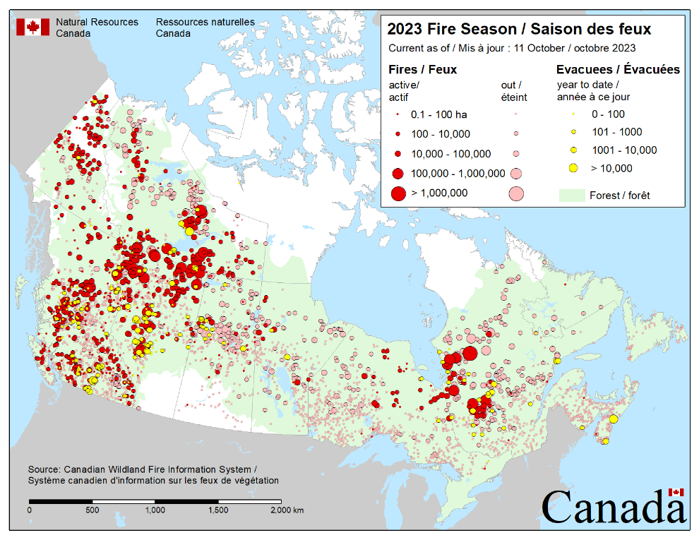
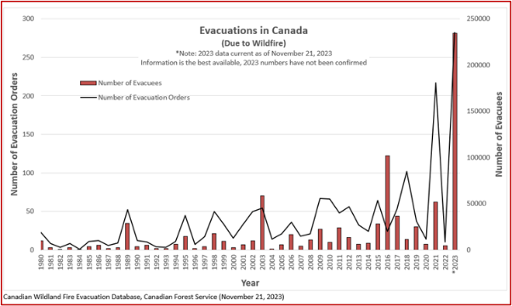
2023 Evacuations
Fire sizes and evacuations as of October 11
Record numbers set in 2023
Increase may result from suburban population growth and fire season change
Notes:
2023 fire sizes are represented by the red circles, and numbers of evacuees with the yellow circles.
<Advance slide>
Evacuation numbers are steadily increasing with more people living in interface areas (where forest meets with
human-built infrastructure) and lengthening and intensifying fire seasons. 2023 data is still being assessed so is
subject to change.

Slide 20
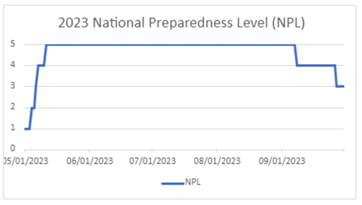
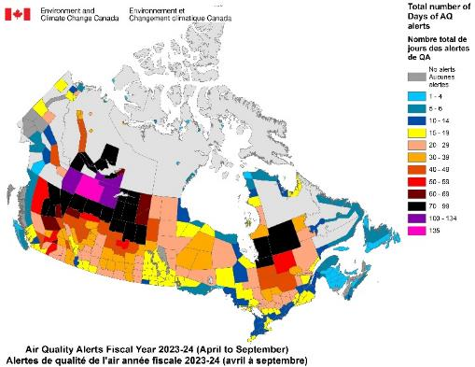
More 2023 Records
Most area burned in modern reporting era (~1980 on)
P/T area burned: BC, NT, AB, QC, NS
Record fire sizes: BC, NS, QC
NPL 5: May 11 – Sept 7 (120 days)
11 nations provided assistance
Media requests
ECCC smoke/smog alerts & warnings
Notes:
A few more records set in 2023:
The National Preparedness Level (NPL) indicates the availability of fire suppression resources in Canada.
Level 1 indicates very little and easily managed fire activity, whereas 5 indicates suppression resources are
fully committed. The period of 120 continuous NPL 5 days in 2023 set a record.
Smog alerts and warnings are unique to some regions in Quebec, while smoke alerts and warnings may be issued
for any other region of the country. One can see a few colored spots in Nunavut, which is not immune to smoke
effects during an active fire season, even though forest is absent in much of the Territory.

Slide 21
Reflections on 2023
Outlier year compared to 1982-2022 data
Large fires and years with large area burned before 1982
Many factors needed to coincide and contribute:
Climate change? Yes, but others …
Fuel buildup? Yes, but others …
Widespread or intense drought may follow extended La Niña
Speed of return to El Niño
Warmer Pacific and Atlantic oscillations with SST boost?
Timing of weather events
Wind was a huge factor
Others? Combinations?
Notes:
The modern era of fire mapping begins in the early 1980s. Canada has had very large fires in years previous to that
(e.g. the 1950 Chinchaga fire, BC/AB, and the 1825 Miramichi fire, NB) and has likely had very large national area burned
totals at various times. This may be inferred from tree rings or lake sediment studies, for example.
This slide shows a few factors that may have contributed to the major area burned in 2023. Many media stories have
focused on only one factor (e.g. climate change, or fuel build up), but many of these would have to coincide to
create an area burned like we saw in 2023.
Timing of weather events may contribute to new starts due to a weak trough crossing a region during daytime,
allowing convection to kick off some weak thundershowers, while the same feature crossing at night may not
result in lightning.

Slide 22
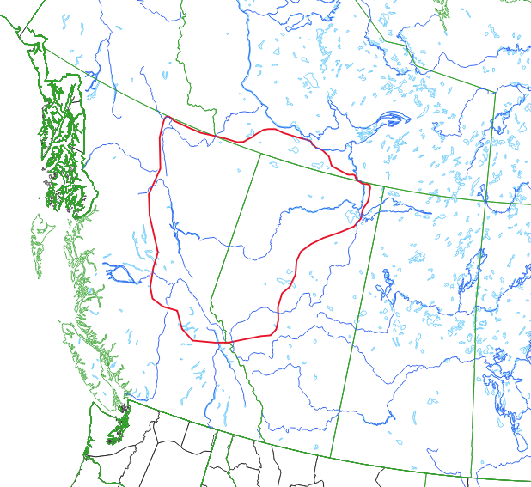
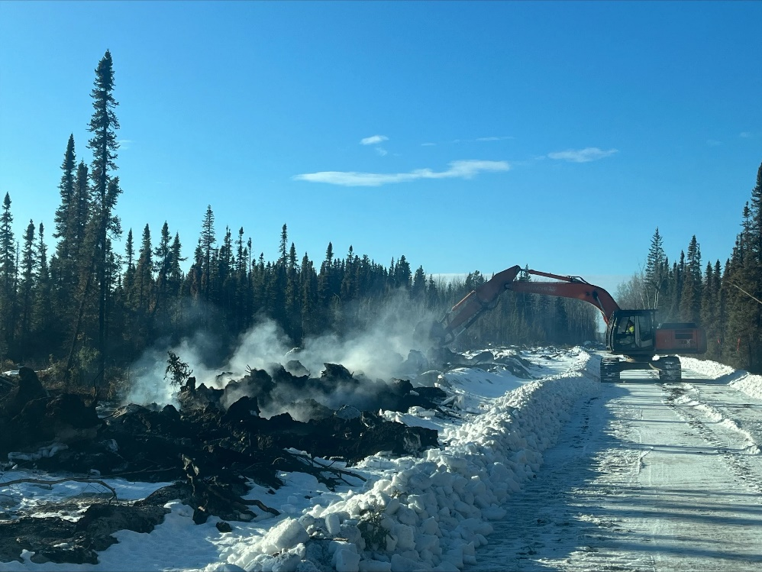
2023 Activity Continues: Holdover Fires
aka “zombie” or “carryover” fires (latter also applies to delay between lightning strikes and fire arrival)
Prolonged smoldering in deep organic layers
Heavy equipment working on hotspots on the southwest perimeter of the Basset fire (HWF058). February 12, 2024. https://srd.web.alberta.ca/high-level-area-update/february-12; accessed April 22, 2024
Notes:
Area outlined in red indicates where known holdover fires occurred in the 2023-24 winter.

Slide 23
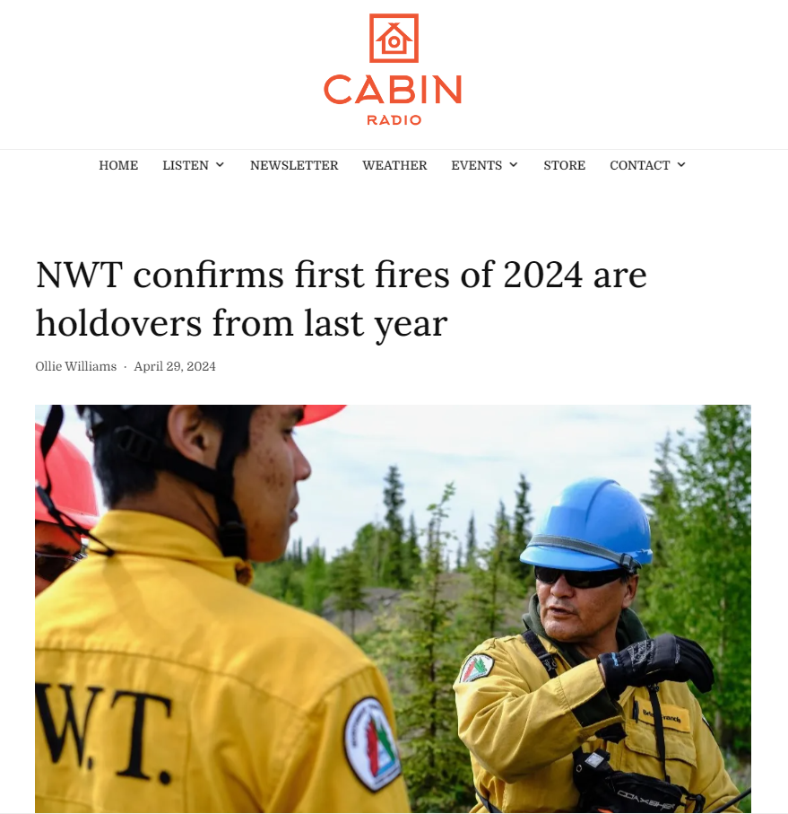
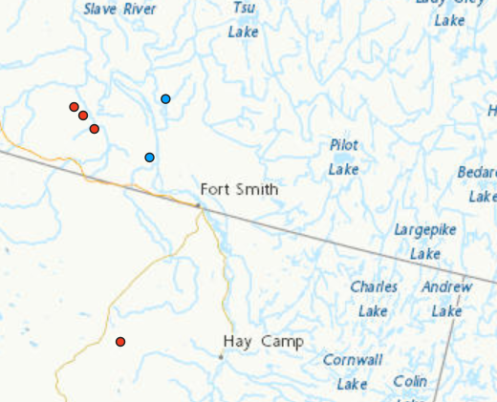
Holdover Fires
Winter remediation includes searching for heat signatures, turning over soil, applying water
As of early 2024:
BC: ~90
AB: 55-60
NT: 2+
BC and AB averages are probably <10 per year
Notes:
The two blue boxes northwest of Fort Smith indicate he NWT holdover fires in the 2023-24 winter.

Slide 24
Information Sources
Fire information:
Canadian Wildland Fire Information System (CWFIS)
Provinces/Territories --> Canadian Interagency Forest Fire Centre (CIFFC)
National Forestry Database (NFDB)
Canadian federal observed and modeled weather:
Environment and Climate Change Canada (ECCC)
Snow:
Canadian Cryospheric Information Network (CCIN)
Drought:
Agriculture and Agri-Food Canada (AAFC)
National Oceanic and Atmospheric Administration – National Centers for Environmental Information (NOAA-NCEI)
Notes:
Nothing to talk about here – these are just reference information sources and acronyms that may have been used
during the presentation.

Slide 25
Reference: Information Sources
Climate Indexes:
National Oceanic and Atmospheric Administration – National Centers for Environmental Information (NOAA-NCEI)
International Research Institute (for Climate and Society) at Columbia University (IRI)
Notes:
Nothing to talk about here – these are just reference information sources and acronyms that may have been used
during the presentation.
.

