Slide 1
An Introduction to
Wildland Fire Weather and Science (“Fire 101”)
Richard Carr
Natural Resources Canada -- Canadian Forest Service

Slide 2
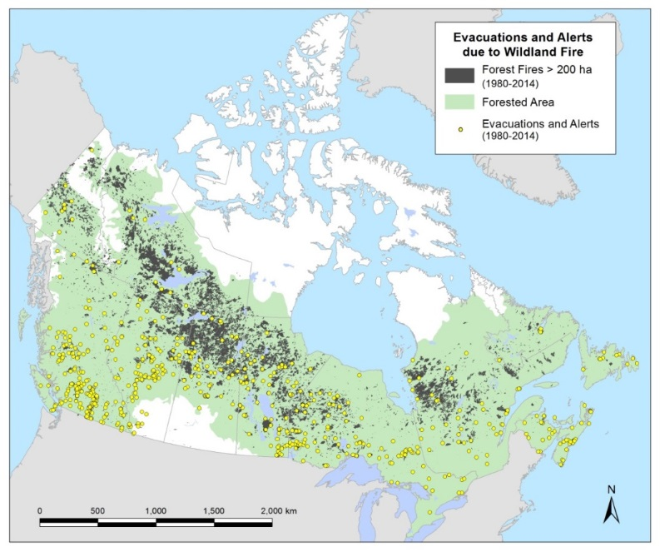
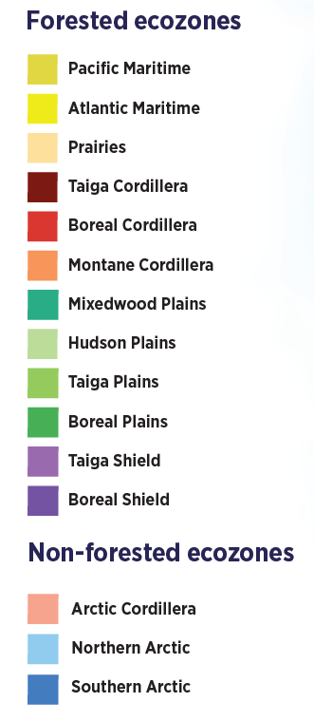
Canada’s Forests
Total area of about 3.62 million km²
40% of Canada’s land area
~33% of Canada is boreal forest
Most fire activity occurs
in the boreal forest
The State of Canada’s Forests (2021)

Slide 3
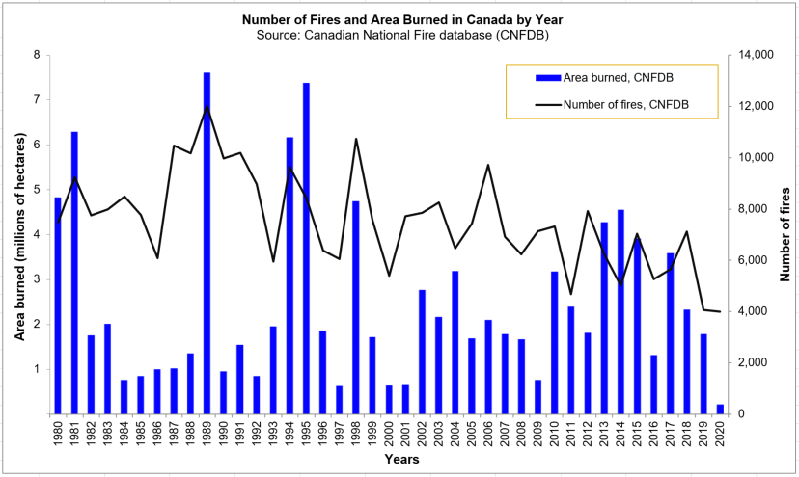
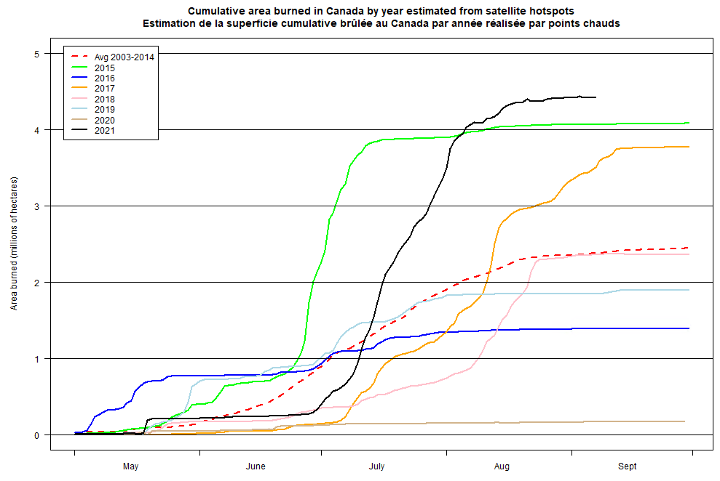
Fire Occurrence in Canada
Each year has about:
7,500 forest fires (NFDB 1990-2016)
2.5 million ha burned (NFDB 1990-2016)
26 communities (9000 people) evacuated
Great annual variability
Past 7 years activity

Slide 4
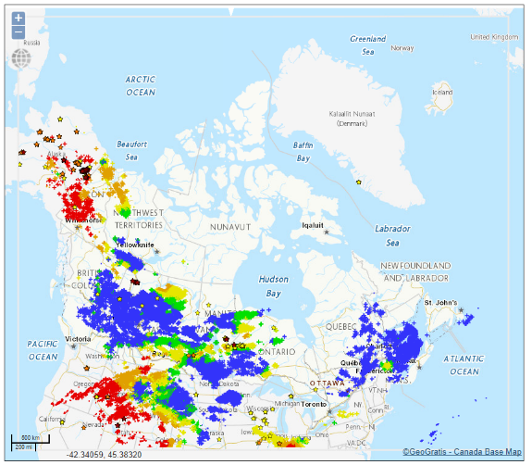
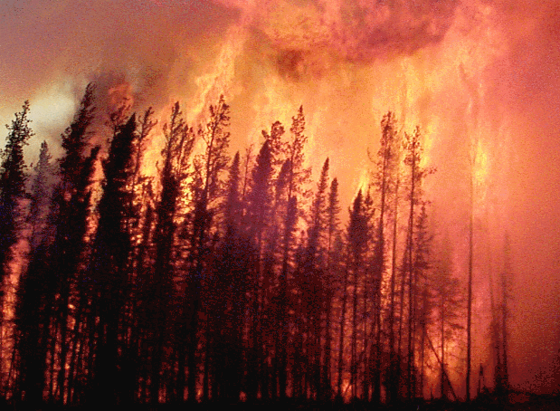
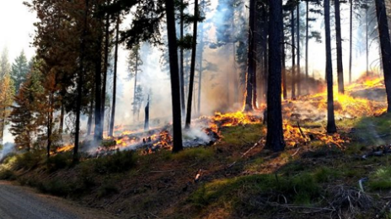
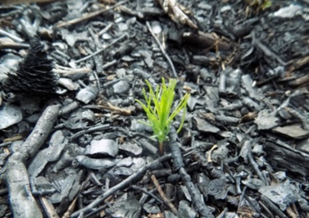
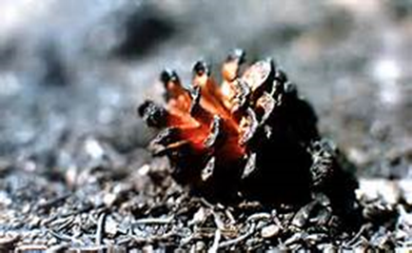
Fire Starters
Natural phenomena
Lightning
Other causes: rare
Humans
Recreational
Industry
Lax diligence
Natural landscape renewal:
Opens serotinous cones
Restarts natural growth cycles
Cleans flammable surface fuels
Notes:
Serotinous=“closed” – seed dispersion is gradual or occurs later

Slide 5
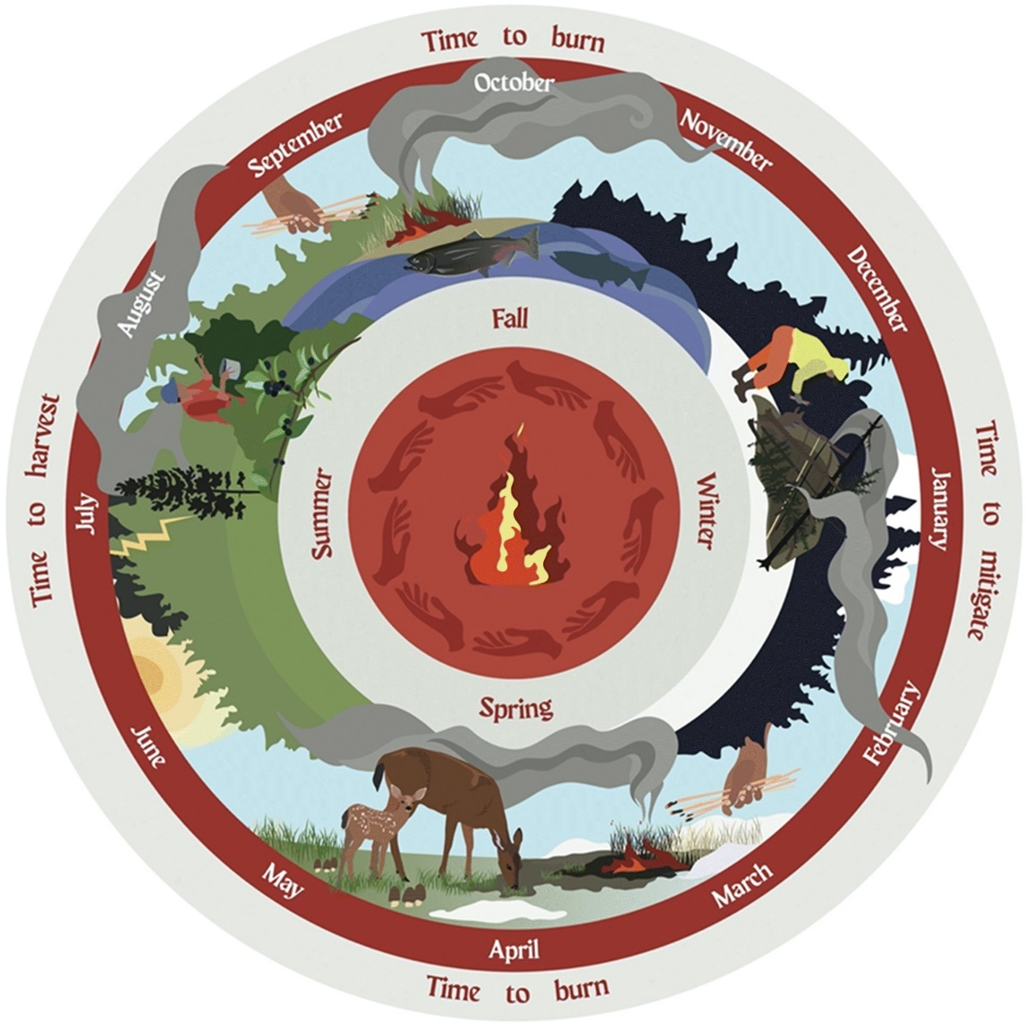
Indigenous Fire Stewardship
Indigenous peoples across Canada use fire to achieve cultural objectives in their territory.
Cultural burning
enhances ecosystem diversity,
assists with the management of complex resources, and
reduces wildfire risk by lessening fuel loads
Thank you, Amy Cardinal Christianson!
Notes:
Relational worldview
Fire used to achieve cultural objectives
Fire as a responsibility
Fire as a medicine
Shackan – Xwisten – what is crown land – what is natural?
Lack of understanding of cultural burning

Slide 6
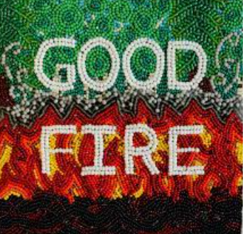
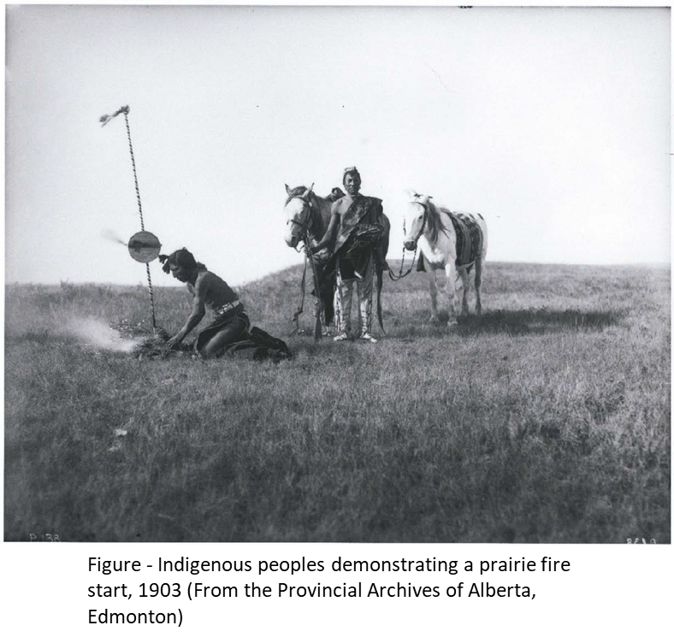
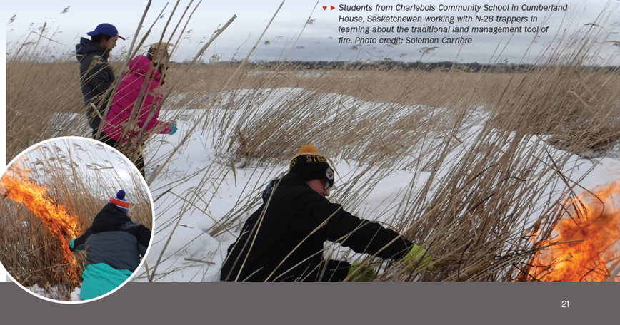
Indigenous Cultural Burning
Good Fire Podcast
https://yourforestpodcast.com/good-fire-podcast
Thank you, Amy Cardinal Christianson!
6
Notes:
Major difference between wildfire and the Indigenous burning practices.
Wildfire can either be started by natural or human causes, and generally occur in the summer months or other times when vegetation is dry and conducive to burning out-of-control.
Indigenous burns are controlled, and generally take place in low risk seasons such as the late fall. These fires are started by people with knowledge and experience about fire behaviour and fire control, and there is generally a purpose for burning.
Lightning started fires were not common enough to be relied upon

Slide 7
Positives and Negatives
Clears out thick understory
Increases soil nitrogen
Promotes natural regrowth cycle
Beneficial to plants and animals
Property damage
Private
Corporate
Infrastructure
Loss of commercial timber
Injury and health issues (fire and smoke)
How do we balance the ecological benefits with the loss of values and the threat to human habitation?

Slide 8
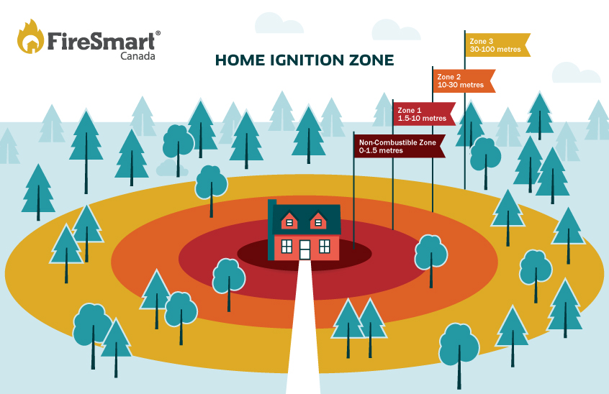
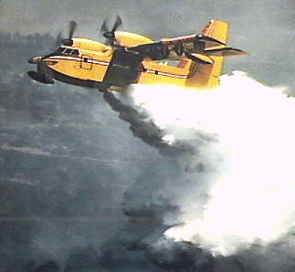
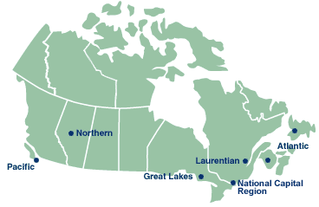
Part of the answer: Programs
Canadian Wildland Fire Strategy
Blueprint for Wildland Fire Science
FireSmart
Prescribed burns (PBs)
Which fires can be let burn?
https://firesmartcanada.ca/programs/firesmart-home-partners-program/
The Canadian Forest Service has conducted fire research since the 1920s

Slide 9
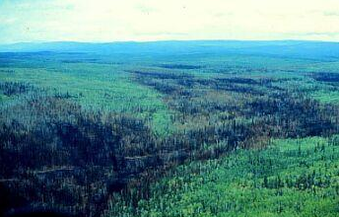
Fire Suppression
$500M - $1B spent fighting fire
Provinces/territories
Parks Canada
DND
First Nations
Resources (people, equipment) are shared between agencies or other nations via CIFFC or regional Compacts

Slide 10
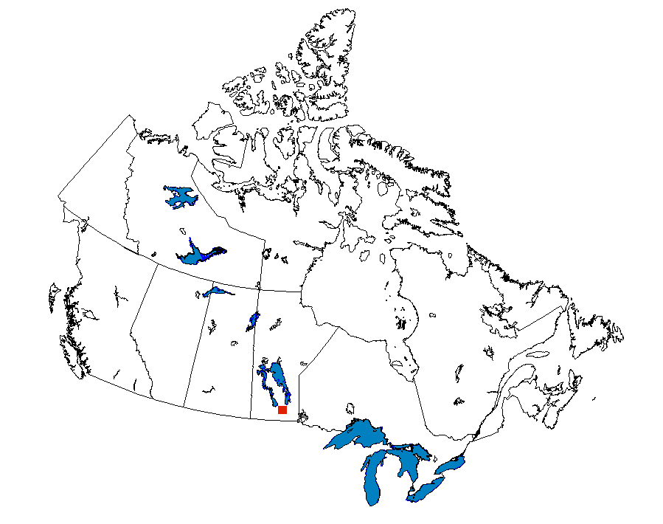
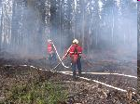
Canadian Interagency Forest Fire Centre (CIFFC)
http://www.ciffc.ca
Coordinates fire-fighting crew, equipment, and services exchange between
  Provinces and territories
  Canada and other nations
Member funding: CFS, Parks, P/T
Oversees working groups for most facets of fire management
Meteorology Working Group
http://www.sopfeu.qc.ca/fr/centre_de_presse/photos.php

Slide 11
Some Basic Fire Science

Slide 12
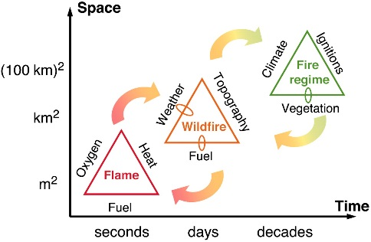
Fire Triangles: Burning requisites
Moritz, Max A.; Morais, Marco E.; Summerell, Lora A.; Carlson, J. M.; Doyle, John (2005-12-13). "Wildfires, complexity, and highly optimized tolerance".
Proceedings of the National Academy of Sciences of the United States of America. 102 (50): 17912–17917. doi:10.1073/pnas.0508985102.
Notes:
Ignition: Fuel=reductant Oxidizing agent: Oxygen

Slide 13
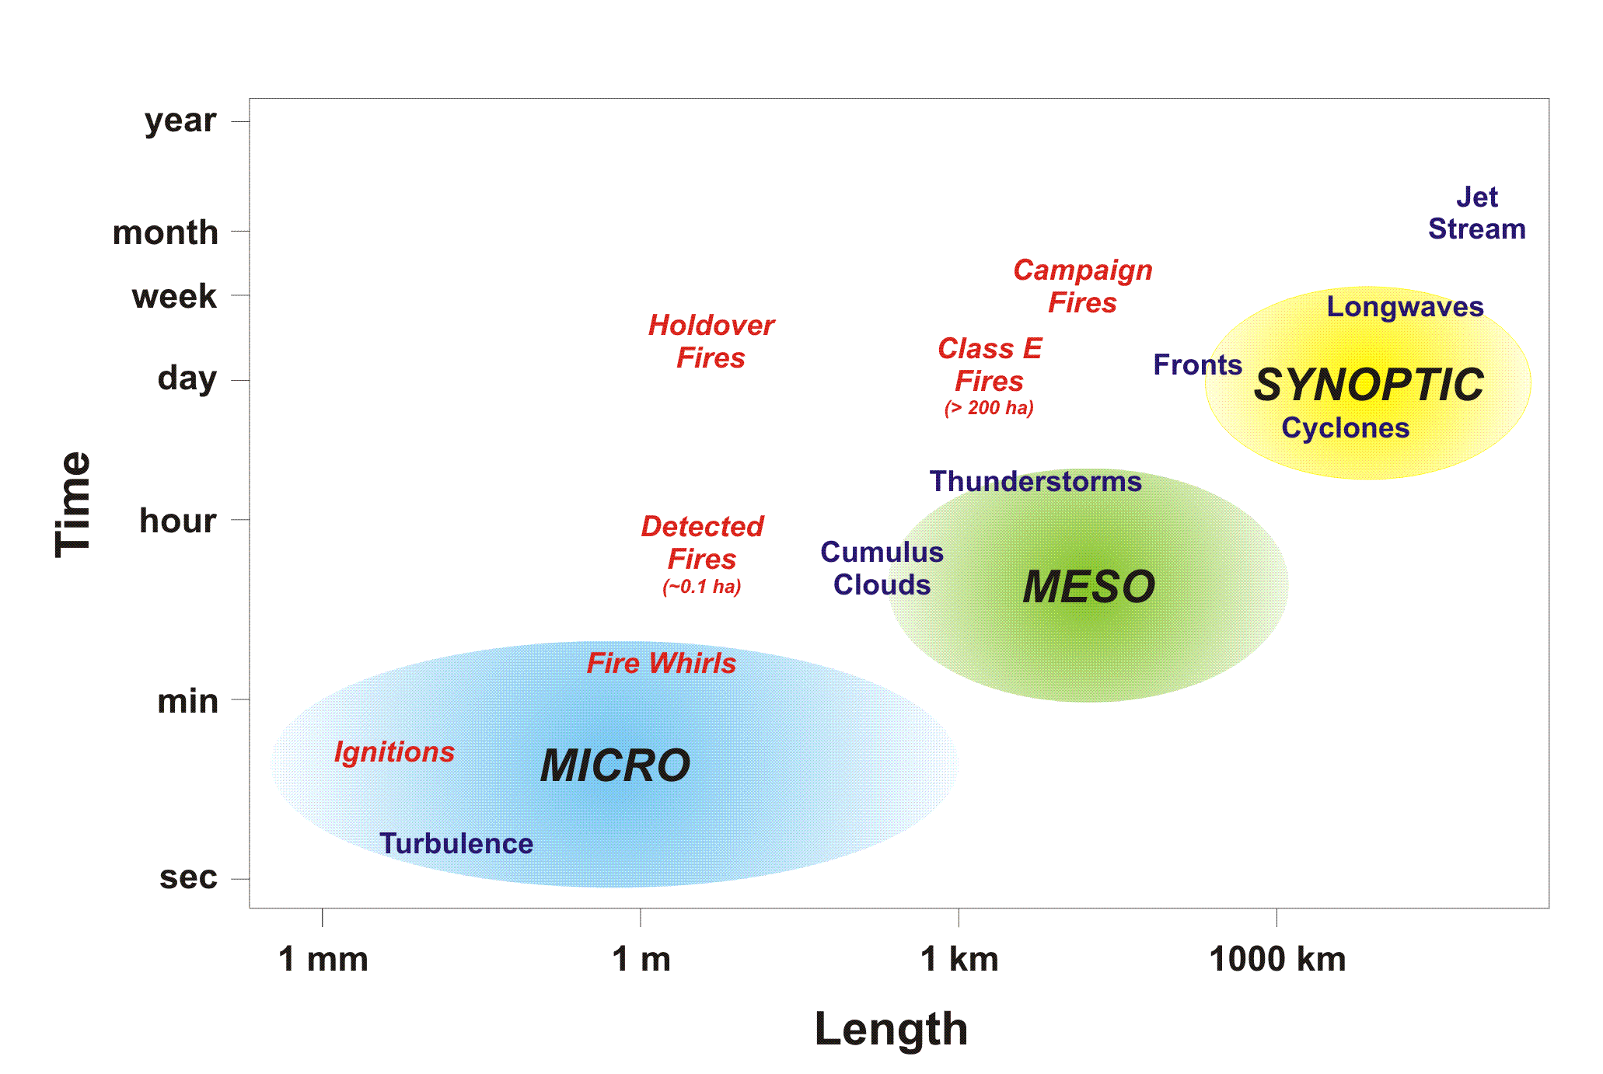
Fire/Growth Scales
Corresponds to important scales in weather/forecasting

Slide 14
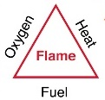
Combustion→flame
Combustion initiated by:
Fuel: Material (organic or not) -- reductant – loses electrons to the oxidizing agent
Oxygen: Oxidizing agent, accepts electrons
Heat or ignition source: Begins endothermic reaction; gas production results in flame

Slide 15
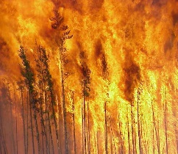
Fire Environment
The fire environment consists of three principal components:
Fuel: Living or dead organic material that is available for combustion and helps determine fire behaviour
Peaks before deciduous greenup and summer
Topography: Characteristics of a landscape, such as slopes and aspects, that influence fire spread
Weather: Atmospheric elements such as wind and rain that affect combustion
Fuels
Topography
Weather

Slide 16
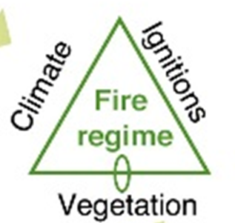
Fire Regime
Long-term fire patterns governed by:
Fuel: Live and dead vegetation available for combustion
Climate: temperature, wind humidity, wind, precipitation, …
Ignitions: Natural and human-caused

Slide 17
Fuel Moisture
Is a crucial factor in combustion and fire behaviour
  During pre-combustion, water (a heat sink) present in the fuel is heated and vaporized as the fuel temperature increases
  High fuel moisture reduces combustion efficiency
Content m is typically measured as a percent difference from its dry weight
moist weight – dry weight
m = 100% x
dry weight

Slide 18
Fire Intensity
Byram’s equation: fire intensity is determined by the fuel consumed and energy released through combustion
Horizontal spread of fire through the litter layer
Depth of burn into the duff layer
I = H w r
I is the intensity of a fire per unit length of fire front [kW/m]
H is the heat of combustion [typically 18000 kJ/kg for dry wood]
w is the weight of the fuel consumed per unit area [kg/m²]
  Fuel moisture (previous slide) is critical
  r is the rate of spread [m/s but normally measured as m/min]

Slide 19
Fire Spread
A wooden match stick illustrates heat transfer processes, which occur:
Weakly through the wood by conduction
Moderately by radiation through free space
Rapidly upward through convection
At varying rates with wind advecting heat away from the source
Convection
Advection
Radiation
Conduction

Slide 20
Fire Growth -- Elliptical
Wind advects heat and drives the overall direction of fire spread, giving an elliptical shape.
In that sense, fire spread is a two dimensional dispersion modelling exercise.

Slide 21
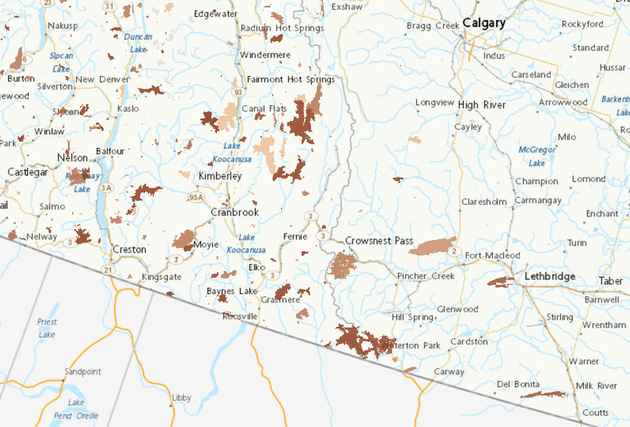
Fire Growth – Non-elliptical
Most fires have growth shaped by:
Fuel types
Moisture content
Non-fuel (rock, ice, water)
Topography
Weather differences
Suppression

Slide 22


Surface vs Crown fire
Crown fire:
Occurs when surface fires are intense enough to ignite tree branches aloft
Ladder fuels (shrubs, branches, bark, tree lichens) assist in carrying surface fire upward
Accelerates the rate of spread as the wind above the tree canopy drives the fire
Increases fire intensity as new fuels are tapped
Surface fire:
Spread is governed by the in-stand wind flow
Canopy (crowns) inhibit winds, creating a region of low wind speed and strong turbulence
Understory density determines presence of a low-level wind maximum
Lodgepole pine
Pinus contorta var. latifolia Engelm. Dougl. ex Loud.)
Balsam fir
Abies balsamea (L.) Mill.
Natural Resources Canada – Canadian Forest Service
Notes:
Surface fire spread is governed by the in-stand wind flow, which is lower that the above-canopy wind speed. The tree canopy (crowns) inhibit winds, creating a region of low wind speed and strong turbulence. Depending on the density of the understory, a low-level wind maximum (jet) can occur below the canopy. These below-canopy winds are what drive the surface fire.
When surface fires reach an intensity sufficient enough to ignite the tree branches aloft, a crown fire may occur. Ladder fuels (shrubs, thin branches, bark flakes and tree lichens below the bulk of the tree canopy) assist in carrying the surface fire into the crown. Crowning leads to a significant acceleration in the rate of spread as the winds above the tree canopy are accessed by the fire. Also, fire intensity increases as a new source of combustible fuel is tapped.

Slide 23
Canadian Forest Fire Danger
Rating System (CFFDRS)

Slide 24
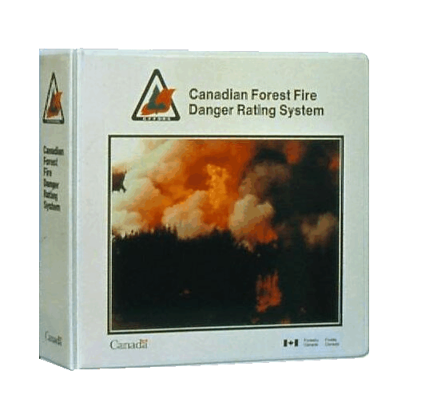
Canadian Forest Fire Danger Rating System
The Canadian Forest Service developed the CFFDRS to predict fire danger in Canada.
It has been important in Canadian forest protection operations since 1970.
Risk
(lightning and
people-caused)
Weather
Topography
Fuels
FOP
System
FWI
System
FBP
System
Accessory
Fuel Moisture
System
CFFDRS

Slide 25
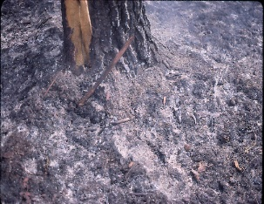
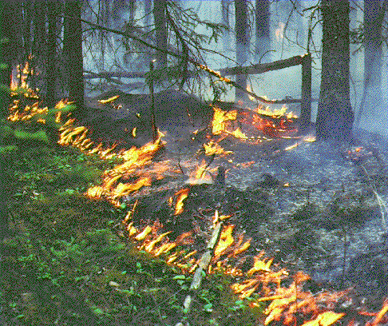

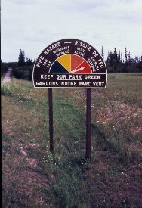
Canadian FWI System Indexes
Noon local standard time; hourly calculations can be done
Fire Weather
Observations
Temperature
Humidity,
Wind, Rain
Temperature,
Humidity,
Rain
Snow depth
Barometric Pressure
Horizontal Visibility
Cloud cover and type
Upper air data
Wind
Temperature,
Rain
Fuel Moisture
Codes
FFMC
Fine Fuel Moisture Code
DMC
Duff Moisture Code
DC
Drought Code
Fire Behavior
Indexes
ISI
Initial Spread Index
BUI
Buildup Index
FWI
Fire Weather Index
BUI
fuel consumption
ISI
rate of spread
DSR/MSR/SSR
FWI
fire intensity

Slide 26



Canadian FWI: Fuel Moisture Codes
Fuel moisture codes represent moisture at three forest floor depths (approximating the LFH layers)
Moisture Depth Layer Woody Fuel Precip
Code Threshold
  FFMC 0-2 cm Litter layer L Fine twigs, needles, etc 0.5mm
  DMC 2-5 cm Fibric layer F Bark, small branches 1.5mm
  DC 5+ cm Humic layer H Logs, large branches 2.8mm
  Drought Code (DC) based on forest floor moisture capacity of ~200mm
L
F
H

Slide 27
Canadian FWI: Fuel Moisture Code Response
The fuel moisture codes dry at different logarithmic rates, which can be expressed as timelags
(time to lose 2/3 excess moisture)
Code | Timelag
FFMC DMC DC | 2/3 day 12 days 52 days
DC
DMC
FFMC
-1

Slide 28
Startup of calculations
Turner & Lawson:
Three consecutive days of no snow cover and noon T>= 12C
First ever calculation: Use default FFMC=85, DMC=6, DC=15 or interpolate from other locations or grids
CWFIS:
Jan-Feb mean snow depth >= 10cm: 3 consecutive days of no snow cover
Else: As above, with noon T >= 12C
Overwintering (values exist for previous year):
Get latest fall DC
Get total winter precipitation
Apply precipitation carryover and wetting efficiency values

Slide 29
Shutdown of calculations
Turner & Lawson:
Three consecutive days of noon T <= 5C, or
Ground is frozen, or
November 1
CWFIS – Temperature criteria as above, plus:
Snow cover < 7 consecutive days:
Enter short term shutdown: calculate fuel moisture codes only
Snow cover >= 7 consecutive days:
Enter winter shutdown

Slide 30
Notes values of FWI indexes
Indexes are tied to many operational activities
Some notable thresholds include:
FFMC Surface ignition & spread Notable values: 74, 92
DMC Lightning ignition Notable values: 20, 60
DC Smoldering / “mop-up” Notable values: 300,500
ISI Containment difficulty Notable values: 20, 70
BUI Fire load fuel consumption Notable values: 60, 90
FWI Fire intensity Notable values: 30, 50
DSR, MSR, SSR How bad have conditions been?
Notes:
Other notable values in the ranges of these indexes exist.
Dark red values indicate extreme activity thresholds.

Slide 31
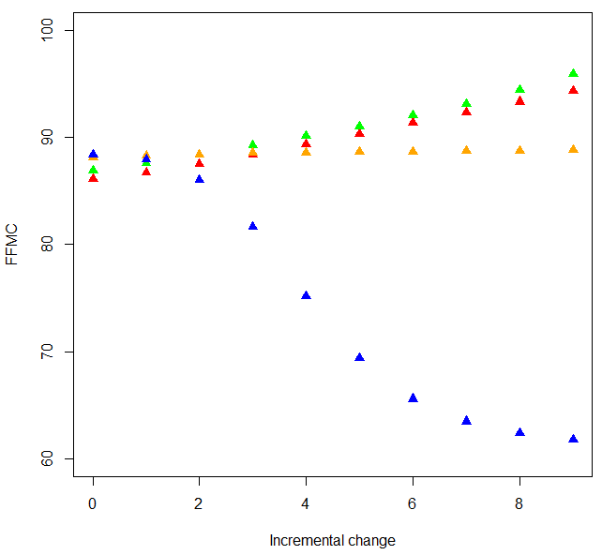
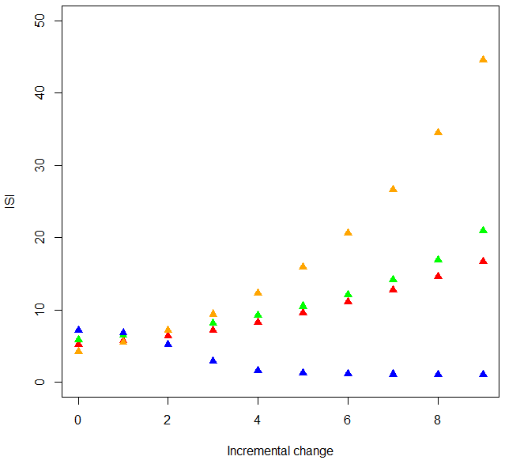
Effects of weather parameters on FFMC and ISI
RH: 50 - 5
T: 5 - 50
WS: 5 - 50
WS: 5 - 50
RH: 50 - 5
Rain: 0.0, 0.6, doubling
T: 5 - 50
Rain: 0.0, 0.6, doubling
Initial FFMC=85
Base (static) weather values: T=20C, RH=40%, WS=15km/h, Rain=0.0
Notes:
“Incremental change” refers to the iteration count.

Slide 32
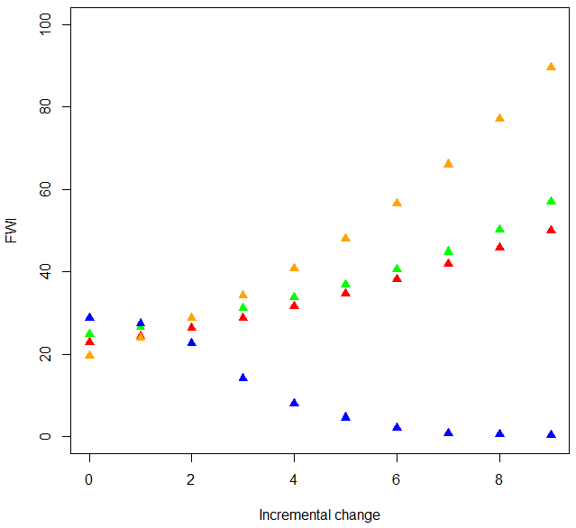
Effects of weather parameters on FWI
WS: 5 - 50
RH: 50 - 5
T: 5 - 50
Rain: 0.0, 0.6, doubling
Initial fuel moisture codes: FFMC=85, DMC=100, DC=500
Base (static) weather values: T=20C, RH=40%, WS=15km/h, Rain=0.0
Notes:
“Incremental change” refers to the iteration count.

Slide 33
Canadian Forest Fire Behaviour
Prediction (FBP) System
Inputs
FBP System
Fuel Type
FFMC, ISI, BUI
Wind Speed
Wind Direction
Percent Slope
Upslope Direction
Elevation
Lat / Long
Date
Elapsed Time
Point or Line
Ignition
Fuels
Weather
Topography
Foliar
Moisture
Content
Type / Duration
of Prediction
Canadian Forest Fire
Behavior Prediction
(FBP) system
Outputs
Primary
Secondary
Rate of Spread
Fuel Consumption
Head Fire Intensity
Fire Description
- Fire Type
- Crown Fraction Burned
Head, Flank & Back Spread Distances
Flank & Back Fire Rates of Spread
Flank & Back Fire Intensities
Elliptical Fire Area & Perimeter
Rate of Perimeter Growth
Length-to-Breadth Ratio

Slide 34
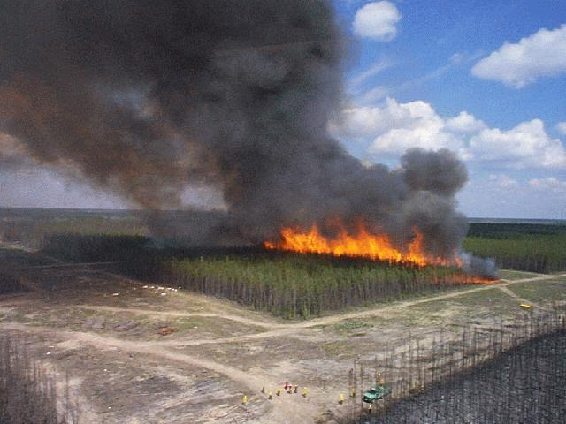
Canadian FBP System: Development
The CFS developed the FBP system in the 1980s
Based on empirical studies
17 fuel types used
Next generation FBP by 2025 includes configurable fuel types

Slide 35
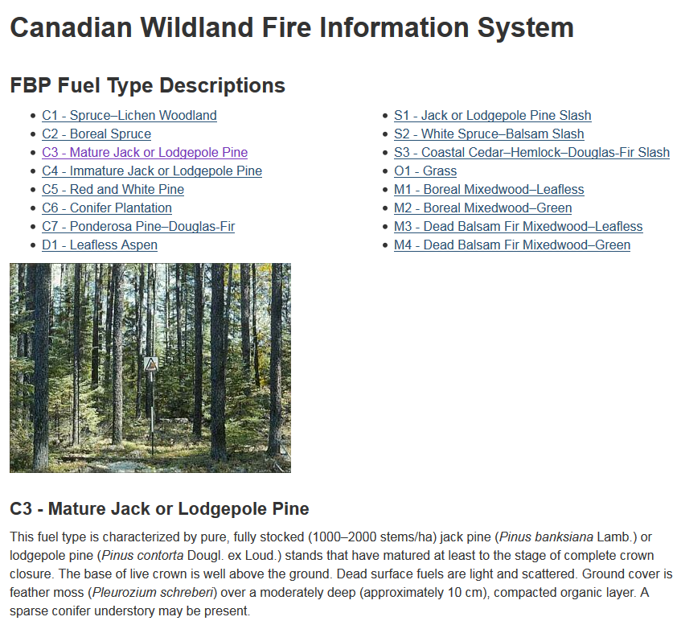
Canadian FBP System: Fuel Types

Slide 36
Forecasting Considerations for Fire Weather

Slide 37
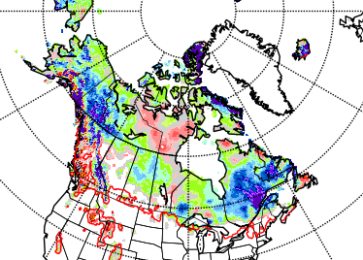
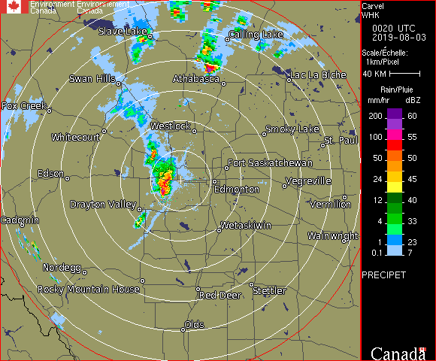
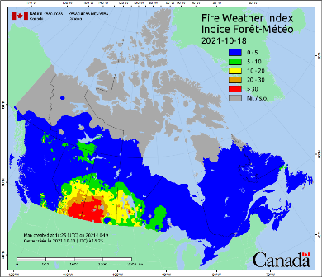
Precipitation
Snow depth:
Mainly affects timing of spring fire season
Has little bearing on summer fire season
Snow cover helps determine when to start/stop FWI
Thunderstorm gust front
Rain
Fuel moisture thresholds (mm): FFMC=0.5 DMC=1.5 DC=2.8
FFMC can recover in hours
Slow 50mm+ rainfall may stop large intense fires
Dry thunderstorms forecasts critical
Borderline stability indexes or dry atmosphere
Lightning fires may smolder for days before “arriving”

Slide 38
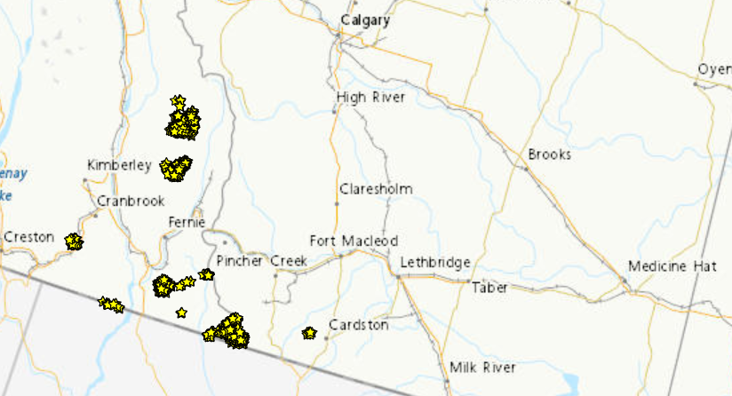
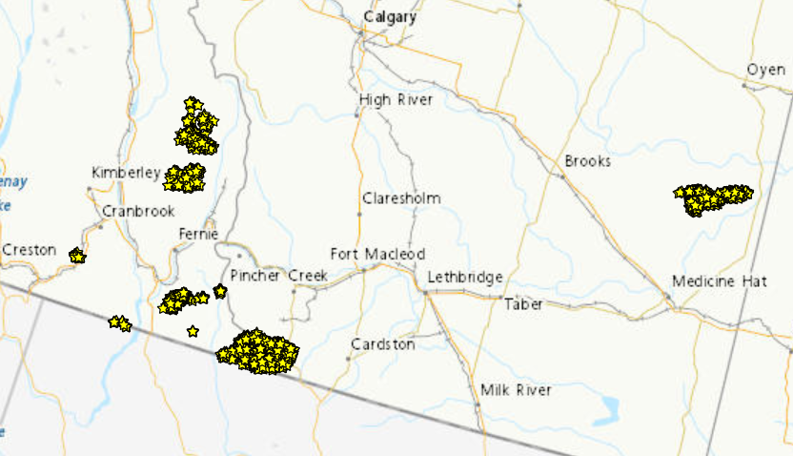
Wind
Wind speed and direction shifts
  Problems for suppression crews:
  Can create a long and intense leading front
  May bring different air mass characteristics
  Usually daytime occurrence but can happen overnight
  Windy period may be short but problematic
  Fires may escape
A
B

Slide 39
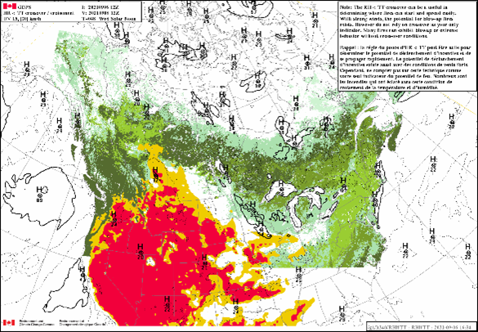
Temperature and RH Trends
RH “recovery”
Do we get close to saturation overnight?
Dry windy warm nights continue fire growth
Temperature/RH Crossover
RH (%) at or below temperature value (e.g. T=20 RH <= 20%)
FFMC = 92 or higher: very high to extreme range

Slide 40
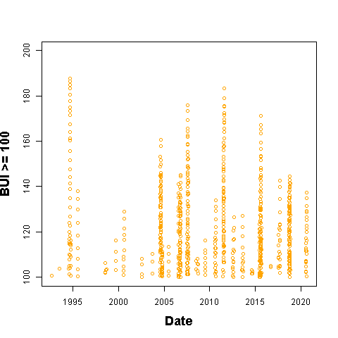
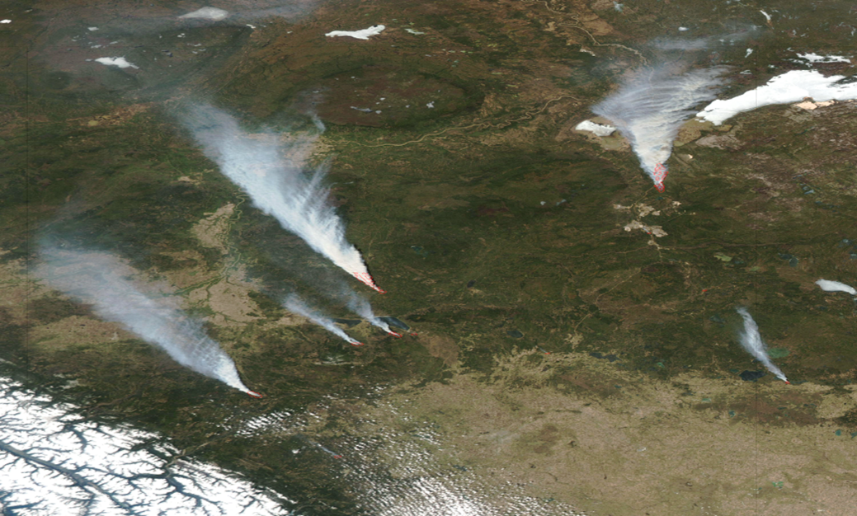
Fire Weather Climatology
Atmospheric/oceanic oscillations
Topography
Fuels
Forest disturbance
Soils
Affects fire weather parameters: T, RH, wind, precip, lightning, …
Notes:
Waves on the Fort Smith BUI graph are hand-drawn

Slide 41
ENSO Springs
El Niño:
Warm, windy, dry in western Canada
La Niña:
Arctic surface highs bring dry air, strong wind around edges
Temperature may be cool
Summer fire problems may depend on other influences
Year | DJF | JFM | FMA | MAM | AMJ | MJJ | JJA | JAS | ASO | SON | OND | NDJ
1991 | 0.4 | 0.3 | 0.2 | 0.3 | 0.5 | 0.6 | 0.7 | 0.6 | 0.6 | 0.8 | 1.2 | 1.5
1992 | 1.7 | 1.6 | 1.5 | 1.3 | 1.1 | 0.7 | 0.4 | 0.1 | -0.1 | -0.2 | -0.3 | -0.1
1993 | 0.1 | 0.3 | 0.5 | 0.7 | 0.7 | 0.6 | 0.3 | 0.3 | 0.2 | 0.1 | 0.0 | 0.1
1994 | 0.1 | 0.1 | 0.2 | 0.3 | 0.4 | 0.4 | 0.4 | 0.4 | 0.6 | 0.7 | 1.0 | 1.1
1995 | 1.0 | 0.7 | 0.5 | 0.3 | 0.1 | 0.0 | -0.2 | -0.5 | -0.8 | -1.0 | -1.0 | -1.0
1996 | -0.9 | -0.8 | -0.6 | -0.4 | -0.3 | -0.3 | -0.3 | -0.3 | -0.4 | -0.4 | -0.4 | -0.5
1997 | -0.5 | -0.4 | -0.1 | 0.3 | 0.8 | 1.2 | 1.6 | 1.9 | 2.1 | 2.3 | 2.4 | 2.4
1998 | 2.2 | 1.9 | 1.4 | 1.0 | 0.5 | -0.1 | -0.8 | -1.1 | -1.3 | -1.4 | -1.5 | -1.6
1999 | -1.5 | -1.3 | -1.1 | -1.0 | -1.0 | -1.0 | -1.1 | -1.1 | -1.2 | -1.3 | -1.5 | -1.7
2000 | -1.7 | -1.4 | -1.1 | -0.8 | -0.7 | -0.6 | -0.6 | -0.5 | -0.5 | -0.6 | -0.7 | -0.7
2001 | -0.7 | -0.5 | -0.4 | -0.3 | -0.3 | -0.1 | -0.1 | -0.1 | -0.2 | -0.3 | -0.3 | -0.3
2002 | -0.1 | 0.0 | 0.1 | 0.2 | 0.4 | 0.7 | 0.8 | 0.9 | 1.0 | 1.2 | 1.3 | 1.1
2003 | 0.9 | 0.6 | 0.4 | 0.0 | -0.3 | -0.2 | 0.1 | 0.2 | 0.3 | 0.3 | 0.4 | 0.4
2004 | 0.4 | 0.3 | 0.2 | 0.2 | 0.2 | 0.3 | 0.5 | 0.6 | 0.7 | 0.7 | 0.7 | 0.7
2005 | 0.6 | 0.6 | 0.4 | 0.4 | 0.3 | 0.1 | -0.1 | -0.1 | -0.1 | -0.3 | -0.6 | -0.8
2006 | -0.8 | -0.7 | -0.5 | -0.3 | 0.0 | 0.0 | 0.1 | 0.3 | 0.5 | 0.7 | 0.9 | 0.9
2007 | 0.7 | 0.3 | 0.0 | -0.2 | -0.3 | -0.4 | -0.5 | -0.8 | -1.1 | -1.4 | -1.5 | -1.6
2008 | -1.6 | -1.4 | -1.2 | -0.9 | -0.8 | -0.5 | -0.4 | -0.3 | -0.3 | -0.4 | -0.6 | -0.7
2009 | -0.8 | -0.7 | -0.5 | -0.2 | 0.1 | 0.4 | 0.5 | 0.5 | 0.7 | 1.0 | 1.3 | 1.6
2010 | 1.5 | 1.3 | 0.9 | 0.4 | -0.1 | -0.6 | -1.0 | -1.4 | -1.6 | -1.7 | -1.7 | -1.6
2011 | -1.4 | -1.1 | -0.8 | -0.6 | -0.5 | -0.4 | -0.5 | -0.7 | -0.9 | -1.1 | -1.1 | -1.0
2012 | -0.8 | -0.6 | -0.5 | -0.4 | -0.2 | 0.1 | 0.3 | 0.3 | 0.3 | 0.2 | 0.0 | -0.2
2013 | -0.4 | -0.3 | -0.2 | -0.2 | -0.3 | -0.3 | -0.4 | -0.4 | -0.3 | -0.2 | -0.2 | -0.3
2014 | -0.4 | -0.4 | -0.2 | 0.1 | 0.3 | 0.2 | 0.1 | 0.0 | 0.2 | 0.4 | 0.6 | 0.7
2015 | 0.6 | 0.6 | 0.6 | 0.8 | 1.0 | 1.2 | 1.5 | 1.8 | 2.1 | 2.4 | 2.5 | 2.6
2016 | 2.5 | 2.2 | 1.7 | 1.0 | 0.5 | 0.0 | -0.3 | -0.6 | -0.7 | -0.7 | -0.7 | -0.6
2017 | -0.3 | -0.1 | 0.1 | 0.3 | 0.4 | 0.4 | 0.2 | -0.1 | -0.4 | -0.7 | -0.9 | -1.0
2018 | -0.9 | -0.8 | -0.6 | -0.4 | -0.1 | 0.1 | 0.1 | 0.2 | 0.4 | 0.7 | 0.9 | 0.8
2019 | 0.7 | 0.7 | 0.7 | 0.7 | 0.5 | 0.5 | 0.3 | 0.1 | 0.2 | 0.3 | 0.5 | 0.5
2020 | 0.5 | 0.5 | 0.4 | 0.2 | -0.1 | -0.3 | -0.4 | -0.6 | -0.9 | -1.2 | -1.3 | -1.2
2021 | -1.0 | -0.9 | -0.8 | -0.7 | -0.5 | -0.4 | -0.4 | -0.5 | -0.7 | -0.8 | -1.0 | -1.0
Large area burned
Virginia Hills, AB
Chisholm, AB
Kelowna, BC
Slave Lake, AB
PDO positive phase
Fort McMurray, AB
Big years in BC
Western half

Slide 42
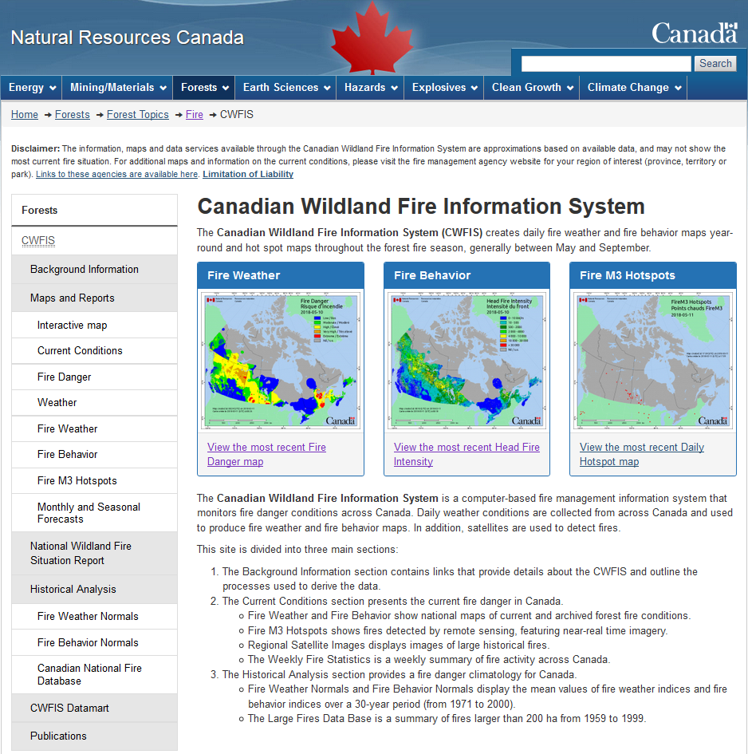
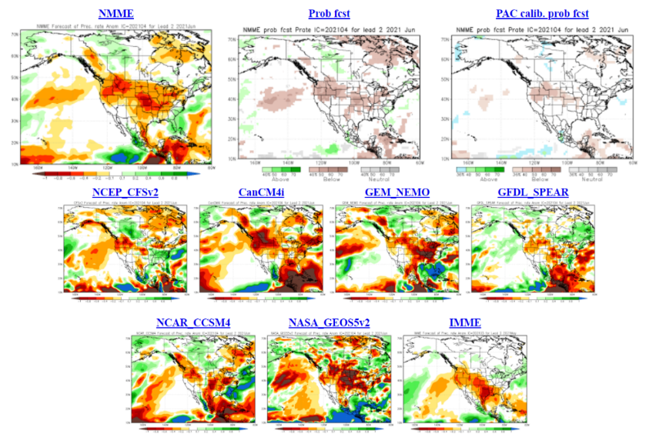
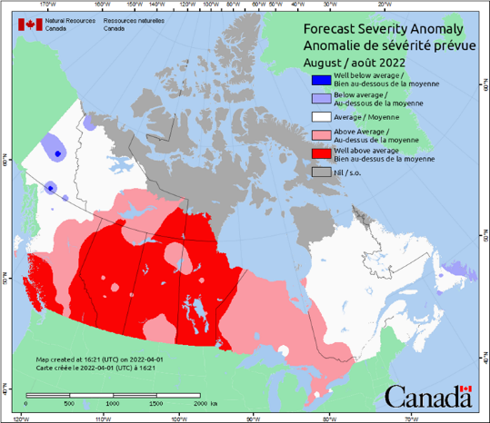
Seasonal Forecasting
NRCan
Some P/T or their contractors
Develop into a community-based product?

Slide 43
P/T fire weather offices
Generally small: 1-4 people
Small offices may use contractors
Spot forecasts
Short (often 3-5 days) to long range outlooks
Must understand CFFDRS index roles in operations and how to forecast them
Forecaster shortages
Seasonal work? Long intense hours?
Hurdles in sharing forecasters between offices

Slide 44
Wildland Fire Information:
Canadian Wildland Fire Information System (CWFIS)

Slide 45
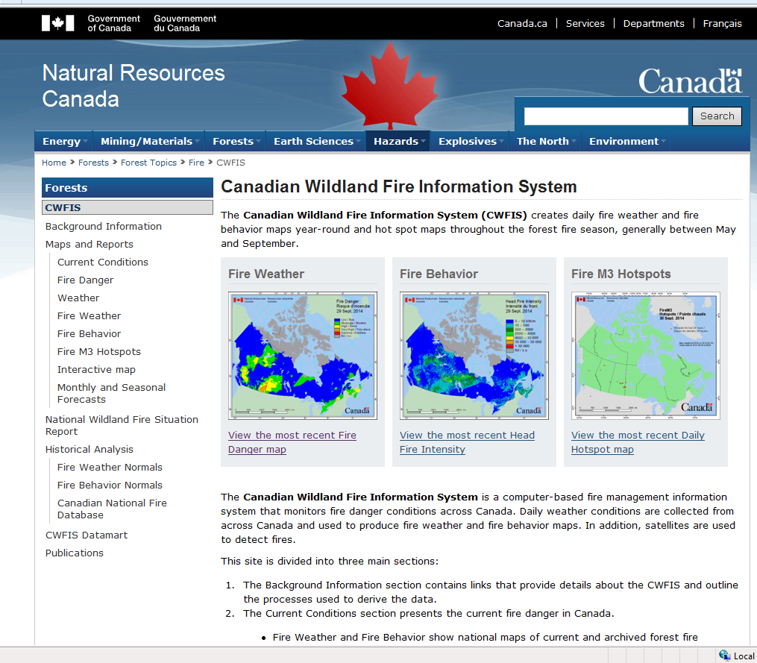
CWFIS: Web site front page (bilingual)
The CWFIS provides national fire weather, fire behaviour, fire locations, and other information.
http://cwfis.cfs.nrcan.gc.ca
Provincial/territorial web sites provide operational focus in their jurisdictions.
Calculations are based on observations from over 2500 provincial, federal and US stations.

Slide 46
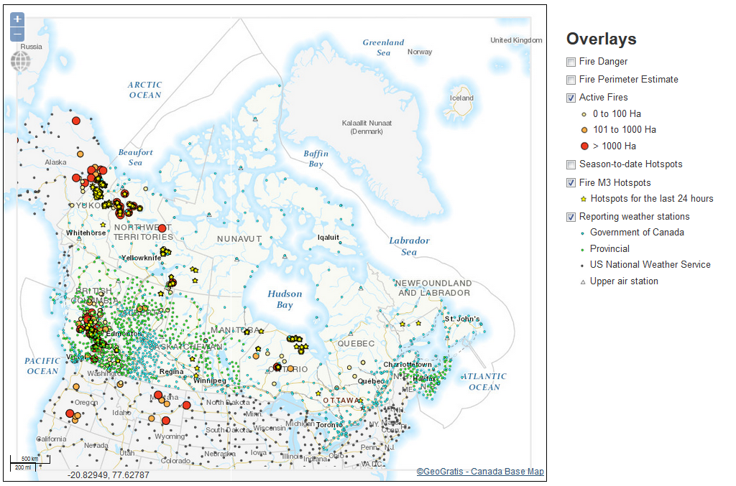
CWFIS: Interactive map and other features
CWFIS features include:
Background information
Forecast indexes: daily to seasonal
Interactive map
Base maps
Fire locations
Hotspots
Perimeter estimates
Fire Danger
Fire History (1980 to current)
Internal site includes fire growth modeling, smoke forecast, extra base layers, …

Slide 47
CWFIS: User and Emergency Support
CWFIS users include
GoC and other federal departments (ECCC included)
Provinces/territories, including emergency management organizations
Public – Canadian and international
Researchers – Canadian and international
Private companies
The CWFIS supports emergency preparedness programs and operations of:
    NRCan
    Other federal departments
    Canadian Interagency Forest Fire Centre (CIFFC)

Slide 48
Fire Growth Modelling

Slide 49
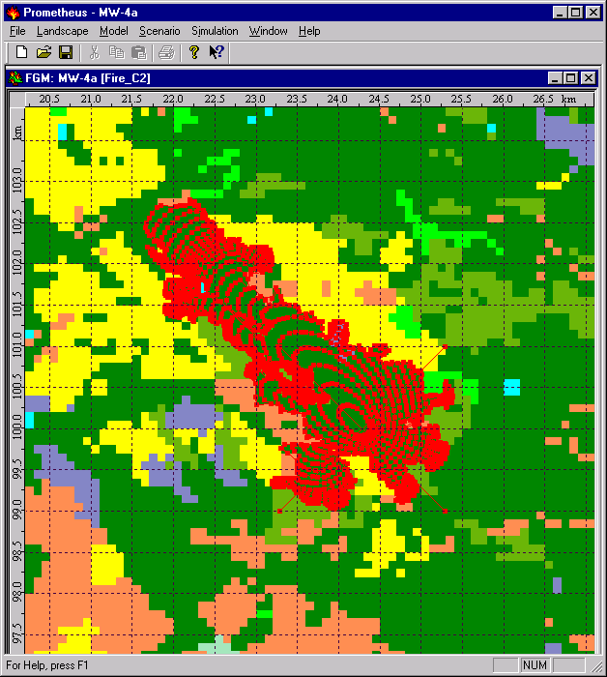
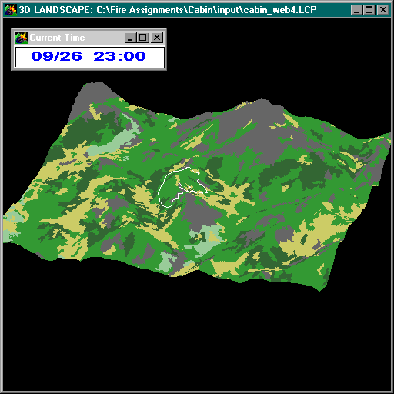
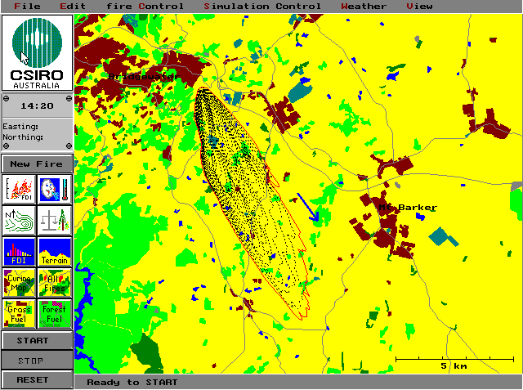

Fire Growth Modeling Concepts
Significant advances in computer modelling
Increased model complexity and resolution
Probabilistic or physical bases
Weather events cause scale change:
Dryness/wind that move a smouldering fire to a flaming fire
Wind causing a small fire to escape
Drought that moves an escape to a campaign fire

Slide 50






Fire Growth Models
Prometheus/Pandora
Pandora makes the Prometheus "fire modeling engine" available to custom applications
Pegasus
Running fire spread simulations over the web
PFAS
Probabilistic Fire Analysis System
Burn-P3
Estimating burn probability / susceptibility
Bigfoot
Hotspot-based operational fire-growth predictions
Notes:
Prometheus – firegrowthmodel.ca

Slide 51


Fire Growth Modeling: NRCan Operations
Provinces & Territories may request modeling via CIFFC
Triage process: which fires can be left to burn?
Team of CFS modelers & analysts
Process becoming more streamlined
CWFIF will help
Accommodate base layers
Manage product distribution
Improved data sharing, improved modelling
Notes:
Various number of people working on FGM response – up to 12 in 2021 but not all at one time.

Slide 52
Interaction and Collaboration

Slide 53
Information Exchange
OGC standards
WCS, WFS, WMS
CWFIS … Geoserver: shapefiles, csv format, …
Data Integration Project (DIP) activities
Define minimal standards
Transform varying data to a common formats
Facilitates a single, accurate, and timely data source
Fire locations
Fire weather in progress

Slide 54

Canadian Wildland Fire Information Framework (CWFIF)
Integration of data, tools, and new science to streamline needs of Canadian fire operators and researchers
Developing physical, logical, and governance structures
SOPs, SDLCs, DMPs, Architecture: structure and supporting processes/tools
Outcomes:
Formalized service delivery processes for increased interoperability;
Timely implementation of new data services and decision tools;
Supports information sharing in the Canadian Wildland Fire Strategy, CIFFC IM/IT strategies, DIP, Blueprint
Notes:
CWFIF Technical architecture based on business requirements identified by partner organizations, including NRCan, CIFFC, FPT fire management agencies and some Federal departments.

Slide 55
NRCan/GOC Fire Season Preparations
Roles and responsibilities review
Seasonal forecast presentations
GOC Placemat
Tabletop Exercises
CIFFC – GOC -- NRCan checks
Media events and preparation
Fire 101 such as this presentation?

Slide 56


Outreach & Interaction with Other Projects
CIFFC: Meteorology Working Group, Fire courses, …
NADM, NASFAO
Fire weather briefings
CIFFC/GOC, Seasonal forecasts
With ECCC:
Fire weather product and science development
Smoke modeling & health – Firework, working groups, etc
Forecast improvement
Short, medium, long range
This brings us to where we are today!

Slide 57
Questions?
Contact:
Richard Carr
Fire Research Analyst
Natural Resources Canada – Canadian Forest Service
Richard.Carr@canada.ca
5320 122 Street NW
Edmonton, AB, Canada
T6H 3S5
825-510-1265 780-710-3147
?
?
?
?
?
Notes:
57

Slide 58


Slide 59


