Slide 1
S589: Upper Air Influences

Slide 2
Objectives
Introduce the “Third dimension of the fire environment”
Upper air: atmosphere to the tropopause (approx.)
Fire and atmospheric interactions
Understand basic storm safety
Wind profiles and plumes
Understand stability indexes applicable to fire
Notes:
Richard Carr, 2021.

Slide 3
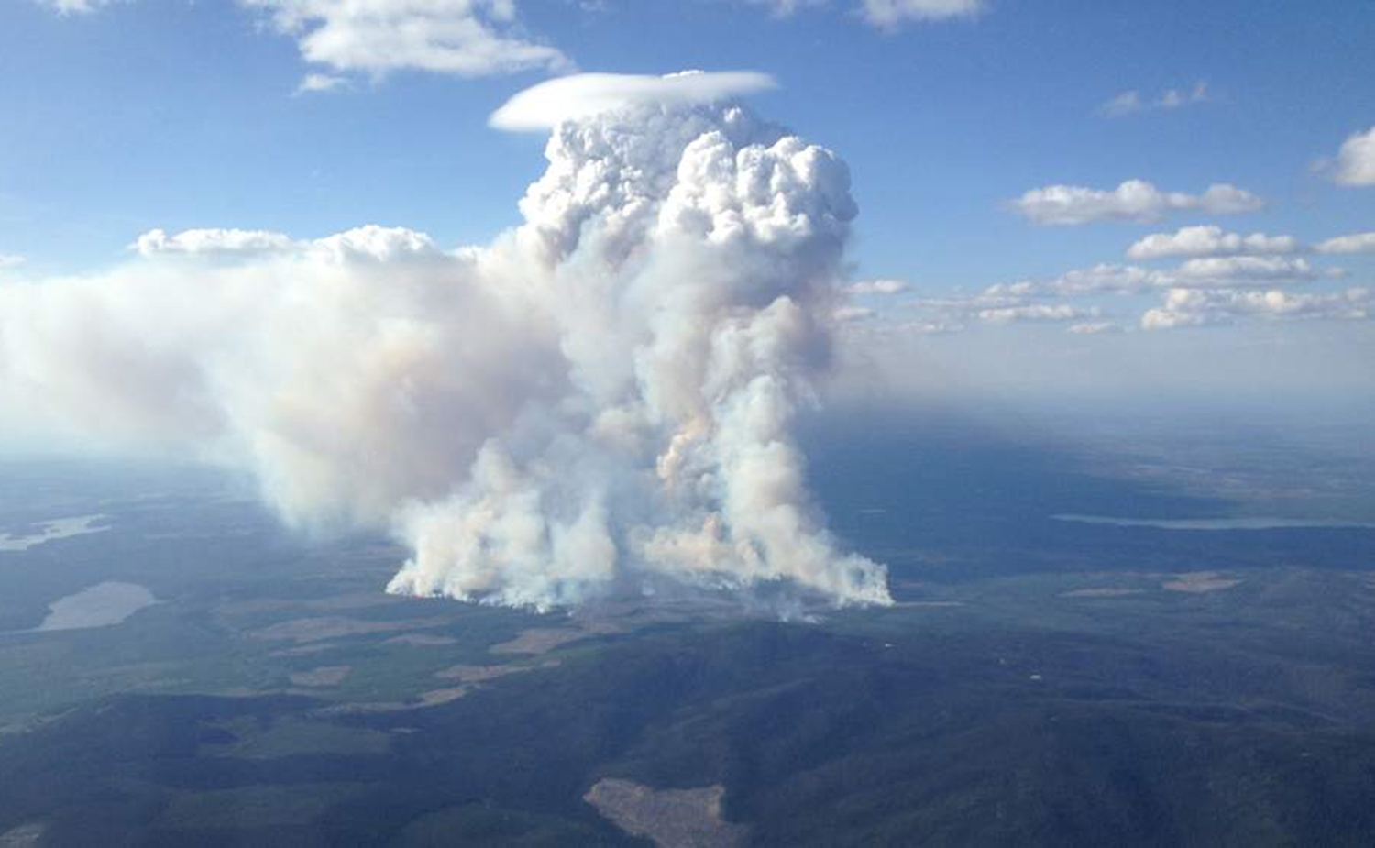
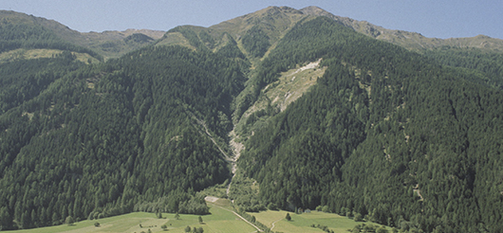
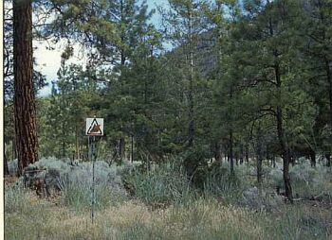
Third Dimension of the Fire Environment
Vertical (z-component)
Atmospheric phenomena
Fire and atmospheric interactions
Topography
https://www.fao.org/sustainable-forest-management/toolbox/modules/mountain-forests/in-more-depth/ar/
Accessed October 22, 2021.
Fuels
Notes:
Richard Carr, 2021.

Slide 4
Storm Safety and Considerations
Notes:
Richard Carr, January 2020: Added section title

Slide 5
Storm Hazards
Wind
Strong storm outflow gusts may exceed 150 km/h
Outflow may lead to new storm cells
Tornados
Precipitation
Large hail
Flooding: cuts off escape routes? Erosion? Slides?
Heat Bursts and Pyro-Cbs (both later)
Crew safety due to storms and fire spread
Notes:
Richard Carr, 2021.

Slide 6
Thunderstorm comparison
 | Single Cell | Multicell | Supercell | Squall Line
Environment | Weak/moderate instability | Strong instability | Strong instability, jet stream, vertical shear | Frontal passage, trough
Life cycle | < 60 min | Hours | Many hours | Hours to days
Movement | With upper winds | Erratic? | Right or left? | With airmass and into low
Precipitation | Rain, small hail | Heavy rain, hail | Heavy rain, large hail | Varied
Anvil | Single distinct | Multiple | Overshooting top | Multiple
Wind | Moderate and brief | Erratic, strong gusts | Strong gust fronts, tornado? | Frontal passage: strong winds may continue for hours
Extent | Small area | Moderate, large in MCC | Moderate | Long line affects large area
Notes:
Richard Carr, 2021.

Slide 7
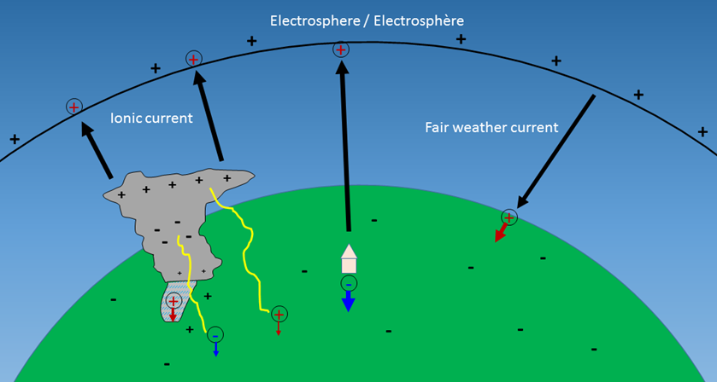
Lightning, not “lightening”!
ECCC: “When thunder roars go indoors”
Watch for cloud glaciation
Negative polarity strikes
Common in or around rain shaft
Lower current
Positive polarity strikes
Anvil to ground
More common in winter and high elevations
Long continuing current
Notes:
Richard Carr, 2021.

Slide 8
Radar Indications
Radar allows speed estimates of storm cells
Thunderstorms may play tricks on you though!
Splitting thunderstorm:
http://climate.weather.gc.ca/radar/index_e.html?site=CASFW&year=2019&month=7&day=13&hour=21&minute=00&duration=2&image_type=PRECIPET_RAIN_WEATHEROFFICE
Quick Development:
http://climate.weather.gc.ca/radar/index_e.html?site=CASCV&year=2019&month=7&day=18&hour=00&minute=30&duration=2&image_type=PRECIPET_RAIN_WEATHEROFFICE
Notes:
Richard Carr, 2021.

Slide 9
Visible distance?
2 m
6371 km = 6371000 m
89.9546 deg
86.0722 deg
3.9732 deg
443 km
Notes:
Richard Carr, 2021.
This calculations assumes a billiard ball flatness to Earth. It may be hard to discern a cloud top just poking over the horizon 400 km away.
A cloud top later to be found in the Calgary region was easily visible from Edmonton one summer day, a distance of about 300 km.

Slide 10

Weather Warning Services
Keep tabs on ECCC weather watches and warnings if possible
ECCC’s WeatherCAN app can provide alerts for customized regions to your mobile device
Maybe your fire weather office provides a service
https://www.canada.ca/en/shared-services/campaigns/stories/weathercan-app.html
Notes:
Richard Carr, October 19, 2021.

Slide 11
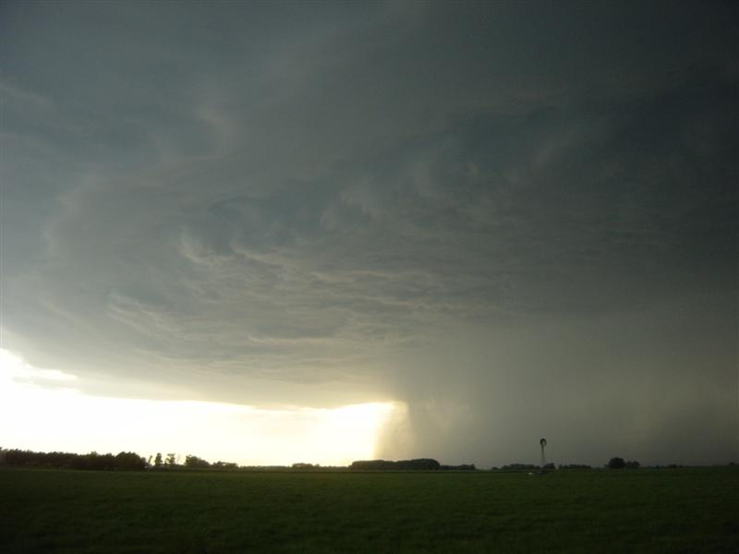
The Heat Burst
Develops during dissipating strong thunderstorms
Downdraft forms in dry upper levels and heats due to adiabatic compression
Downdraft reaches ground producing strong winds, a rapid temperature increase, and RH drop
Rare … atmospheric conditions must be ‘ideal’.
Notes:
Richard Carr, 2021. Condensed material from several slides in previous course editions and wordsmithed a bit.

Slide 12
Heat Burst Examples
Springbank Airport – Friday Aug 17, 2001
Time Temp. RH(%) Wind(km/h) Weather
2100 21 41 220/08 Smoke
2200 20 47 230/16 LTG SW
2300 25 23 200/48 CB South
2316 - - 210/60g100 RW
0000 26 20 200/14 -
0100 19 38 230/12 -
Glasgow Montana - Sept 9, 1994
Temp at 0502 : 19ºC
Temp at 0517 : 34ºC
What would RH do? Assume T-Td=10C (RH ~ 50%) to start
Notes:
Richard Carr, 2021. Condensed material from a couple slides from previous course editions.
Assume some dew point, such as 10C. With T=34C, T-Td=24C, which gives RH ~ 20%.
The result, of course, depends on the dew point chosen and the assumption it remains constant.

Slide 13
Heat burst vs collapsing plume
Heat burst / thunderstorm downdraft, and collapsing plume have similarities
Warming and drying due to adiabatic compression
Strong outflow winds
Change in fire behaviour?
More about collapsing plumes later …
Notes:
Richard Carr, 2021.

Slide 14
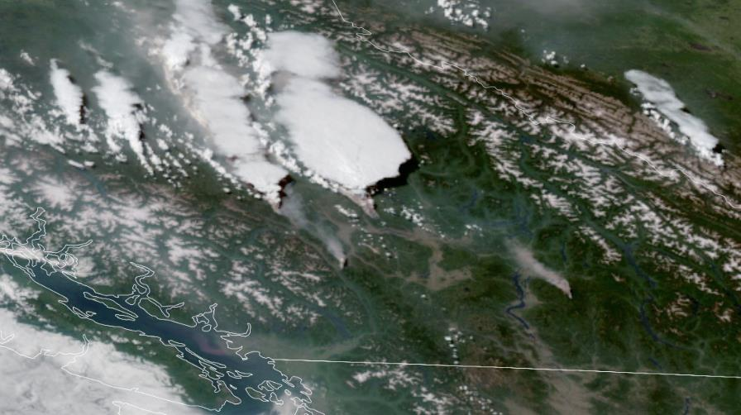
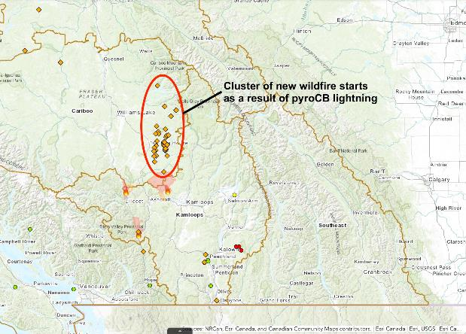
Pyro-CBs
Cumulonimbus flammagenitus
Additional lightning … may produce little rain
Notes:
Richard Carr, October 22, 2021. The lateral and satellite views of fires and pyro-cbs are not the same incident.
Note the pileus on top of the lateral view plume – updraft has reached a moist layer.

Slide 15
Atmospheric Stability Indexes
Notes:
Richard Carr, January 2020: Added section title

Slide 16
Stability Indexes
Most are for shower/thunderstorm potential
Upper air temperature, humidity, wind
K, Totals, SWEAT, Showalter, Lifted, CAPE, …
Interest: weak or strong storms?
Haines Indexes developed for blow-up fire potential
Stability and dryness (moisture) components
Notes:
Richard Carr, 2021.

Slide 17
Stability and fire blow-up: Haines Index
A numerical rating of stability in the lower levels of the atmosphere and the fire environment (Donald Haines, USFS, 1988).
Stability and moisture (dryness) factors
Required data: 850 hPa: Temperature and dew point
700 hPa: Temperature
In very low country: use 950 and 850 hPa
In high country: use 700 and 500 hPa
Notes:
Richard Carr, 2021. Reorganized material from previous course editions.
Donald A Haines. 1988. A Lower Atmospheric Stability Severity Haines Index for Wildlife (sic) Fires. USDA, Forest Service.
http://nwafiles.nwas.org/digest/papers/1988/Vol13-Issue2-May1988/Pg23-Haines.pdf

Slide 18
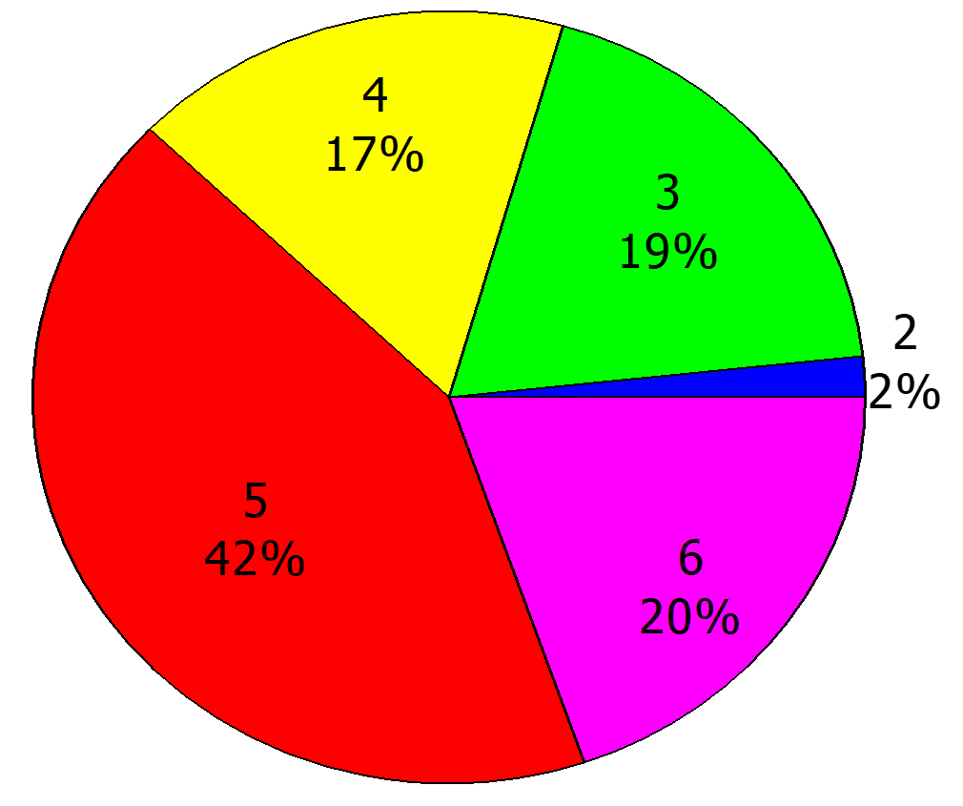
Haines Index Calculation
Stability factor
T(850 MB) - T(700 MB) Factor A
Less than 6 degrees 1
6 to 11 degrees 2
> 11 degrees 3
Dryness factor
T(850 MB) - Td(850 MB) Factor B
Less than 6 degrees 1
6 to 13 degrees 2
> 13 degrees 3
HI for Stony Plain, AB
May-Aug 1980-92
Sum the Factors
HI=A+B
<3 Very low
4 Low
5 Moderate
6 High
Notes:
Richard Carr, 2021: Revised Factor B 3rd class to follow original values and took out “Nick’s rule of thumb”.

Slide 19
Continuous Haines Index
Developed in Australia
Original formula gives too many 6s
Decimal value to maximum ~ 13; no lower bound
Pressure levels chosen as with original HI
Stability Factor
C_{A} = 0.5(T₁-T₂) - 2.0
Dryness Factor
C_{B} = 0.3333(T₁-Td₁) - 1.0
  if (T₁-Td₁) > 30.0 then C_{B}=9.0
  if (C_{B} > 5.0) then C_{B} = 5.0 + 0.5*(C_{B} - 5.0)
Summation (sorry, we don’t have danger classes)
HI_{C} = C_{A} + C_{B}
Notes:
New slide: Richard Carr, November 15, 2019.
The continuous Haines Index variation is described in:
Mills, Graham A. and McCaw, Lachlan. 2010. Atmospheric Stability Environments and Fire Weather in Australia -- extending the Haines Index. CSIRO, BoM. http://www.cawcr.gov.au/technical-reports/CTR_020.pdf.

Slide 20
Wind Profiles
Notes:
Richard Carr, January 2020: Added section title

Slide 21
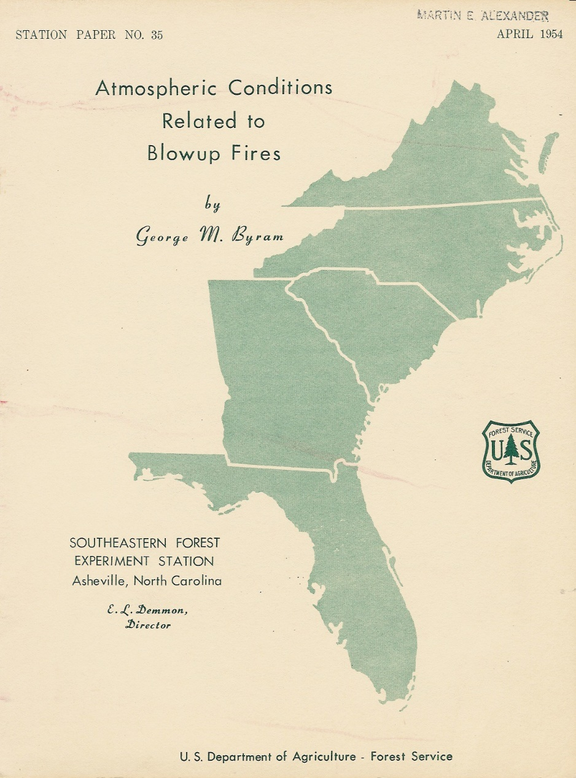
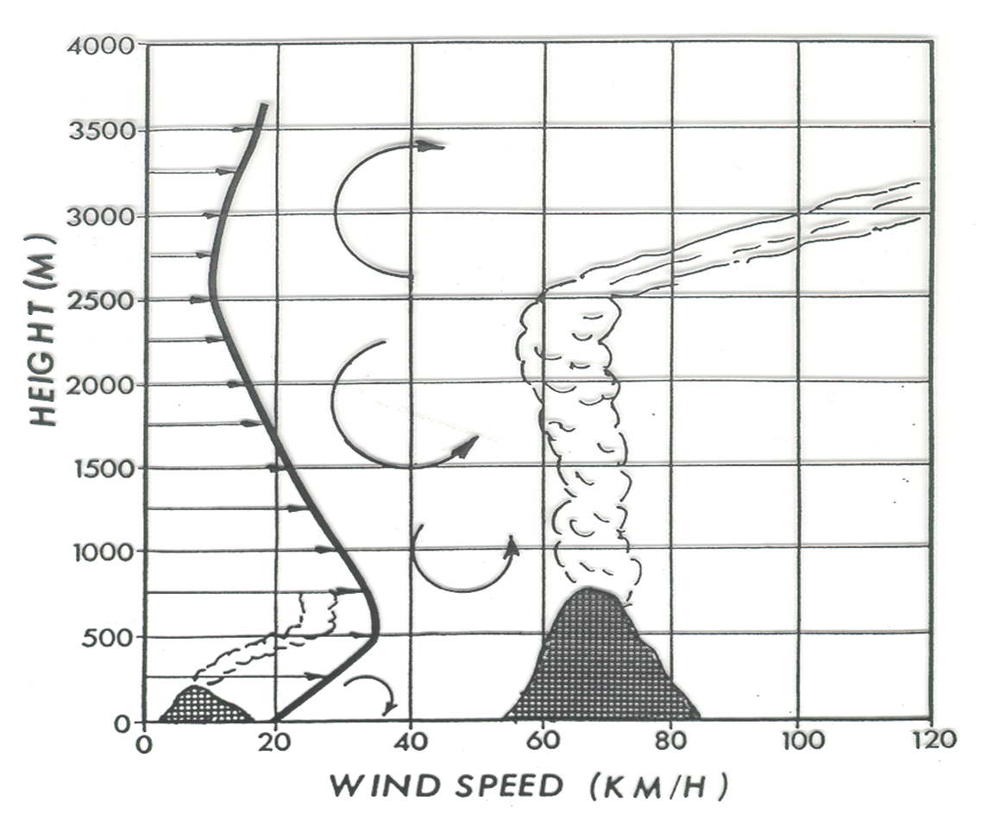
Byram’s conditions for blow-up
Low level
Jet profile
Notes:
Richard Carr, 2021. Combined material from previous course editions into single slide.
George Byram made the initial link between fire behavior and the upper atmosphere.
Vertical wind and temperature profiles correlated with extreme fire behavior.
The Byram conditions for blow-up were derived from this study –review the Byram conditions: fuels, surface wind of 30 km/h, unstable atmosphere and the low level jet profile.

Slide 22
Byram’s Wind Profiles
Byram’s classification of wind profiles considers:
Vertical wind speed profile
Surface wind speed at the base of the profile (substantial)
Lower number indicates highest risk...
Based on fires primarily in SE states
Notes:
Richard Carr, 2021.

Slide 23
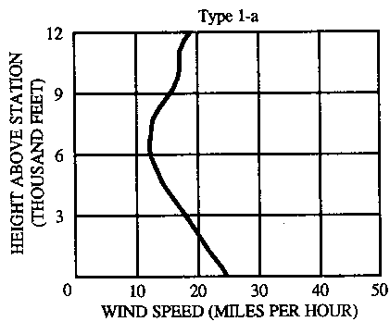
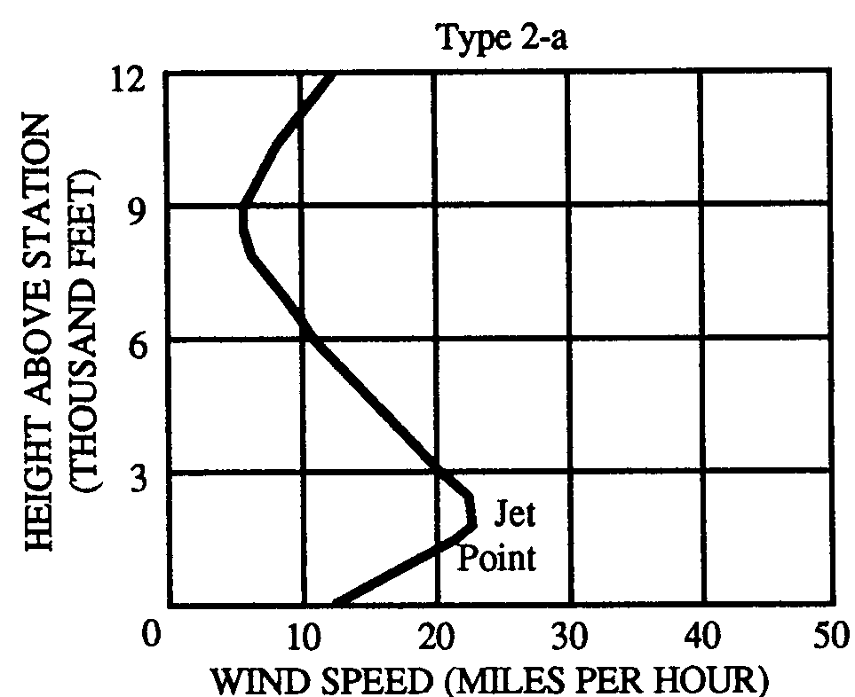
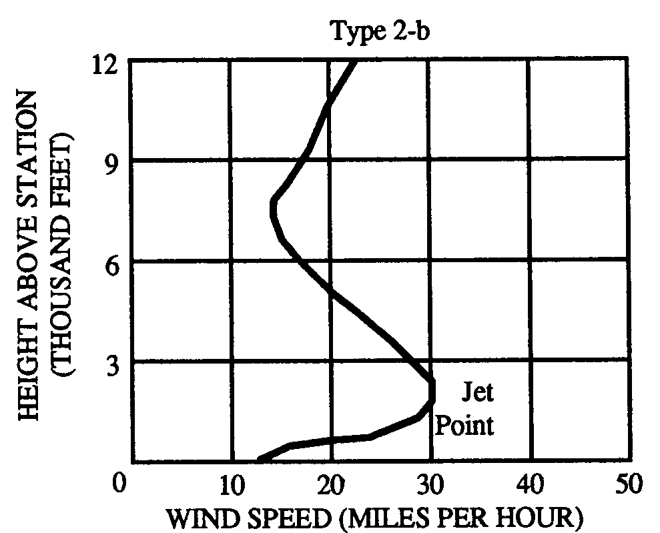
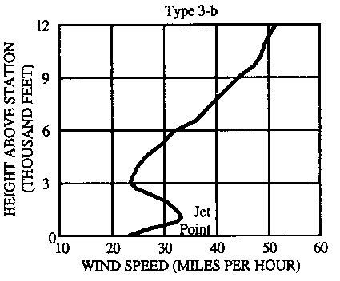
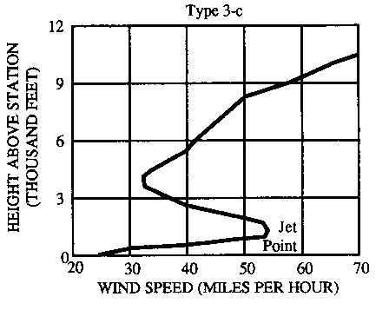
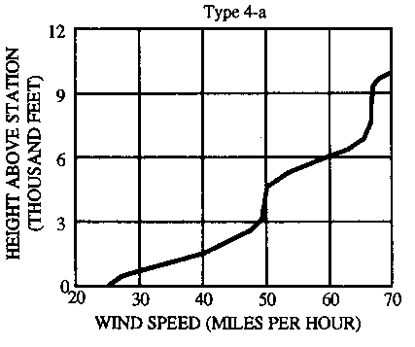
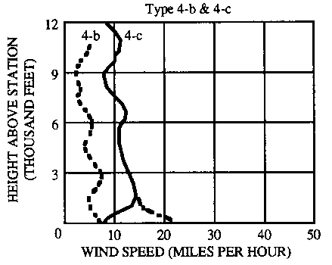
Byram’s Wind Profiles
Erhard Reinelt (1989)
10% fit Byram’s classifications
3% match Byram’s surface wind speed
<1% are Type 1a
Caveat: 20 years (which?) of sondes and pibals used
Caveat: Pibal wind data good?
Notes:
Richard Carr, 2021: Combined material from several slides from previous course edition into single slide.
1. Classification scheme has lower number classification as having a higher potential to contribute to blow-up fire behavior.

Slide 24
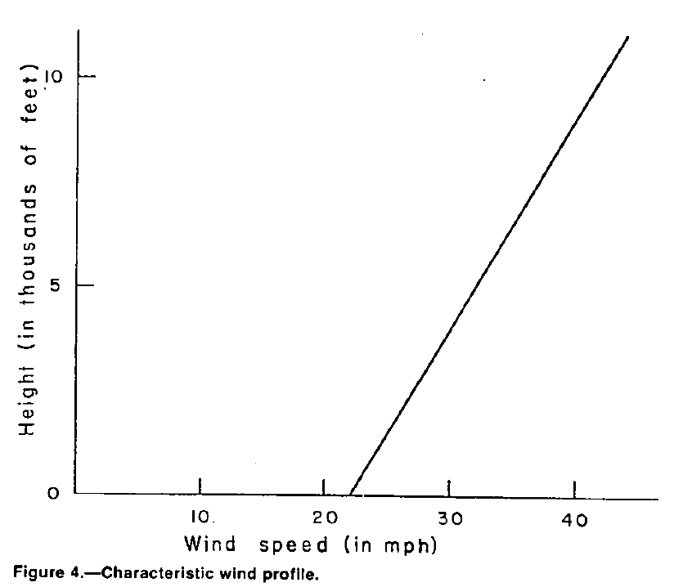
Brotak and Reifsnyder (1977)
Edward A. Brotak and William E. Reifsnyder:
https://www.fs.usda.gov/sites/default/files/legacy_files/fire-management-today/038_02_0.pdf
Study details:
52 east USA fires, 1963-73, 5000+ acres
33% had LLJ: |du/300m| >= 2.2 m/s
Prefrontal jets
Similar to Byram 4-a … contradictory result?
Notes:
Richard Carr, 2021.

Slide 25
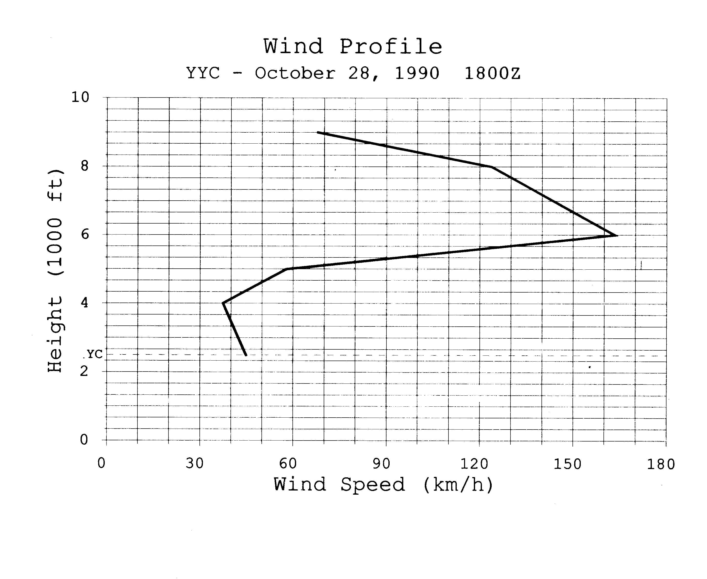
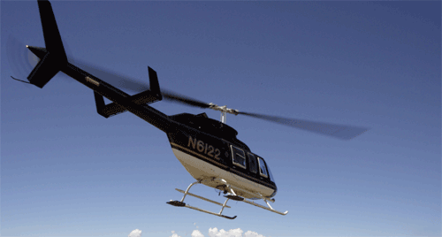
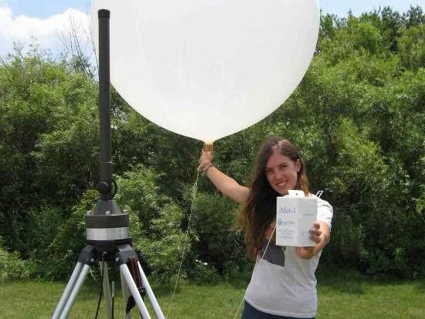
Low Level Jet Example
GPS
Pibal/portable sonde
Which Byram’s profiles may this fit?
3b, 3c
Notes:
Richard Carr, 2021. Combined material from several slides in previous course edition into a single slide.
I note the elevation of Calgary International Airport (YYC) is about 1100m (3300 ft) above sea level. I believe this diagram has an error, as
the lowest point is marked at about 2300 ft, which would occur a long distance east or north of Calgary.

Slide 26
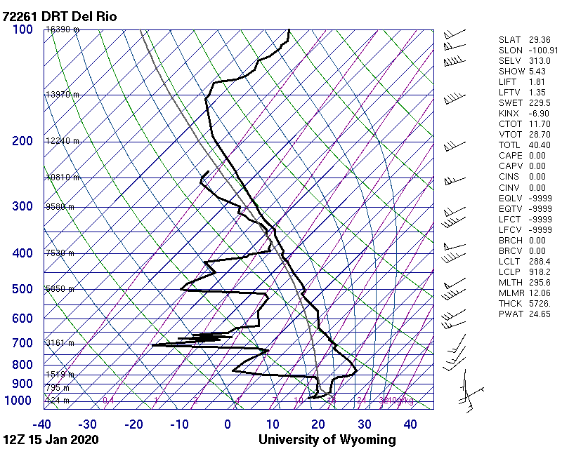
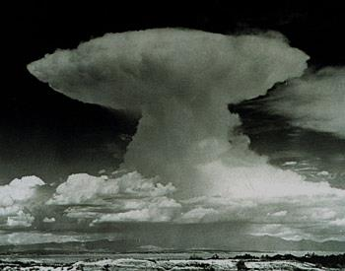
Value of vertical profiles
Temperature and humidity
Inversion detection: breakdown leads to increased fire intensity
Air mass stability assessment
Showers, fire behaviour
Wind
Detection of strong winds aloft, including low level jet
May reach surface as inversion breaks, air mass mixes
Gusts
Notes:
Richard Carr, 2021.

Slide 27
Plume vs Wind-dominated fires
Vertical profiles help determine if fire will be:
Convection/plume-dominated:
Frequently display much higher rates of spread than expected under ambient wind conditions
Wind driven:
Dominated by the energy of the wind field
Tend to form smoke plumes rather than ‘dynamic’ convection columns
Notes:
Richard Carr, 2021. Updated material from previous course edition.
It would be good to add some recent high definition photographs of plume- and wind-driven fires.

Slide 28
Plume-dominated fires
Free convection, high-intensity burning, and rapid spread rates result from:
Heavy, dry fuel loads
Unstable airmass
Surface winds of 30-35 km/h and light winds aloft
Convection column may collapse or develop strong downdrafts similar to thunderstorms
Difficult to predict fire behavior
Strong and erratic winds
Heat transfer to dry fuels
Notes:
New slide: Richard Carr, November 15, 2019.
The continuous Haines Index variation is described in:
Mills, Graham A. and McCaw, Lachlan. 2010. Atmospheric Stability Environments and Fire Weather in Australia -- extending the Haines Index. CSIRO, BoM. http://www.cawcr.gov.au/technical-reports/CTR_020.pdf.

Slide 29
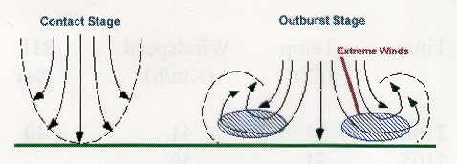
Plume-dominated fires
Appearance of showers or virga signals downdrafts have begun
Yellowstone: downdraft from column observed by Rothermel uprooted and broke trees over 5 km front.
Notes:
Richard Carr, 2021. Updated material from previous course edition.

Slide 30
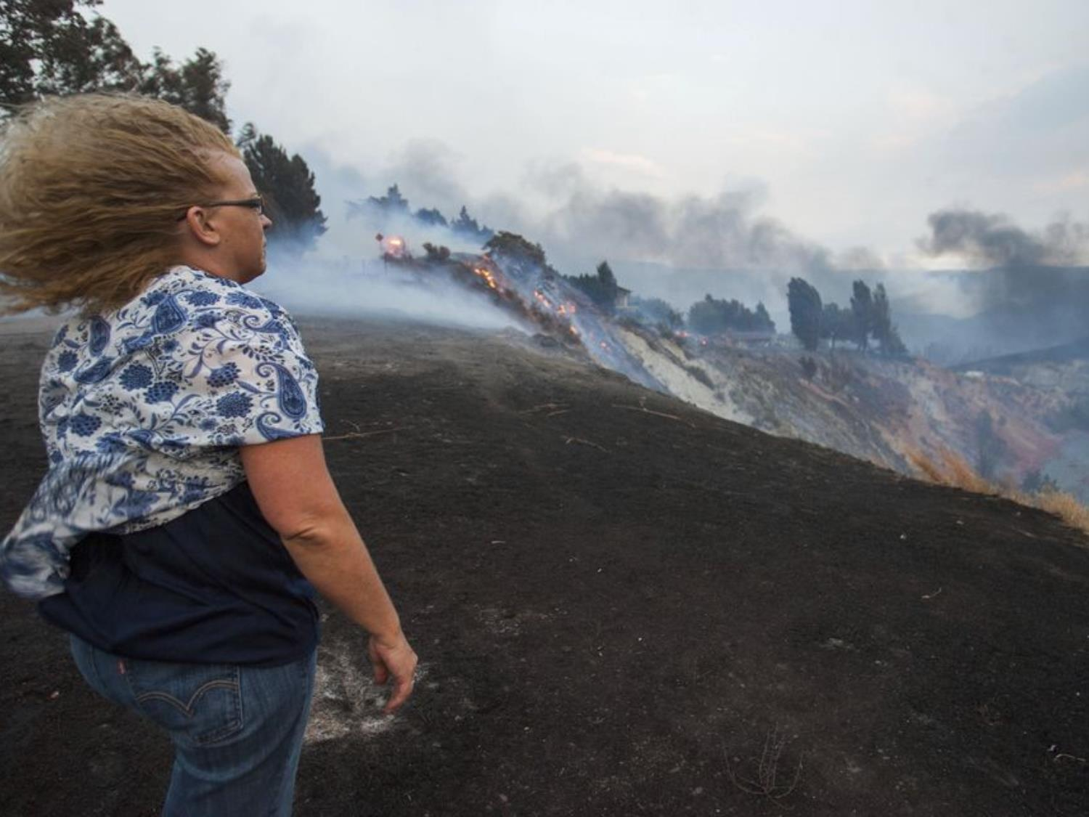
Byram’s Convection Number (1/3)
Power of the fire vs power of the wind
N_{c} = P_{fire} / P_{wind}
Notes:
Richard Carr, February 24, 2020. Combined two slides into one.

Slide 31
Byram’s Convection Number (2/3)
N_{c} = P_{f} / P_{w} = 2gI / ρC_{p}T(v-R)³
I Fire intensity (kW/m)
g Acceleration of gravity (~9.81 m/s²)
ρ Air density (kg/m³) at calculation level
P Atmospheric pressure (Pa)
R_{d} Gas constant for dry air (287.0 J/kgK)
C_{p} Heat capacity of dry air (~1003.5 J/kgK)
T Air temp (ºC) at the elevation of the fire
v Wind speed (m/s) at some height above the fire
R Rate of spread (m/s) = ROS(m/min)/60
N_{c} should be calculated at the surface and at several other levels.
Notes:
Richard Carr, September 21, 2021: Changed wind speed symbol W to v and is in m/s, not km/h. Changed gas constant R to R_{d} .
Richard Carr, February 24, 2020. Added full symbolic equation, full symbol definitions, and reworked the previously hard-coded constant in the denominator. Values of density and heat capacity differ from the values originally used by Byram (1.171 and 1010). Some ambiguity in choices of heat capacity exist; this will result in many slightly different answers that could still be considered correct.
Richard Carr, November 15, 2019. Replaced embedded document object with a text box

Slide 32
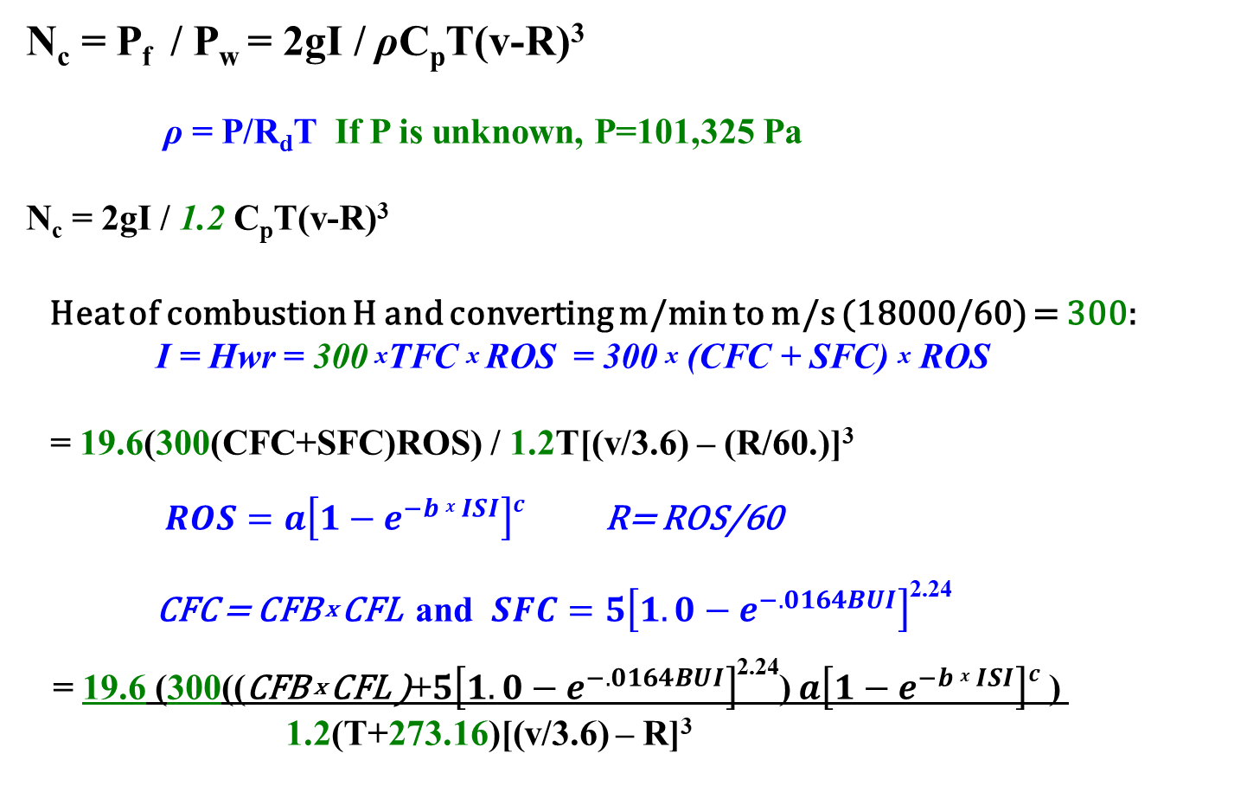
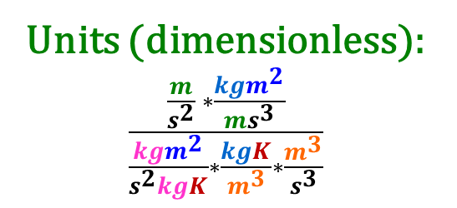
Byram’s Convection Number (3/3)
N_{c} = P_{f} / P_{w} = 2gI / ρC_{p}T(v-R)³
ρ = P/R_{d}T If P is unknown, P=101,325 Pa
N_{c} = 2gI / 1.2 C_{p}T(v-R)³
Heat of combustion H and converting m/min to m/s (18000/60) = 300:
I = Hwr = 300 ^{x}TFC ^{x} ROS = 300 ^{x} (CFC + SFC) ^{x} ROS
= 19.6(300(CFC+SFC)ROS) / 1.2T[(v/3.6) – (R/60.)]³
$ROS=a\left[1−e^{−b x ISI}\right]c$ R= ROS/60
CFC = CFB ^{x} CFL and $SFC=5\left[1.0−e^{−.0164BUI}\right]$^{2.24}
= 19.6 (300((CFB ^{x} CFL )+$5\left[1.0−e^{−.0164BUI}\right]$^{2.24}) $a\left[1−e^{−b x ISI}\right]c$ ) 1.2(T+273.16)[(v/3.6) – R]³
Units (dimensionless): $\frac{\frac{m}{s^{2}} ∗\frac{kgm^{2}}{ms^{3}}}{\frac{{kgm}^{2}}{s^{2}kgK}∗\frac{kgK}{m^{3}}∗\frac{m^{3}}{s^{3}}}$
Notes:
Richard Carr, September 21, 2021. Reworked equations. Changed wind speed symbol W to v. Revived this as a take-home exercise.
Constant 300 comes from H = 18000 kJ/kg and conversion of Rate of Spread R from m/min to m/s, so 18000/60=300.
Constant 19.6 is |2g|.
Richard Carr, February 24, 2020. Added full symbolic equation, full symbol definitions, and reworked the previously hard-coded constant in the denominator. Values of density and heat capacity differ from the values originally used by Byram (1.171 and 1010). Some ambiguity in choices of heat capacity exist; this will result in many slightly different answers that could still be considered correct.
Richard Carr, November 15, 2019. Replaced embedded document object with a text box

Slide 33
Some Reading
Ralph M. Nelson, Jr. 1993. Byram's Derivation of the Energy Criterion for Forest and Wildland Fires. Int. J. Wildland Fire 3(3): 131-138. https://www.publish.csiro.au/wf/pdf/WF9930131. Accessed February 24, 2020.
Read and answer the following questions (see Assignment in Canvas):
Why was Byram’s approach initially criticized?
How is the Froude Number related to Byram’s Nc?
What assumptions are made that may not have been discussed in Byram’s original studies?
Notes:
Richard Carr, October 19, 2021: New slide.

Slide 34
Convection Number Alternatives
Other papers to look at are:
D. Morvan and N. Frangeih. 2018. Wildland fire behaviour: Wind effect versus Byram’s convective number and consequences on the regime of propagation. International Journal of Wildland Fire 2018, 27, 636–641. https://doi.org/10.1071/WF18014. See also Corrigendum. Accessed February 24, 2020.
Notes:
Richard Carr, October 19, 2021. Changed content a bit with the Nelson paper now on the preceding slide.
Further research into use of he Froude Number or other alternatives is warranted.
Richard Carr, February 2020: New slide. May want to include Froude number variant equations.

Slide 35
Byram’s Convection Number
At-home Exercise
Exercise details are found in S589-III-A-2_Exercise2022.pptx
Fuel type: C3 FFMC: 93
ISI: 18 BUI: 55
CFB: 1.0 CFL: 1.15 kg/m²
Surface wind: 20 km/h
Surface temp: 18 ºC
Calculate the value of N_{c} for the above conditions.
A helicopter sounding determines that the wind at 300 m above the fire is 35 km/h. Calculate the convection number at this level.
Notes:
Richard Carr, September 21, 2021. Revived this as a take-home exercise.
Richard Carr, February 24, 2020. Changed “Exercise” to “Example” in the title. This will no longer be used as an exercise.
Richard Carr, November 15, 2019. Pulled the text out of the document object and used normal text boxes.
If this slide is to be used in different applications is may be easiest to export to a PNG or other image.

Slide 36
Summary
Atmospheric phenomena can influence fire; fire can influence atmosphere
Crew safety depends on weather and fire factors
Downdraft from thunderstorm or collapsing plume can cause:
Erratic fire behaviour
Heat burst?
Vertical atmospheric profiles help determine:
Blow-up potential
Likelihood of plume-driven fire

Slide 37
Contact Information
Contact:
Richard Carr
Wildland Fire Research Analyst
Richard.Carr@NRCan-RNCan.gc.ca
5320 122 Street NW
Edmonton, AB, Canada
T6H 3S5
825-510-1265 780-710-3147
?
?
?
?
?
Notes:
Richard Carr, January 2020: Added section title

