Slide 1
S589: Upper Air Influences
Take-home Exercise

Slide 2
Byram’s Convection Number
At-home Exercise (1/6)
Fuel type: C3 FFMC: 93
ISI: 18 BUI: 55
CFB: 1.0 CFL: 1.15 kg/m²
Surface wind: 20 km/h
Surface temp: 18 ºC
Calculate the value of N_{c} for the above conditions.
A helicopter sounding determines that the wind at 300 m above the fire is 35 km/h. Calculate the convection number at this level.
Notes:
Richard Carr, September 21, 2021. Revived this as a take-home exercise.
Richard Carr, February 24, 2020. Changed “Exercise” to “Example” in the title. This will no longer be used as an exercise.
Richard Carr, November 15, 2019. Pulled the text out of the document object and used normal text boxes.
If this slide is to be used in different applications is may be easiest to export to a PNG or other image.

Slide 3
Byram’s Convection Number
At-home Exercise (2/6)
N_{c} = P_{f} / P_{w} = 2gI / ρC_{p}T(v-R)³
I Fire intensity (kW/m)
g Acceleration of gravity (~9.81 m/s²)
ρ Air density (kg/m³) at calculation level
P Atmospheric pressure
R_{d} Gas constant for dry air (287.0 J/kgK)
C_{p} Heat capacity of dry air (~1003.5 J/kgK)
T Air temp (ºC) at the elevation of the fire
v Wind speed (m/s) at some height above the fire
R Rate of spread (m/s) = ROS(m/min)/60
N_{c} should be calculated at the surface and at several other levels.
Notes:
Richard Carr, September 21, 2021: Changed wind speed symbol W to v and is in m/s, not km/h. Changed gas constant R to R_{d} .
Richard Carr, February 24, 2020. Added full symbolic equation, full symbol definitions, and reworked the previously hard-coded constant in the denominator. Values of density and heat capacity differ from the values originally used by Byram (1.171 and 1010). Some ambiguity in choices of heat capacity exist; this will result in many slightly different answers that could still be considered correct.
Richard Carr, November 15, 2019. Replaced embedded document object with a text box

Slide 4
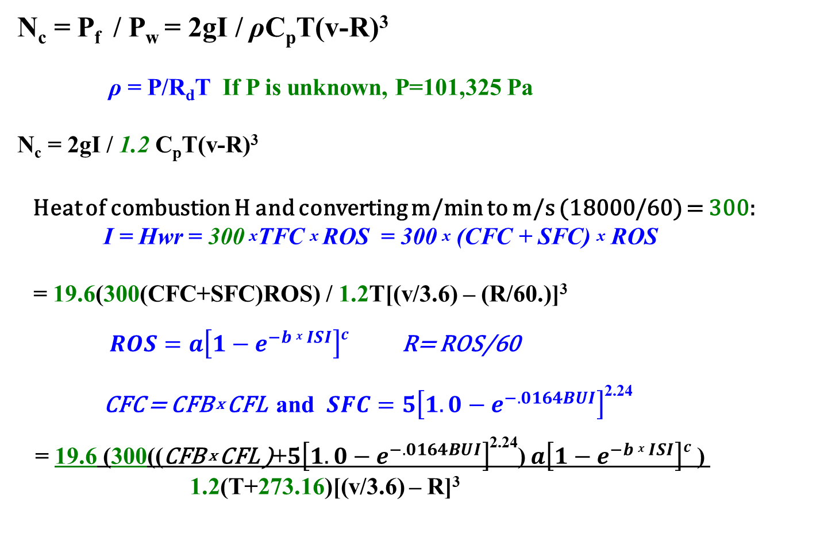
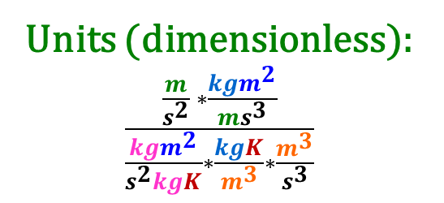
Byram’s Convection Number
At-home Exercise (3/6)
N_{c} = P_{f} / P_{w} = 2gI / ρC_{p}T(v-R)³
ρ = P/R_{d}T If P is unknown, P=101,325 Pa
N_{c} = 2gI / 1.2 C_{p}T(v-R)³
Heat of combustion H and converting m/min to m/s (18000/60) = 300:
I = Hwr = 300 ^{x}TFC ^{x} ROS = 300 ^{x} (CFC + SFC) ^{x} ROS
= 19.6(300(CFC+SFC)ROS) / 1.2T[(v/3.6) – (R/60.)]³
$ROS=a\left[1−e^{−b x ISI}\right]c$ R= ROS/60
CFC = CFB ^{x} CFL and $SFC=5\left[1.0−e^{−.0164BUI}\right]$^{2.24}
= 19.6 (300((CFB ^{x} CFL )+$5\left[1.0−e^{−.0164BUI}\right]$^{2.24}) $a\left[1−e^{−b x ISI}\right]c$ ) 1.2(T+273.16)[(v/3.6) – R]³
Units (dimensionless): $\frac{\frac{m}{s^{2}} ∗\frac{kgm^{2}}{ms^{3}}}{\frac{{kgm}^{2}}{s^{2}kgK}∗\frac{kgK}{m^{3}}∗\frac{m^{3}}{s^{3}}}$
Notes:
Richard Carr, September 21, 2021. Reworked equations. Changed wind speed symbol W to v. Revived this as a take-home exercise.
Constant 300 comes from H = 18000 kJ/kg and conversion of Rate of Spread R from m/min to m/s, so 18000/60=300.
Constant 19.6 is |2g|.
Richard Carr, February 24, 2020. Added full symbolic equation, full symbol definitions, and reworked the previously hard-coded constant in the denominator. Values of density and heat capacity differ from the values originally used by Byram (1.171 and 1010). Some ambiguity in choices of heat capacity exist; this will result in many slightly different answers that could still be considered correct.
Richard Carr, November 15, 2019. Replaced embedded document object with a text box

Slide 5
Byram’s Convection Number
At-home Exercise
Use the last equation on the previous slide and the given values on the previous 2 slides to complete the calculations for:
Ground level
300m above ground level

Slide 6
Contact information
Richard Carr
Natural Resources Canada / Canadian Forest Service
Richard.Carr@canada.ca
825-510-1265
780-710-3147 (cell, during Covid)

