Slide 1
S589: Factors in Fire Weather Climatology

Slide 2
Heading: Arial 32pt centred, vertical=0.5cm
Module Title Corbel 44pt
Section Title: Corbel 40pt
Text: Level 1 = Arial 28 pt
Text level 2 = Arial 24pt

Slide 3
Objectives
Identify some climatic patterns that may affect fire regimes
Look at some local factors
Examine weather factors
Construct a simple example climatology
Extreme fire behaviour is exciting but we are interested in all fires here

Slide 4
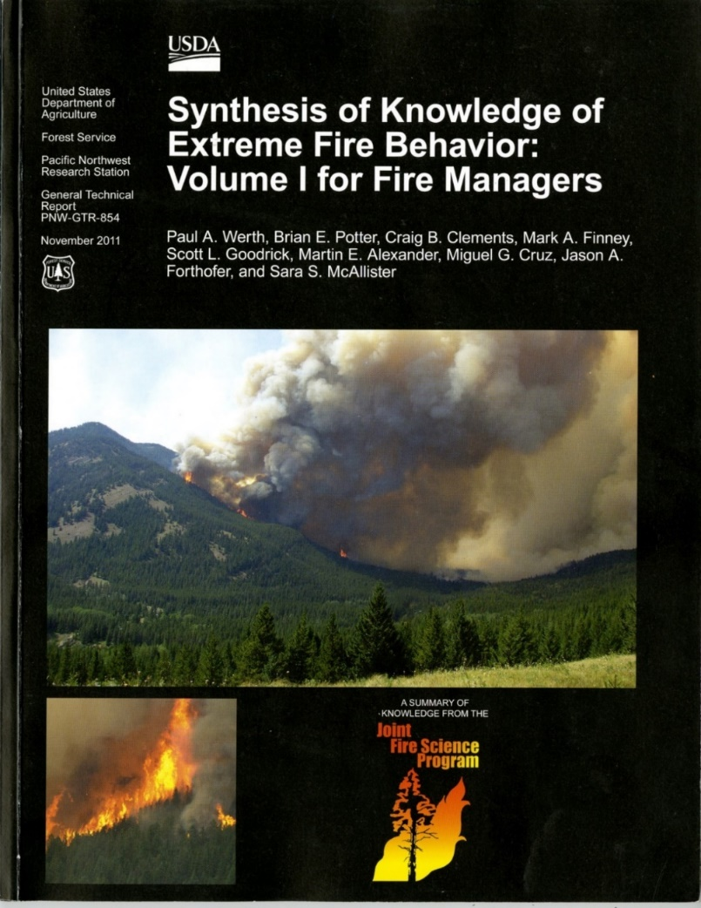
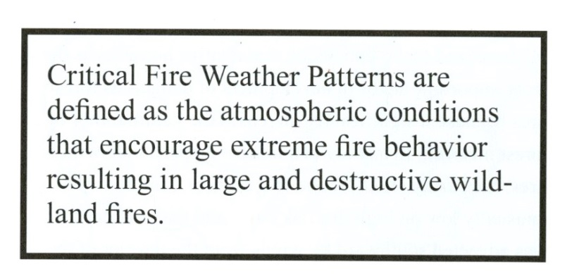
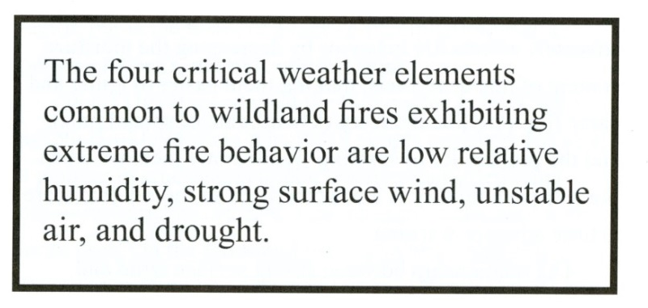
Fire Weather Patterns
The composite over time of the weather elements that affect fire business and behavior
PNW- GTR-854
Notes:
Richard Carr, September 2021: Combined the 3 lower items (January 2020) with
the top text box, which was on a separate slide.
Richard Carr, January 2020: Combined three slides into one.

Slide 5
Global Circulation Patterns

Slide 6
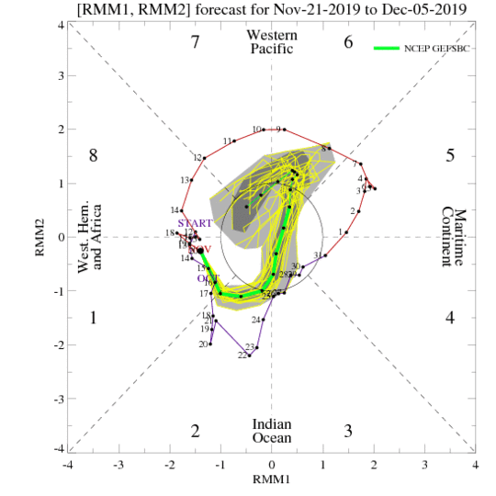
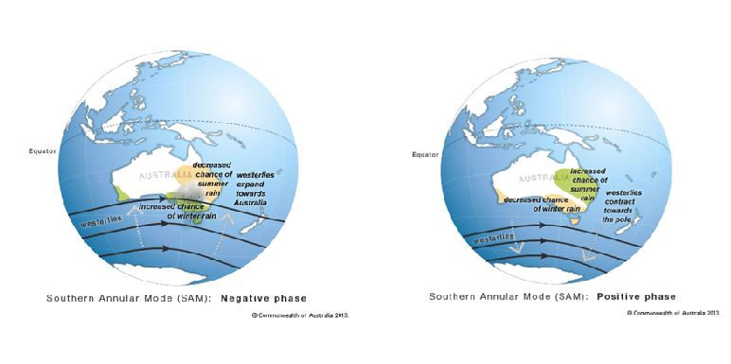
Some Ocean/atmosphere Oscillations
El Nino/Southern Oscillation (ENSO)
Pacific Decadal Oscillation (PDO)
Madden-Julian Oscillation (MJO)
Arctic Oscillation (AO)
North Atlantic Oscillation (NAO)
Quasi-biennial Oscillation (QBO)
Indian Ocean Dipole (IOD)
Southern Annular Mode (SAM)

Slide 7
Some Oscillations directly affecting Canada
El Nino/Southern Oscillation Tropical
Pacific Decadal Oscillation Mid latitude
Madden-Julian Oscillation Tropical
Arctic Oscillation Mid-high Latitude
North Atlantic Oscillation (NAO) Mid-high Latitude
Quasi-biennial Oscillation (QBO) All latitudes?

Slide 8
8
Fire in ENSO Springs
El Niño:
Warm, windy, dry in western Canada
La Niña:
Arctic surface highs bring dry air, strong wind around edges
Temperature may be cool
Summer fire problems may depend on other influences
Year | DJF | JFM | FMA | MAM | AMJ | MJJ | JJA | JAS | ASO | SON | OND | NDJ
1991 | 0.4 | 0.3 | 0.2 | 0.3 | 0.5 | 0.6 | 0.7 | 0.6 | 0.6 | 0.8 | 1.2 | 1.5
1992 | 1.7 | 1.6 | 1.5 | 1.3 | 1.1 | 0.7 | 0.4 | 0.1 | -0.1 | -0.2 | -0.3 | -0.1
1993 | 0.1 | 0.3 | 0.5 | 0.7 | 0.7 | 0.6 | 0.3 | 0.3 | 0.2 | 0.1 | 0.0 | 0.1
1994 | 0.1 | 0.1 | 0.2 | 0.3 | 0.4 | 0.4 | 0.4 | 0.4 | 0.6 | 0.7 | 1.0 | 1.1
1995 | 1.0 | 0.7 | 0.5 | 0.3 | 0.1 | 0.0 | -0.2 | -0.5 | -0.8 | -1.0 | -1.0 | -1.0
1996 | -0.9 | -0.8 | -0.6 | -0.4 | -0.3 | -0.3 | -0.3 | -0.3 | -0.4 | -0.4 | -0.4 | -0.5
1997 | -0.5 | -0.4 | -0.1 | 0.3 | 0.8 | 1.2 | 1.6 | 1.9 | 2.1 | 2.3 | 2.4 | 2.4
1998 | 2.2 | 1.9 | 1.4 | 1.0 | 0.5 | -0.1 | -0.8 | -1.1 | -1.3 | -1.4 | -1.5 | -1.6
1999 | -1.5 | -1.3 | -1.1 | -1.0 | -1.0 | -1.0 | -1.1 | -1.1 | -1.2 | -1.3 | -1.5 | -1.7
2000 | -1.7 | -1.4 | -1.1 | -0.8 | -0.7 | -0.6 | -0.6 | -0.5 | -0.5 | -0.6 | -0.7 | -0.7
2001 | -0.7 | -0.5 | -0.4 | -0.3 | -0.3 | -0.1 | -0.1 | -0.1 | -0.2 | -0.3 | -0.3 | -0.3
2002 | -0.1 | 0.0 | 0.1 | 0.2 | 0.4 | 0.7 | 0.8 | 0.9 | 1.0 | 1.2 | 1.3 | 1.1
2003 | 0.9 | 0.6 | 0.4 | 0.0 | -0.3 | -0.2 | 0.1 | 0.2 | 0.3 | 0.3 | 0.4 | 0.4
2004 | 0.4 | 0.3 | 0.2 | 0.2 | 0.2 | 0.3 | 0.5 | 0.6 | 0.7 | 0.7 | 0.7 | 0.7
2005 | 0.6 | 0.6 | 0.4 | 0.4 | 0.3 | 0.1 | -0.1 | -0.1 | -0.1 | -0.3 | -0.6 | -0.8
2006 | -0.8 | -0.7 | -0.5 | -0.3 | 0.0 | 0.0 | 0.1 | 0.3 | 0.5 | 0.7 | 0.9 | 0.9
2007 | 0.7 | 0.3 | 0.0 | -0.2 | -0.3 | -0.4 | -0.5 | -0.8 | -1.1 | -1.4 | -1.5 | -1.6
2008 | -1.6 | -1.4 | -1.2 | -0.9 | -0.8 | -0.5 | -0.4 | -0.3 | -0.3 | -0.4 | -0.6 | -0.7
2009 | -0.8 | -0.7 | -0.5 | -0.2 | 0.1 | 0.4 | 0.5 | 0.5 | 0.7 | 1.0 | 1.3 | 1.6
2010 | 1.5 | 1.3 | 0.9 | 0.4 | -0.1 | -0.6 | -1.0 | -1.4 | -1.6 | -1.7 | -1.7 | -1.6
2011 | -1.4 | -1.1 | -0.8 | -0.6 | -0.5 | -0.4 | -0.5 | -0.7 | -0.9 | -1.1 | -1.1 | -1.0
2012 | -0.8 | -0.6 | -0.5 | -0.4 | -0.2 | 0.1 | 0.3 | 0.3 | 0.3 | 0.2 | 0.0 | -0.2
2013 | -0.4 | -0.3 | -0.2 | -0.2 | -0.3 | -0.3 | -0.4 | -0.4 | -0.3 | -0.2 | -0.2 | -0.3
2014 | -0.4 | -0.4 | -0.2 | 0.1 | 0.3 | 0.2 | 0.1 | 0.0 | 0.2 | 0.4 | 0.6 | 0.7
2015 | 0.6 | 0.6 | 0.6 | 0.8 | 1.0 | 1.2 | 1.5 | 1.8 | 2.1 | 2.4 | 2.5 | 2.6
2016 | 2.5 | 2.2 | 1.7 | 1.0 | 0.5 | 0.0 | -0.3 | -0.6 | -0.7 | -0.7 | -0.7 | -0.6
2017 | -0.3 | -0.1 | 0.1 | 0.3 | 0.4 | 0.4 | 0.2 | -0.1 | -0.4 | -0.7 | -0.9 | -1.0
2018 | -0.9 | -0.8 | -0.6 | -0.4 | -0.1 | 0.1 | 0.1 | 0.2 | 0.4 | 0.7 | 0.9 | 0.8
2019 | 0.7 | 0.7 | 0.7 | 0.7 | 0.5 | 0.5 | 0.3 | 0.1 | 0.2 | 0.3 | 0.5 | 0.5
2020 | 0.5 | 0.5 | 0.4 | 0.2 | -0.1 | -0.3 | -0.4 | -0.6 | -0.9 | -1.2 | -1.3 | -1.2
2021 | -1.0 | -0.9 | -0.8 | -0.7 | -0.5 | -0.4 | -0.4 | -0.5
Large area burned
Virginia Hills, AB
Chisholm, AB
Kelowna, BC
Slave Lake, AB
Fort McMurray, AB
Big years in BC
Big years in BC

Slide 9
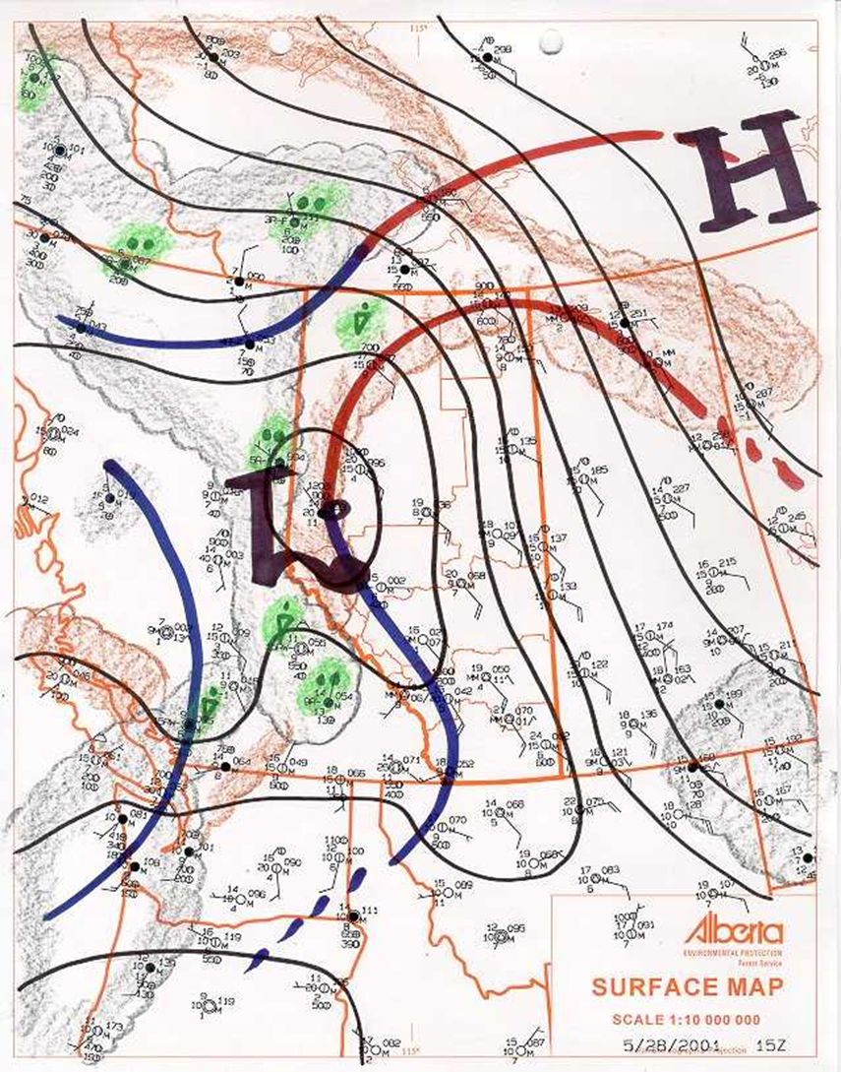
Alberta: Distinctive Patterns
H
La Nina spring?
H
El Nino spring?
May 28 2001 - 0900

Slide 10
Non-weather/climate parameters

Slide 11
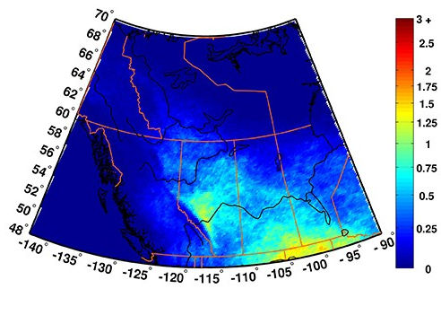
Local Influences
Mountains/hills
Lakes and oceans
Soils
Forest disturbance
Lightning and
human activity
https://www.canada.ca/en/environment-climate-change/services/lightning/statistics/maps-hotspots.html

Slide 12
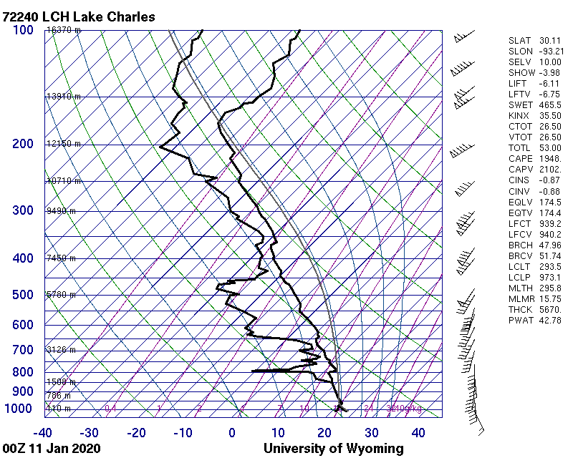
Instability
May drive extreme fire behavior
Synoptic pattern dependence
Topography: mountains/hills, lakes, oceans
More detail previously, and in Unit III-A
Notes:
New slide, Richard Carr, November 2019.

Slide 13
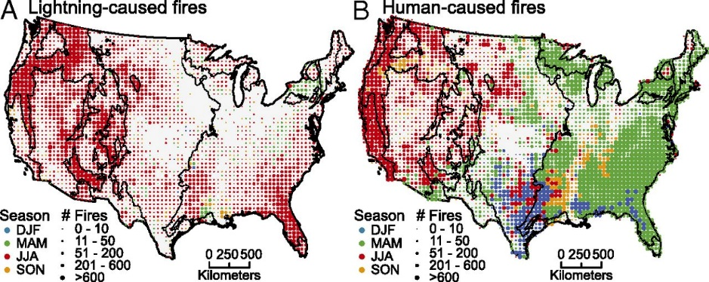
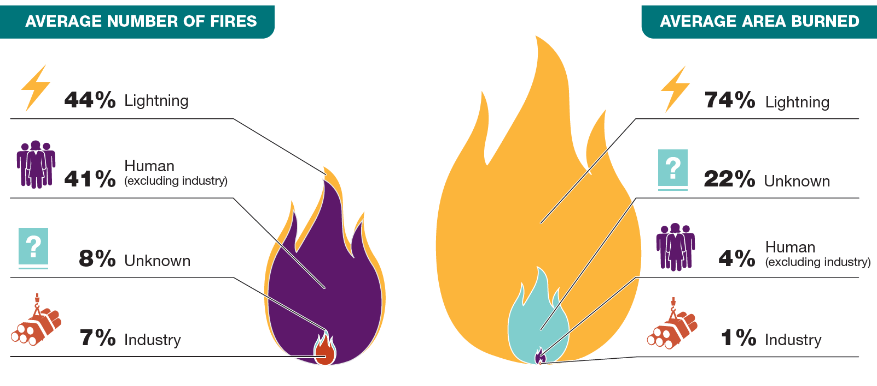
Lightning-caused vs Human-caused fires
Canada:
Lightning bigger starter in northwest
Time of year: spring fires are usually human-caused
Climatology may differ between regions with dominant human-caused vs lightning-caused fires
https://www.pnas.org/content/114/11/2946
NRCan, 2007-17 data. See speaker notes for source
Notes:
New slide, Richard Carr, January 2020
https://www.nrcan.gc.ca/our-natural-resources/forests-forestry/state-canadas-forests-report/disturbance-canadas-forests/16502

Slide 14
Regional Variation of Fire Seasons
N/Central Alberta: Mid-late spring peak
British Columbia: Mid-July to August/Sept
Southeastern USA: Winter
USA SW/S. Plains: Early spring
Mexico: February – May
Southeast Asia: El Nino, esp. outside NE
monsoon (Nov – Mar)

Slide 15
Weather Factors

Slide 16
General Weather Factors
Temperature
Humidity
Wind
Precipitation
Snow cover
Drought
Atmospheric pressure (optional)
Lightning: an ignition agent
Upper air height deviations (e.g., optional)
CFFWIS

Slide 17
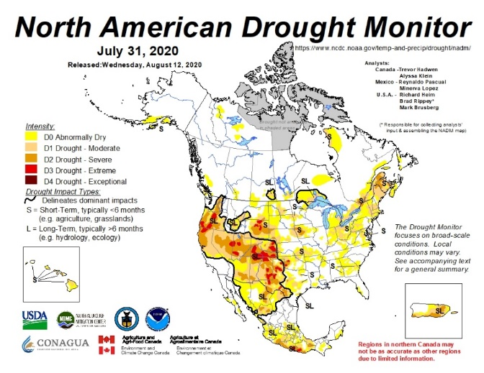
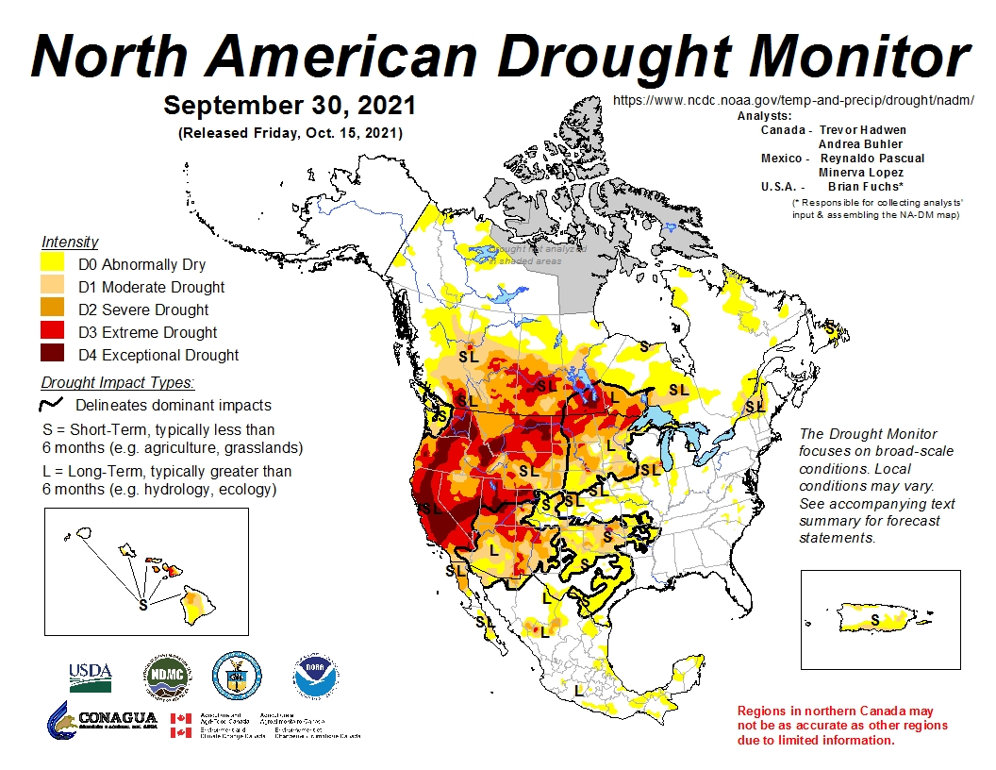
Drought
Long and short term
Long term example:
Southern Manitoba 2020-21
Notes:
Richard Carr, September 2021:

Slide 18
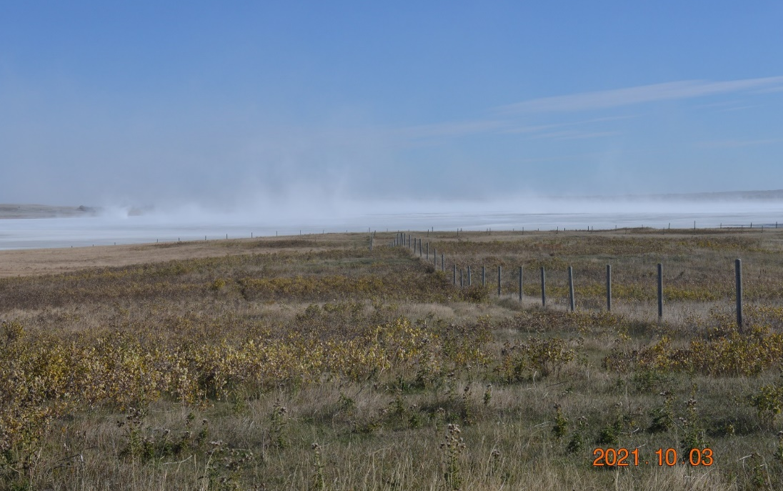
Flash Drought
Flash Drought
Event with rapid onset of one that intensifies rapidly
Recent examples BC 2017, 2018, 2021?
Agricultural or hydrological drought can affect fire behavior and suppression
Fuel drying
Stream and lake levels
Notes:
Richard Carr, September 2021:

Slide 19
Data Concerns
What accuracy is needed in your study results?
How much missing data can be tolerated?
Do you have a good weather station history?
Have standard siting, instrumentation, and maintenance practices been followed?
Enough years of data?
What changes have occurred during the period?
Notes:
Richard Carr, November 2019, updated September 2021:

Slide 20
More Data Criteria
Limit FWI records to stations with >= x% obs
We tried 95% available observations in CWFIS … too limiting for FWI at ECCC stations
Our Fort Smith example has better than 80% completeness
These are based on T, RH, wind, precip (obs/4*ndays)
Some study types are more sensitive
Climate change studies need rigorous controls
Notes:
Richard Carr: September 27, 2021.

Slide 21
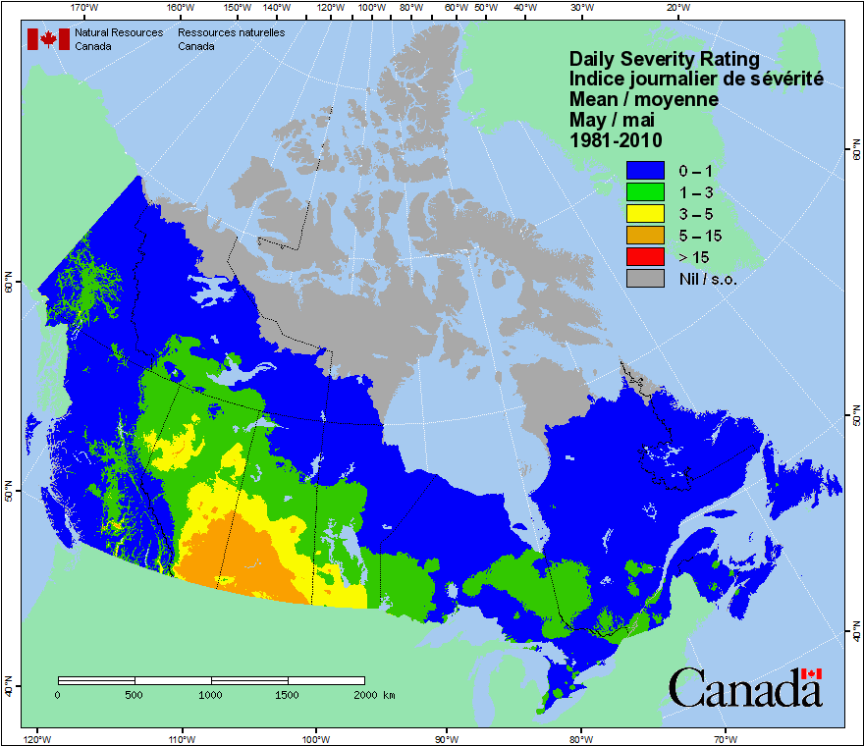
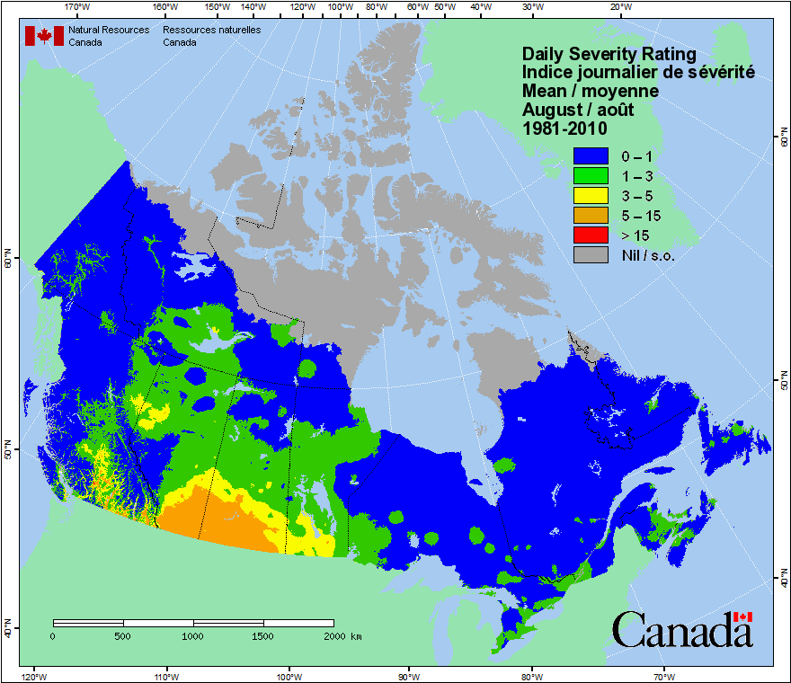
Uses of Averages (1/2)
Helps determine the most likely month or season for active fire and/or severe behavior
Extreme fire behaviour often results from deviations from average climatic conditions
Notes:
Richard Carr, September 28, 2021: Rearranged text and placed in new template.
Richard Carr November 20, 2019: Added mean May and August DSR maps from the CWFIS.

Slide 22
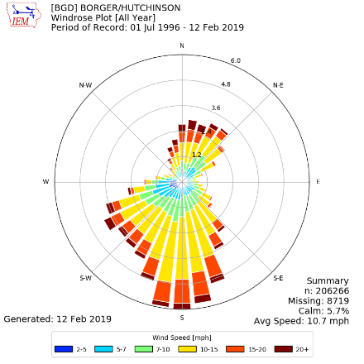
Uses of Averages (2/2)
Fire weather indicators considered with averages:
Time-wise/seasonal distribution of rainfall
Snow cover arrival and departure dates
Favored wind speed/direction/drying
(reflected in major runs?)
Careful not to average winds on either side of 360º
https://www.weather.gov/ama/borgerwindroseinformation
Notes:
Richard Carr, September 28, 2021: Rearranged text and placed in new template.
Removed “Consecutive days with low RH values” and combined wind comments into one. Added snow cover bullet.

Slide 23
Let us Build a Sample Climatology

Slide 24
Climatology Example
We will only use one station location for our climatology
Fort Smith, NT ECCC stations
Complex studies may use many stations from a larger area
Many ways to display information
We will show some simple examples (scatter plots, histograms, trend lines, …)
Notes:
Richard Carr: September 27, 2021.

Slide 25
Problem!
Oh-oh! CWFIS has a problem in its FWI calculations: Ft Smith Upper Air station, not the Primary Surface station, appears in 1971-89 station tables, except 1975
Similar problem for 3-4 upper air locations – will fix in our next historical FWI update
Let’s use 1991-2021 for the Fort Smith study
Is it long enough? Just

Slide 26
Fort Smith ECCC Station History
Any changes in location, instrumentation?
Notes:
Richard Carr, September 27, 2021: This list has been shortened to fit on the slide. Stations 2202196 and 2202198, and 2202200 before 1953 are not shown since we do not have hourly weather data and thus no FWI before 1953. Yellow rows indicate items to look for – change in elevation, station ID, etc.

Slide 27
Period of Study
Fort Smith, NT ECCC station assessment
2202200 – Good: ~98% observations complete
2202201 – No precipitation
2202202 – Climate station Nov 2003 --, ~84% complete
2202203 – No precipitation, visibility, weather type
When is the data missing? What parameters?
Assume ECCC runs new instruments at a site in parallel for 1-2 years before new site reports “official” observations
Notes:
Richard Carr: September 27, 2021.

Slide 28
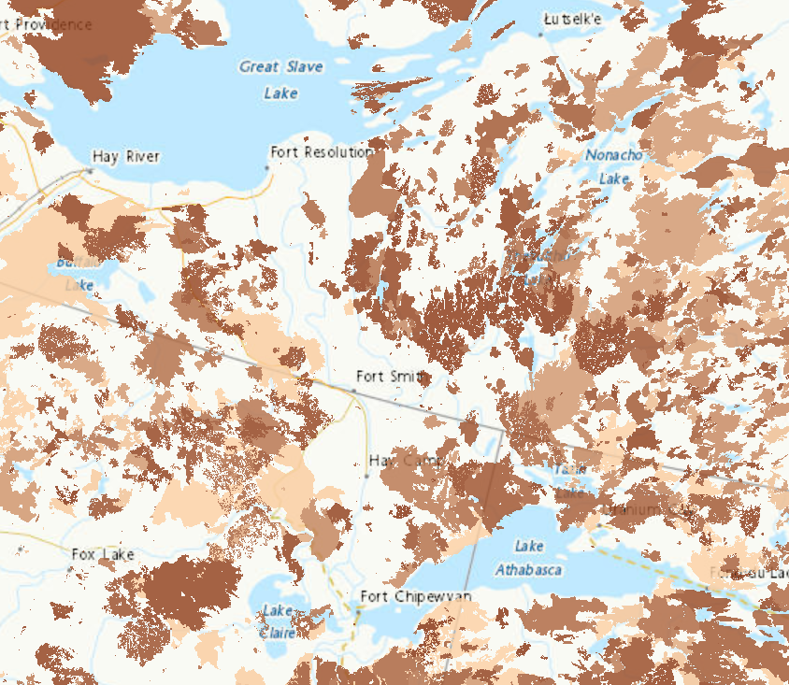
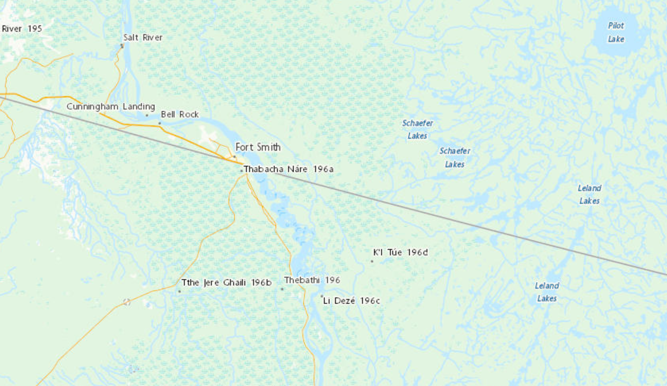
Fort Smith Area Fire History
Fire history
Why are no fires near the town? Suppression, fuel types?
Notes:
Richard Carr, August 27, 2021

Slide 29
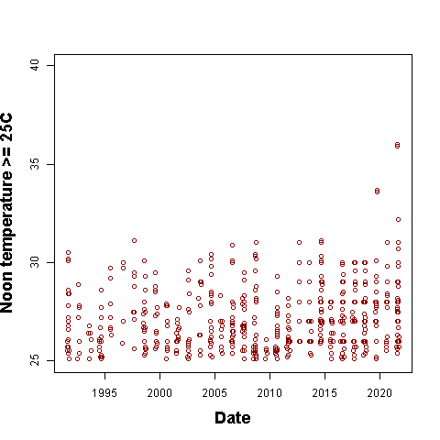
Noon Temperature >= 25C
Any apparent increasing or decreasing trends?
Are the clusters increasing or decreasing in density?
Big NT fire years in 2013-15, 2017
Two cool summers followed the Mt Pinatubo 1991 eruption
Notes:
Richard Carr, October 13, 2021.
Cluster densities may increase with time.
What will happen with temperature post-2021??
We may want to exclude period from 1991-93 due to Pinatubo eruption.

Slide 30
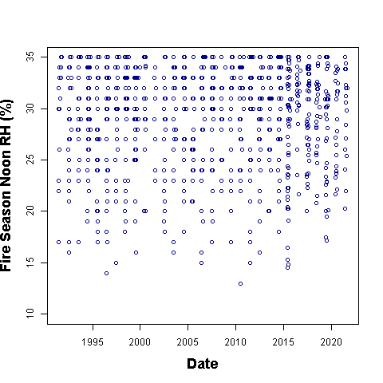
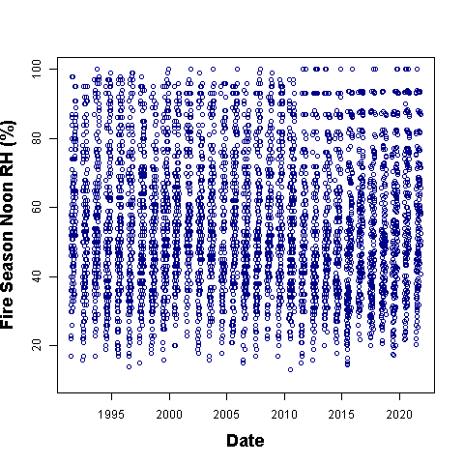
Noon Relative Humidity at 2202200
Trends?
Plot of all noon RH: Weird pattern in the 90-100% range post-2010
Notes:
Richard Carr, October 13, 2021.
Apparent visual trend to lower minimum RH with time.
Cluster density increases at least to 2015-20 period.

Slide 31
Wind
Sorry, I couldn’t create a true wind rose!!
Direction histograms are scaled to the North (most common)
N
962
NW
817
NE
423
E
413
W
811
SW
354
SE
745
0-10 10-20 20-30 30-40 40-50 >50
Wind Speed range (km/h)
S
778

Slide 32
Precipitation Game
Guess the approximate location of these annual precipitation profiles …
Shout out your answers!
I will advance the slide and the location will appear in blue under the graph title
Notes:
Richard Carr, September 27, 2021: Replace title-like slide used in 2020.

Slide 33
Port Alberni, BC
400
Normal Annual Precipitation – 2198 mm

Slide 34
Lillooet, BC
45
Normal Annual Precipitation – 349 mm

Slide 35
Dryden, ON
120
Normal Annual Precipitation = 688 mm

Slide 36
Gander, NF
120
Normal Annual Precipitation – 1186 mm

Slide 37
Fort Smith, NT
60
Normal Annual Precipitation – 354 mm

Slide 38
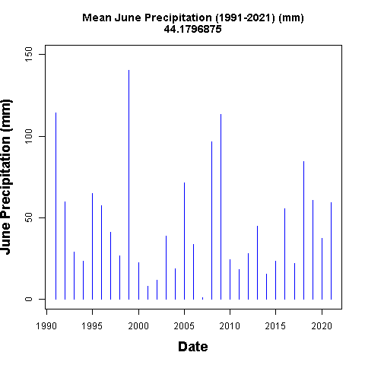
Precipitation Histogram - June
Compare variation between June and July/August (next slide)
Monthly means (previous slide) tell part of the story
Notes:
Richard Carr, October 13, 2021.

Slide 39
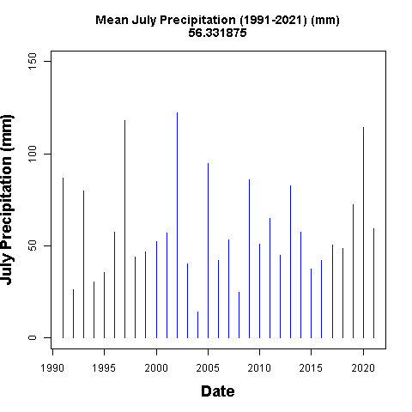
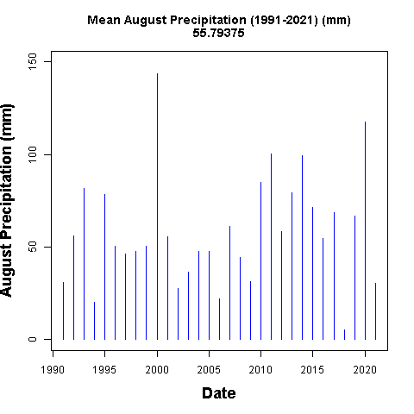
Precipitation Histograms – July, August
Remember July’s pattern for the BUI plot (next)
Notes:
Richard Carr, October 13, 2021.

Slide 40
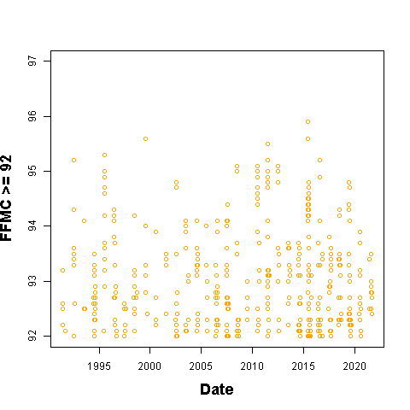
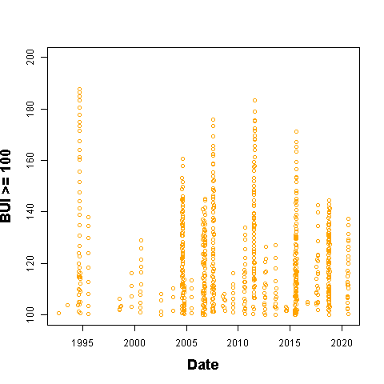
CFFWIS
FFMC: A bit noisy?
BUI: Somewhat regular cycles (the curves are my scribbles)
Notes:
Richard Carr, October 13, 2021:

Slide 41
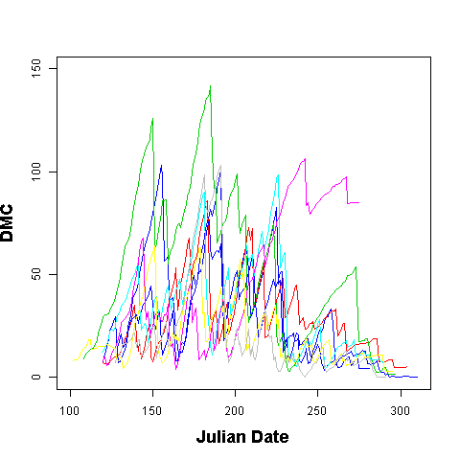
Duff Moisture Code
Annual comparison (2013-2021 for “simplicity”)
Notes:
Richard Carr, October 14, 2021:

Slide 42
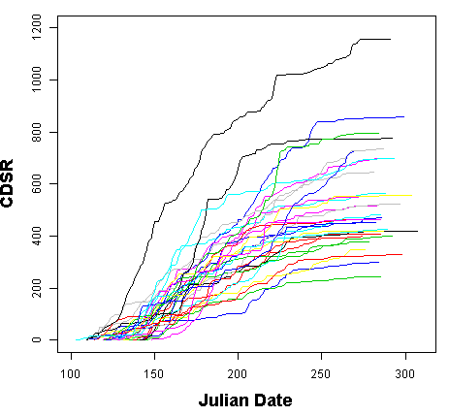
Cumulative DSR
Calculations usually start April-May
Fast early summer climb
Curves usually flatten by August
2017
Notes:
Richard Carr, October 21, 2021:

Slide 43
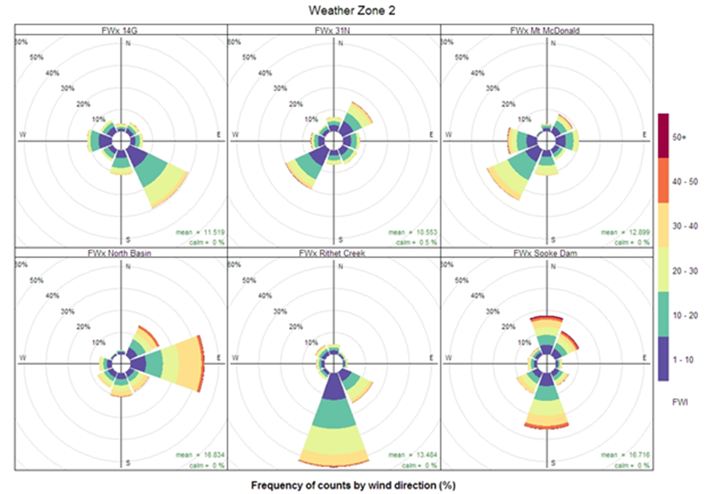
CFFWIS Roses – Vancouver Island
Similar concept to wind roses can be used with FWI outputs
Fire Weather Index (FWI) Roses by station, showing frequencies of wind direction by FWI value class, grouped between Weather Zones 1 and 2. ‘Calm’ refers to instances of FWI<1.
Notes:
Richard Carr and Dan Perrakis, October 26, 2021. Graphic supplied by Dan.

Slide 44
Outcomes
Recognizable in fire regimes
Historical fire incidence
Time of year of significant fire problems
Direction of major fire runs
FFMC / BUI / DC ranges
Notes:
Richard Carr, November 2019:
Divided original content on this slide into 3 slides: title, weather factors, outcomes. Added the CWFIS large fire map to this, the Outcomes slide.

Slide 45
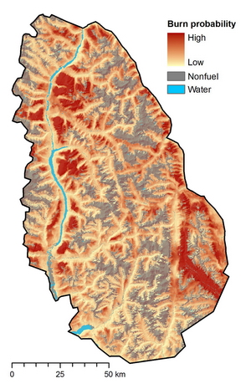
Burn P3
Limited area simulation
Many thousands of fires simulated to determine areas most likely to burn
Data pool includes fire weather history of the region, fuels, topography, …
http://firegrowthmodel.ca/burnp3/overview_e.php
Accessed October 22, 2021
Notes:
Richard Carr, October 22, 2021.

Slide 46
Summary
Fire climate is defined by influences driving repetitive or severe fire behavior
Contributions from large-scale circulations, local weather patterns, and geographic situation
Discernable patterns in the fire landscape
Peak fire seasons in different regions may be at different times of the year
Varied analysis techniques may be used to analyze required parameters
Notes:
New slide: Richard Carr, January 2020.

Slide 47
Exercise
Time allotment: x days
Answer a few questions about the lightning data
Construct a histogram plot of weekly lightning or some other factor (data supplied in a spreadsheet) … this covers small geographic areas so we don’t need huge data sets
Notes:
Richard Carr, September 2021.

Slide 48
Contact Information
Contact:
Richard Carr
Wildland Fire Research Analyst
Richard.Carr@NRCan-RNCan.gc.ca
5320 122 Street NW
Edmonton, AB, Canada
T6H 3S5
825-510-1265 780-710-3147
?
?
?
?
?

