Slide 1
S589: Venting
Original material developed by Mike Pistilli
Planning and Information Coordinator, Northwest Region
Aviation, Forest Fire, and Emergency Service, Ontario
Adapted for the 2022 WFBS Course, S589 Module
Richard Carr, Natural Resources Canada – Canadian Forest Service

Slide 2
Heading: Arial 32pt centred, vertical=0.5cm
Section Title: Corbel 40pt centred hor.
Text: Level 1 = Calibri 28 pt
Text level 2 = Calibri 24pt

Slide 3
Objectives
Describe venting and its effects on fire behaviour
Calculate the venting index by calculating the atmosphere’s mixing height and winds
Notes:
Richard Carr, October 8, 2021. Adapted for S589-2022 meteorology slide master. Added apostrophe to “atmosphere’s”.

Slide 4
Venting
The ability of the lower atmosphere to mix and transport smoke through the boundary layer (normally considered to extend up to 3000’, or 1000m AGL)
Can be higher, especially in unstable air masses
During a surface inversion the ability of the atmosphere to disperse smoke is virtually zero
Notes:
Richard Carr, October 8, 2021. Adapted for S589-2022 meteorology slide master. Added point indicating boundary layer can be higher in unstable air masses.

Slide 5
Ventilation Index
What is it?
It is a crude estimate of how well smoke released into the atmosphere will be carried away from the surface during the afternoon –i.e. will the valley be cleaned up quickly?
How is it calculated?
Using the mixed layer depth (m) multiplied by the wind speed (m/s).
Notes:
Richard Carr, October 8, 2021. Adapted for S589-2022 meteorology slide master.
The Ventilation Index is a term used in air pollution meteorology.
The index is a numerical value related to the potential of the atmosphere to disperse airborne pollutants, such as smoke from a prescribed fire.
It is based on both the current wind speed in the mixed layer and the mixing height. The mixed layer is the surface layer of air that is turbulent and well mixed. The mixing height is the thickness (sometimes zero) of this mixed layer.
The units of the equation are calculated in meters for the depth and meters per second for wind speed. For a final value in m²/s
The index has been converted to a scale

Slide 6
Ventilation Index
CAUTION!
It is not related to calculation of the Air Quality Index
It was not designed for small fires in cold valleys, it was designed for large fires on level ground.
Clear and cold winter days are usually poor venting days.
It has little to do with the way a plume behaves near the ground.
Notes:
Richard Carr, October 8, 2021. Adapted for S589-2022 meteorology slide master. Added “calculation of” in the first bullet. Took out the sentence “It has nothing to do with good weather.” in the third bullet. A summer pattern with moderate winds and cumulus cloud development may signify good venting, for example.
The ventilation index is used in B.C. to allow or deny open air burning. There are 26 stations around the province that calculate the daily index.
To allow open air burning, the following criteria must be met: venting index of good today, and at least fair for tomorrow.
The important points are that venting doesn’t affect plume behaviour, clear days are generally the poorest venting days.

Slide 7
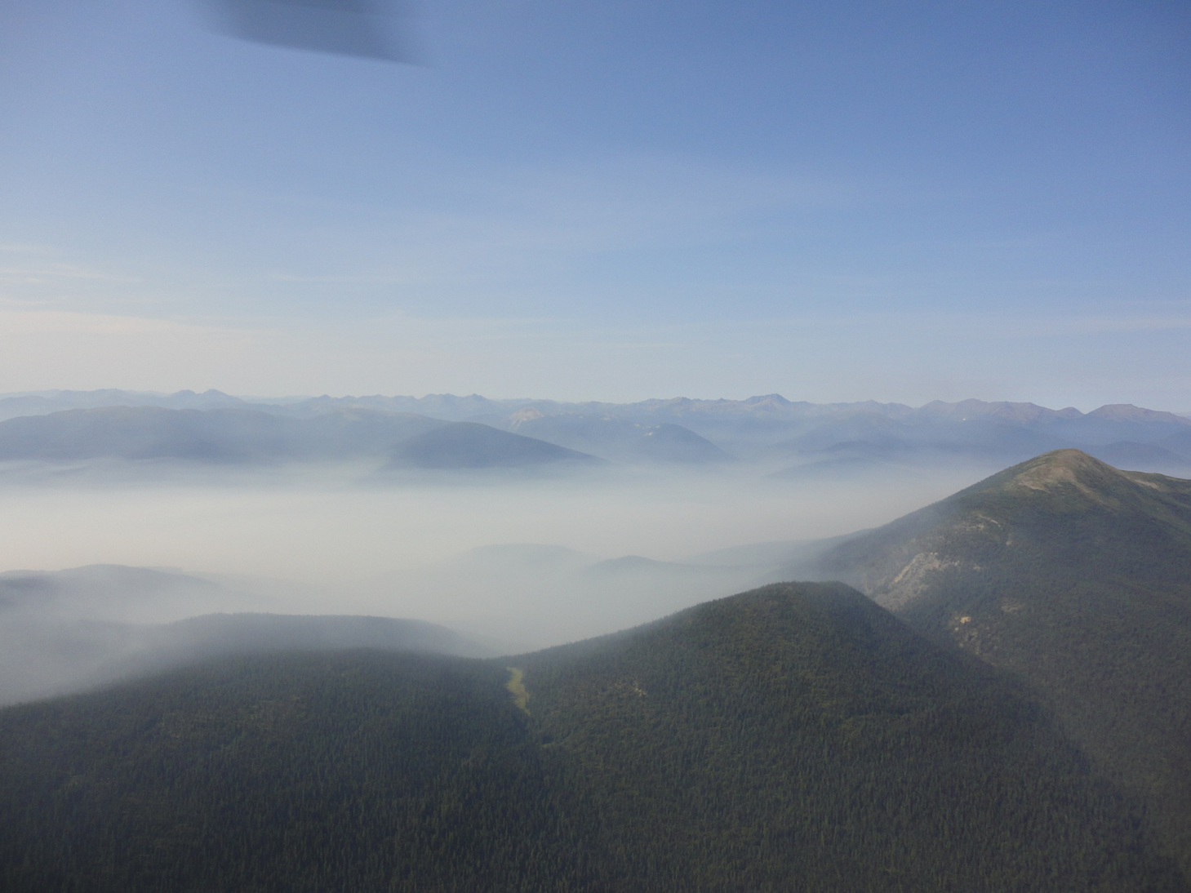
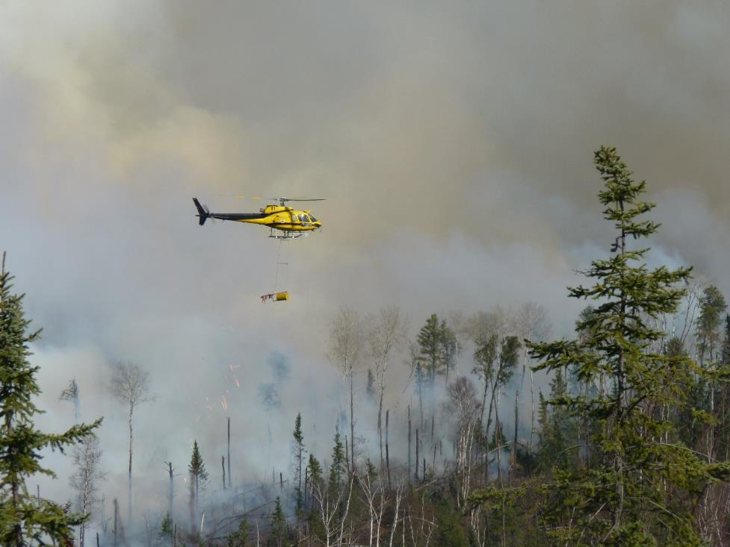
Ventilation
Low mixing heights cause smoke to get trapped at the surface:
  Poor air quality
  Poor visibility
  Firing operations
Notes:
Richard Carr, October 8, 2021. Adapted for S589-2022 meteorology slide master.
strong winds at the surface would not allow good vertical development and may lead to smoke adhering close to the surface and allow smoke to have a greater impact

Slide 8
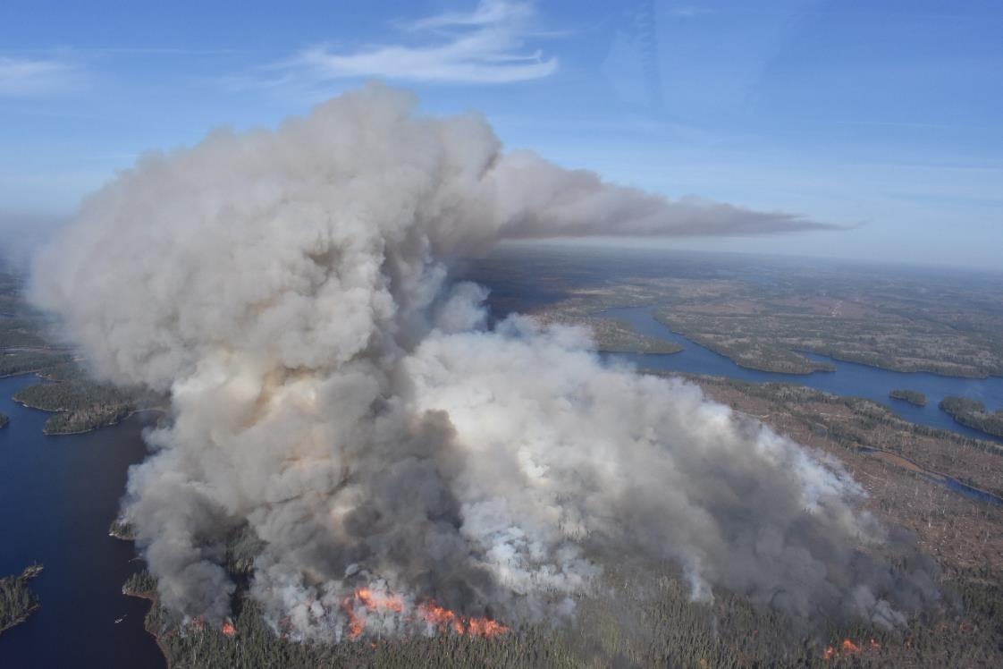
Ventilation Index
High mixing heights usually allow for the dispersion of smoke through a deeper part of the atmosphere
Burn operations are more successful when dispersion is good
Categorized as Poor, Fair, or Good
Notes:
Richard Carr, October 8, 2021. Adapted for S589-2022 meteorology slide master.
Unstable conditions with light winds at the surface are best for column development and vertical transport.
Stronger winds aloft coupled with an inversion and light winds at the surface (which may happen quite a lot in winter) might be better for venting as the smoke would reach a higher height above the surface and be carried/dispersed aloft not affecting people on the surface in closer proximity

Slide 9
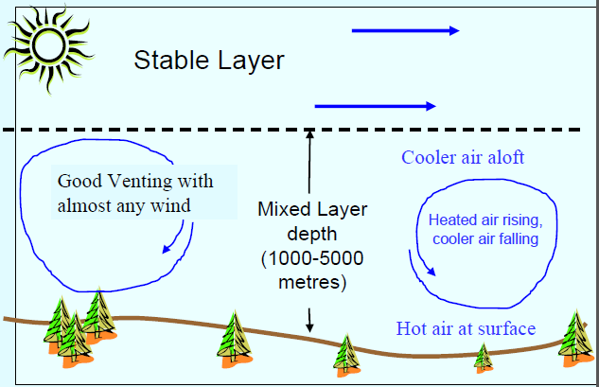
Mixing Height
The top of the surface layer where a parcel of air (smoke) stops rising
This layer is turbulent and well mixed together
Notes:
Richard Carr, October 8, 2021. Adapted for S589-2022 meteorology slide master.
Explanation of the concept. This is a summer example, the mixed layer heights may be a little lower than indicated in the graph.
Use the example of a basement. If basement height is 8’ and a small fire is started, the smoke will disperse through the basement. If the basement is a crawlspace, the same small fire will fill the volume of space more and the smoke will be thicker in the crawlspace.
Point out the rising and cooling air is what creates trubulance and mixing of all aspects of the mixed layer. Winds may be different speeds at different altitudes

Slide 10
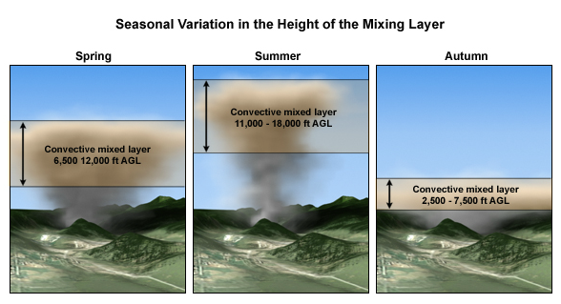
Mixing Height
Notes:
Richard Carr, October 8, 2021. Adapted for S589-2022 meteorology slide master.
Mixing heights vary by season
* Lowest in the winter, gradually rising through spring, and reaching its maximum in summer.

Slide 11
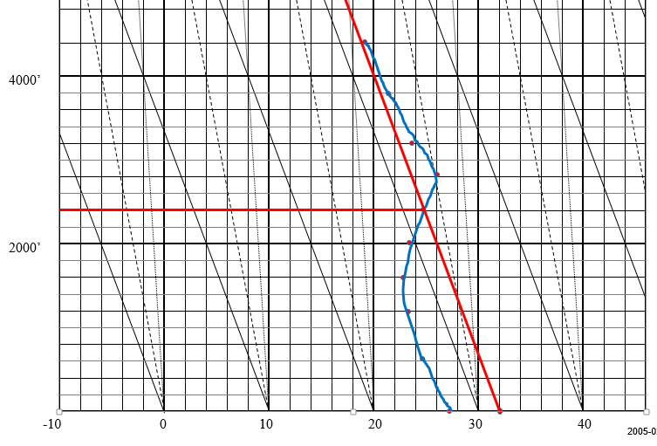
Mixing Height
Calculating the afternoon mixing height
  Using the 00 UTC sounding if available
  Extend the temp profile to the max temp for the day (use forecast if earlier in the day)
  Follow a line using the dry adiabatic lapse rate until it intersects the temperature profile
Notes:
Richard Carr, October 8, 2021. Adapted for S589-2022 meteorology slide master.
This concept builds on the atmospheric stability presentation where students are required to assess a temp. profile and determine when an inversion will be lifted.
In this case we reverse engineer that concept by starting with the max temp at the surface and follow it along the dry adiabat until it crosses the temp profile. This is because the parcel of air at the surface will rise until it is the same temp as the air around it (this is the point it crosses the temp profile). It will stop rising and create a cap trapping the air below. Thus the mixing height.
All air below the mixing height will mix together through turbulance

Slide 12
Mixing Height
Estimating the afternoon mixing height
  Extend the temp profile to the forecast maximum temp for the day, or
  Using the 00 UTC sounding if available
  Follow a line using the dry adiabatic lapse rate until it intersects the temperature profile (assuming air is dry throughout this layer)
Notes:
Richard Carr, October 8, 2021. Adapted for S589-2022 meteorology slide master. I had a few issues with the original content (saved as a hidden slide before this one). First, we may need an estimate of the mixing height long before the 00Z sounding is available. You could start with the afternoon forecast temperature and the morning sounding (can require manipulation to compensate for daytime mixing of the lower atmosphere), or use a model vertical profile (“prog tephi”) to estimate the afternoon conditions. This approach (Holzworth) is the simplest, but probably not the most accurate. One must assume the mixed layer is in dry air. Other methods include use of moisture (virtual temperature, for example), the use of Bulk Richardson Number, or turbulent kinetic energy. So, I changed the following:
- “Calculating” to “Estimating” in the first bullet
- Exchanged positions of the 00z sounding bullet and the max temp bullet and revised wording
- Added qualifier in the last bullet regarding assumption of dry air
The following are the original speaker notes for this slide:
This concept builds on the atmospheric stability presentation where students are required to assess a temp. profile and determine when an inversion will be lifted.
In this case we reverse engineer that concept by starting with the max temp at the surface and follow it along the dry adiabat until it crosses the temp profile. This is because the parcel of air at the surface will rise until it is the same temp as the air around it (this is the point it crosses the temp profile). It will stop rising and create a cap trapping the air below. Thus the mixing height.
All air below the mixing height will mix together through turbulance

Slide 13
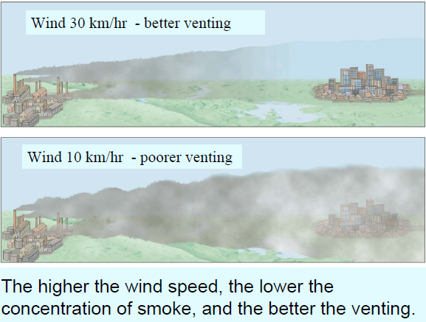
Transport Winds
Important factor in smoke management forecasts
The average speed and direction of all winds in the mixing layer
Used to predict horizontal smoke dispersion
Notes:
Richard Carr, October 8, 2021. Adapted for S589-2022 meteorology slide master.

Slide 14
Venting Exercise

Slide 15
Venting Exercise
Required
  WFBS spreadsheet
  Blank Thermodynamic diagram
Notes:
Richard Carr, October 8, 2021. Adapted for S589-2022 meteorology slide master. For online submission, the students may enter their data onto an electronic copy of a blank thermodynamic (Stuve) diagram.
Instructor: Take some time to ensure that each student has a couple blank copies of the thermo diagram. Ensure that all students have the spreadsheet accessible. You may want to coordinate with the unit leader to mention that the students will need their computers and the spreadsheet in their intro to the section.
This is essentially a data entry exercise, apart from plotting temps in the thermo diagram which the do in the atmospheric stability section as well.
You may choose to walk the students through the exercise. I found it useful for the students to do it on their own. The exercise took about 15 minutes.

Slide 16
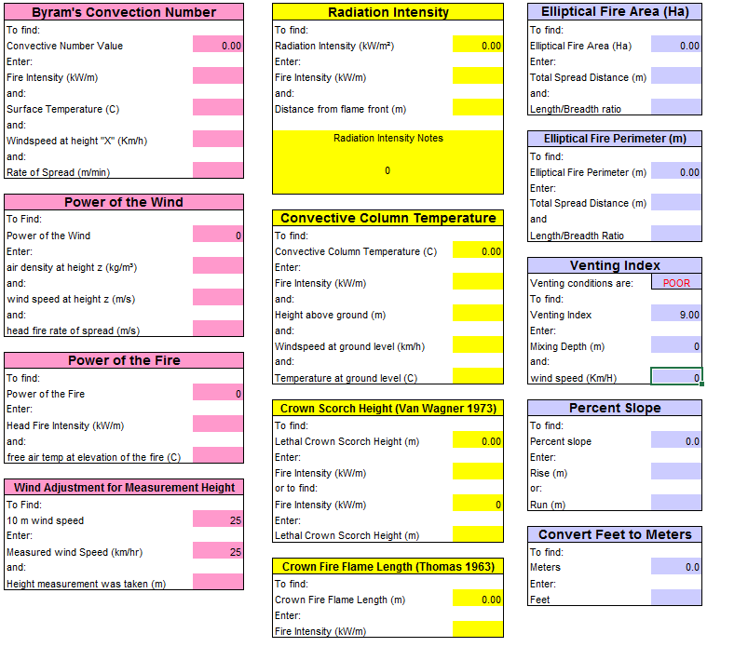
WFBS Spreadsheet
Notes:
Richard Carr, October 8, 2021. Adapted for S589-2022 meteorology slide master.
Venting can be calculated using the first tab of the spreadsheet

Slide 17
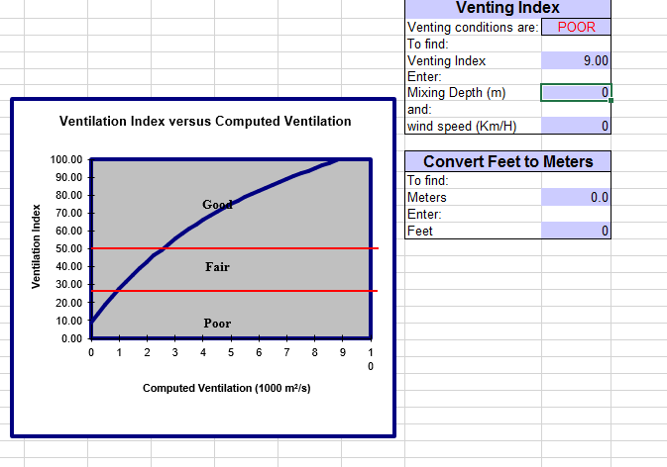
WFBS Spreadsheet
Notes:
Richard Carr, October 8, 2021. Adapted for S589-2022 meteorology slide master.
It can also be calculated using the venting tab of the spreadsheet. This also allows you to convert feet to meters.
The spreadsheet converts the computed index from m sq/second to the scale out of 100.

Slide 18
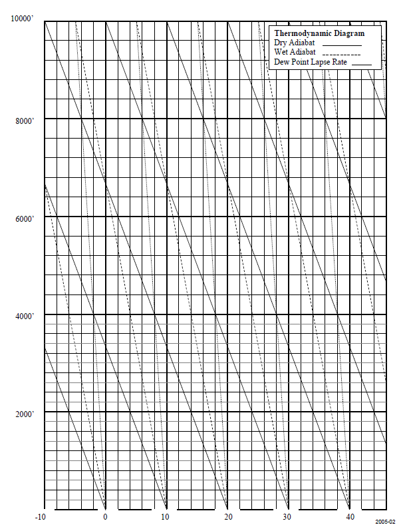
Thermodynamic (Stuve) diagram
Electronic versions of this are available in the course material (ThermodynamicDiagram.pdf, StuveDiagram.png).
Be sure you have this on your computer.
It is probably easiest to load into a Word or Powerpoint document and annotate the diagrams there.
Notes:
Richard Carr, October 8, 2021. Adapted for S589-2022 meteorology slide master. Added text for online course submission.
Instructor: Ensure there is an adequate supply of diagrams for the students. It is also used in the stability section.

Slide 19
Calculate Venting
Plot the temperature profile on the diagram
Max temperature for the day was 24C
Calculate the mixing height by following the dry adiabatic from the max temp until it crosses the temp profile
Calculate the average winds within the mixing layer
Minisonde sounding for Oct 20, 2017 at 17 UTC
Notes:
Richard Carr, October 8, 2021. Adapted for S589-2022 meteorology slide master.
Note to Instructor: This is actual data from a minisonde ascent on the Sakwite Lake Prescribed Burn, Oct 20, 2017. Fort Frances District, Ontario.
The students will need to focus on temp, altitude and wspd. Note* altitude is AGL

Slide 20
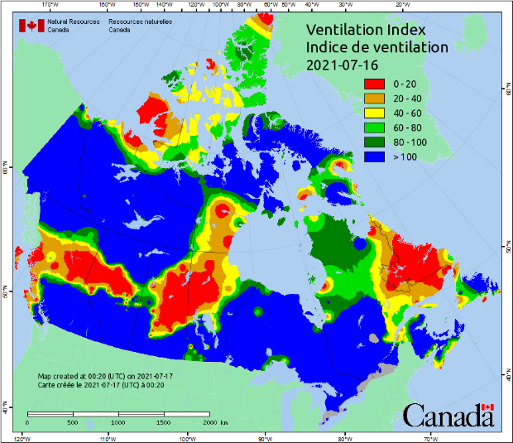
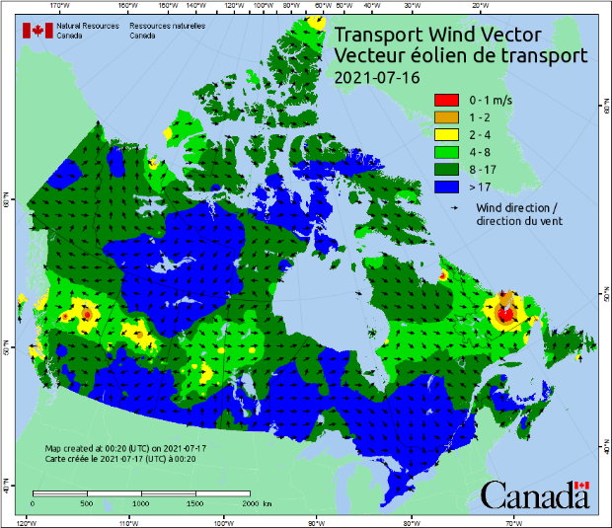
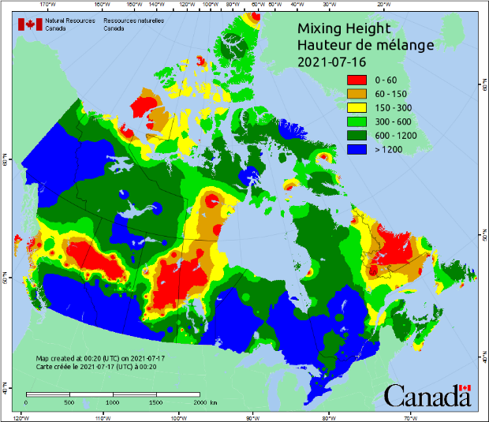
Some CWFIS Examples
Notes:
Richard Carr, October 8, 2021. New slide.

Slide 21
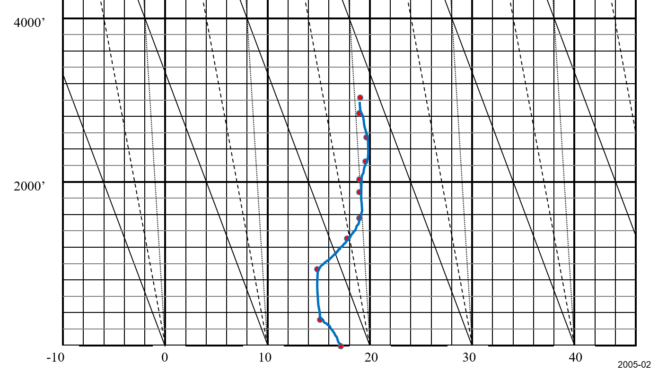
Venting Exercise – Temperature Profile
Notes:
Richard Carr, October 8, 2021. Adapted for S589-2022 meteorology slide master.
Using the max forecasted temp of 24C and extending the dry adiabatic laps rate through the temp profile, we come up with a mixing layer height of 1600’

Slide 22
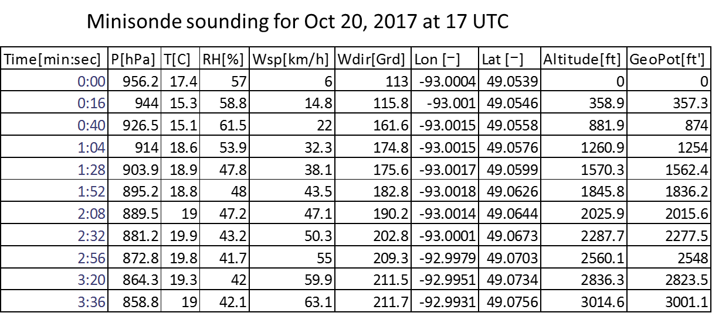
Calculate Wind
Sum of all wind values to 1600’
113.2 / 5 = 22.6 km/h
Notes:
Richard Carr, October 8, 2021. Adapted for S589-2022 meteorology slide master.

Slide 23
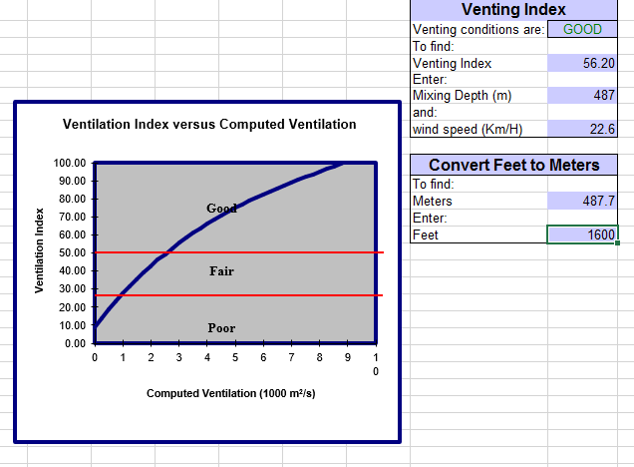

Spreadsheet Inputs
Notes:
Richard Carr, October 8, 2021. Adapted for S589-2022 meteorology slide master.
Input the calculated values into the spread sheet. It works out to a good venting index
1600’ with a 22.6km/h wind = an index value of 56.2.

Slide 24

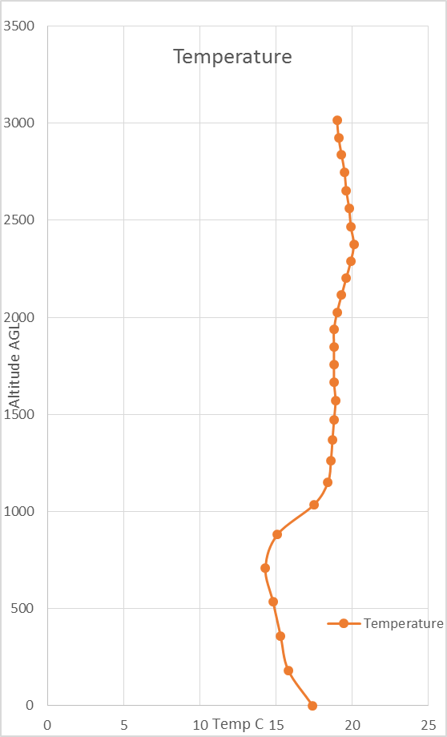
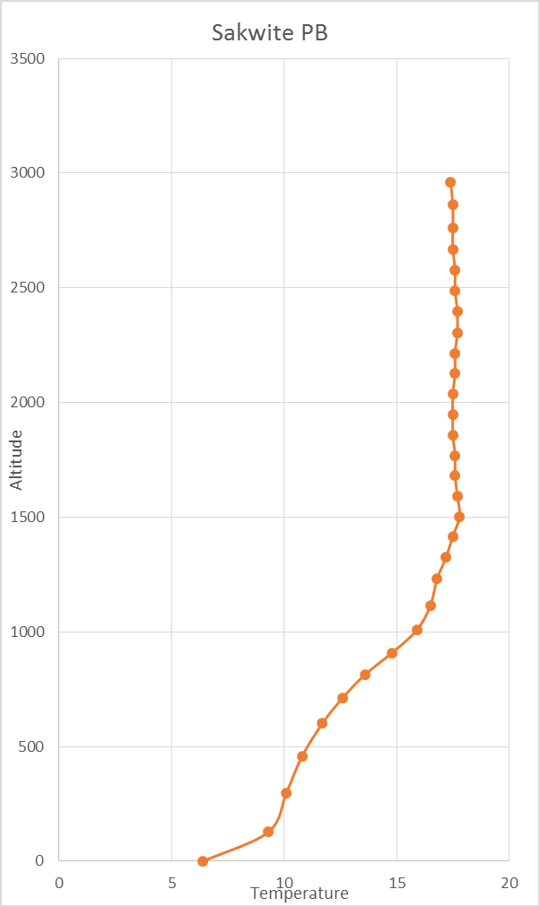
Sakwite Lake PB Temperature Profile
Notes:
Richard Carr, October 8, 2021. Adapted for S589-2022 meteorology slide master.
Noted max temperature at Fort Frances RCS was about 25C. Follow the dry adiabat up from 25C and note the upper red line is
slightly above this point. Plume top roughly corresponds with the inversion near 2500’.
*NOTE: This is the Sakwite Lake Prescribed Burn, Oct 20, 2017. Fort Frances District, Ontario.
The lines correlate with actual heights above the fire. Verified as accurately as you can from a helicopter.
The temperature profile follows the dry adiabatic lapse rate to about 1000’. Above 1000’ the temperature is fairly constant and therefore neutral in stability. Overall the air over the fire is stable.
The mixing height has been calculated to be at 1600’. The smoke stays very close to the surface through this area but the heat of the fire carries the smoke above this layer.

Slide 25
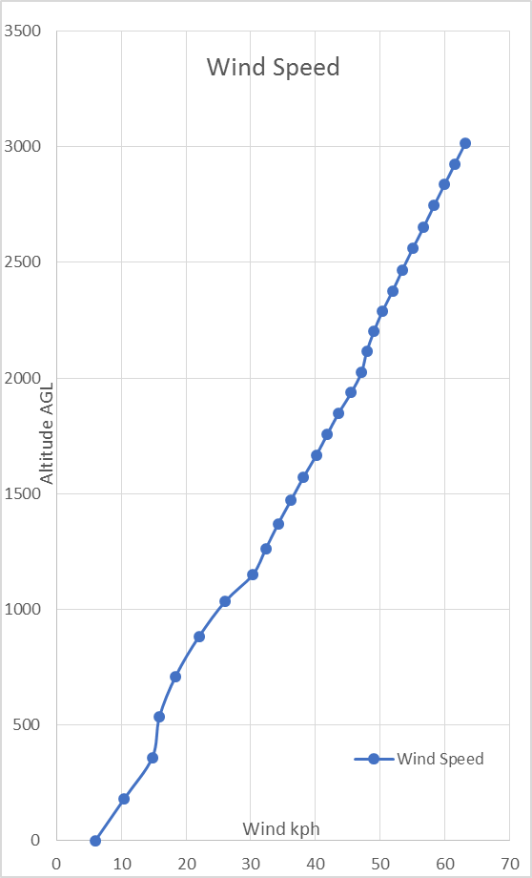
Sakwite Lake PB Wind Profile
Notes:
Richard Carr, October 8, 2021. Adapted for S589-2022 meteorology slide master.
The smoke rises above the mixing layer because the heat generated from the convection created by ignition is able to overcome the stable/neutral temperature profile, the strong upper winds then dispersed the smoke above the surface.
That night we ended up smoking out the town of Dryden which is 85 km away.

Slide 26
Summary
Venting, or the Ventilation Index, is a crude estimate of how well smoke released into the atmosphere will be carried away from the surface during the afternoon
Uses the mixed layer depth multiplied by the wind speed.
Notes:
Richard Carr, October 8, 2021. Adapted for S589-2022 meteorology slide master. Added “Venting, or the Ventilation Index,“ to the first bullet. Changed “Using” to “Uses” in the second bullet.

Slide 27
Contact Information
Contact:
Richard Carr
Wildland Fire Research Analyst
Richard.Carr@NRCan-RNCan.gc.ca
5320 122 Street NW
Edmonton, AB, Canada
T6H 3S5
825-510-1265 780-710-3147
?
?
?
?
?
Mike Pistilli
Planning and Information Coordinator, Northwest Region
Aviation, Forest Fire, and Emergency Service
Ontario
Mobile: 807-275-6767
mike.pistilli@ontario.ca
Notes:
Richard Carr, October 8 2022. Added Mike Pistilli’c contact information.

