Slide 1
S589: Weather and Atmospheric Stability

Slide 2
Heading: Arial 32pt centred, vertical=0.5cm
Module Title Corbel 44pt
Section Title: Corbel 40pt
Text: Level 1 = Arial 28 pt
Text level 2 = Arial 24pt

Slide 3
Objectives
Identify atmospheric stability types
Know the difference between dry and moist adiabatic lapse rates
Understand how atmospheric stability affects fire and smoke
Introduce thermodynamic diagrams and perform simple temperature plots
Notes:
Richard Carr, October 4, 2021.

Slide 4
Convective Stability
Convective vs baroclinic (synoptic)
Convective stability/instability:
Atmosphere’s resistance to vertical motion
Types/degrees/conditions: stable, neutral, unstable
Air parcel concept used to assess stability:
Adiabatic: no mixing with the environment
Allowed to expand or compress
Unit mass or volume of air
Notes:
Richard Carr 20210528: Revised text
Forecasters use three types of stability to describe the atmosphere – stable, unstable and neutral. These are also sometimes referred to as positively buoyant, negatively buoyant and neutrally buoyant.
Stable (negatively) suppresses or resists vertical movement. It will rise to a certain level and then sink because it is colder than its surrounding environment.
Unstable air (positively) enhances or encourages vertical movement. Unstable air parcels will rise until it reaches equilibrium level with it’s surrounding environment aka gets to the same ambient temperatue.
Neutral air has neither of the above qualities.
The air parcel contruct is used to help define the movement of air within the atmosphere. This is where a parcel of air is moved vertically and horizontally but remains self contained. It is expanded and compressed with movement through the environment but the outside atmosphere does not mix. Think of it as a balloon or beach ball.

Slide 5
Types of Atmospheric Stability
Stable atmosphere
Warm air overlays cool air
Potential temperature rises with height
Lifted air parcel is cooler than environment
Neutral atmosphere
Potential temperature constant
Lifted air parcel is same temperature as environment
Unstable atmosphere
Cooler air overlays warm air
Potential temperature falls with height
Lifted parcel is warmer than environment
Notes:
Richard Carr 20210528: Revised text
Forecasters use three types of stability to describe the atmosphere – stable, unstable and neutral. These are also sometimes referred to as positively buoyant, negatively buoyant and neutrally buoyant.
Stable (negatively) suppresses or resists vertical movement. It will rise to a certain level and then sink because it is colder than its surrounding environment.
Unstable air (positively) enhances or encourages vertical movement. Unstable air parcels will rise until it reaches equilibrium level with it’s surrounding environment aka gets to the same ambient temperatue.
Neutral air has neither of the above qualities.
The air parcel contruct is used to help define the movement of air within the atmosphere. This is where a parcel of air is moved vertically and horizontally but remains self contained. It is expanded and compressed with movement through the environment but the outside atmosphere does not mix. Think of it as a balloon or beach ball.

Slide 6
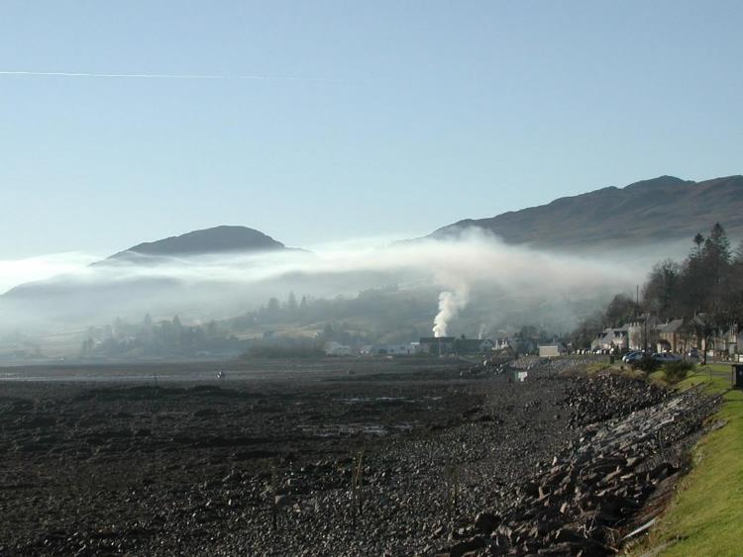
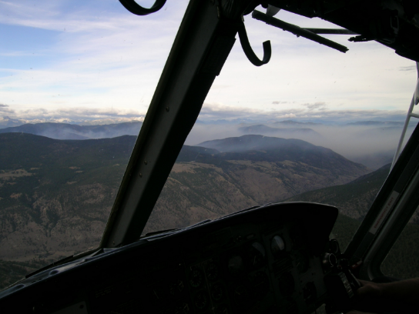
Inversions
Warm air overlays cool air
Katabatic flow: subsidence
Advection: sea/land breeze, frontal zones (warm front anabatic flow)
Radiation: night
WARM
Radiation
Advection
COLD
Katabatic flow
Notes:
Richard Carr 20210528: Blended 2020 and Amanda Ashton’s 2018 approach.
Clouds can be a good indication of inversions – where temperatures increase with height. Can be found through the entire atmosphere or within a smaller layer ie) capping inversions
There are four types of inversions:
Night time or radiation inversion is the most common. When the air near the ground cools faster than the air above
Marine occurs when cool, moist, stable air slides under warm, dry unstable air. Also called a “marine push”
Subsidence
Frontal – cold air pushes in under warmer air or warm air slides up and over cold air mass
Stratus clouds define the top

Slide 7
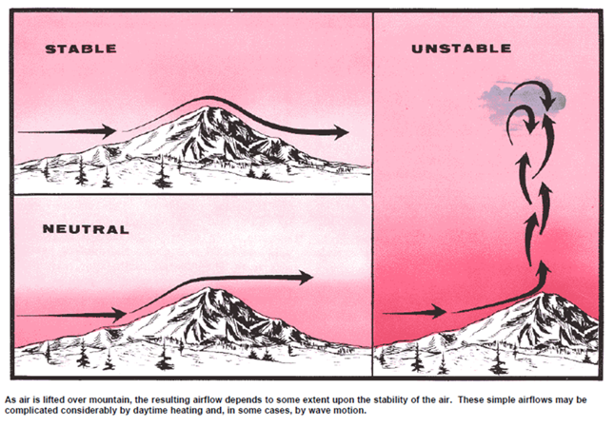
Stable, Neutral, and Unstable Depiction
Schroeder and Buck, Fire Weather, 1970, pg 57

Slide 8
Lapse Rates
Lapse rate: Change of temperature with change of altitude (elevation)
Adiabatic process: no mixing of environmental air with air parcel
Dry or wet (moist)
Notes:
Richard Carr 20210528: Revised from Amanda Ashton’s 2018 slides.
Meteorologists refer to the change in temperature with height as the environmental lapse rate.

Slide 9
Dry Adiabatic Lapse Rate
Dry air rising and falling follows the dry adiabatic lapse rate:
Γ_{d} = g/Cp (e.g. degrees C or K per metre)
~3C/1000 feet or 9.8C/km
Sinking air compresses and warms → potential temperature ϴ
Notes:
Richard Carr 20210528: Revised from Amanda Ashton’s 2018 slides.
A parcel of air that is lifted by any of the lifting processes, will continue to rise at the DALR until it cools to the same temperature as the surrounding environment.

Slide 10
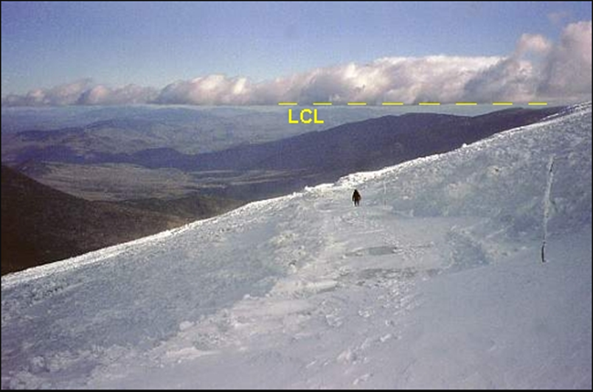
Moist Adiabatic Lapse Rate
Moist air rising follows the moist (wet) adiabatic lapse rate:
1.5C/1000 feet or 5C/km
Varies with temperature, greater value in cold air
Moist air sinking compresses and warms, so follows the dry adiabatic lapse rate when unsaturated
T=Td=Saturation
Net condensation
at Lift Condensation Level (LCL)
Notes:
Richard Carr, May 28, 2021: Revised from Amanda Ashton’s 2018 slides.
If the air parcel temperature decreases to the same temperature as the environmental dew point, it is now considered a saturated air parcel and will continue to rise at the SALR until it is the same temperature as the surrounding environment.

Slide 11
Inversions applied to fire operations
Inversion present: dense smoke near ground
Fumigation
Health impacts
Reduced visibility: hampers aircraft operation
Crew safety affected?
Need photo of dense smoke near ground
Notes:
Class discussion
Smoke issues
Can lookouts do their jobs?
Aircraft visibility

Slide 12
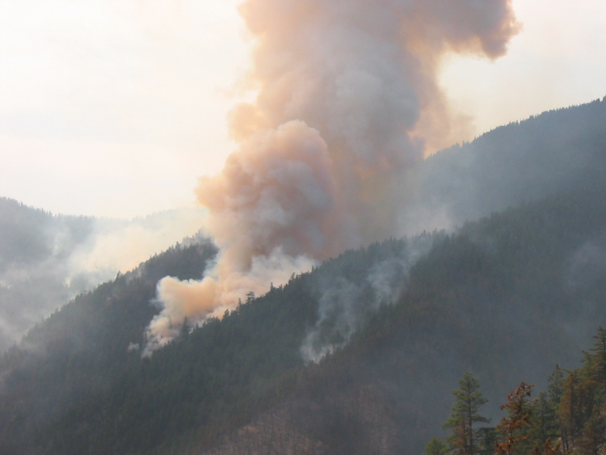
Inversion breaking applied to fire operations
Inversion breaks: fire intensity increases
Improves visibility near surface
Safety of crews above fire compromised
Plume-driven fire?
Notes:
Class discussion
Smoke issues
Can lookouts do their jobs?
Aircraft visibility?
What happens when an inversion breaks?

Slide 13
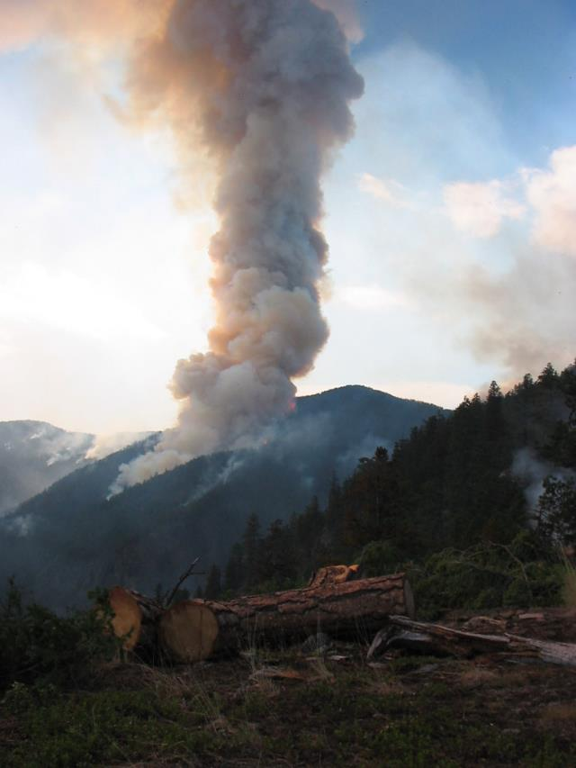
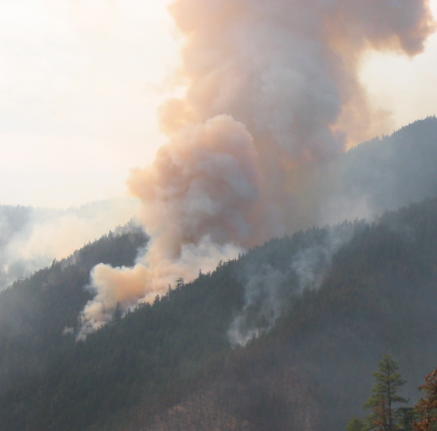
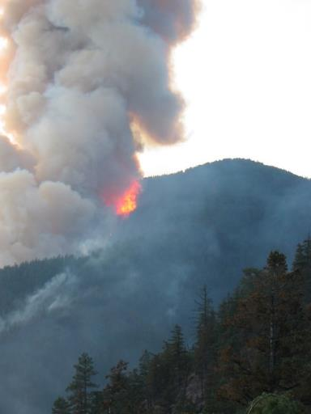
What does this plume look like?
Notes:
The full set of smoke plume photos can be found in pre-2020 versions of this powerpoint.
Class discussion
Smoke issues
Can lookouts do their jobs?
Aircraft visibility?
What happens when an inversion breaks?

Slide 14
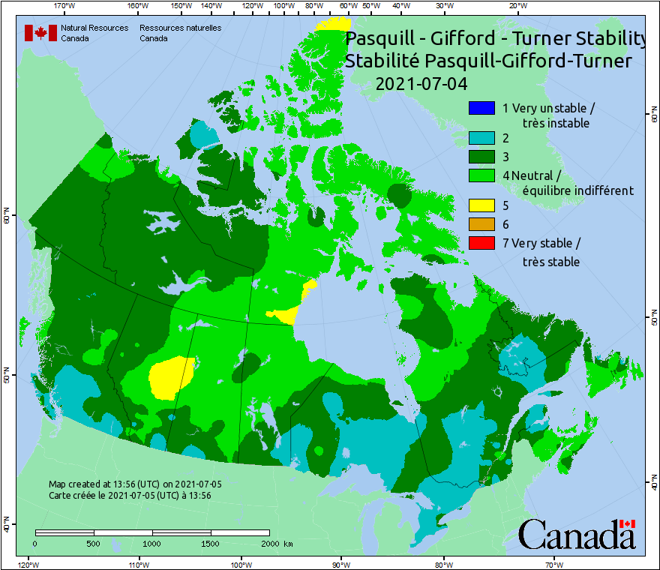
Ground-based Stability Observations
Estimates
Pasquill (-Gifford-Turner) stability assessment
Solar radiation
Sun angle
Cloud cover
Wind speed
Lavdas (1986) Dispersion Index
Ventilation Index
More information on venting in II-B-3
Notes:
Richard Carr, October 4, 2021.

Slide 15
Thermodynamic Diagrams
Notes:
Richard Carr, January 2020: Added section title

Slide 16
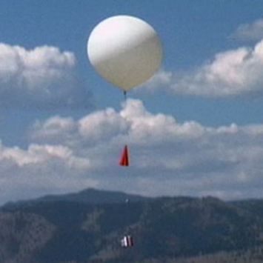
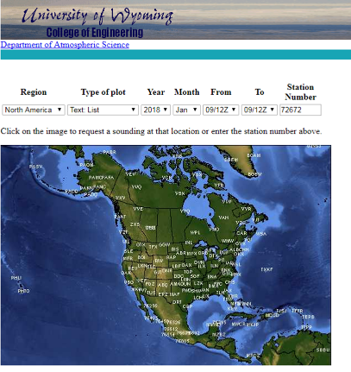
Upper Air Data Sources
Weather balloons
Pibals
Aircraft … helicopters
Dropsondes
Rocket sondes
Data from fixed stations available in text and thermodynamic diagram form
Plot examples in the previous
chapter, “Weather Data Sources”
Notes:
Richard Carr, October 4, 2021.

Slide 17
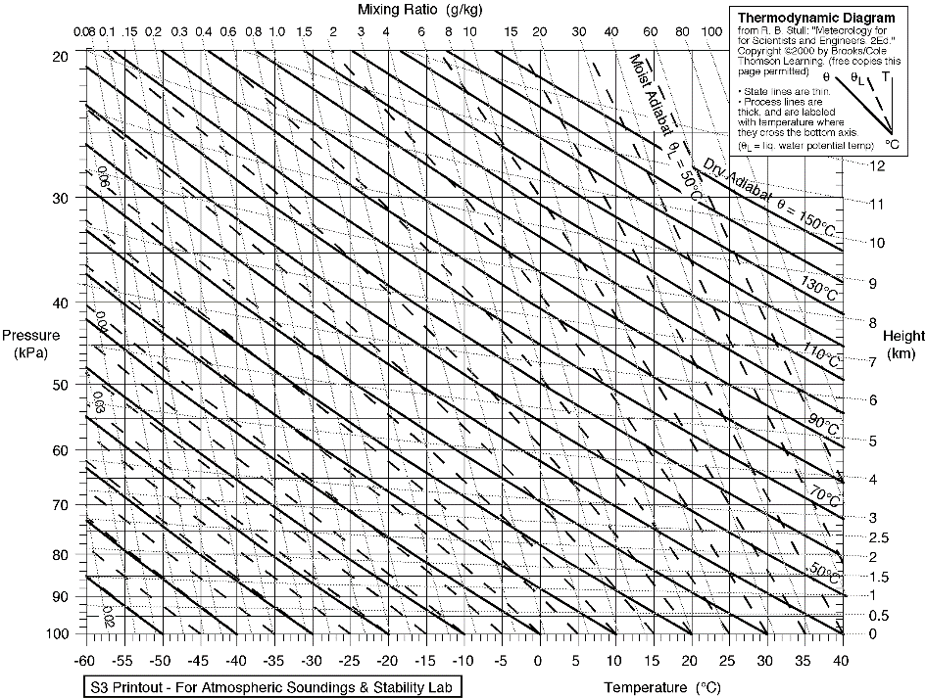
Emagram
Predecessor to the T-phi (tephigram)
Used in Europe?
Isotherms
Isobars/height
Mixing Ratio
Dry Adiabats
Moist Adiabats
https://upload.wikimedia.org/wikipedia/commons/1/13/Emagram.GIF
Accessed May 28, 2021.
Notes:
Richard Carr, 2021.

Slide 18
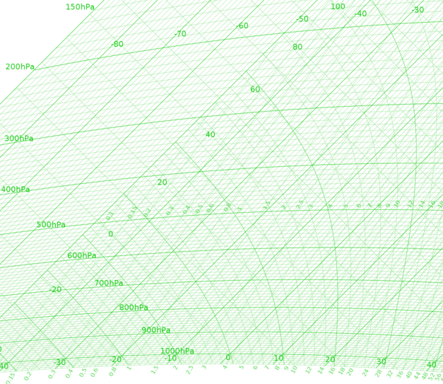
T-Phi Diagram
Used extensively by ECCC and UK
Temperature vs phi (entropy)
Allows all types of instability calculations
Isotherms
Isobars/height
Mixing Ratio
Dry Adiabats
Moist Adiabats
https://en.wikipedia.org/wiki/File:Tephigram.png
Accessed May 28, 2021.
Notes:
Richard Carr, 2021.

Slide 19
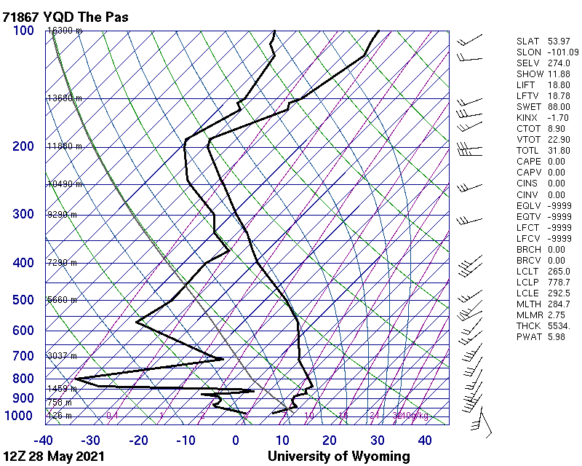
Skew T/log P Diagram
Common
Allows all types if instability calculations
Wind
Stab
T_{d}
T
Isotherms
Isobars/height
Mixing Ratio
Dry Adiabats
Moist Adiabats
Notes:
Richard Carr, 2021.
T-Td = Dew point depression or spread
Where is air dry? Moist enough to generate cloud?
Can you find an inversion?
Notes from Amanda Ashton’s 2018 slide:
Skew-T’s are essentially a visual thermodynamic calculator that meteorologists can use to look at the entirety of the atmosphere. It relays information on temperature, pressure, humidity and winds. We will only be concerned with the temperatures at each height and the DALR and MALR for the purpose of our exercise.
Quick observations can be made by looking at just the temperature and dew point profiles – determinations on stability, instability, air mass moisture and wind shear can all be made at glance.

Slide 20
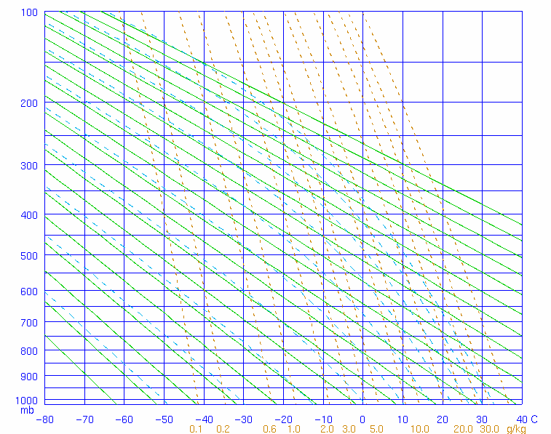
Stüve Diagram
Simple
More common in Europe
Difficult to depict lifted stability parameters such as CAPE
Isotherms
Isobars/height
Mixing Ratio
Dry Adiabats
Moist Adiabats
https://en.wikipedia.org/wiki/File:Stüve_diagram
Accessed May 28, 2021.
Notes:
Richard Carr, 2021.

Slide 21
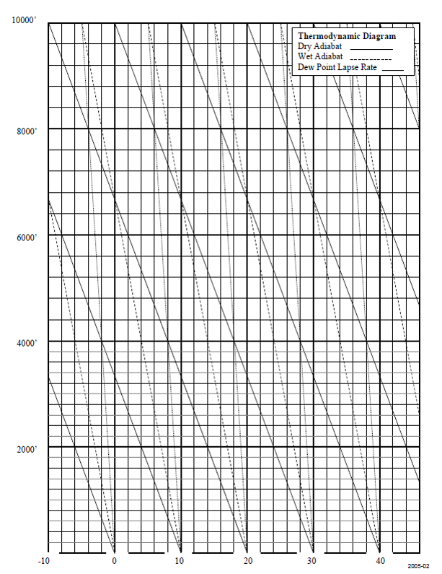
Stability Profiles
Stable
Unstable
Wet (moist)Adiabat
Dew Point Lapse Rate
~2C/km (dry parcel)
Dry Adiabat
Notes:
Richard Carr, 2021. Added new and clearer diagram.
Adapted from Amanda Ashton’s 2018 slide.

Slide 22
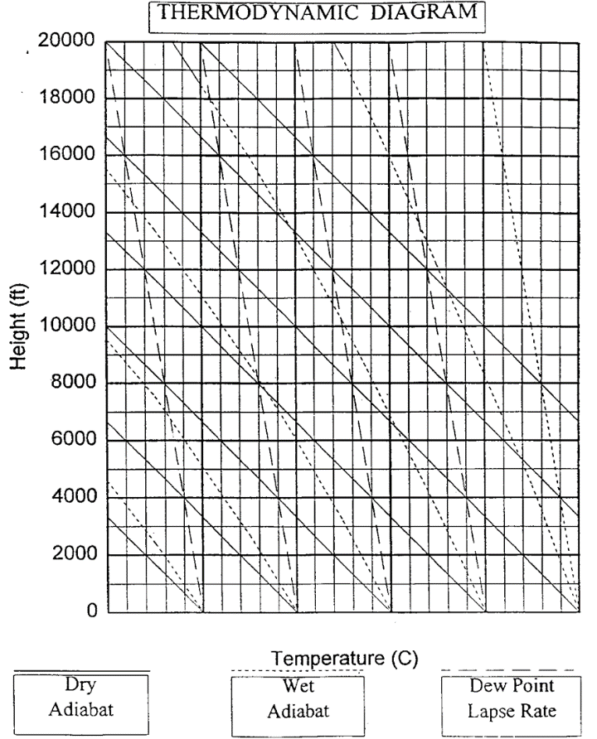
Temperature Plot Example
We will go through some sample plots then do an exercise
We use the Stüve Diagram
-7C @ 10 000 ft
10C @ 2500 ft
31C @ 1000 ft
-10 0 10 20 30 40
Notes:
Richard Carr, 2021. Edited the text a bit.
Adapted from Amanda Ashton’s 2018 slide.
Temperatures are read like a Cartesian graph
E.g. 31 degrees at 1000ft in red
10C @ 2500 ft in purple
-7C @ 10000 ft in Blue

Slide 23
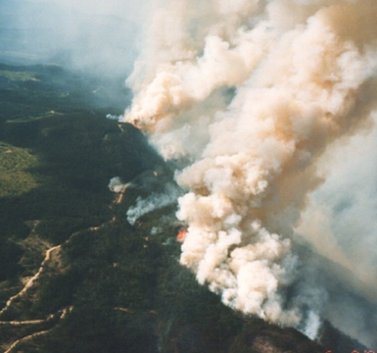
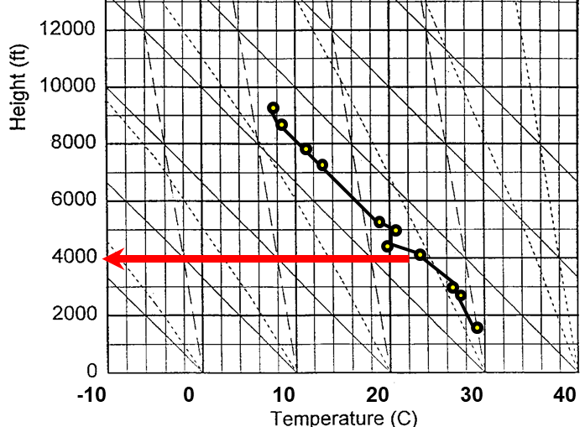
Sample helicopter sounding
Salmon Arm, BC August 4, 1998 16:00
Dry Adiabat
Wet Adiabat
Dew point lapse rate
Notes:
Adapted from Amanda Ashton’s 2018 slide. Text in bold replaces strikeout: Richard Carr 20210528.
Starting at the surface at ~ 1600 ft, the temperature profile was completed to 9000ft. From this we can determine that the environmental profile is unstable to about between about 3000 to slightly over 4000ft where it becomes slightly more stable at 5000 ft. with a slight inversion. Above that the profile appears neutrally stable.
Does the fire activity pictured match an unstable environment? What may be occurring at the top of this smoke column out of the picture?

Slide 24
Exercise 1: Helicopter sounding example
  Stability Assessment
Plot the data supplied by helicopter pilots working in the vicinity at 5 am on the morning of August 5th to determine the stability of the lower atmosphere.
What is of concern this morning?
What surface temperature is required to break the inversion?
Notes:
Have the class build a profile from the Helicopter sounding.
Ensure the class has a Stuve Diagram to work with.

Slide 25
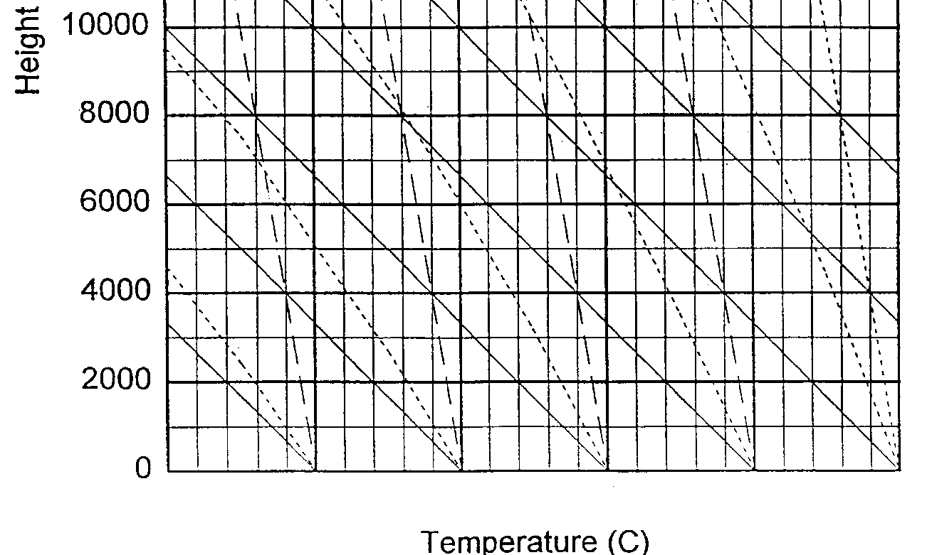
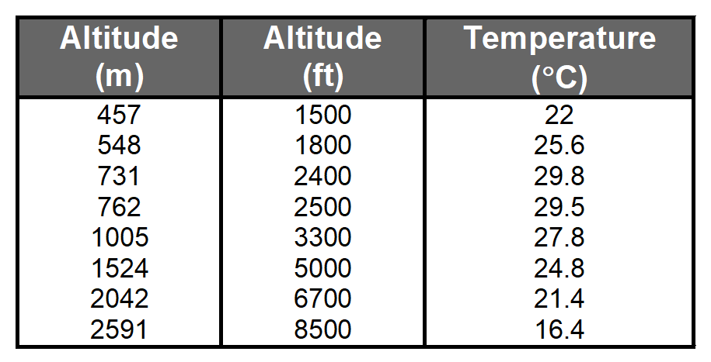
Exercise 1: Plot
Dry Adiabat
Wet Adiabat
Dew point lapse rate
-10 0 10 20 30 40
Notes:
Have the class build a profile from the Helicopter sounding.
Explain how to determine at what temperature the inversion is going to break – by following the dry adiabatic to the surface.

Slide 26

Exercise 2: OK Mtn Park Fire (at home)
Stability Assessment
Use the data you collected over the fire at 8 am on the morning of August 31st to determine the stability of the lower atmosphere.
What is concerning this morning?
Notes:
Plot the profile from Kelowna in 2003

Slide 27
Exercise 2: Helicopter sounding
Okanagan Mountain Park fire, Kelowna, 2003
Notes:
Have the class build a profile from the Helicopter sounding.
Ensure the class has a Stuve Diagram to work with.

Slide 28
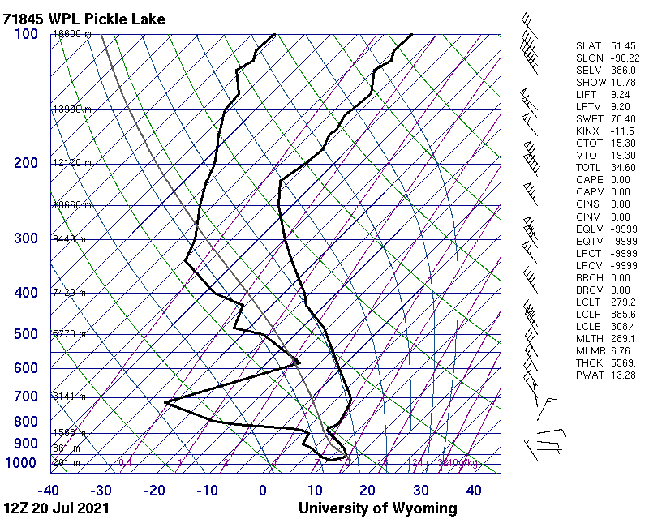
Adding humidity
Sample plot from University of Wyoming
T_{d}
T
The T/T_{d}/RH conversion spreadsheet may help estimate RH
Moist
Dry
Inversion
Stability
Saturation?
Wind
Notes:
Richard Carr, 2021.

Slide 29
Clouds
Stability indicator: cumulus vs stratiform
Cloud base height estimate: H=400(T-Td)
>8000 ft = dry
≤4000 ft = wet
Low cloud: <6500 ft (~2000m)
Mid-level cloud: 6500-23000 ft (2000-7000m)
High cloud: >23000 ft (> 7000m)
Dew point depression can indicate scattered, broken, continuous, or no cloud
Notes:
Richard Carr 20210528: Revised from Amanda Ashton’s 2018 slides.
https://www.canada.ca/en/environment-climate-change/services/weather-manuals-documentation/manobs-surface-observations/sky.html#p-1-8-5-2 (link no longer exists)
Chart 1.8.5.2 – Approx. Height of Base of the CU Cloud as determined by differences between T and Td in Celsius
From Paul Kruger, AB Fire Wx Meteorologist
Low clouds – have direct impacts on potential weather and fire behaviour
Middle – can be direct and/or indirect indicators
High - usually seen as indirect indicators of behaviour

Slide 30
Thermodynamic Diagrams: Other uses
Stability indexes
Brief discussion in III-A-2 (“Upper Air Influences”)
Cloud assessment
Adiabatic heating (chinooks, for example)
Wind profiles
Others …
Notes:
Richard Carr, 2021.

Slide 31
Summary and Skills
Understand definition and conditions of stability using the air parcel model
Recognize a few thermodynamic diagrams
Perform simple temperature plots and interpret stable and unstable layers
Identify dew point and temperature lines on a thermodynamic diagrams and estimate RH from the accompanying spread

Slide 32
Contact Information
Contact:
Richard Carr
Wildland Fire Research Analyst
Richard.Carr@NRCan-RNCan.gc.ca
5320 122 Street NW
Edmonton, AB, Canada
T6H 3S5
825-510-1265 780-710-3147
?
?
?
?
?
Notes:
Richard Carr, January 2020: Added section title

