Slide 1
S589: Weather Data Sources

Slide 2
Heading: Arial 32pt centred, vertical=0.5cm
Section Title: Corbel 40pt centred hor.
Text: Level 1 = Calibri 28 pt
Text level 2 = Calibri 24pt

Slide 3
Objectives
Look at differences between federal public and fire weather network data sources
Sample a few data products and sites
FBAN/Specialist may not use these directly, should be aware of them
Can discuss usage with your fire weather office
Learn some uses and caveats of ensemble models

Slide 4
ECCC and Fire Management Agency Products

Slide 5
Fire Weather Product and Services
Provincial and territorial (P/T) fire management networks in place for 40-60 years
Federal fire weather presence varied over the years
Renewed interest in fire response after 2016
Most P/T offices provide observed and forecast services
Some may use private contractor (e.g. NT, Atlantic)
Let us look at Canadian weather stations …

Slide 6
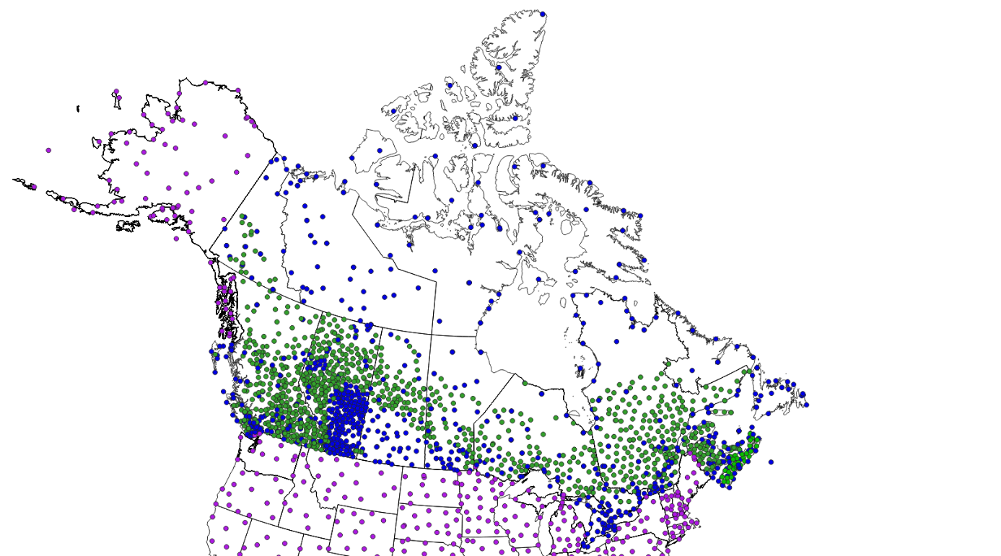
Weather Stations used in the CWFIS
Federal + Alberta Ag
P/T
USA
Notes:
Discuss density of ECCC and P/T stations nationally, and take a look at density in AB, BC, NB, NS, and contrast with other areas.
NT is only showing ECCC stations on this map.
Mention we have seen recent fires in areas without much of a fire history (Hudson Bay lowlands, NW BC, Vancouver Island, tundra).
USA “lower 48” stations are a subset of NWS locations. RAWS are not in the CWFIS yet.
.

Slide 7
Public vs Fire Weather Forecast
P/T usually have web or internal sites
Little standardization between appearance or products
Fire weather observations and forecasts include RH, wind direction
CFFDRS indexes
ECCC data mart provides a large variety of data
Observations, model output, expert discussions
Does not contain all elements necessary for fire weather

Slide 8
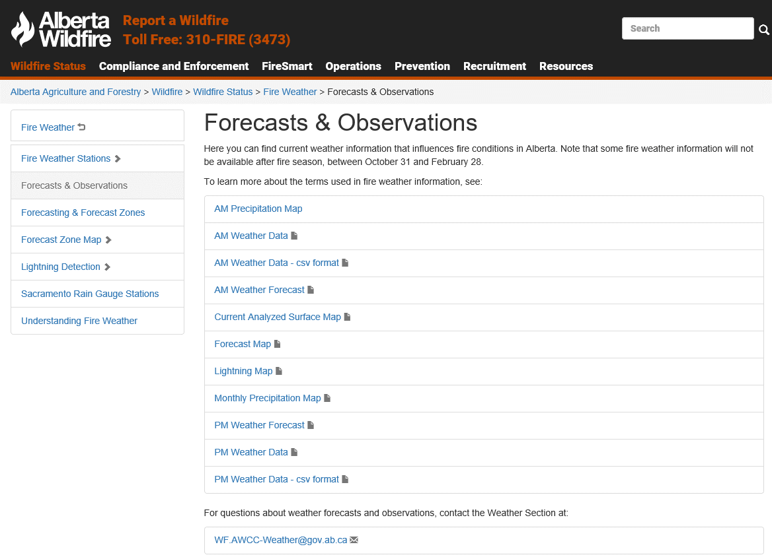
Sample fire weather page: Alberta
Notes:
New slide – Richard Carr, November 13, 2019

Slide 9
Sample Fire Weather Forecast
Synopsis: a text description of weather features expected to shape the fire environment today and tomorrow
Regional Weather Forecasts: specific weather data/forecast values for each region in tabular format:
Today: maximum T, minimum RH, maximum afternoon wind speed and average direction (significant wind shifts highlighted), comments
Tonight: overnight low T, maximum RH (RH recovery), average wind speed and direction, comments
Tomorrow: maximum T, minimum RH, maximum afternoon wind speed and average direction (significant wind shifts highlighted), comments
500 mb Actual and Forecast Values: Trend in heights for each region for the next 24-48 hours.
Outlook: A text discussion of weather features expected over the next 5 days.
Gives general weather conditions over a large geographical area. For site-specific forecasts, a spot forecast should be requested.
Notes:
Richard Carr, September 3, 2021: Modified last bullet and colored text. Green items differ from ECCC public forecasts.
Richard Carr, January 2020. New slide. Text has been borrowed from a sample Agency Weather System document in CIFFC’s repository of FFMWG material. Content has been edited for brevity and to protect source agency’s identity.

Slide 10
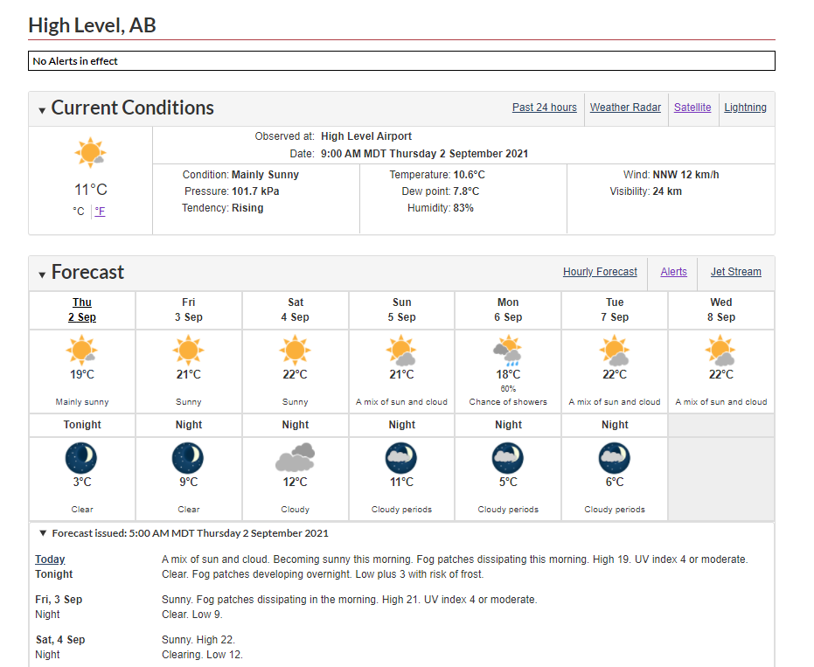
ECCC Public Forecast (1/2)
Notes:
Richard Carr: Concept added for 2020 WFBS, November 13, 2019. Modified September 2, 2021 with forecast from late in the fire season.
Wind is sometimes not mentioned (may be light with variable direction). Speed sometimes is mentioned but not direction.
RH is not provided.

Slide 11
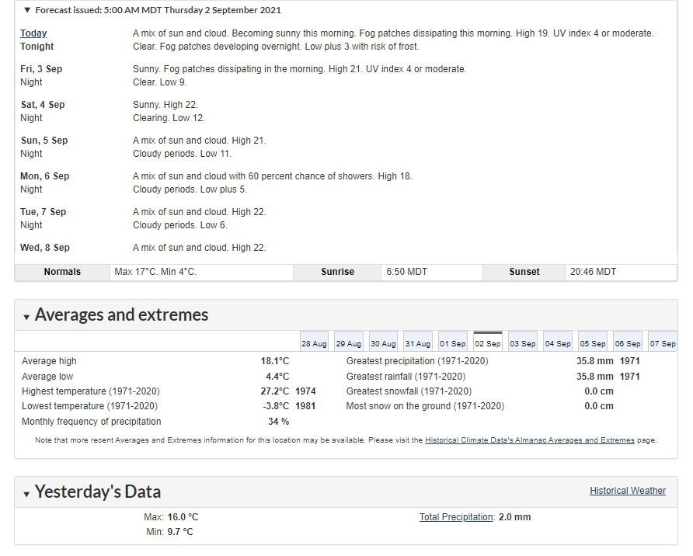
ECCC Public Forecast (2/2)
Notes:
Richard Carr: September 2, 2021: Updated with late fire season forecast
Richard Carr, November 13, 2019: New screen shots with current ECCC forecast page format.
Highlight normals in rounded (upper red box) and decimal formats (lower red boxes).
Highlight sunrise/sunset (orange box). Why are these useful in fire weather? [day length affects fuel moisture].
Yesterday’s data (blue box) – note rainfall will also appear here if reported.

Slide 12
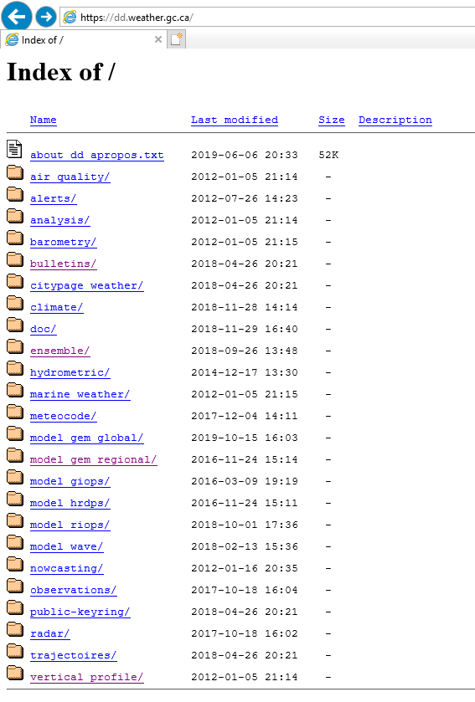
ECCC Data Mart
Alphanumeric Bulletins
Ensemble
Model GRIB output
Vertical profiles

Slide 13
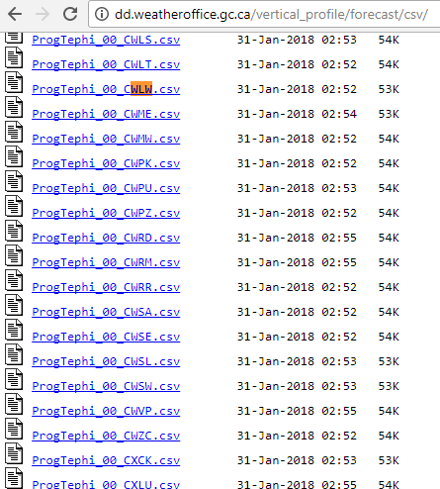
ECCC Datamart: Vertical Profiles
Also known as “Prog Tephis”
About 325 locations
00Z and 12Z runs

Slide 14
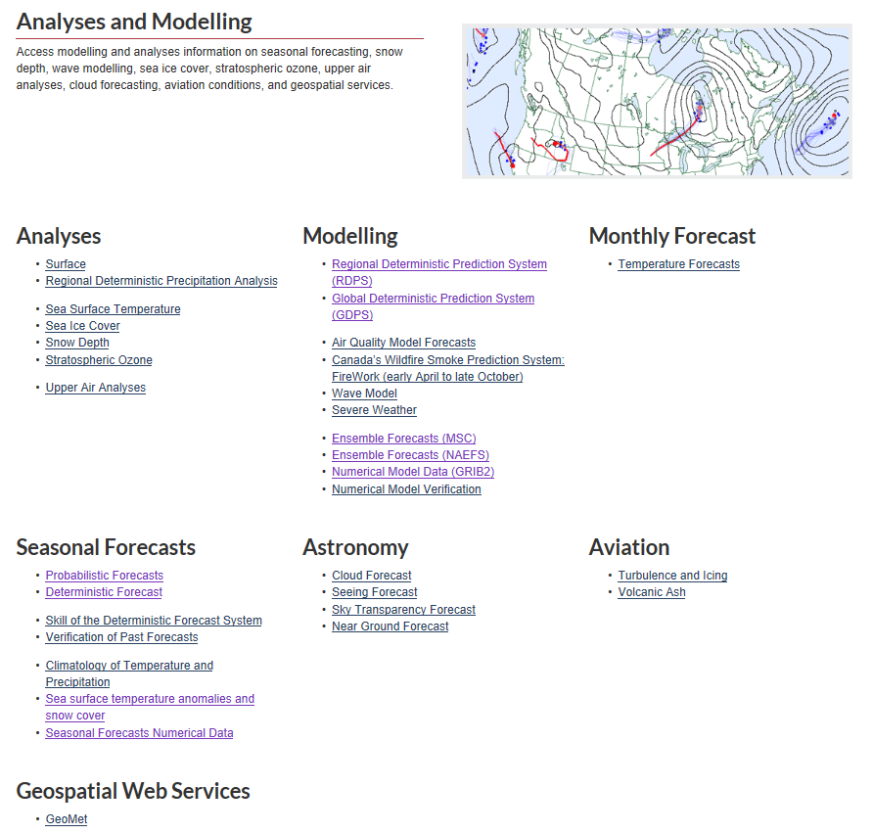
ECCC Analysis and Modeling Web Page
Focus on content – top and bottom of actual page are cropped

Slide 15
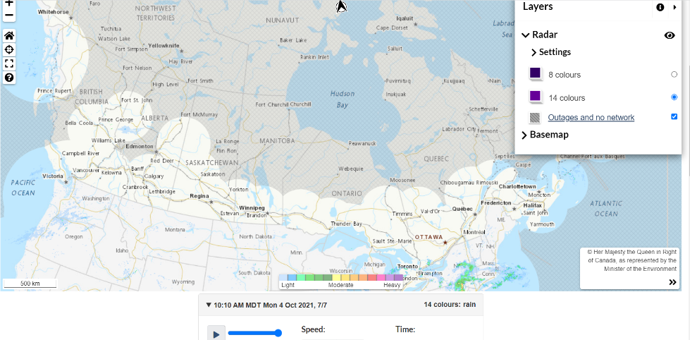
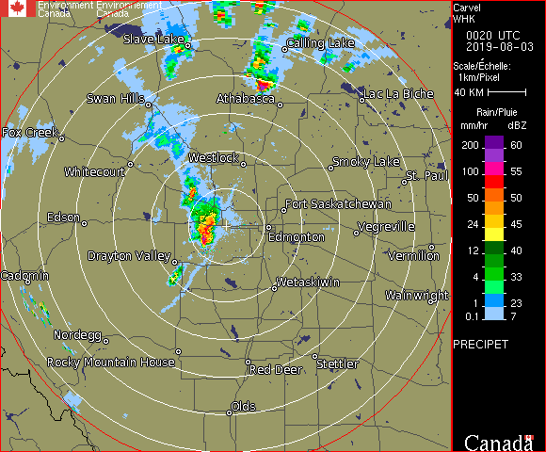
Radar Imagery
Designed for populated areas
Some usage for forest fire apps
New S-band dual-polarization
Extends range
Helps eliminate false echoes
False echoes:
Hills/mountains
Insect swarms or bird flocks
Non-precipitation echoes
can be useful
Frontal disturbances
Coming soon to Fort McMurray
Thunderstorm gust front
Notes:
Richard Carr, October 4, 2021: Changed base map with ECCC’s new display and dropped arrow to Prince George, which was missing on the old style map. The new style map includes USA radar and allows the user to zoom and pan. The sample with the thunderstorm gust front is from the old-style display. The band of grey in central Alberta indicates the Stony Plain radar near Edmonton was not in operation. At the time, the new S-band radar was being installed.
Richard Carr, added for 2020

Slide 16
Satellite Imagery
Visible
Snow cover
Low cloud
Smoke
Infrared
Cloud tops and heights
Water vapor
Notes:
Richard Carr, October 5, 2021:

Slide 17
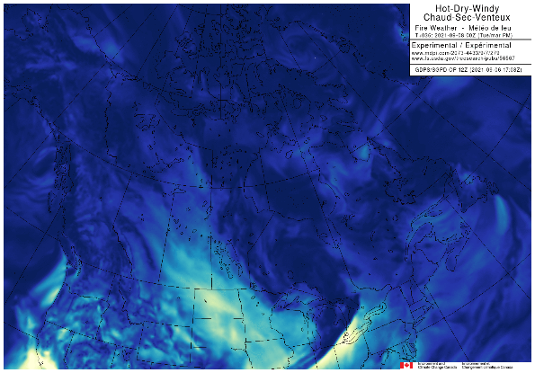
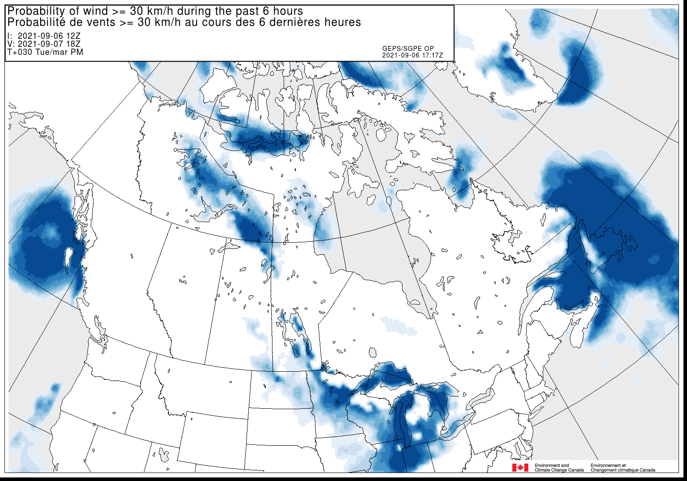
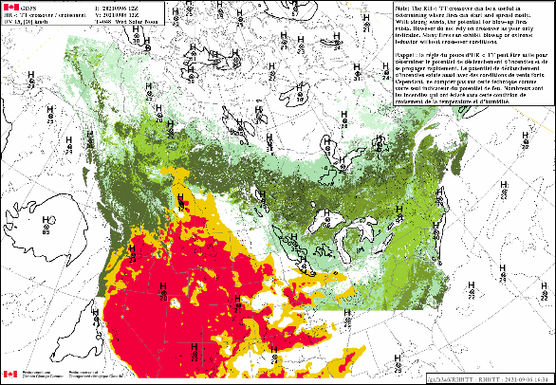
ECCC/NRCan Products
https://collaboration.cmc.ec.gc.ca/cmc/cmop/NRCAN_CFS/
grib2/
hot-dry-windy/
probability/
solar_noon/
wind_shift/
Notes:
Richard Carr, 2021. New slide.

Slide 18
Other Sources of Observed and Modeled Data

Slide 19
Overview
These are only a few of the many data sources
They sample the types of information easily available
A comprehensive list would take days to complete and deliver
Likely more sources of plotted and/or modeled data than observations

Slide 20
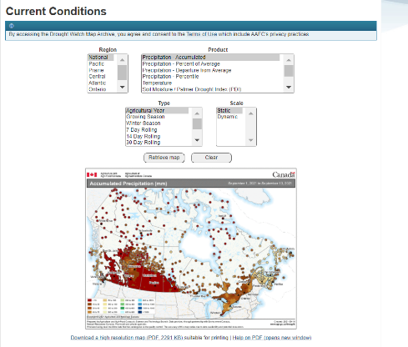
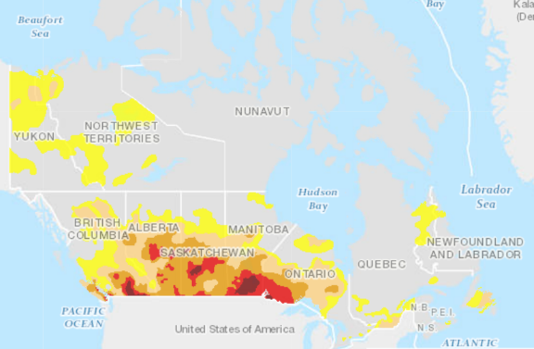
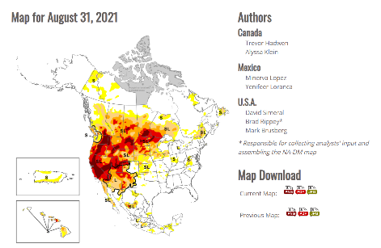
Drought
Canadian Drought Monitor – AAFC
https://agriculture.canada.ca/en/agriculture-and-environment/drought-watch-and-agroclimate
North American Drought Monitor
NCEI: https://www.ncdc.noaa.gov/temp-and-precip/drought/nadm/
NDMC: https://drought.unl.edu/droughtmonitoring/Tools.aspx

Slide 21
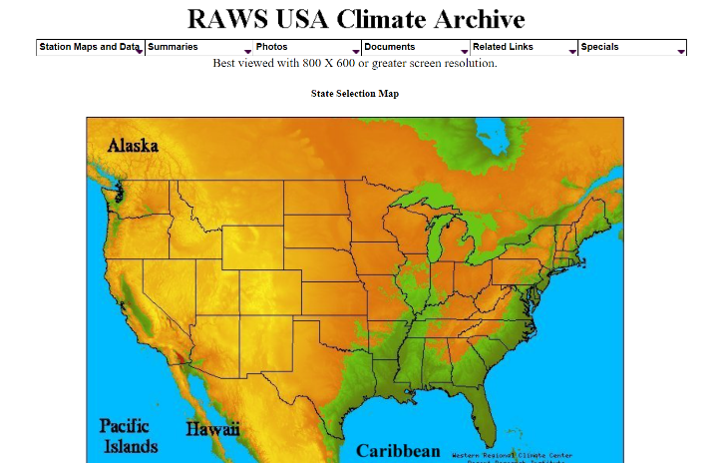
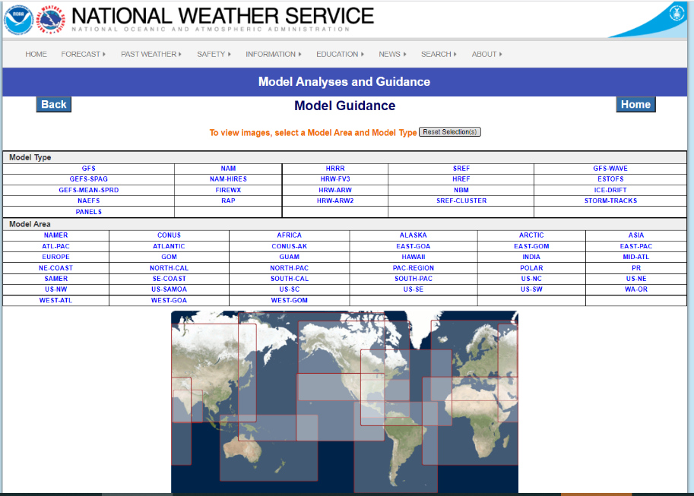
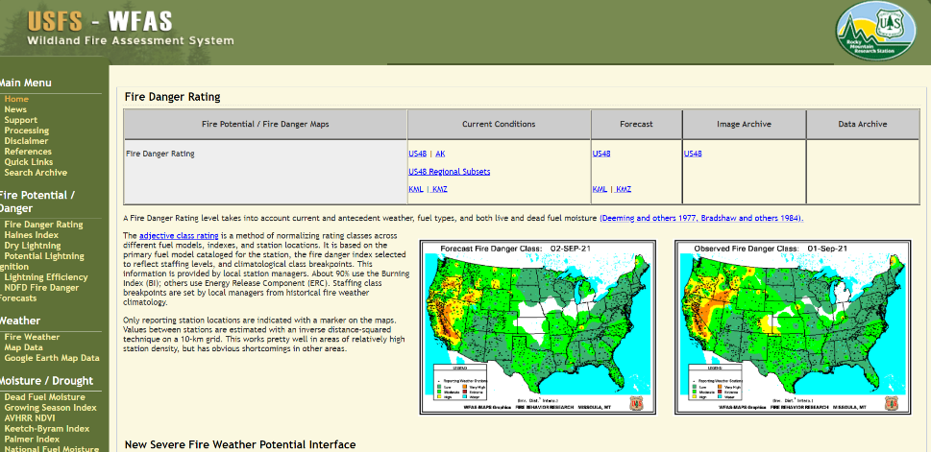
USA Data
DRI-WRCC RAWS
NOAA NCEP/NWS
USFS-WFAS
Notes:
Richard Carr September 2, 2021: Combined DRI and WFAS screen shots with the NWS/Models shot.

Slide 22
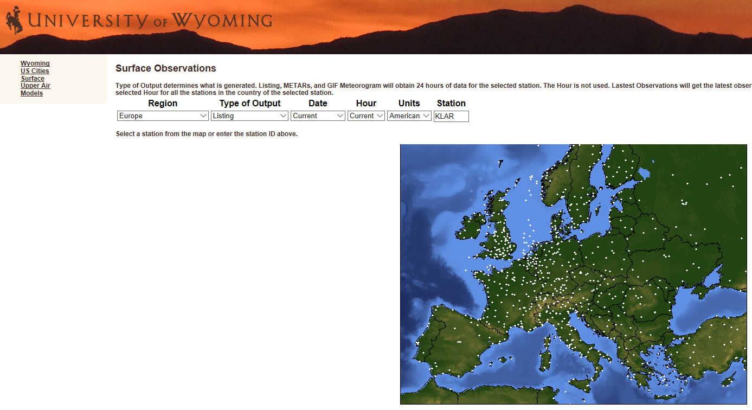
Global Observations
WMO mandate
Fire weather or other networks may exist but are not included
Notes:
New slide – Richard Carr, November 14, 2019. Modified September 2, 2021.

Slide 23
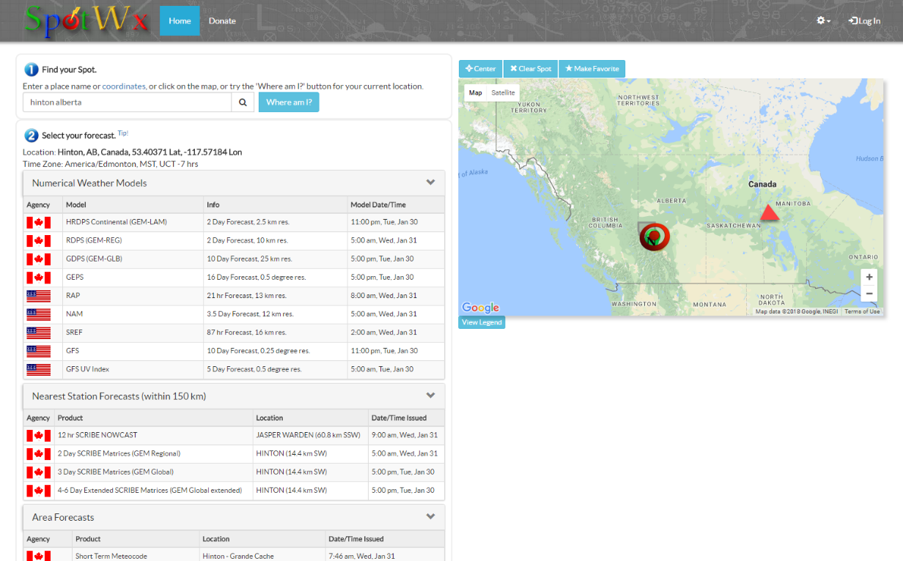
SpotWx (A Canadian fire weather site)
https://spotwx.com
Free for casual use
Nominal fee may apply for subscription service

Slide 24
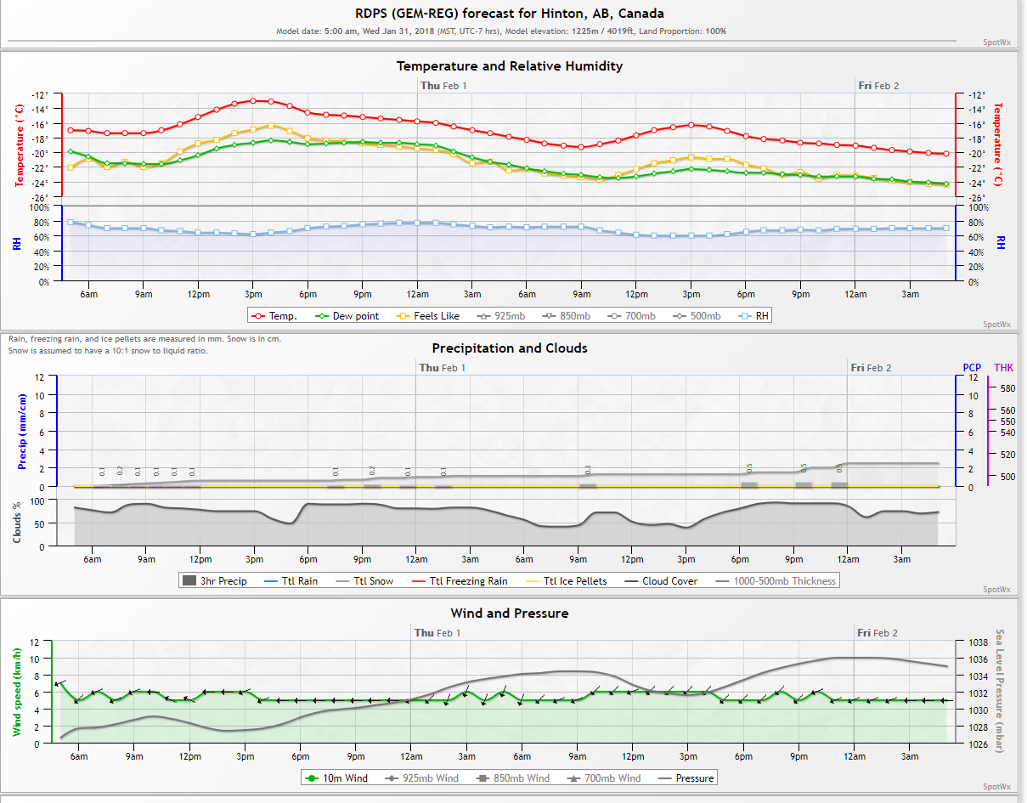
SpotWx Sample Time Series

Slide 25
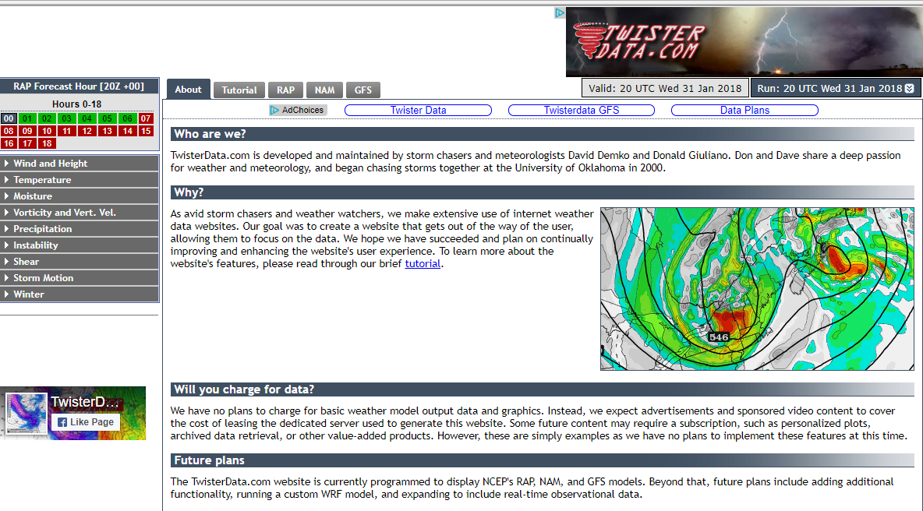
TwisterData.com (U of Oklahoma origin)
http://www.twisterdata.com
Text level 1
Text level 2

Slide 26
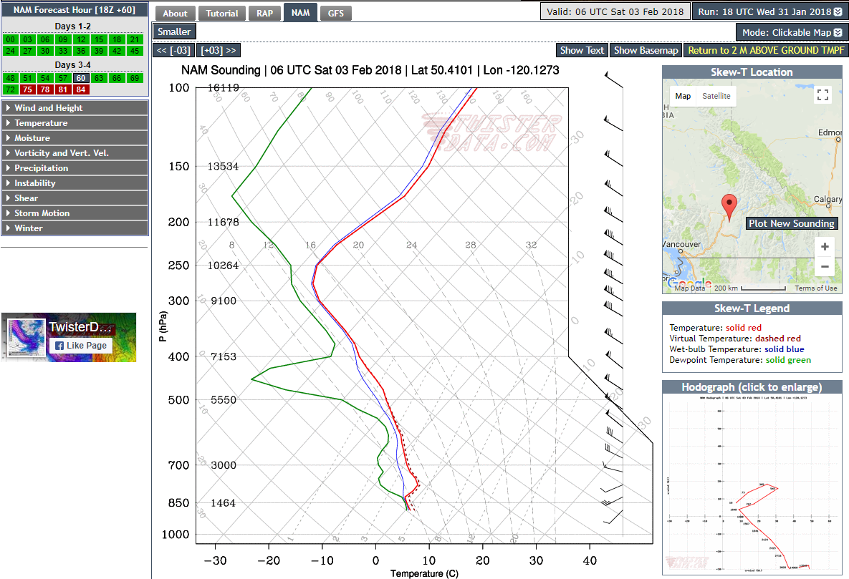
TwisterData.com Sample Model Profile

Slide 27
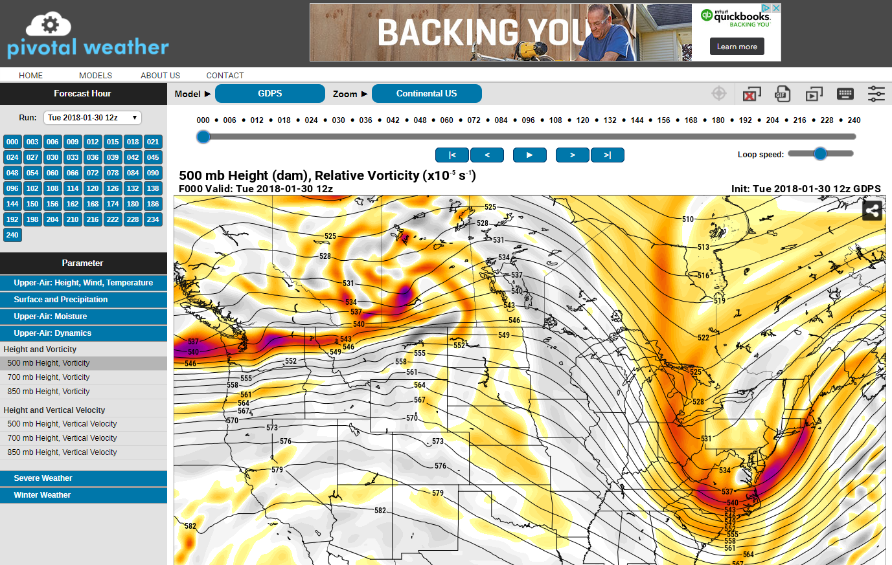
Pivotal Weather
https://pivotalweather.com
Good site for model scenario comparison

Slide 28
Using Model Data

Slide 29
Model Characteristics
Every decade, we increase accurate forecast period by 1 day
High resolution: Finer features/processes resolved
Shorter forecast period
Short time step: Improved feature timing and position
Model grid arrangement, physics packages may differ
Raw (e.g. GRIB), specialized text, and graphical products
 | Resolution (km) | Domain | Forecast (hrs)
HRDPS | 2.5 | Sub-continental | 48
RDPS | 10 | Continental | 48
GDPS | 15 | Global | 240
GEPS | 0.5 degree | Global | 384, 768*
CanSIPS | 2.5 degrees | Global | 12 months
Notes:
Richard Carr, October 4, 2021: Removed GDPS 25km and 66km and replaced with 15km. Modified table for better fit.
Richard Carr, November 2019: New material
As of 2021, ECCC has been experimenting with a variable-domain 250m model for wind. Testing in west central Alberta.

Slide 30
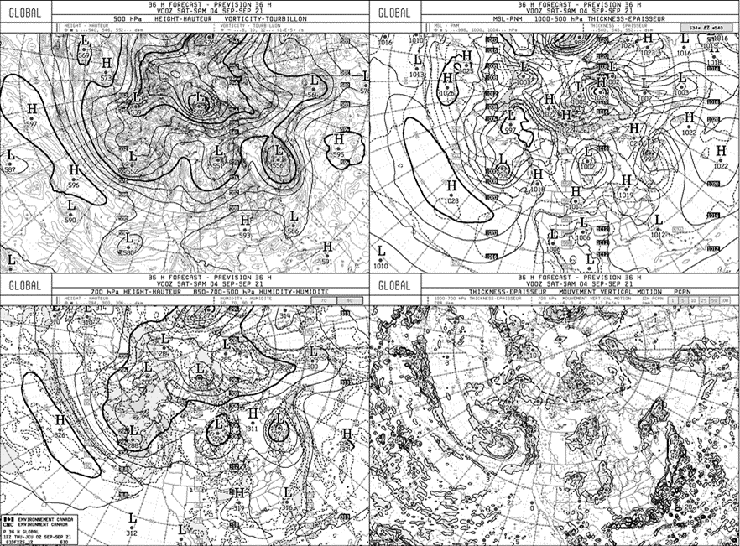
Deterministic Models
Conventional Numerical Forecast
  One Model
  One Solution
Notes:
Richard Carr, November 2, 2021: Combined separate text, 500 hPa, and Surface map slides into one.
This depicts the ECCC 4-panel display.

Slide 31
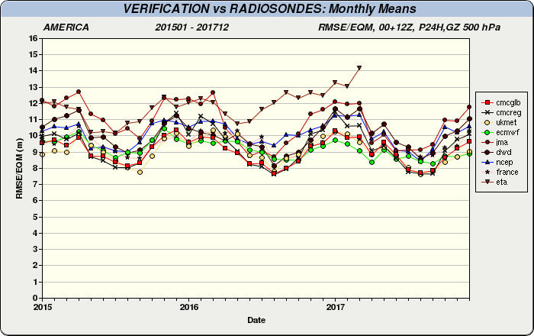
How well do models perform?
500 hPa height 24-hour forecast
RMS errors vs observation
ECMWF and CMC Global good
NCEP may be better now

Slide 32
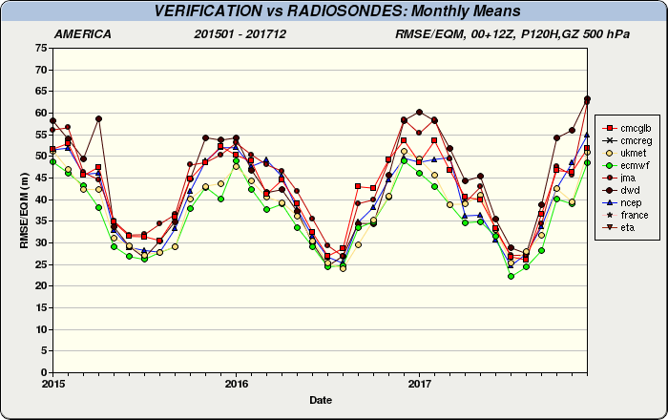
How well do models perform?
500 hPa Seasonal Comparison: 120-hour
RMS errors vs observation
Correlation best in summers

Slide 33
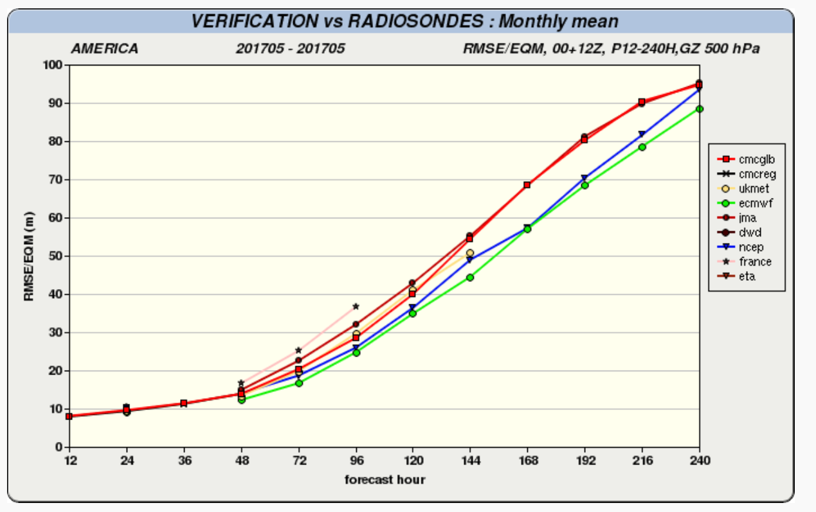
Verification vs Radiosondes
Monthly mean
May 2017 shown here
Notes:
Richard Carr: September 2021: Resized to fit 2021-22 template. Recolored for better visualization. Repositioned 144-240 best fit line for better correlation.
January 2020: Combined this and subsequent slide, which had the shaded boxes, into one.

Slide 34
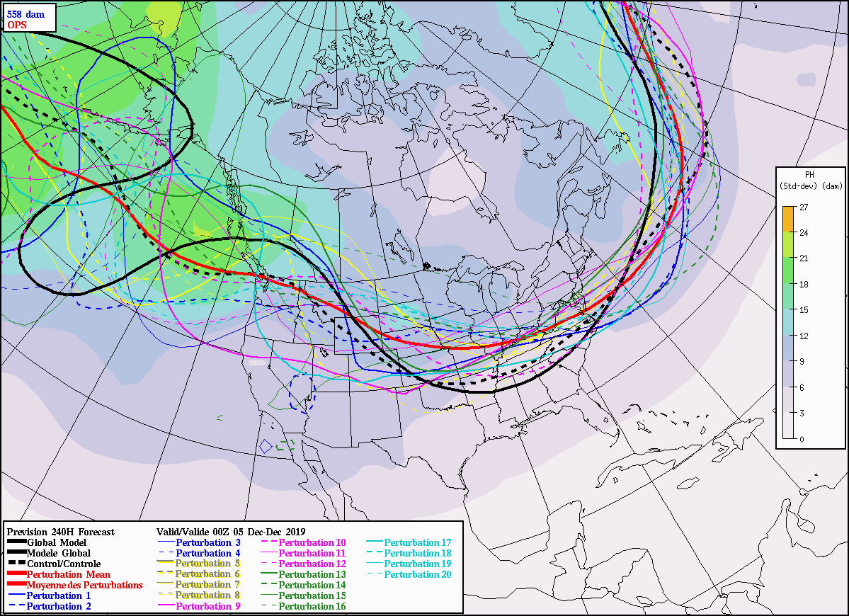
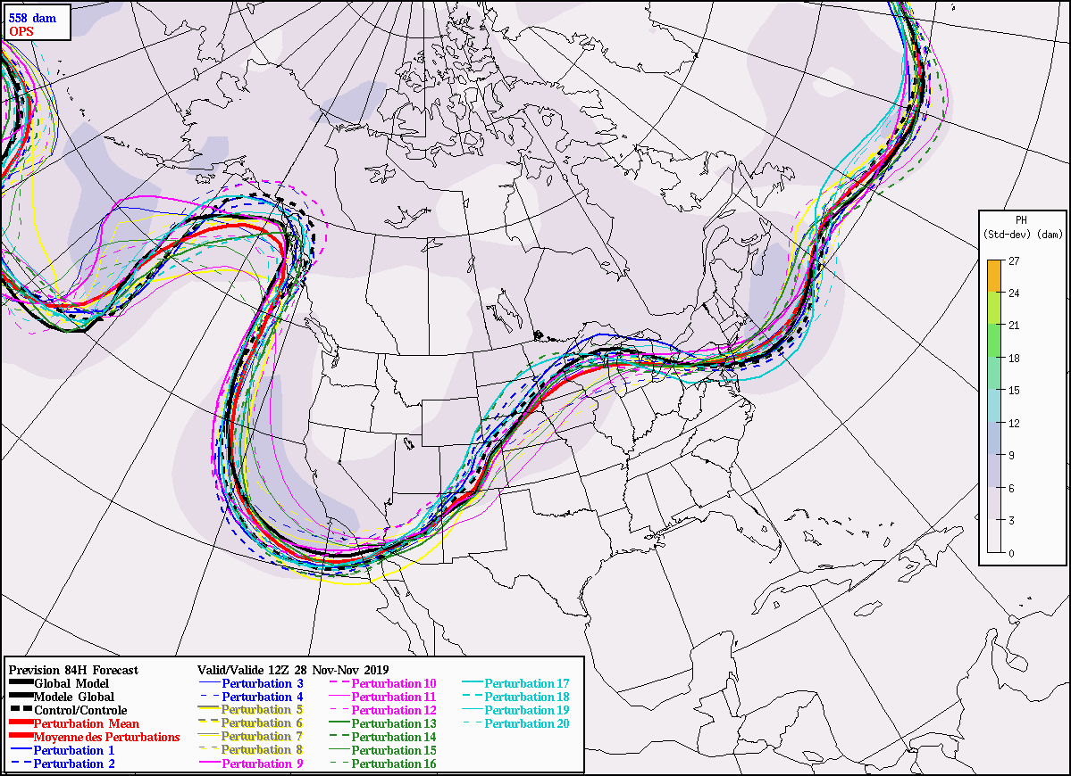
Ensemble Models
Recent trend towards probabilistic forecasting
  Many models
  Many solutions
  Weather or climate
We will explore use of ensembles soon …
Notes:
Richard Carr, November 2, 2021: Combined separate text and spaghetti plot slides into one.
These are 84 and 240-hour forecasts. Note the spread between ensemble elements generally increases with forecast time. In this run in eastern Canada, the elements were actually farther apart at about 168 hours. The 558 dam level is selected since these images were captured in December; in the summer the 570 level is more appropriate.

Slide 35
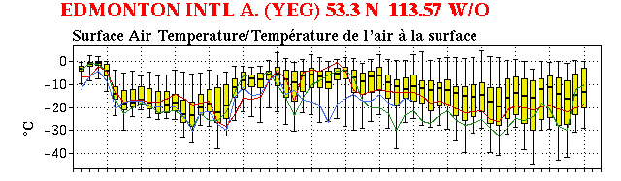
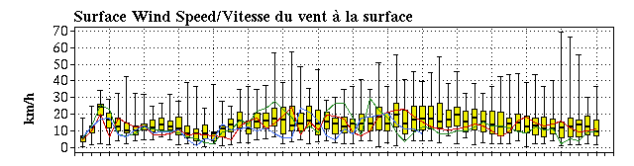
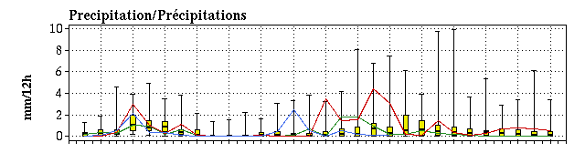
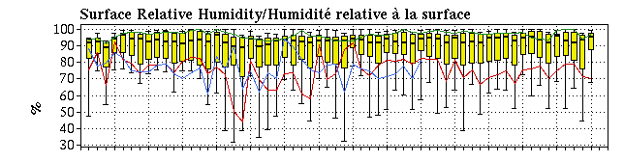
Ensembles: NAEFS EPSGrams
Available on ECCC web site
This display is pieced together from 2 drop-down selections

Slide 36
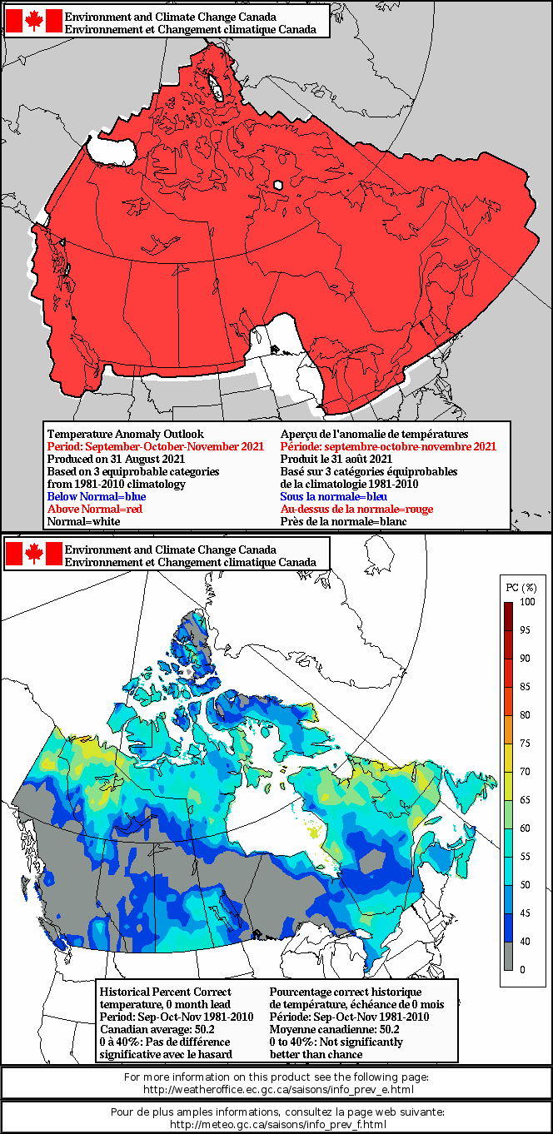
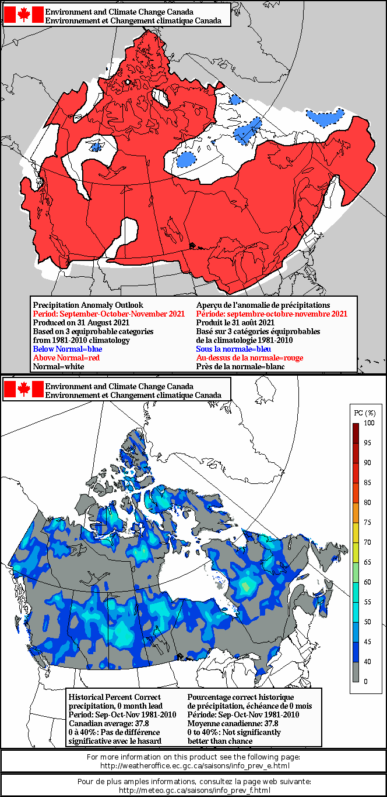
ECCC Deterministic Seasonal Forecast
Temperature
Precipitation
Notes:
Richard Carr, September 15, 2021: Revised with temperature and precipitation forecast maps current for development time.

Slide 37
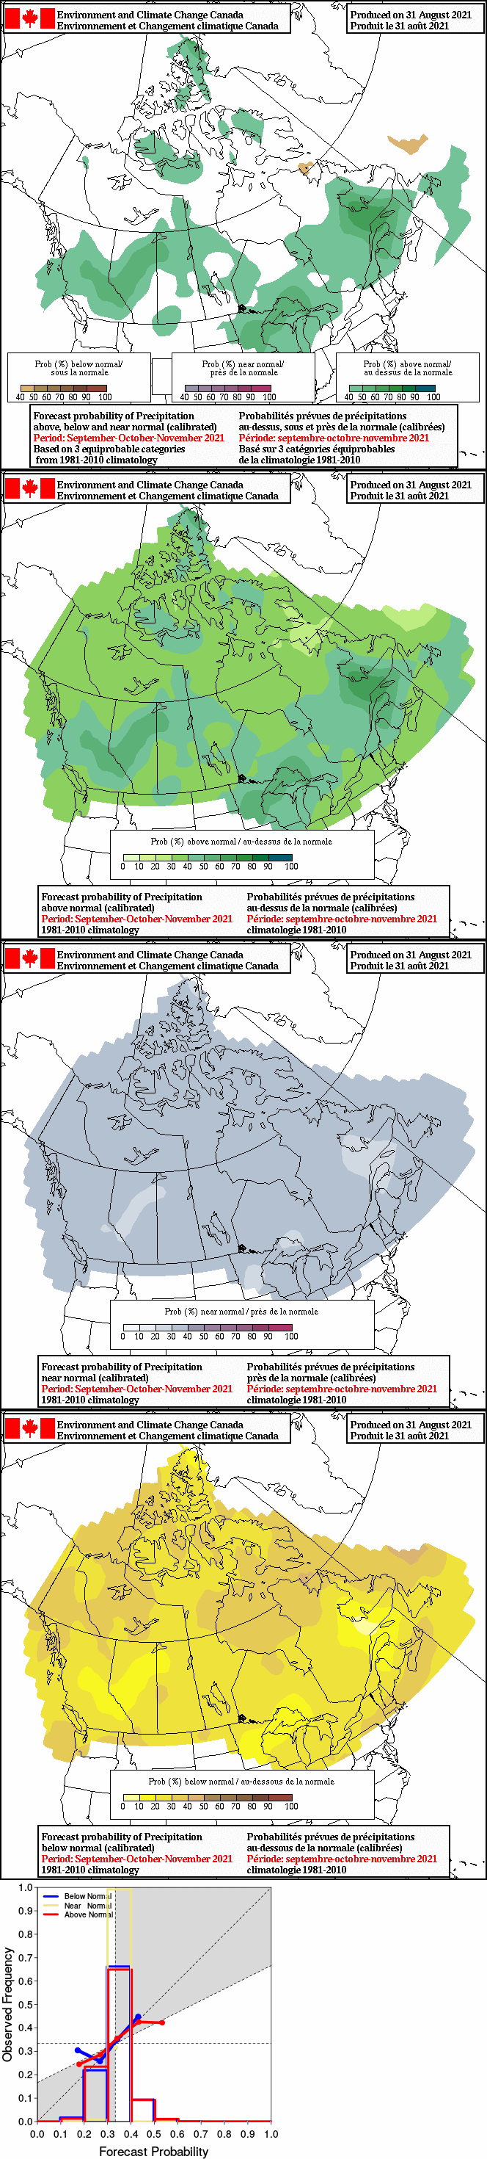
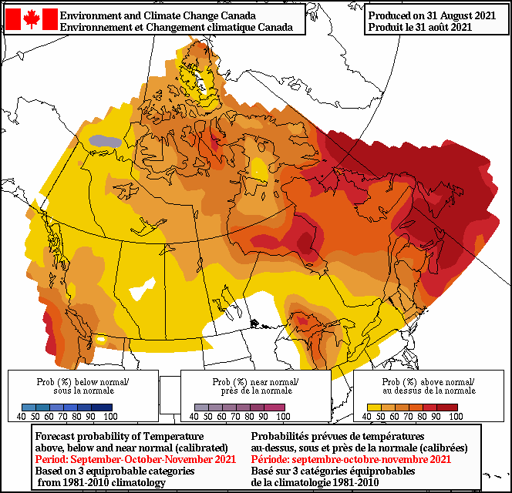
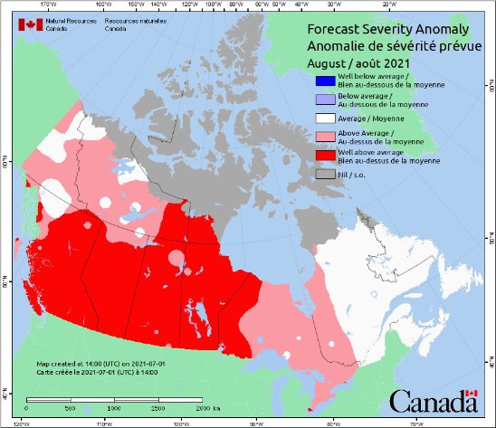
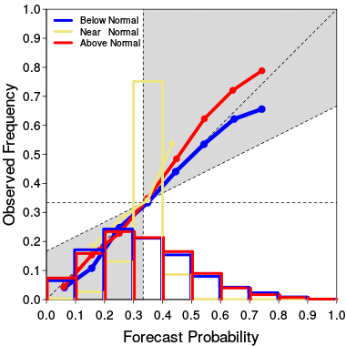
ECCC Probabilistic Forecast
Precipitation
Temperature
NRCan Seasonal Forecast on CWFIS
Notes:
Richard Carr, September 15, 2021: Used imagery current for development season and added NRCan seasonal forecast.

Slide 38
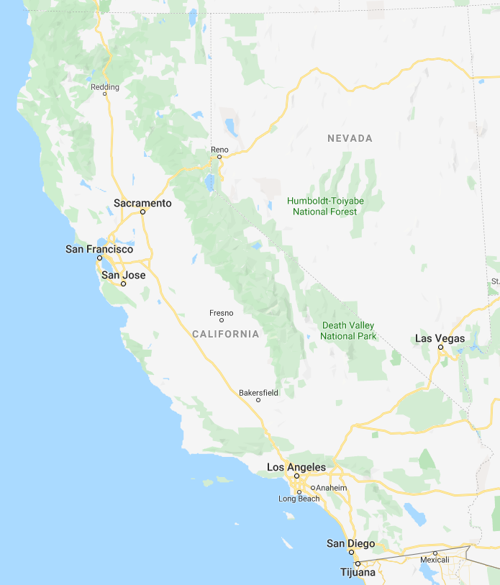
Unit II-B Part 1 Exercise
Study the NWP maps (S589-II-B-1_Exercise_2022.pptx) and NAEFS forecast data (2019111800_SACRAMENTO.xlsx)
Do the model groups (ECCC, NCEP) predict the same wind and RH trends?
Do the elements within a single model group predict the same trends?
What wind event is more likely, Santa Ana (near Los Angeles) or Diablo (near San Francisco)?
Is Sacramento a suitable station for this event?
Eureka
Sacramento
San Francisco
Diablo
Hanford
Santa Ana
Los Angeles
San Diego

Slide 39
Using Ensembles

Slide 40

Ensemble Forecasts
Ensemble means/median are a form of averages
Averages may mask extreme events
Extreme events drive big fire runs
Individual ensemble elements may be useful
Ensemble element agreement indicates forecast confidence
Notes:
Richard Carr, September, 2, 2021: Added photo from another slide and modified text.
Richard Carr, November 2019. Added “agreement=confidence” bullet.

Slide 41
Box Plot Composition
Maximum Forecast Value
Consensus Forecast Value
Variability
Minimum Forecast Value
Notes:
Richard Carr, September, 2, 2021: Added photo from another slide and modified text.
Richard Carr, November 2019. Added “agreement=confidence” bullet.

Slide 42
Box Plot Interpretation
Small Variability
High Confidence
Large Variability
Low Confidence
Notes:
Richard Carr, September, 2, 2021: Added photo from another slide and modified text.
Richard Carr, November 2019. Added “agreement=confidence” bullet.

Slide 43
Temp. Forecast: Consensus vs Variability
Date | Time | Consensus | Lower End | Upper End
2011-02-15 | 17:00 | -4.4 | -6.4 | -1.3
2011-02-16 | 17:00 | -16.7 | -18.4 | -11.0
2011-02-17 | 17:00 | -18 | -21.3 | -14.3
2011-02-18 | 17:00 | -18.5 | -22.0 | -12.0
2011-02-19 | 17:00 | -8.4 | -12.2 | -4.5
2011-02-20 | 17:00 | -5.6 | -10.4 | -2.4
2011-02-21 | 17:00 | -5.6 | -11.2 | -2.7
2011-02-22 | 17:00 | -4.3 | -7.7 | -2.3
2011-02-23 | 17:00 | -6.4 | -12.8 | -2.4
2011-02-24 | 17:00 | -11 | -17.3 | -6.0
2011-02-25 | 17:00 | -12.5 | -19.4 | -8.0
2011-02-26 | 17:00 | -14.7 | -21.9 | -9.3
2011-02-27 | 17:00 | -13.9 | -23.3 | -6.9
2011-02-28 | 17:00 | -11.5 | -24.5 | -6.3
2011-03-01 | 17:00 | -13.5 | -20.2 | -2.9
Notes:
Richard Carr, January 2020: Combined consensus and variability slides into one and improved formatting.

Slide 44
Ensemble Precipitation Forecasts
“Ensemble means/medians have little meaning for discontinuous weather elements”
Many solutions forecast no precipitation on a particular day
Forecasts may differ due to weather system timing, or different convective capabilities
“Reduce the consensus precipitation amounts”?
“BUI values trend higher”
Consider timing of rain and effects on fire weather
Notes:
Richard Carr, September, 2, 2021: Modified text. The “quotes” are from previous WFBS offerings, which I feel wre biased against ensembles.. I am hoping to provide a different perspective on ensemble precipitation predictions.

Slide 45
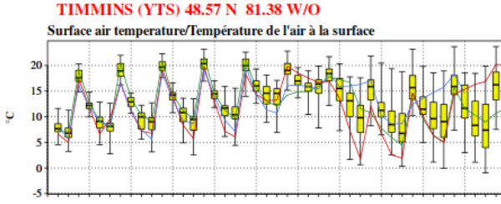
Box Plot Confidence vs Accuracy
4 5 6 7 8 9 10 11 12 13 14
Notes:
Richard Carr: November 3, 2021. Blue dots are observed conditions. Forecast for early October 2021.
What may cause less temperature variation in latter part of forecast [cloud?].

Slide 46
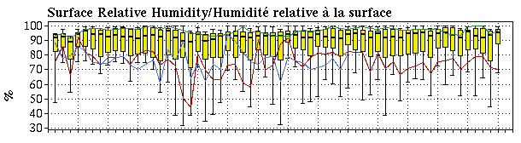
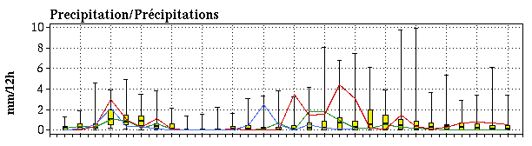
Box Plots: RH and Precipitation
Notes:
Richard Carr, January 2020. Combined precipitation and RH plots into one slide.

Slide 47
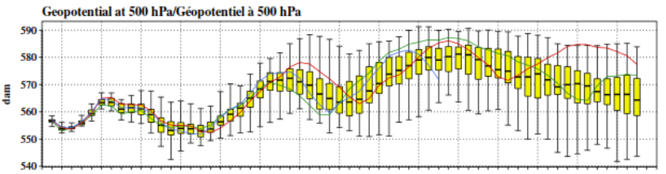
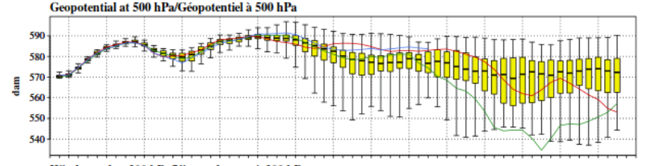
Ensembles: 500 hPa Trend
Kelowna
Ottawa
Notes:
Richard Carr, September 2021: Replaced the early spring plot with two current late summer plots.
January 2020: We should try to replace this (early spring plots) with a summer scenario.

Slide 48
Ensemble Forecast Reminder!
Ensemble forecast interpretation is challenging!
Much research into ensemble usage still needs to be done with regards to fire weather
Discuss usage and questions with your fire weather office
They may have answers for your questions, but an offer expert assessment
Notes:
Richard Carr, October, 5, 2021

Slide 49
Ensemble Case Study:
Flattop Complex, May 15, 2011

Slide 50
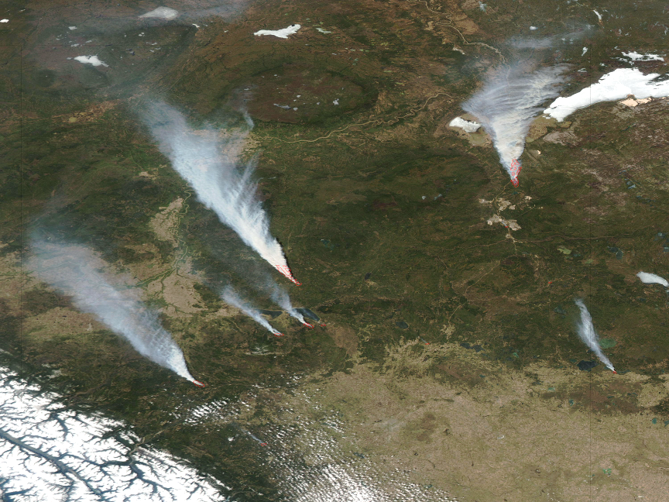
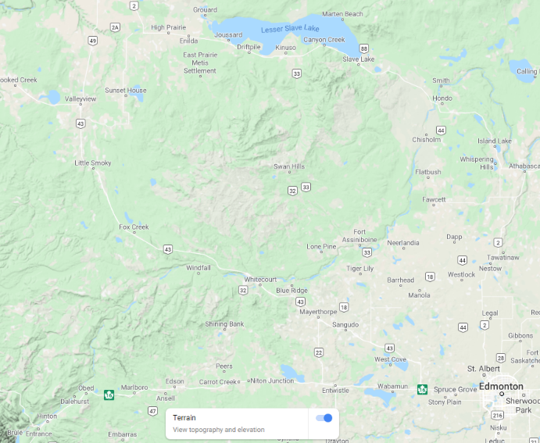
Flattop Complex Setting
Lesser Slave Lake
Hinton
Edmonton
Notes:
Richard Carr, January 2020: Added key map

Slide 51
Slave Lake Ensemble Rainfall
Forecasts for event: 18:00 MDT May 15, 2011
Notes:
Richard Carr, September 15, 2021: Cropped out old title and added new date and time in bigger font in a new text box. The
previous hidden slide contains the chart object these next few were derived from.
January 16, 2020: Took out the animations so we just see the whole plot at once.
November 14, 2019: Added exit animations to white boxes so we can uncover parts of the time series. The
original subsequent slide, which showed the same plot, has now been deleted.

Slide 52
Slave Lake Ensemble Wind Speed
Forecasts for event: 18:00 MDT May 15, 2011
Actual Sustained Windspeed 46 km/h
Notes:
Richard Carr, September 15, 2021: Copied base plot from predecessor’s chart object and pasted as image, then cropped out
title and resized. The original slide is kept as a hidden slide a couple places back.
Suspected I was misinterpreting the intent of these plots … these are all successive daily
forecasts for May 15, so took out the plot and text relating to observed data.
November 14, 2019: Deleted previous slide, which showed same plot but without the full animation series on
this slide. Replace horizontal 46 km/h observed line with rough daily plot of 6pm MDT
wind speed observed at Slave Lake AWOS A, 3066002. Added animations regarding
possible frontal passage timing on May 3/4.
January 26, 2020: Took out the animated boxes covering part of the basic plot. We now show it all at once.

Slide 53
Slave Lake Ensemble RH
Forecast for event: 18:00 MDT May 15, 2011
This event occurred with an Arctic surface high to east. Why may the early forecasts be inaccurate?
A slight change in shape or position may affect moisture content.
Recorded Rh 22%
Notes:
Richard Carr, September 15, 2021: Copied base plot from predecessor’s chart object and pasted as image, then cropped out
title and resized. The original slide is kept as a hidden slide a couple places back.
Suspected I was misinterpreting the intent of these plots … these are all successive daily
forecasts for May 15, so took out the plot and text relating to observed data.
Richard Carr, November 14, 2019: Added rough daily plot of 6pm MDT RH observed at Slave Lake AWOS A, 3066002.
Deleted subsequent slide with same plot.
January 16, 2020: Took out animated box that covered part of the plot – we now show it all at once.

Slide 54
Slave Lake Ensemble 500 hPa Height
Forecast for event: 18:00 MDT May 15, 2011
Actual Height
Positive Anomaly
Average Height
Notes:
Richard Carr, September 15, 2021: Copied base plot from predecessor’s chart object and pasted as image, then cropped out
title and resized. The original slide is kept as a hidden slide a couple places back.
January, 2020: Took out the animated box that covered part of the plot – we now show it all at once.

Slide 55
Slave Lake Ensemble 500 hPa Height
Forecast for event: 18:00 MDT May 15, 2011
Positive Anomaly
Negative Anomaly
Notes:
Richard Carr, September 15, 2021: Copied base plot from predecessor’s chart object and pasted as image, then cropped out
title and resized. The original slide is kept as a hidden slide a few places back.

Slide 56
Ensemble Case Study:
Lee of Rockies

Slide 57
Why may early RH forecast be too high?
Subsidence over Rockies inaccurate?
Position and shape of surface high?
Notes:
Richard Carr, September 15, 2021: Suspected I was misinterpreting the intent of these plots … these are all successive daily
forecasts for May 15, so took out the plot of observed data. Added “early” in the blue
question and answer point in green about shape and position of surface high.
Kept this as a hidden slide as it contains the original chart object.
Richard Carr, November 14, 2019: Added rough plot of 6pm MDT RH observed at Rocky Mountain House (AUT), 3015523, and question and possible answer
about early period forecast inaccuracy.

Slide 58
Rocky Mtn House Ensemble RH
Forecast for event: 18:00 MDT May 15, 2011
Why may early RH forecast be too high?
Subsidence over Rockies inaccurate?
Position and shape of surface high?
Notes:
Richard Carr, September 15, 2021: Suspected I was misinterpreting the intent of these plots … these are all successive daily
forecasts for May 15, so took out the plot of observed data. Added “early” in the blue
question and answer point in green about shape and position of surface high.
Copied base plot as image for resizing. Original chart object is in hidden slide (previous).
Richard Carr, November 14, 2019: Added rough plot of 6pm MDT RH observed at Rocky Mountain House (AUT), 3015523,
and question and possible answer about early period forecast inaccuracy.

Slide 59
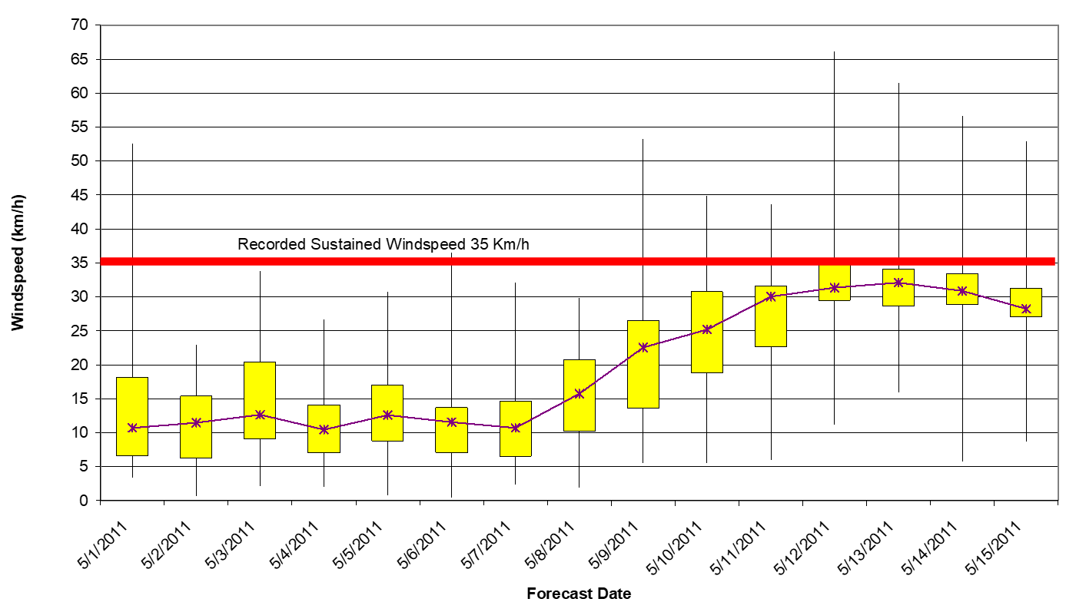
Rocky Mtn House Ensemble Wind Speed
Forecast for event: 18:00 MDT May 15, 2011
Notes:
Richard Carr, September 15, 2021: Copied base plot as image for resizing. Original chart object is in hidden slide 2 spots
back.

Slide 60
Ensemble Case Study:
Kenow Fire

Slide 61
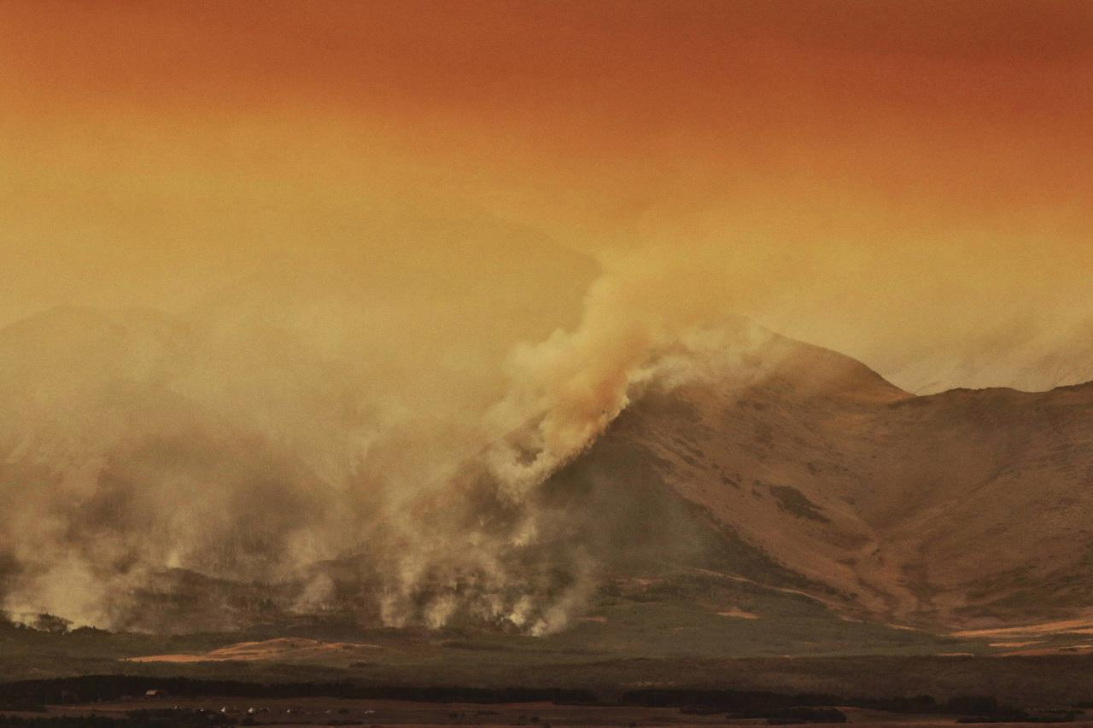


Kenow Fire Ensemble Forecasts
Notes:
Richard Carr, November 2019. Combined 2 slides; added key map

Slide 62







Kenow Fire SpotWx Forecast 14, 8, 1 day leads
RH
Time | Temp | RH | Td | Wspd | Wgust | Wdir
9/11/2017 12:00:00 | 22.4 | 18 | -2 | 33 | 57 | SW
9/12/2017 12:00:00 | 19.6 | 17 | -5 | 31 |  | SW
Wspd
Wdir
Notes:
Richard Carr, October 4, 2021: Added table with observed values, parameter labels for plots, and dashed lines for time.
Richard Carr, November 29, 2018. Combined 3 forecast lead times into one slide.

Slide 63
Summary
Networks: know major differences between
Provincial/territorial fire weather
Federal sources
View a sampling of other data sources
Modeled data
Plots or maps of observed or modeled data
USA fire weather data sources
Deterministic and Ensemble models
Understand some basic differences
Ensembles: know some caveats and basic usage

Slide 64
Contact Information
Contact:
Richard Carr
Wildland Fire Research Analyst
Richard.Carr@NRCan-RNCan.gc.ca
5320 122 Street NW
Edmonton, AB, Canada
T6H 3S5
825-510-1265 780-710-3147
?
?
?
?
?
Notes:
Richard Carr, January 2020: Added section title

Slide 65
Title
Text level 1
Text level 2

