Slide 1
S589: Weather Data Sources
Exercise

Slide 2
Unit II-B Part 1 Exercise
Study the supplied NWP maps and text NAEFS forecast data (2019111800_SACRAMENTO.xlsx)
Do the model groups (ECCC, NCEP) predict the same wind and RH trends?
Do the elements within a single model group predict the same trends?
What wind event is more likely, Santa Ana (near Los Angeles) or Diablo (near San Francisco)?
Is Sacramento a suitable station for this event?
Eureka
Sacramento
San Francisco
Diablo
Hanford
Santa Ana
Los Angeles
San Diego

Slide 3
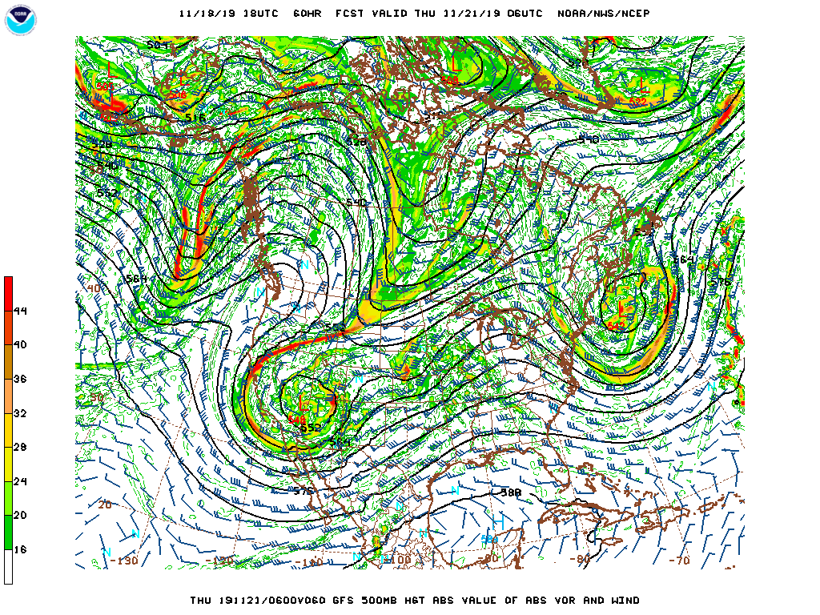
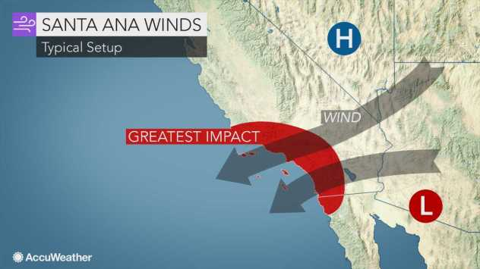
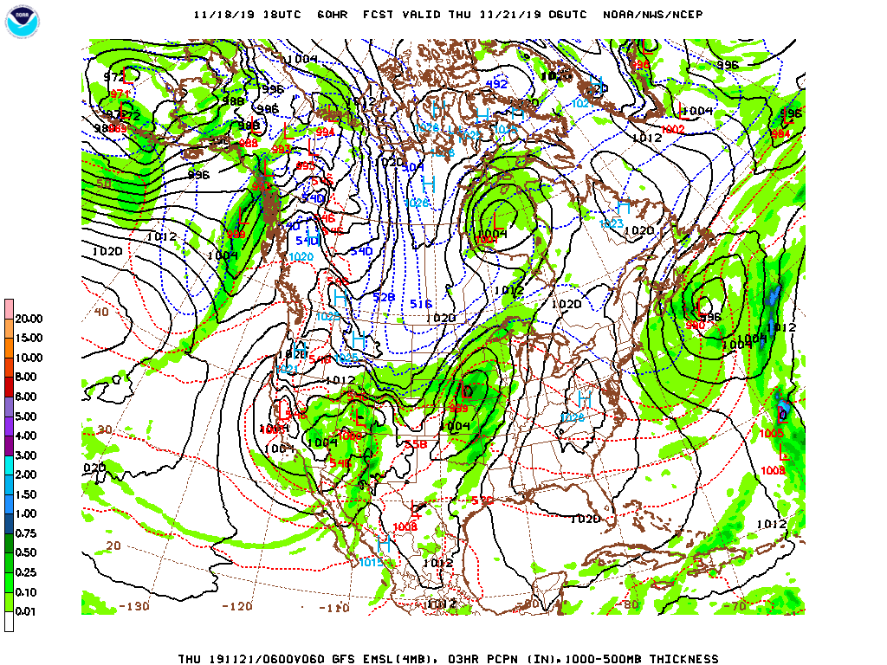
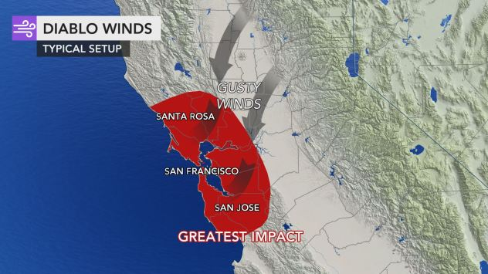
Unit II-B Part 1 Exercise
Mt Diablo

Slide 4
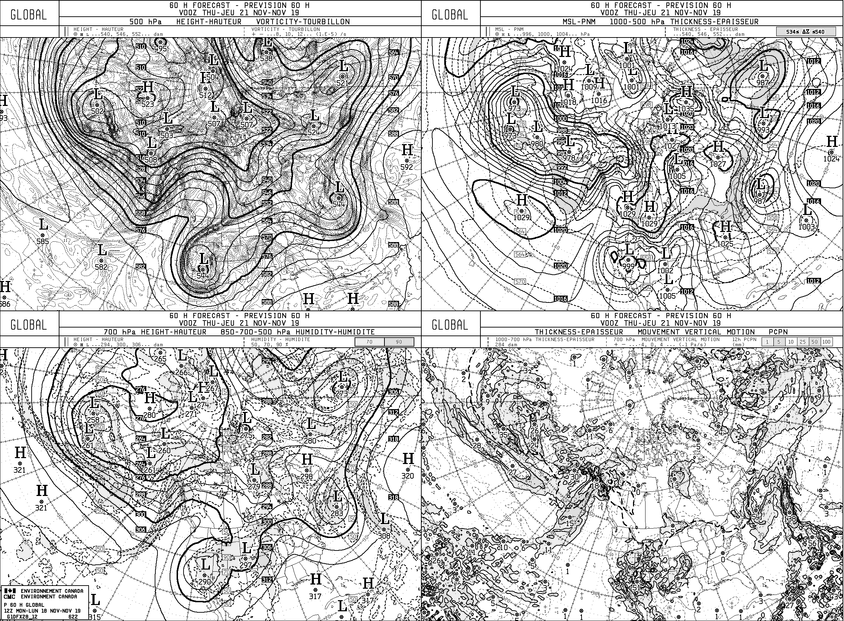
Unit II-B Part 1 Exercise

Slide 5
Unit II-B Part 1 Exercise
Your name:
Answer the questions and submit a copy in any format (pptx, pdf, Word). You can use this slide for submission:

Slide 6
Contact Information
Contact:
Richard Carr
Wildland Fire Research Analyst
Richard.Carr@NRCan-RNCan.gc.ca
5320 122 Street NW
Edmonton, AB, Canada
T6H 3S5
825-510-1265 780-710-3147
?
?
?
?
?
Notes:
Richard Carr, January 2020: Added section title

