Slide 1
Background Material for WFBS 2022 Meteorology Chapters
Purpose
Provide some basic atmospheric information
Show some rules of thumb

Slide 2
Heading: Arial 32pt centred, vertical=0.5cm
Section Title: Corbel 40pt centred hor.
Text: Level 1 = Arial 28 pt
Text level 2 = Arial 24pt

Slide 3
A bit of RJC Weather Philosophy
Weather systems are much like people … they may look similar on maps but …
In reality, they present a huge variety of faces
Factors: shape, movement, geographic location; wind, temperature, humidity profiles
Human observer is important
Instruments can reveal unseen features
Notes:
Richard Carr, October 19, 2021

Slide 4
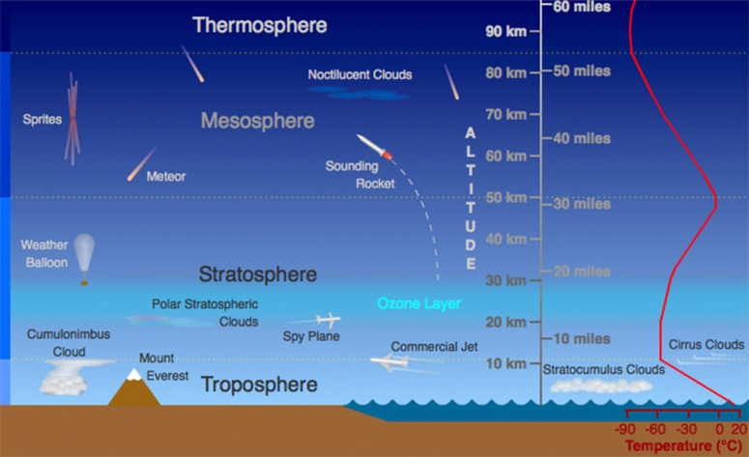
Atmosphere Review
Earth’s weather occurs in the troposphere
~ 35 000 ft (10km) to surface
*Photo Credit: UCAR
Notes:
Dashed lines on graphic at ~ 10km and 20km added by Richard Carr, August 2021
Most of Earth’s weather occurs in the lower 35 000 feet (~11 000 m) of the atmosphere in the troposphere – we are concerned with the smaller envelope around the fire environment. Strong thunderstorm tops may exceed 60 000 feet (~20 000 m), and strong smoke plumes may inject particulates above the tropopause.

Slide 5
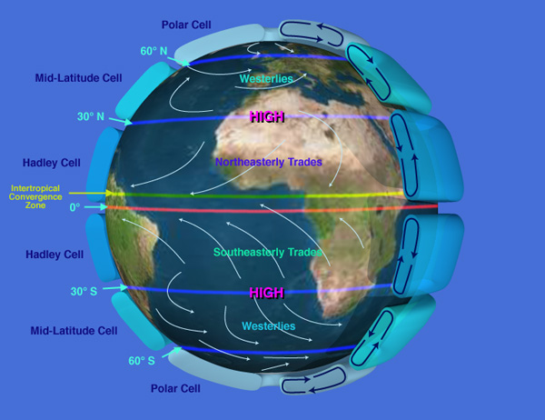
General Circulation
https://upload.wikimedia.org/wikipedia/commons/f/fa/NASA_depiction_of_earth_global_atmospheric_circulation.jpg
Notes:
Cover the general circulation here – ITCZ, Hadley cells, subtropical highs, etc. Let’s leave details pertinent to fire seasons, such as dry/wet (monsoon) seasons to the Fire Danger Climatology session.

Slide 6
Ideal Gas Law
Atmosphere generally obeys Charles Law and thus the Ideal Gas Law:
T/V = constant with constant mass and pressure
P= (n/v)RT P=ρRT
ρ= 1/v
R = Dry air gas constant:
8.3145 J/molK
287 J/kgK
Notes:
The movement of the air parcel up and down through the atmosphere is governed by the gas law where:
P = pressure
M = mass
V = volume
R = Gas constant
T = temperature
Involving kinetic theory and movement of molecules

Slide 7
T/RH Conversion Rule of Thumb
T-T_{d} | RH (%) |  | T-T_{d} | RH (%)
0 | 100 |  | 16 | 34
1 | 94 |  | 17 | 32
2 | 88 |  | 18 | 30
3 | 83 |  | 19 | 28
4 | 77 |  | 20 | 26
5 | 73 |  | 21 | 24
6 | 68 |  | 22 | 22
7 | 64 |  | 23 | 21
8 | 60 |  | 24 | 19
9 | 56 |  | 25 | 18
10 | 52 |  | 26 | 17
11 | 49 |  | 27 | 15
12 | 45 |  | 28 | 14
13 | 42 |  | 29 | 12
14 | 40 |  | 30 | 12
15 | 37 |  | 31 | 11
Works best between about 10C and 25C
This table uses the Bohren and Albrecht equation (see TTdRHConversionTable2022.xlsx for more detail)

Slide 8
Contact Information
Contact:
Richard Carr
Wildland Fire Research Analyst
Richard.Carr@NRCan-RNCan.gc.ca
5320 122 Street NW
Edmonton, AB, Canada
T6H 3S5
825-510-1265 780-710-3147
?
?
?
?
?

