Slide 1
Canadian Fire Weather Situation Presented to the Canadian Interagency Forest Fire Centre (CIFFC)
August 20, 2025
Via Teams
Richard Carr / Liam Buchart / Michael Smith
Canadian Forest Service
Wildland Fire Information Systems Group, Northern Forestry Centre

Slide 2
Instructions to developer
Linking Images:
Some images are linked to URLs and update automatically. Linking images can be done by using menu items <Insert> then <Pictures>, and specifying the URL or network location in the <File name> box, and choosing <Insert> then <Insert and link>, for example. The speaker notes on each slide indicate if images update automatically or need manual updates. When you are done this presentation for the current day’s briefing: Copy it to a presentation dated for your next briefing day On the current day’s presentation Go to the <File> menu
Select “Info” Under <Related Documents>, go to <Edit Links to File> Select each file and choose <Break link to file> This procedure ensures if you open an old presentation, the chosen images for that date are not overwritten by the automatic updates.
Notes:
2

Slide 3
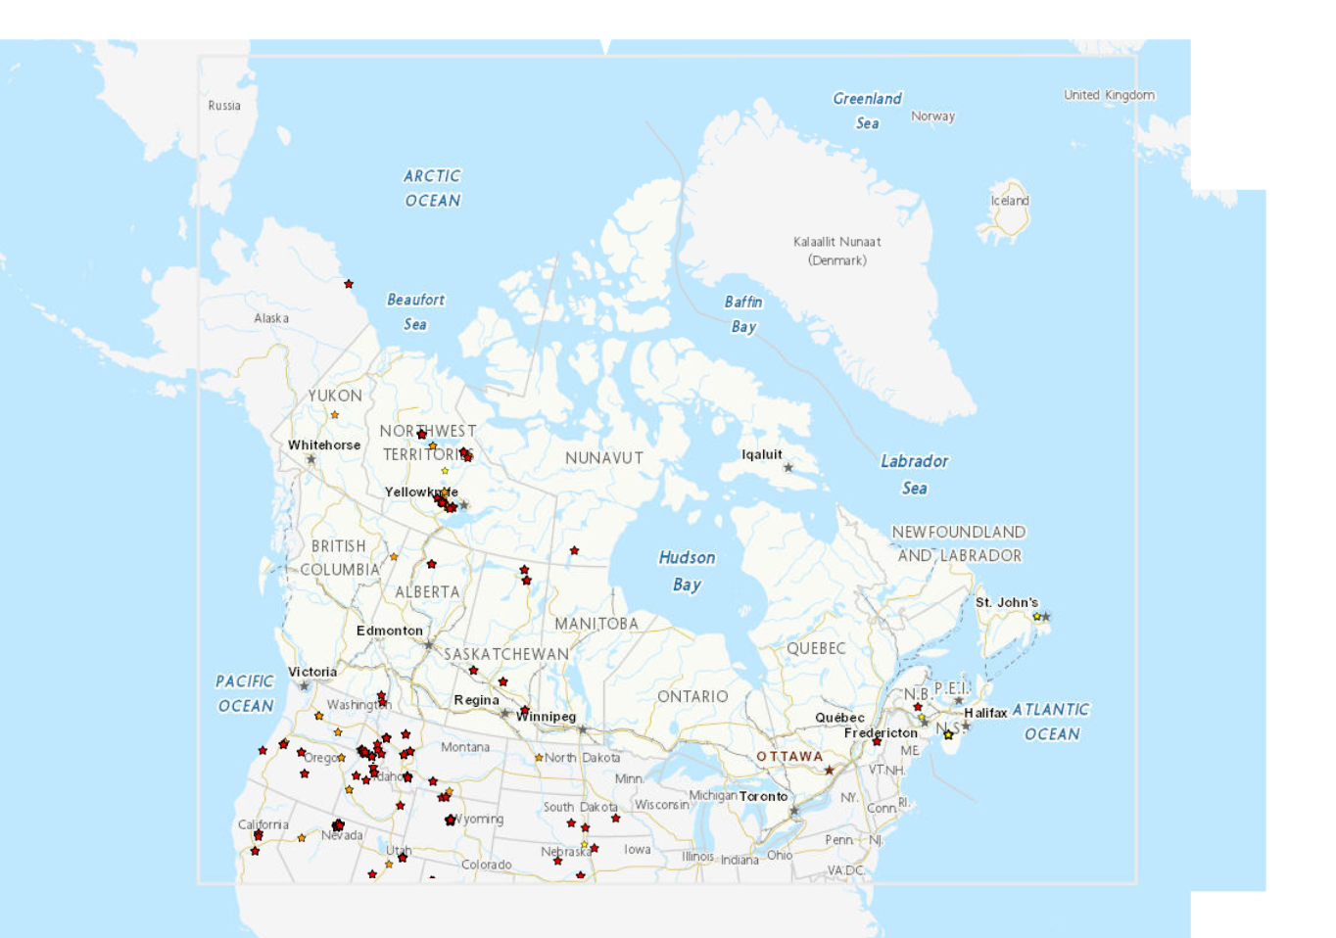
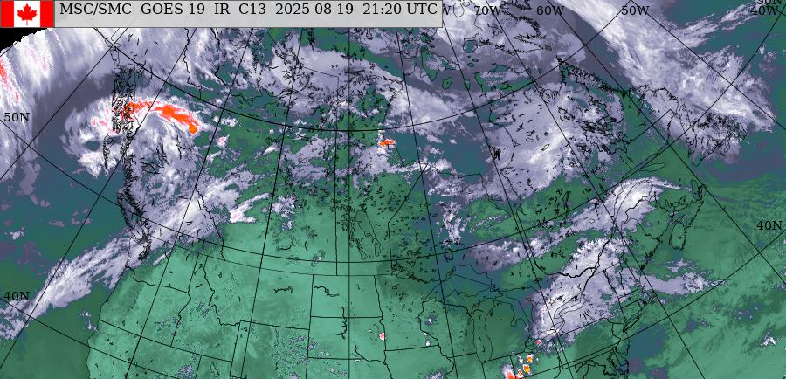

CWFIS Hotspots (Interactive Map)
https://cwfis.cfs.nrcan.gc.ca/interactive-map
Erin
https://weather.gc.ca/satellite/satellite_anim_e.html?sat=goes&area=nam&type=1070
Interactive map : ~14.5H x 22.8W 9Hx11.6W
Notes:
Update images manually. We want to preserve the images from the previous afternoon.
To overlay a semi-transparent satellite image:
-Align the red line from the southern tip of Haida Gwaii to the southeast tip of Newfoundland’s Avalon Peninsula.
-Get the CWFIS interactive map image from late afternoon on Tuesday and align with the red line as above
-Choose the late afternoon Tuesday North American GOES composite image. Rotate ~7 degrees, transparency ~50%.
and align with the red line/CWFIS interactive map image.
Previous afternoon’s CWFIS active fire layer with other themes such as hotspots as you see fit. Red circles are fires of > 1000 ha, orange 100-1000 ha, yellow < 100 ha.
Include satellite image from Environment Canada (North American IR & topography) from about the same time as the CWFIS screenshots.
The inset shows fires in Yukon via the Data Integration Project. Red circles indicate uncontrolled fires.
3

Slide 4
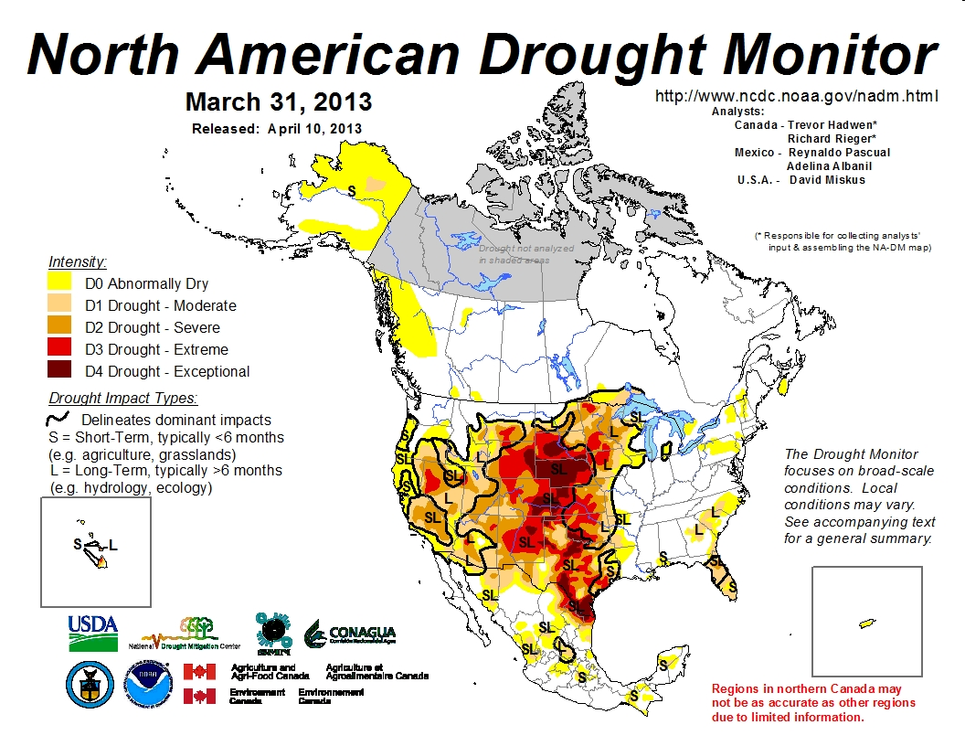
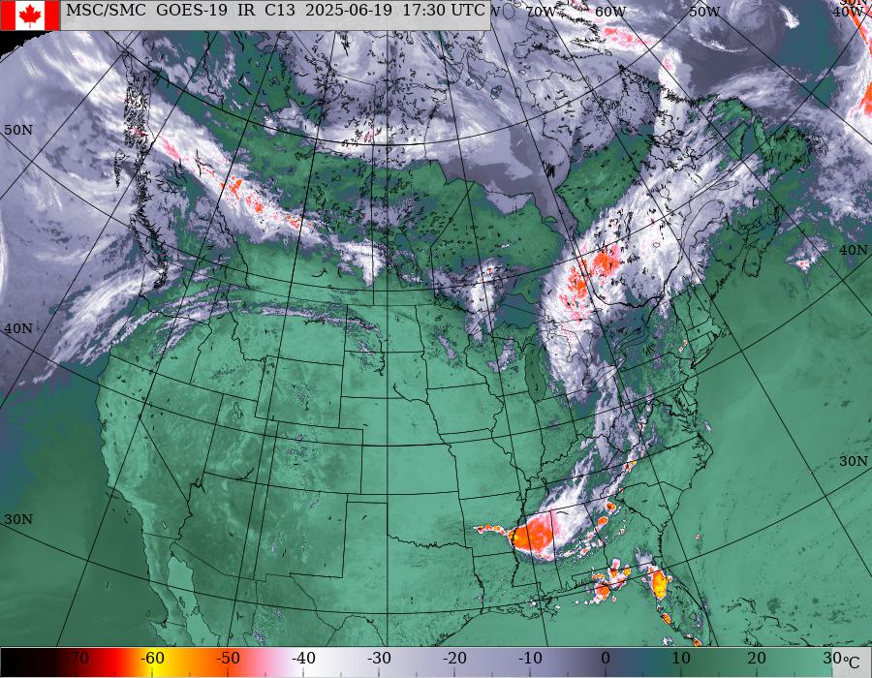
North American IR Composite
http://weather.gc.ca/data/satellite/goes_nam_1070_100.jpg
14H x 18W
Notes:
Image is updated automatically from web.

Slide 5
Water Vapor Imagery
College of Dupage (COD) water vapor loop
14H x 18W
Notes:
Image is updated automatically from web.

Slide 6
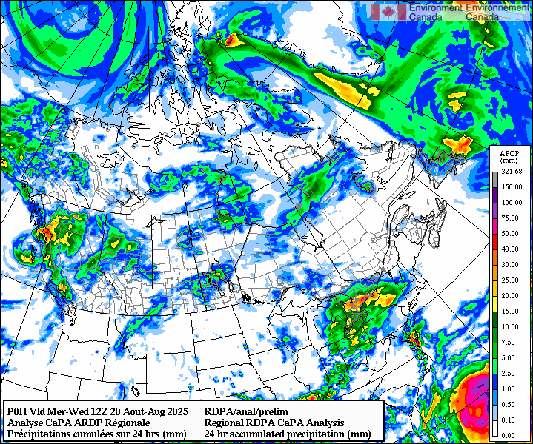
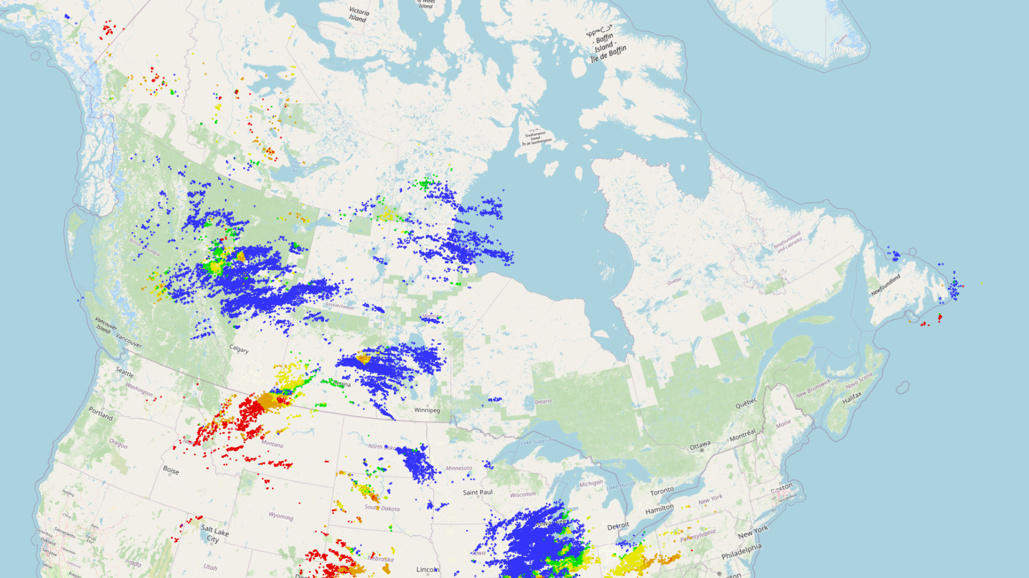
Lightning and CaPA
https://weather.gc.ca/data/analysis/regional/rdpa/2025040312_054_CR_canada_I_RDPA_prelim@pr@024_000.png
Local Repository: W:\EDM\Fire\CIFFC\WeatherBriefings\Gen_Image_Repo\capa_prelim1.png
CLDN past 48 hours
14Hx16.8W 6.9H x 12W
Notes:
Automatic update of CaPA image when downloaded using Markus’ tool.
We likely need to update the Ops Room Viewer image manually as layers have to be chosen. Use https://app-portal-cwfis-sbx.azurewebsites.net/situation-viewer
6

Slide 7
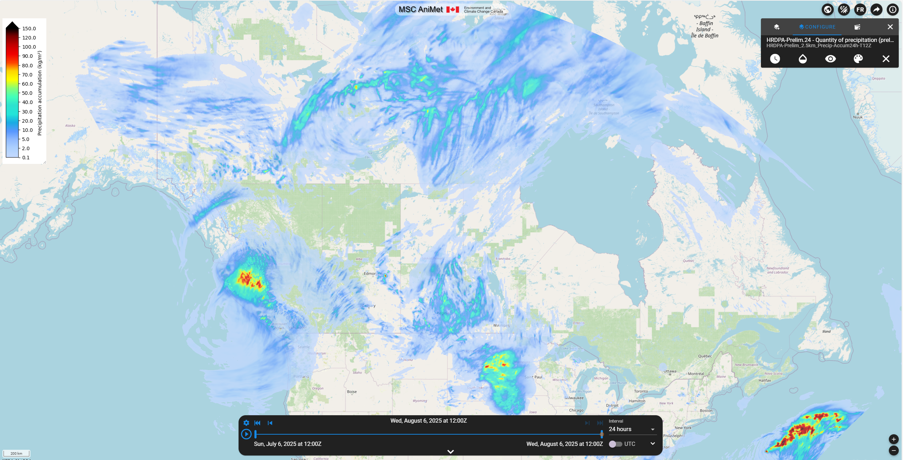
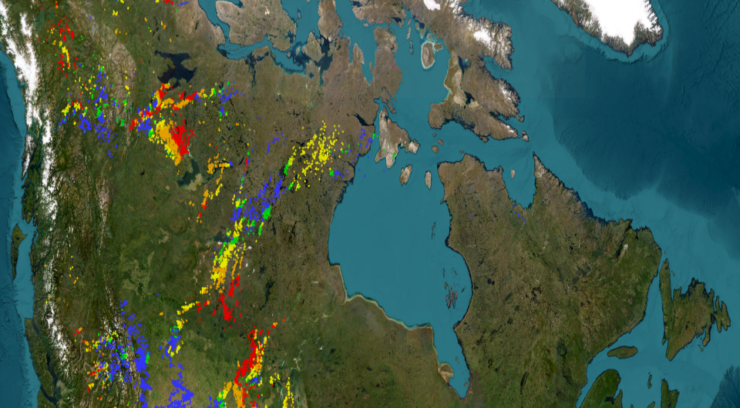
Lightning and CaPA
https://weather.gc.ca/data/analysis/regional/rdpa/2025040312_054_CR_canada_I_RDPA_prelim@pr@024_000.png
Local Repository: W:\EDM\Fire\CIFFC\WeatherBriefings\Gen_Image_Repo\capa_prelim1.png
CLDN past 48 hours
14Hx16.8W 6.9H x 12W
Notes:
Automatic update of CaPA image when downloaded using Markus’ tool.
We likely need to update the Ops Room Viewer image manually as layers have to be chosen. Use https://app-portal-cwfis-sbx.azurewebsites.net/situation-viewer
7

Slide 8
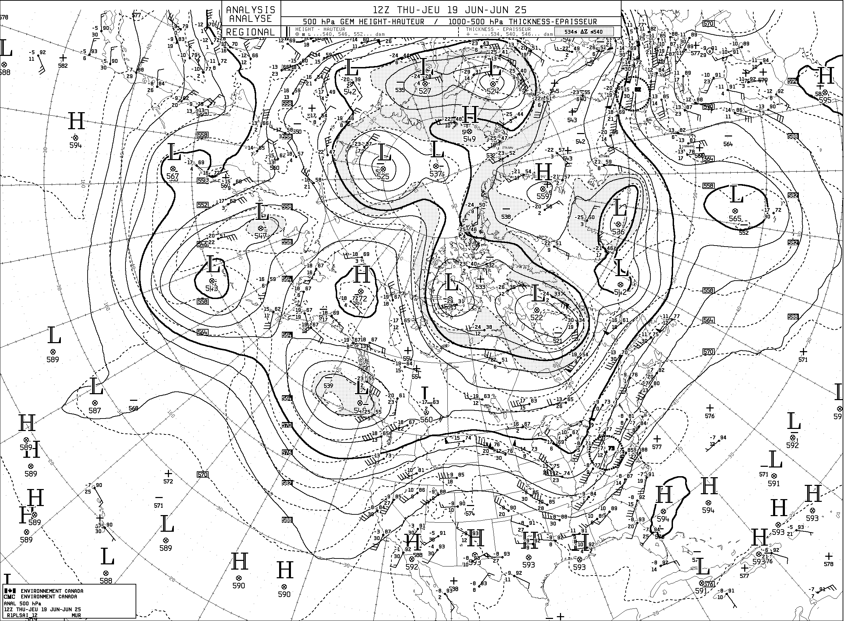
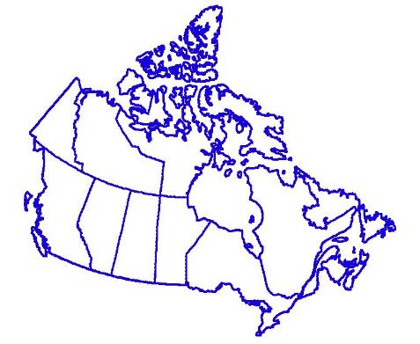
500 hPa Analysis (12 UTC)
250 hPa: https://weather.gc.ca/data/analysis/sah_100.gif
500 hPa: https://weather.gc.ca/data/analysis/sai_100.gif
L
L
H
L
L
H
H
L
H
L
H
14H x 19W
Notes:
Images are updated automatically from the web.
250 hPa analysis shows jet stream features (or lack thereof)
Point out major troughs and ridges and areas without significant features. The latter are often prone to fire if unchanged over a period of a few days or more.

Slide 9
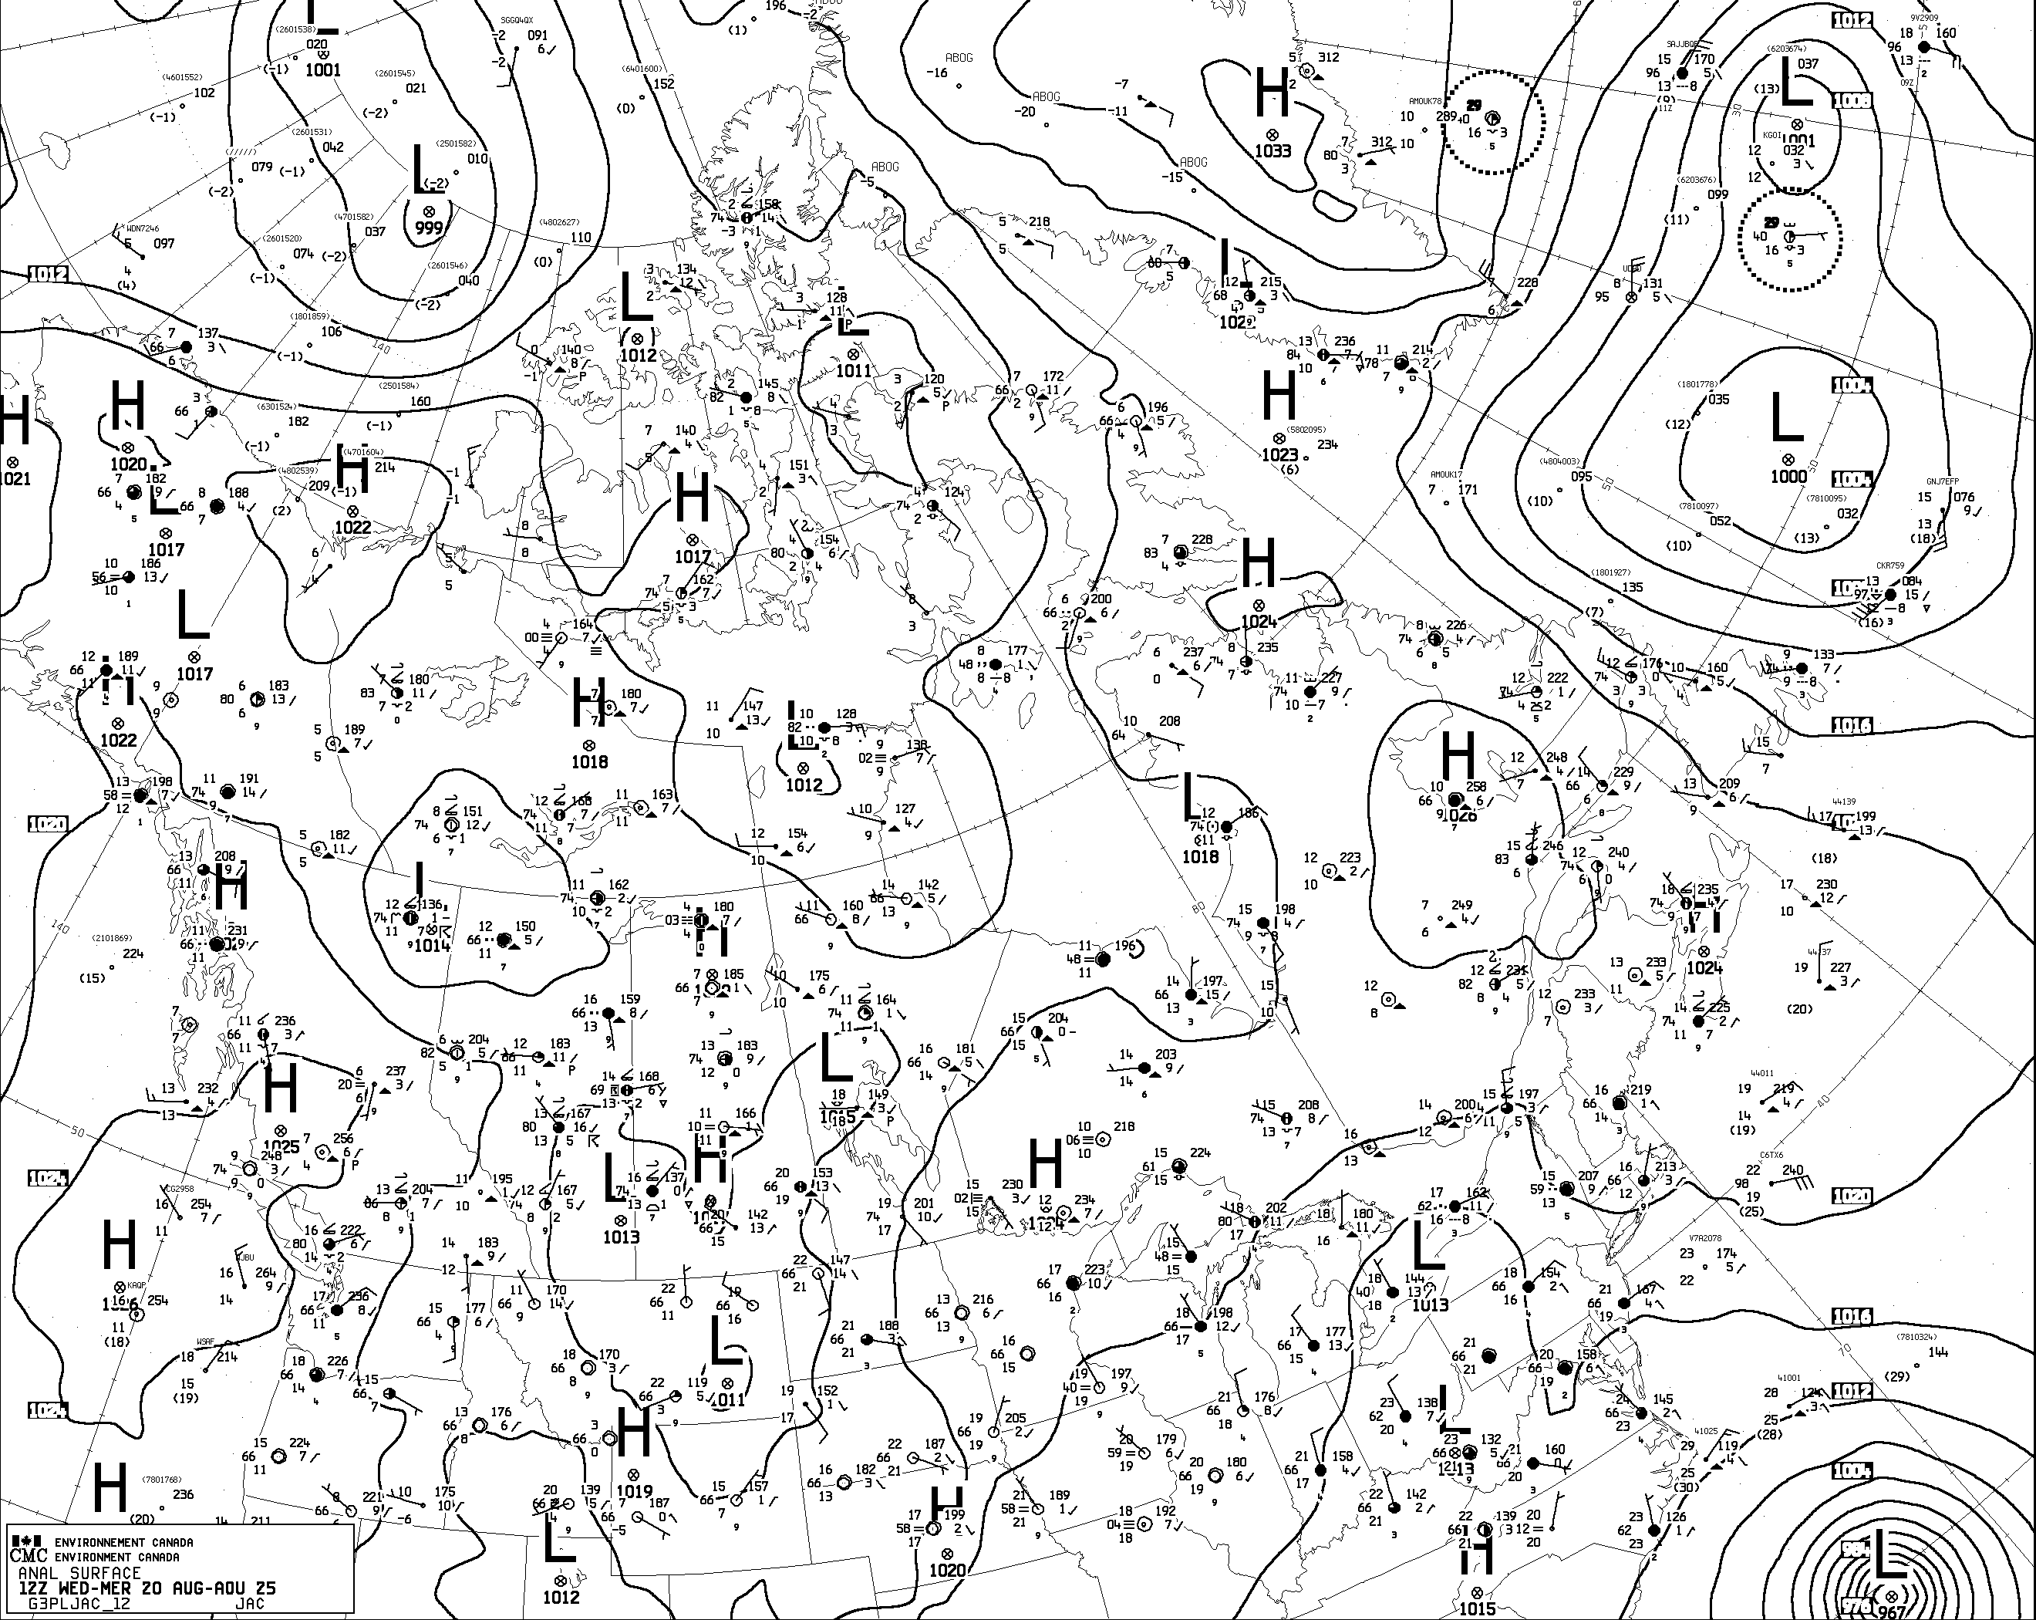
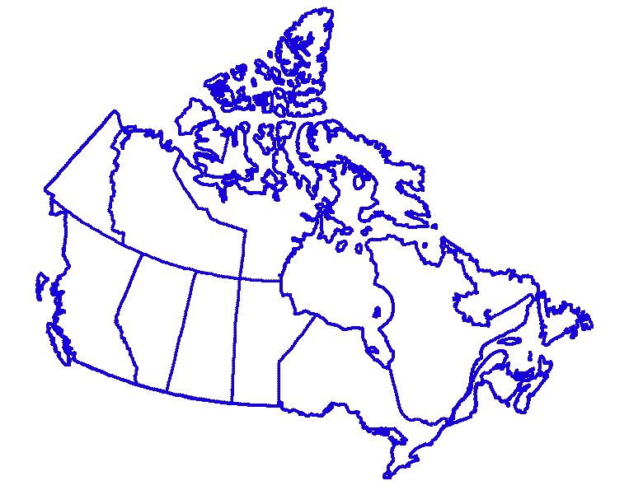
Surface Analysis (12 UTC)
http://weather.gc.ca/data/analysis/jac12_100.gif
L
L
H
H
14H x 19W
Notes:
Images are updated automatically from the web.
Morning (12Z) surface analysis for Canadian region showing surface pressure pattern (or lack thereof)
Point out major troughs and high pressure areas and areas without significant features.

Slide 10
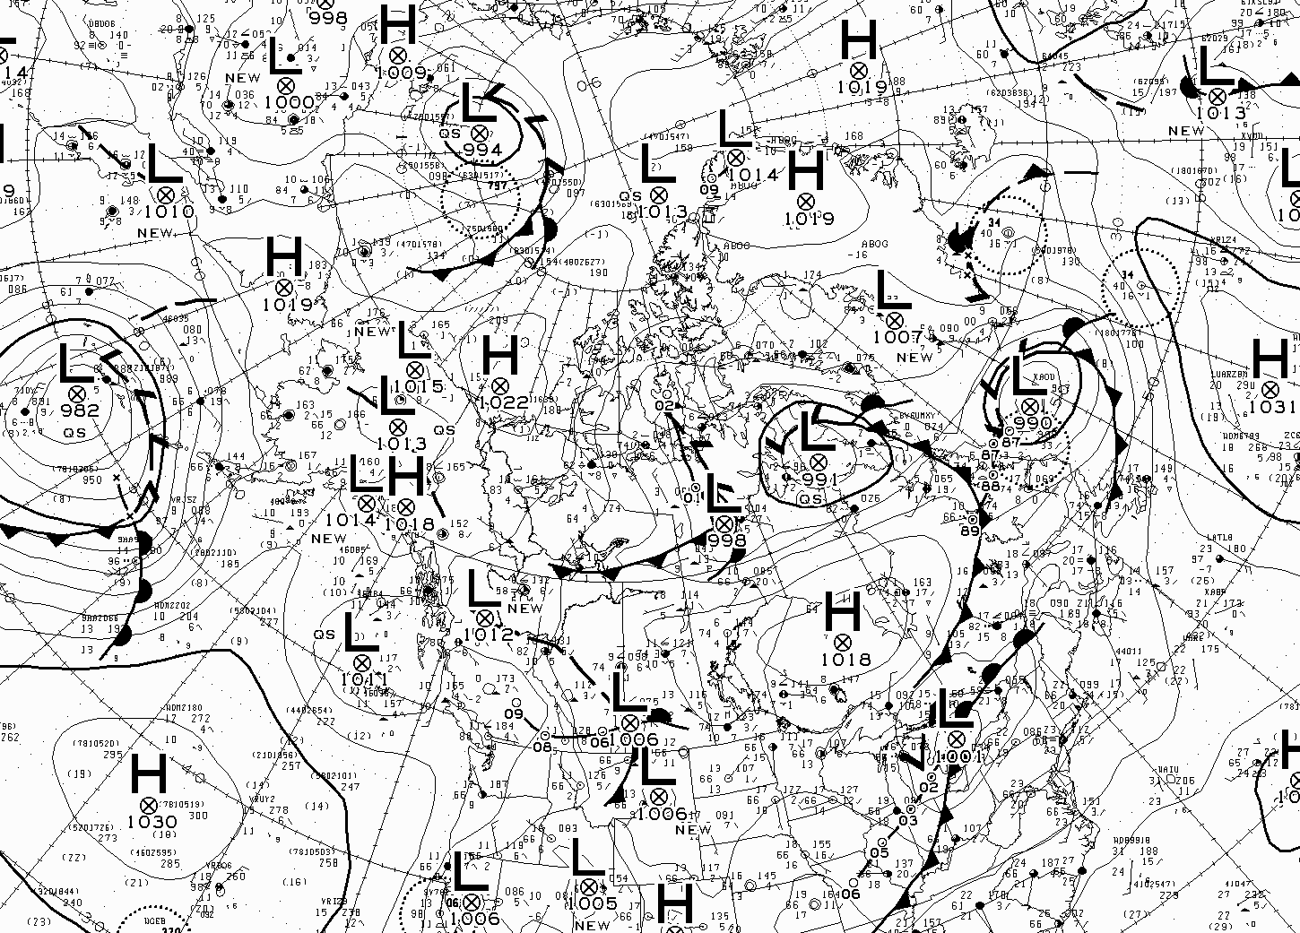
Surface Analysis (12 UTC)
http://weather.gc.ca/data/analysis/935_100.gif
15H x 17.5W
Notes:
Images are updated automatically from the web.
Morning (12Z) surface analysis for Canadian region showing surface pressure pattern (or lack thereof)
Point out major troughs and high pressure areas and areas without significant features.

Slide 11
Forecast conditions

Slide 12
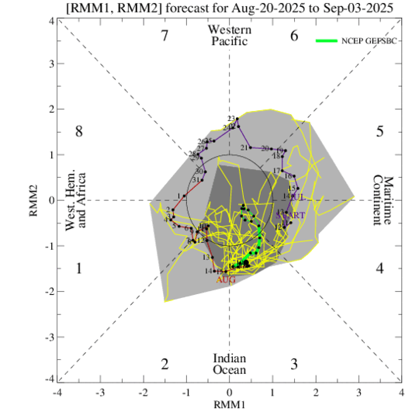
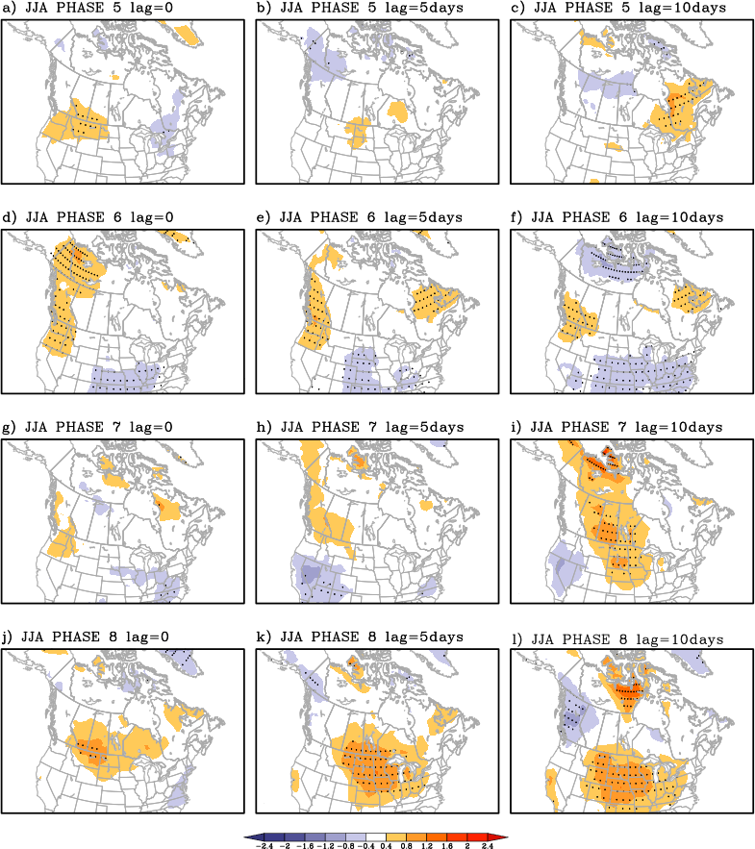
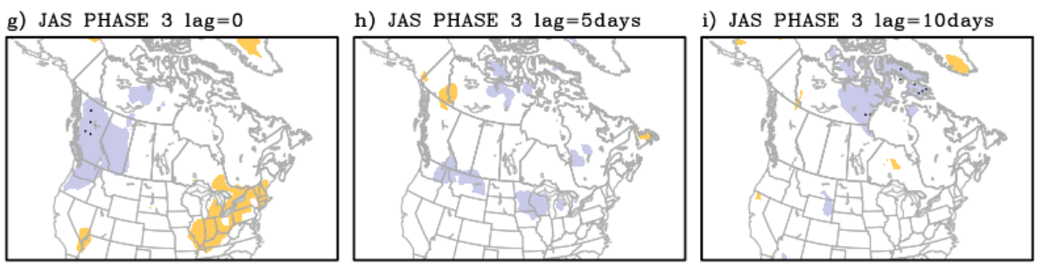
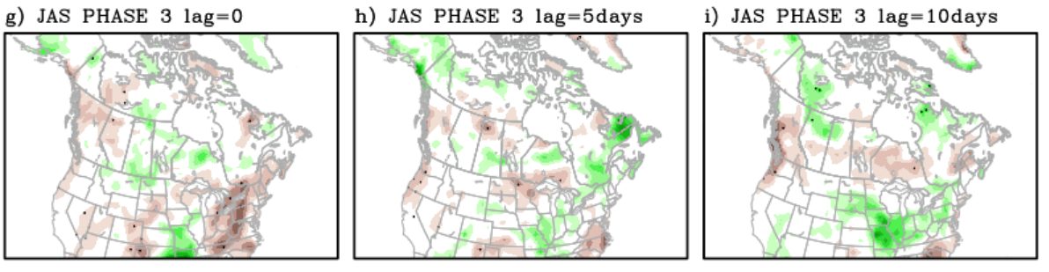
Madden-Julian Oscillation
https://www.cpc.ncep.noaa.gov/products/precip/CWlink/MJO/foregfs.shtml
Local Repository: W:\EDM\Fire\CIFFC\WeatherBriefings\Gen_Image_Repo\MJO1.png
MJO presence is indicated by 2 of 3 of:
200 hPa zonal wind anomaly
850 hPa zonal wind anomaly
OLR anomaly
These are indicated by RMM1 and RMM2 on the phase diagrams.
https://hpfx.science.gc.ca/~lin001/
Temperature
Precipitation
Notes:
MJO phase diagram is updated automatically upon download with Markus’ tool.
Update Hai Lin’s images manually – we have to choose the season and crop to the MJO phase.

Slide 13
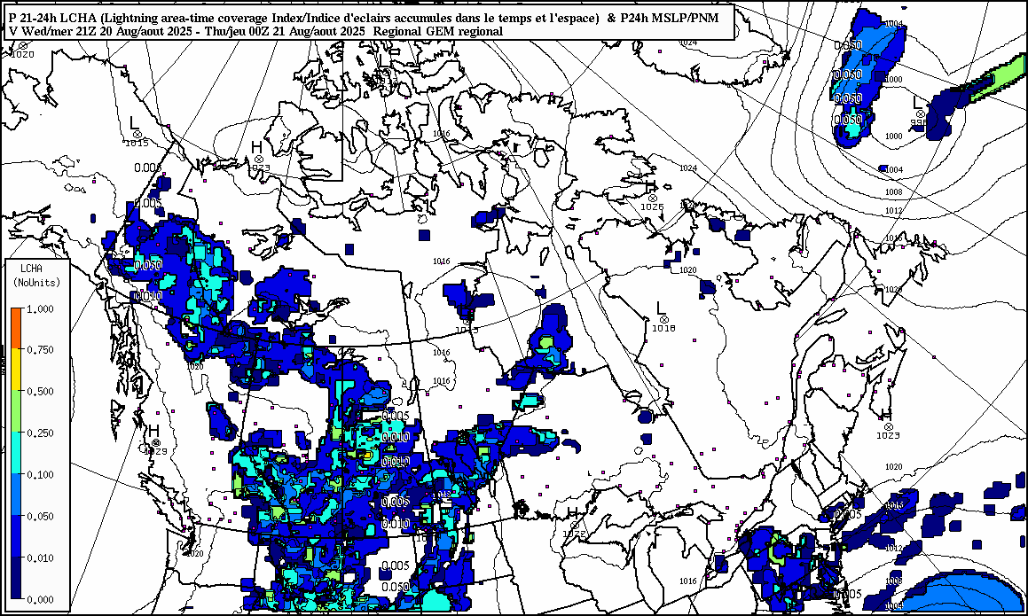
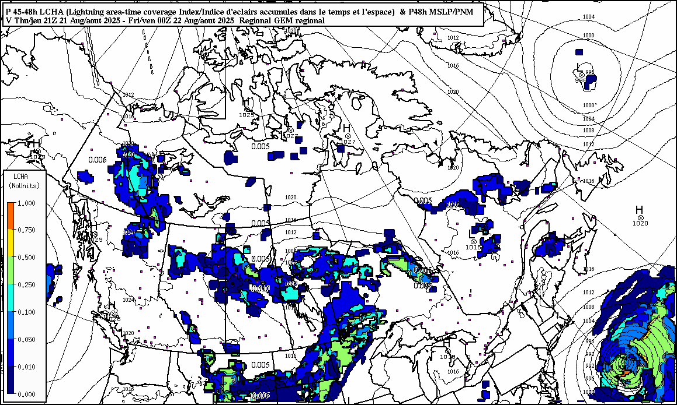
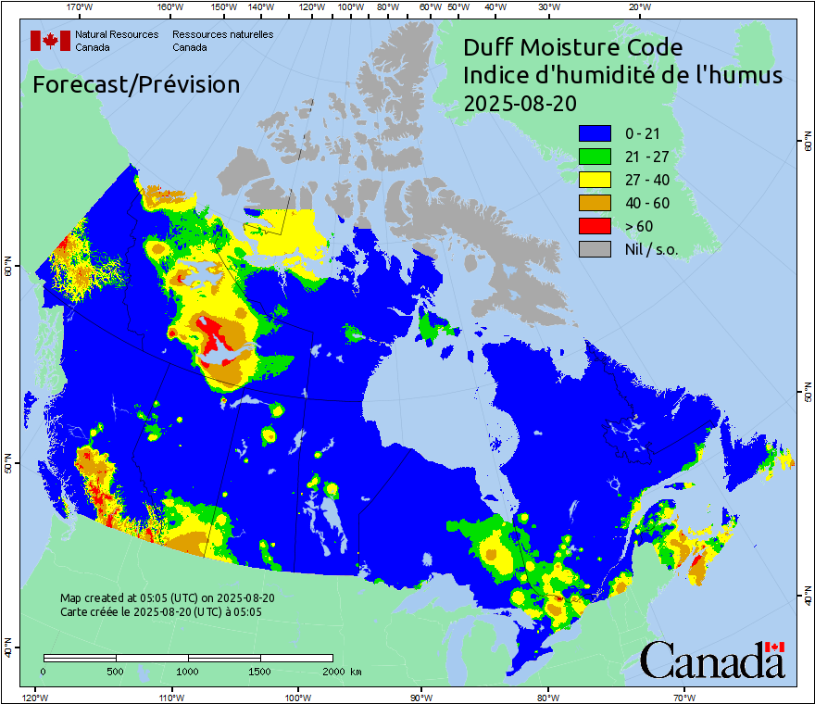
Lightning Forecast
https://hpfx.collab.science.gc.ca/~snlw001/billdata1/lightning_forecasts
Wed pm
Maps generated by Environment Canada –
Meteorological Service of Canada
Lightning area time coverage index
Thu pm
7.5H x 12.5W
Notes:
Update manually for now.
Short-term lightning forecast maps from Bill Burrows at EC-MSC’s Alberta/Arctic weather centre in Edmonton. These are uploaded to daily at about 11:00 am MDT, so we miss the morning update when doing most CIFFC briefings (except SPU, which runs at noon MDT). Normally use the 21 and 45 hour images, valid late afternoon today and tomorrow.

Slide 14
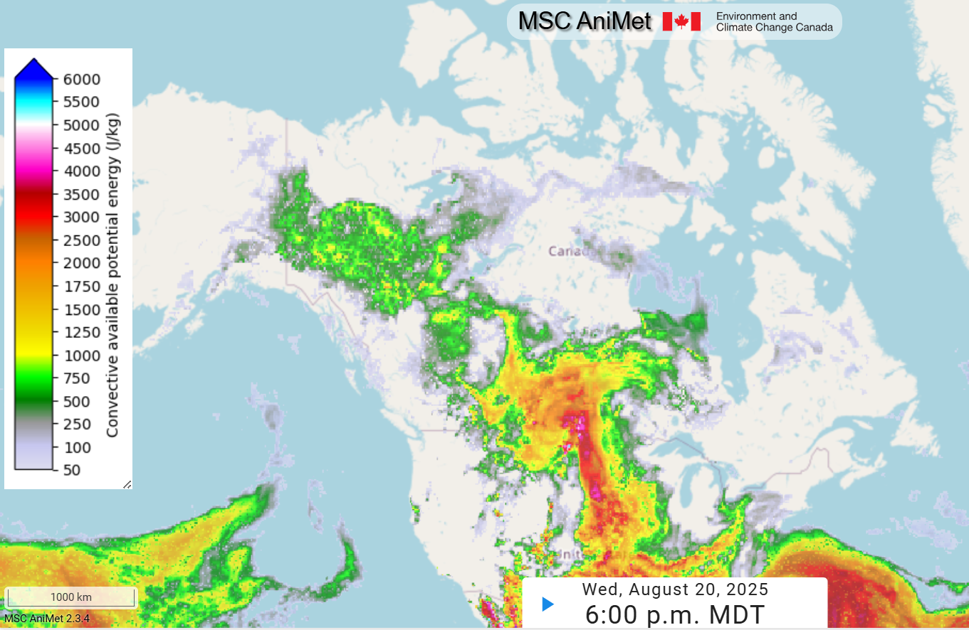
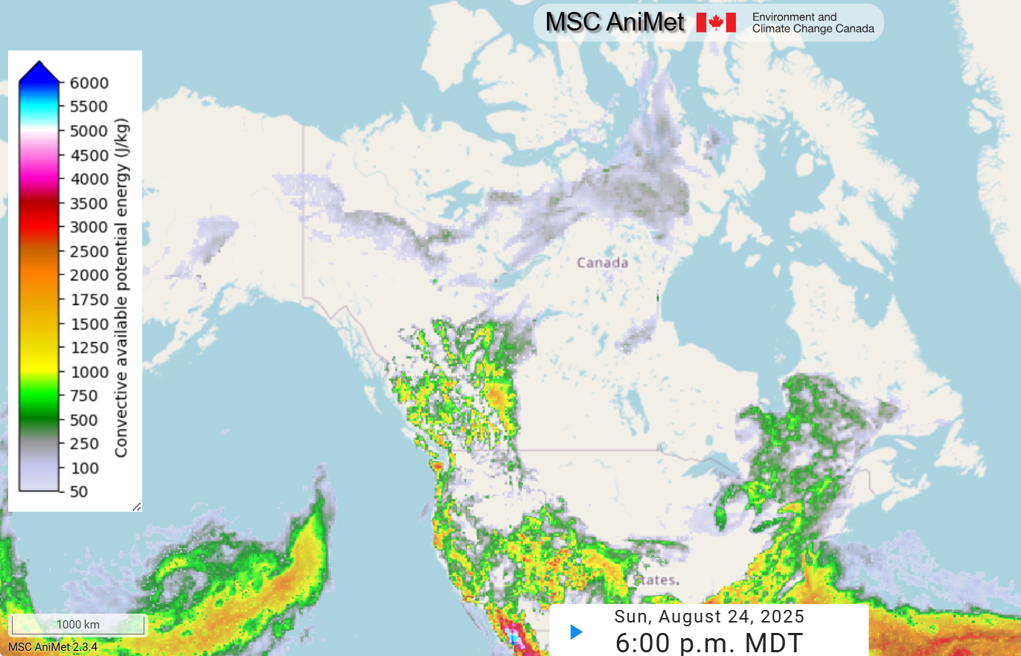
Lightning Forecast
\\MSC AniMet
Wed Aug 20 6pm MDT, Sfc-based CAPE
Maps generated by Environment Canada –
Meteorological Service of Canada
Sun Aug 24 6pm MDT, Sfc-based CAPE
6.8H x 14W
Notes:
Update manually for now.

Slide 15
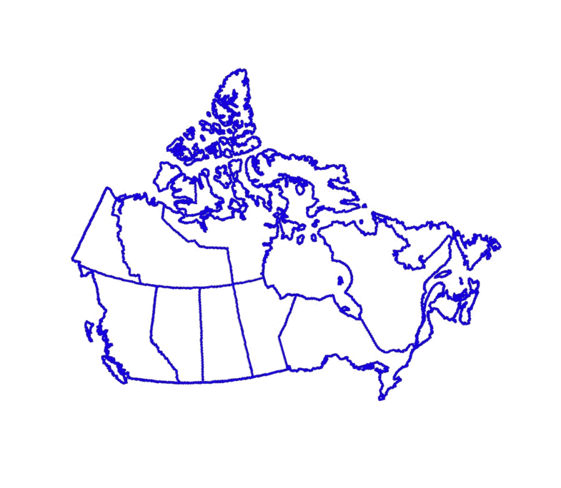
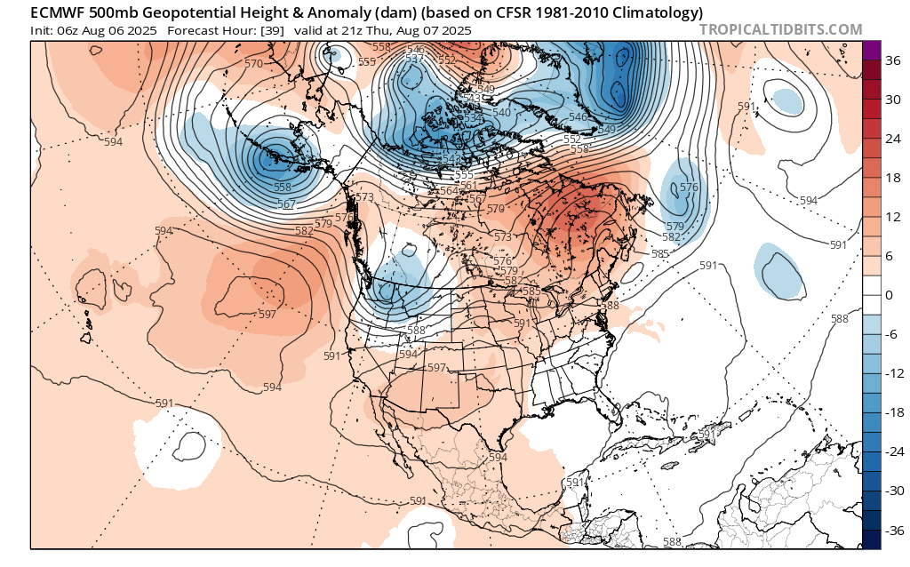
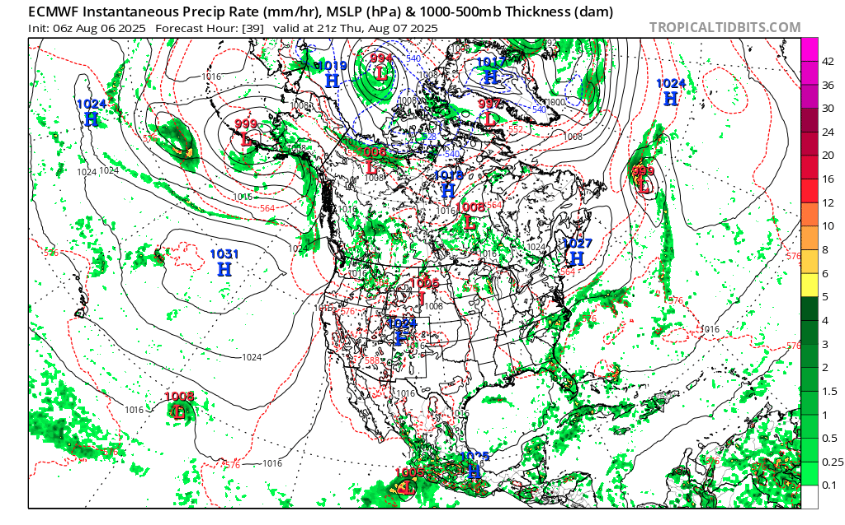
ECMWF
ECMWF Model – Z500, Vort, & Wind for North America | Tropical Tidbits
t=39h XXXXX
L
L
L
L
L
L
L
L
L
L
L
H
L
H
L
L
L
H
H
L
each 10H x 12.4W
Notes:
Update manually for now – Markus’ tool looping may be too slow to be efficient.
NWP maps from NCEP’s NAM/GFS/NAEFS models. From this main page, choose the Model Area and Model Type. On the next page, choose the initialization time from the top row of the table, then choose the parameters you wish to view, and the forecast time (hours from initialization). Note it is difficult to capture individual images when looping through the output, so instead choose the forecast hour you wish to display. Remember to change the date and time in the text box above the charts!
Copy this slide to a new one if you want to show additional forecast times.
Left: 500 hPa level (5-6 km up)
Right: Surface – green/blue areas show forecast precipitation
Highlight ridges and troughs and areas without significant upper air features. The latter are often prone to fire if unchanged over a period of a few days or more. Indicate areas where lightning/heat/dryness/wind may cause problems, and where significant rain is expected.

Slide 16
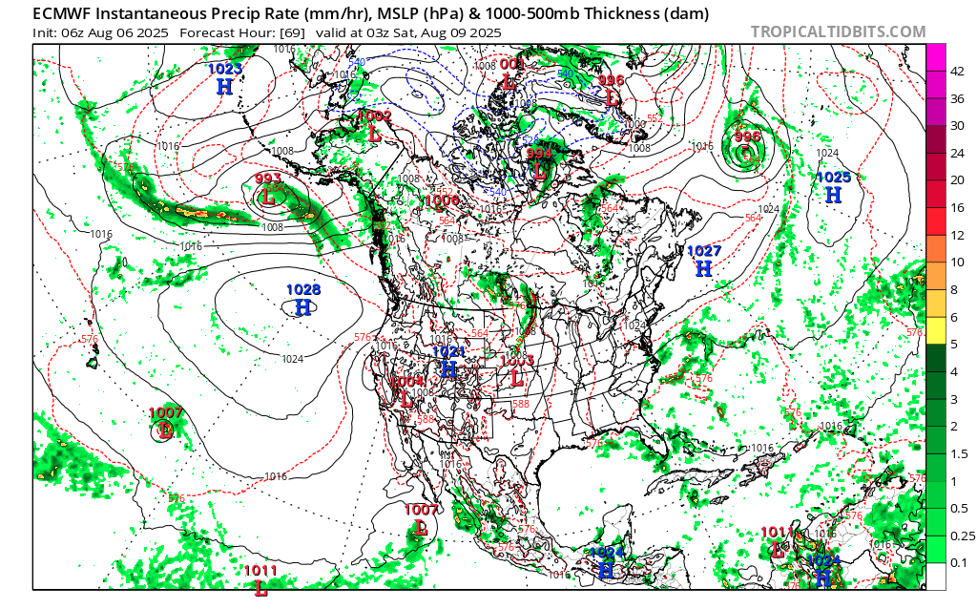
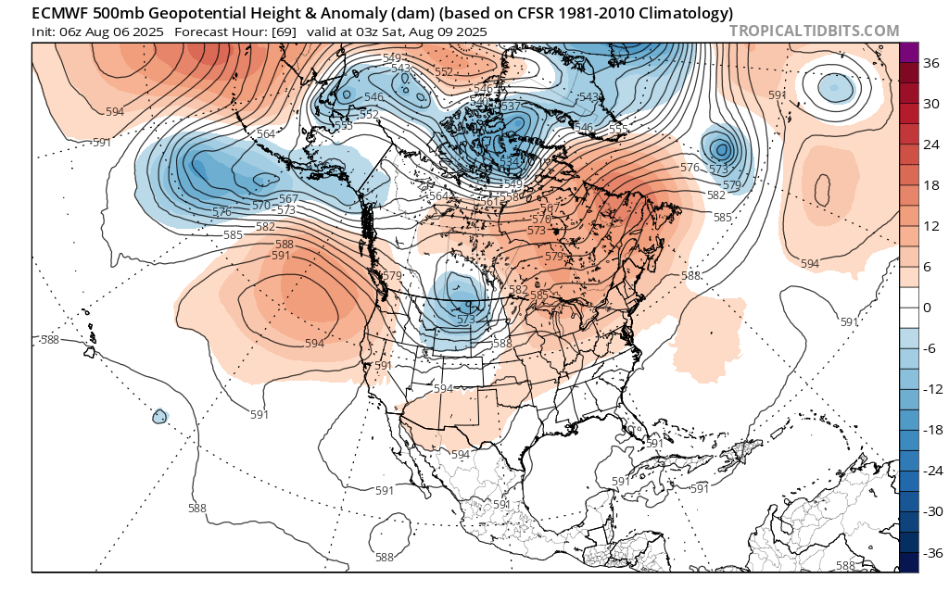
ECMWF
http://mag.ncep.noaa.gov/model-guidance-model-area.php
L
t=69h XXXXX
H
L
L
L
L
H
L
L
L
L
H
L
H
L
H
L
L
H
H
L
H
H
L
H
each 10H x 12.4W
Notes:
Update manually for now – Markus’ tool looping may be too slow to be efficient.
NWP maps from NCEP’s NAM/GFS/NAEFS models. From this main page, choose the Model Area and Model Type. On the next page, choose the initialization time from the top row of the table, then choose the parameters you wish to view, and the forecast time (hours from initialization). Note it is difficult to capture individual images when looping through the output, so instead choose the forecast hour you wish to display. Remember to change the date and time in the text box above the charts!
Copy this slide to a new one if you want to show additional forecast times.
Left: 500 hPa level (5-6 km up)
Right: Surface – green/blue areas show forecast precipitation
Highlight ridges and troughs and areas without significant upper air features. The latter are often prone to fire if unchanged over a period of a few days or more. Indicate areas where lightning/heat/dryness/wind may cause problems, and where significant rain is expected.

Slide 17
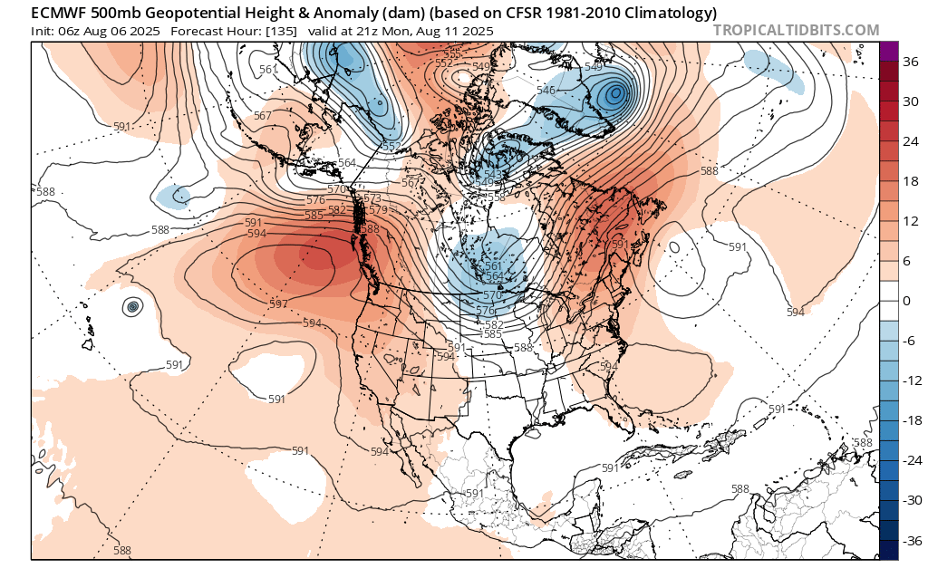
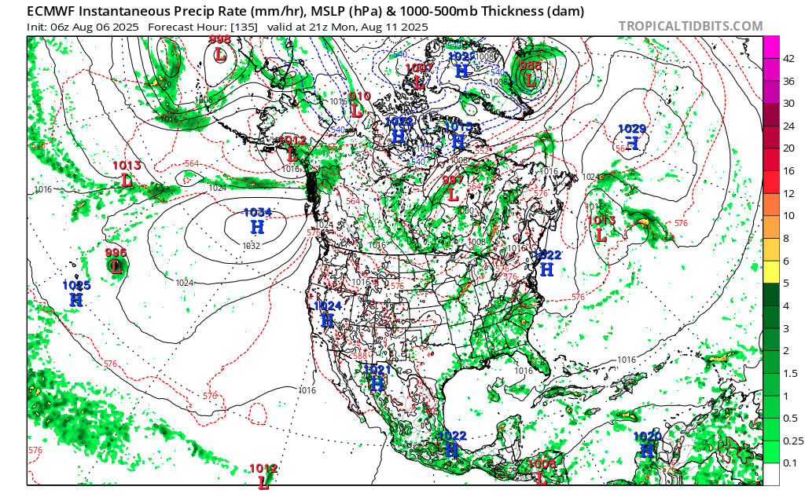
ECMWF
L
http://mag.ncep.noaa.gov/model-guidance-model-area.php
L
t=135h XXXXX
H
L
L
L
L
L
H
L
L
L
H
L
H
L
L
H
H
H
H
L
H
H
L
each 10H x 12.4W
Notes:
Update manually for now – Markus’ tool looping may be too slow to be efficient.
NWP maps from NCEP’s NAM/GFS/NAEFS models. From this main page, choose the Model Area and Model Type. On the next page, choose the initialization time from the top row of the table, then choose the parameters you wish to view, and the forecast time (hours from initialization). Note it is difficult to capture individual images when looping through the output, so instead choose the forecast hour you wish to display. Remember to change the date and time in the text box above the charts!
Copy this slide to a new one if you want to show additional forecast times.
Left: 500 hPa level (5-6 km up)
Right: Surface – green/blue areas show forecast precipitation
Highlight ridges and troughs and areas without significant upper air features. The latter are often prone to fire if unchanged over a period of a few days or more. Indicate areas where lightning/heat/dryness/wind may cause problems, and where significant rain is expected.

Slide 18
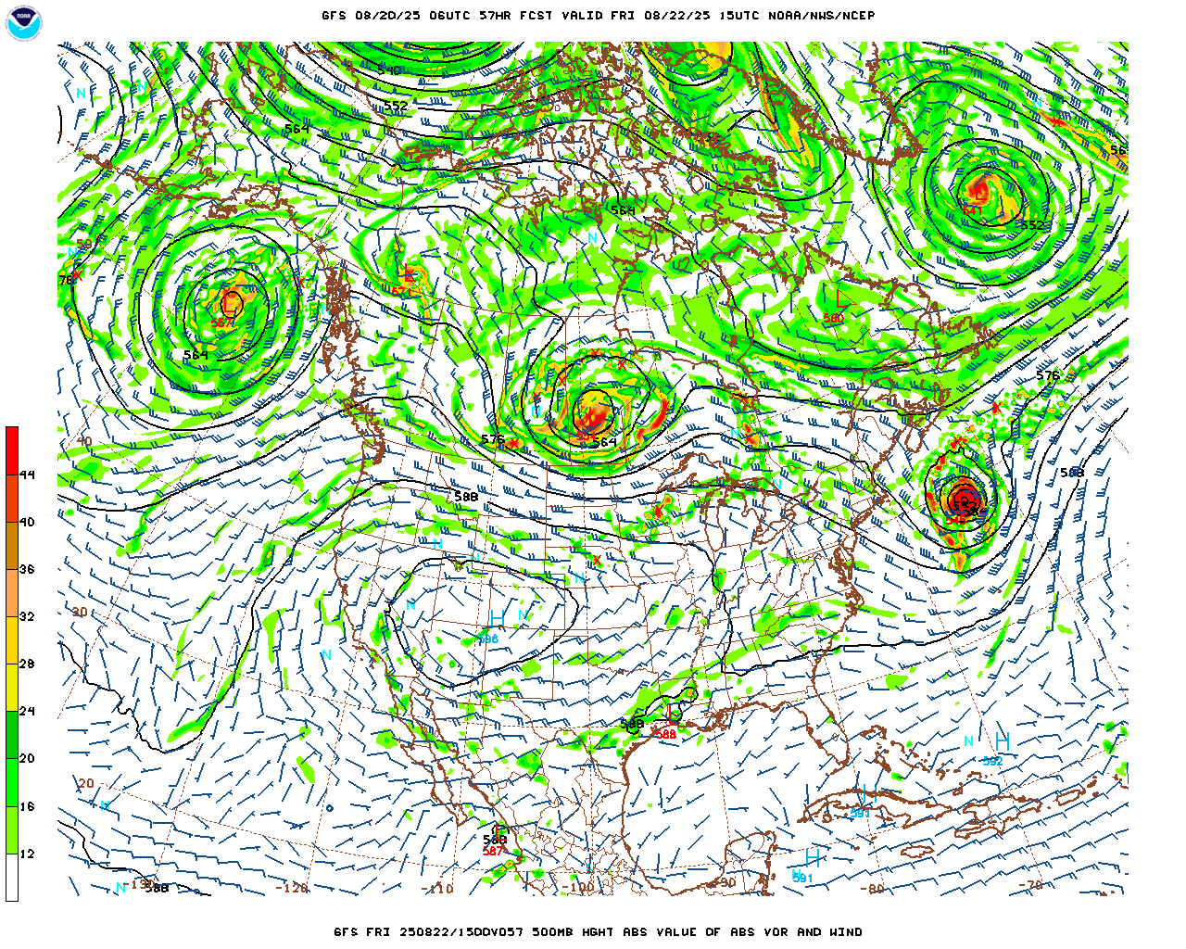
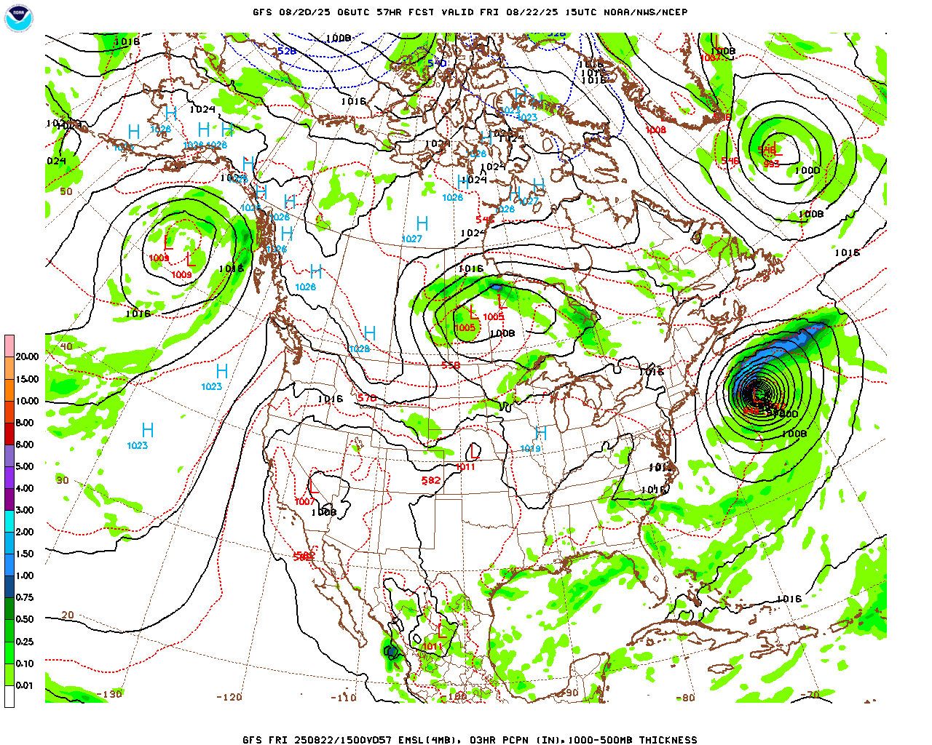
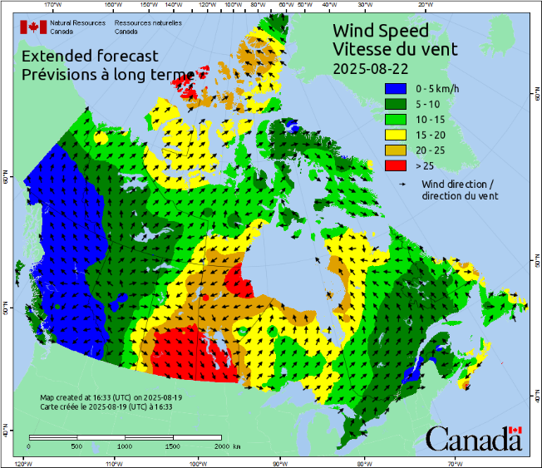
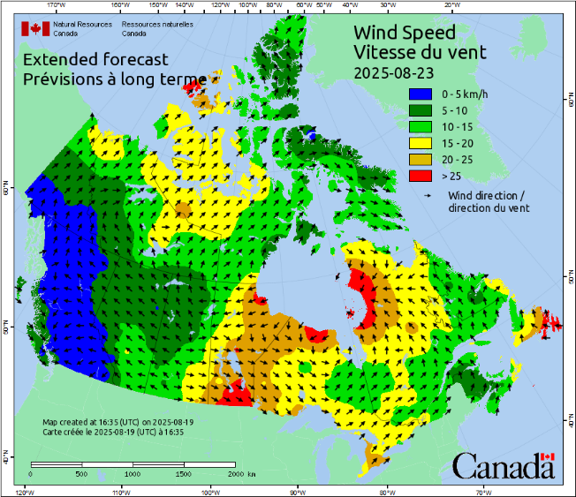
NAM/GFS/NAEFS
http://mag.ncep.noaa.gov/model-guidance-model-area.php
t=57h 2025080200Z Fri August 22 mid-am MDT
H
L
L
L
L
L
H
L
L
H
H
L
L
H
H
H
Erin
Erin
H
L
each 10H x 12.4W
Notes:
Update manually for now – Markus’ tool looping may be too slow to be efficient.
NWP maps from NCEP’s NAM/GFS/NAEFS models. From this main page, choose the Model Area and Model Type. On the next page, choose the initialization time from the top row of the table, then choose the parameters you wish to view, and the forecast time (hours from initialization). Note it is difficult to capture individual images when looping through the output, so instead choose the forecast hour you wish to display. Remember to change the date and time in the text box above the charts!
Copy this slide to a new one if you want to show additional forecast times.
Left: 500 hPa level (5-6 km up)
Right: Surface – green/blue areas show forecast precipitation
Highlight ridges and troughs and areas without significant upper air features. The latter are often prone to fire if unchanged over a period of a few days or more. Indicate areas where lightning/heat/dryness/wind may cause problems, and where significant rain is expected.

Slide 19
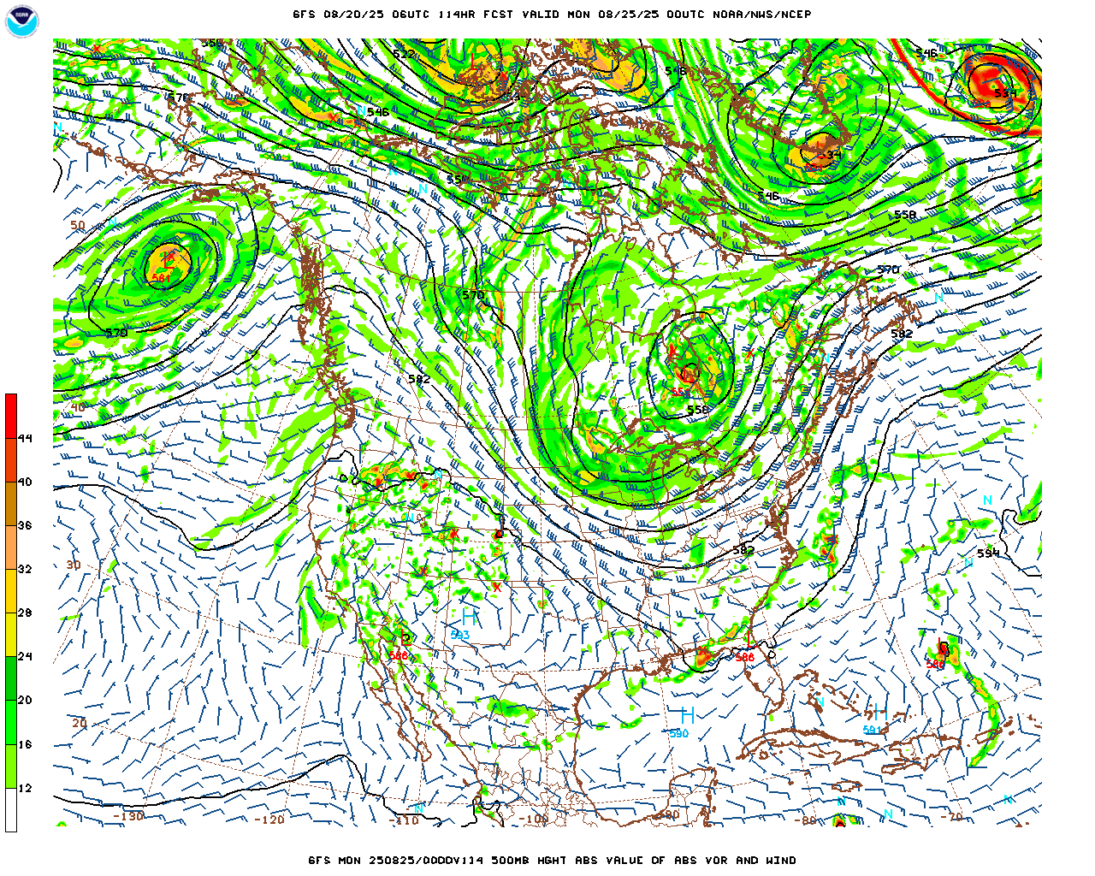
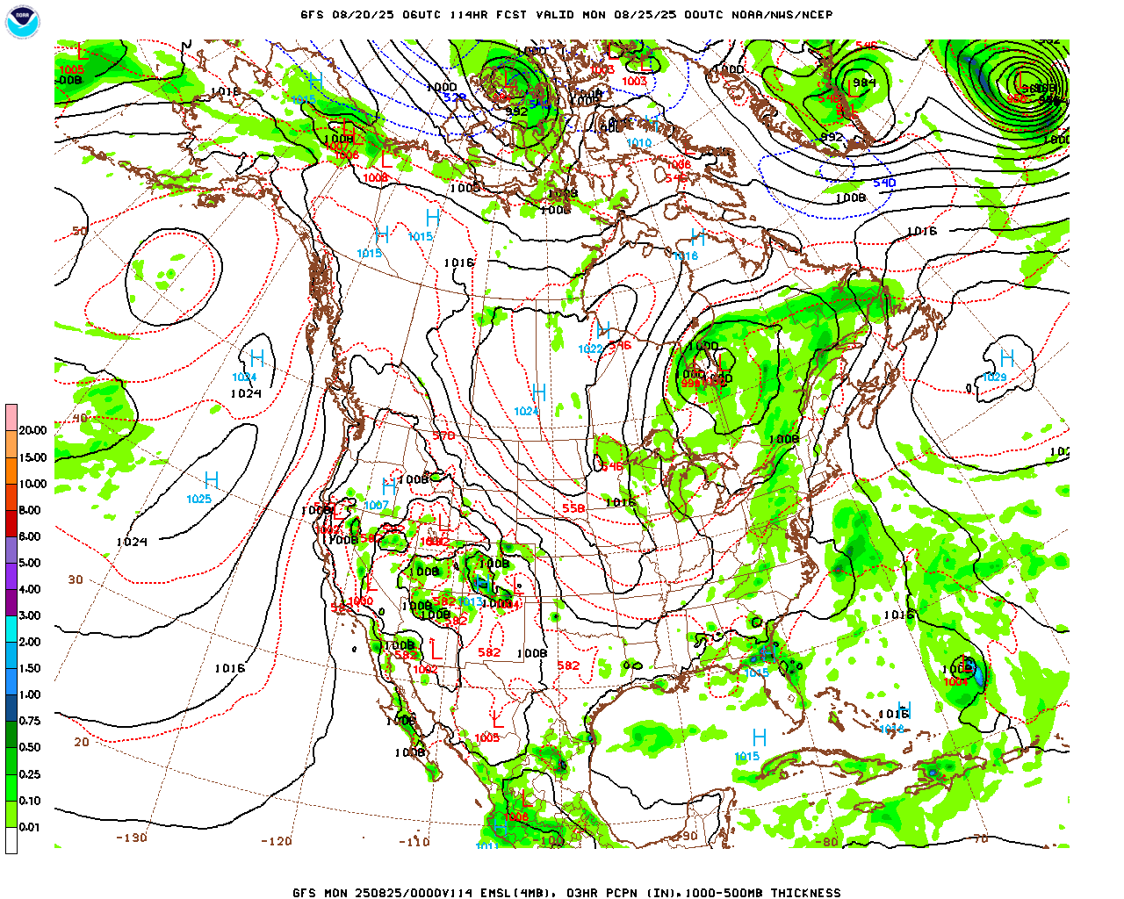
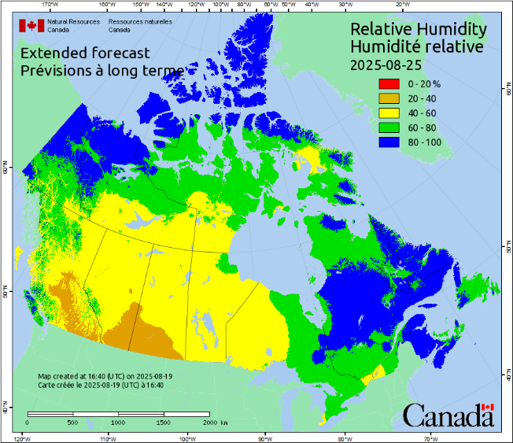
NAM/GFS/NAEFS
http://mag.ncep.noaa.gov/model-guidance-model-area.php
t=114h 2025082500Z Sunday Aug 24 pm
L
L
L
L
L
L
L
H
L
L
H
L
H
L
H
H
H
H
each 10H x 12.4W
Notes:
Update manually for now – Markus’ tool looping may be too slow to be efficient.
NWP maps from NCEP’s NAM/GFS/NAEFS models. From this main page, choose the Model Area and Model Type. On the next page, choose the initialization time from the top row of the table, then choose the parameters you wish to view, and the forecast time (hours from initialization). Note it is difficult to capture individual images when looping through the output, so instead choose the forecast hour you wish to display. Remember to change the date and time in the text box above the charts!
Copy this slide to a new one if you want to show additional forecast times.
Left: 500 hPa level (5-6 km up)
Right: Surface – green/blue areas show forecast precipitation
Highlight ridges and troughs and areas without significant upper air features. The latter are often prone to fire if unchanged over a period of a few days or more. Indicate areas where lightning/heat/dryness/wind may cause problems, and where significant rain is expected.

Slide 20
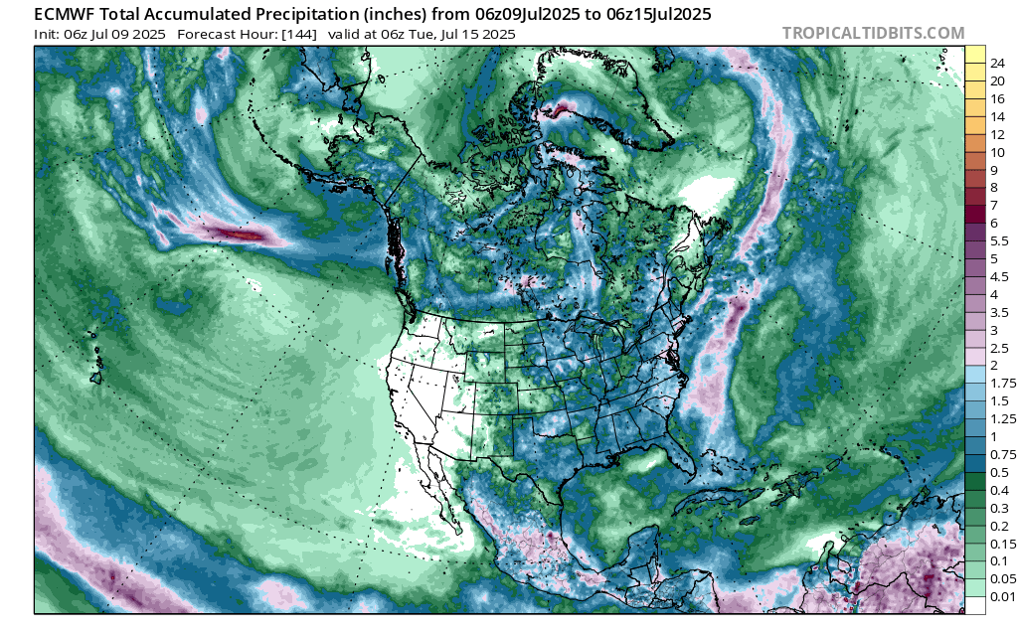
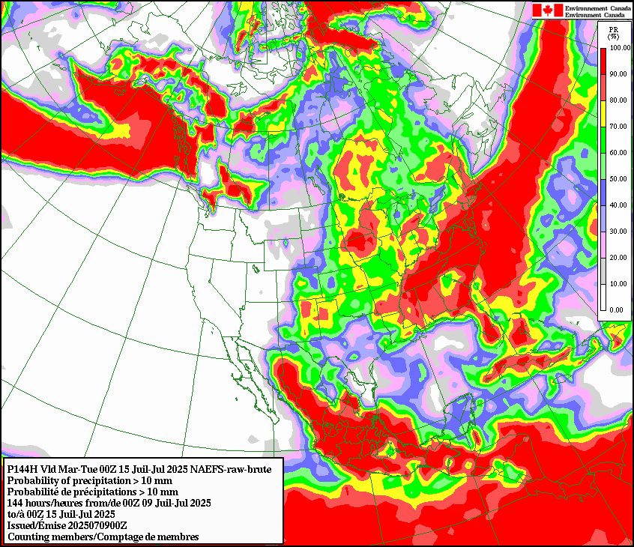
NAEFS
http://weather.gc.ca/ensemble/index_e.html#spagat
Local repository: W:\EDM\Fire\CIFFC\WeatherBriefings\Gen_Image_Repo\naefstotalPcp168h1.png
Ju – July 23 00z
10 mm accumulation
July 16 – July 23 00z
Total accumulation
14.5H x 16.8W Inset 250%
Notes:
Updates automatically from local repository if downloaded using Markus’ tool. If you want a different precipitation threshold or time period then update manually from the web.
Choose the “Precip. accumulation” amount you want to show from the “Product Type” drop-down box. Choose the model initialization time (00 or 12) from the drop-down on the right, then run out the “Forecast End” date for the period you need.

Slide 21
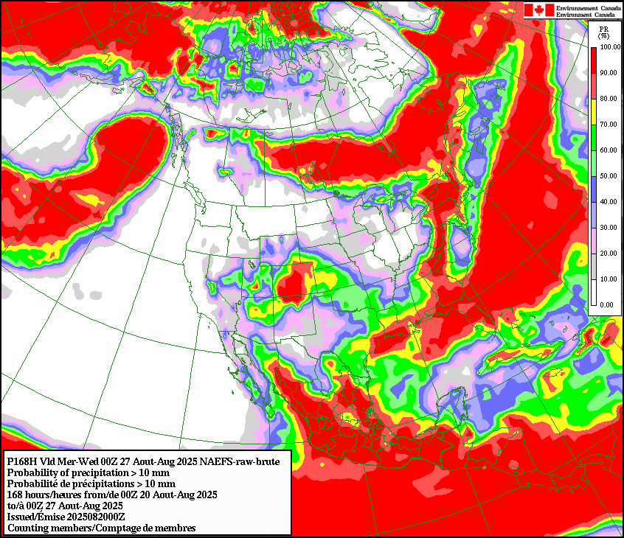
NAEFS
http://weather.gc.ca/ensemble/index_e.html#spagat
Local repository: W:\EDM\Fire\CIFFC\WeatherBriefings\Gen_Image_Repo\naefstotalPcp168h3.png
Aug 20 – Aug 27 00z
10 mm total
14.5H x 16.8W Inset 250%
Notes:
Updates automatically from local repository if downloaded using Markus’ tool. If you want a different precipitation threshold or time period then update manually from the web.
Choose the “Precip. accumulation” amount you want to show from the “Product Type” drop-down box. Choose the model initialization time (00 or 12) from the drop-down on the right, then run out the “Forecast End” date for the period you need.

Slide 22
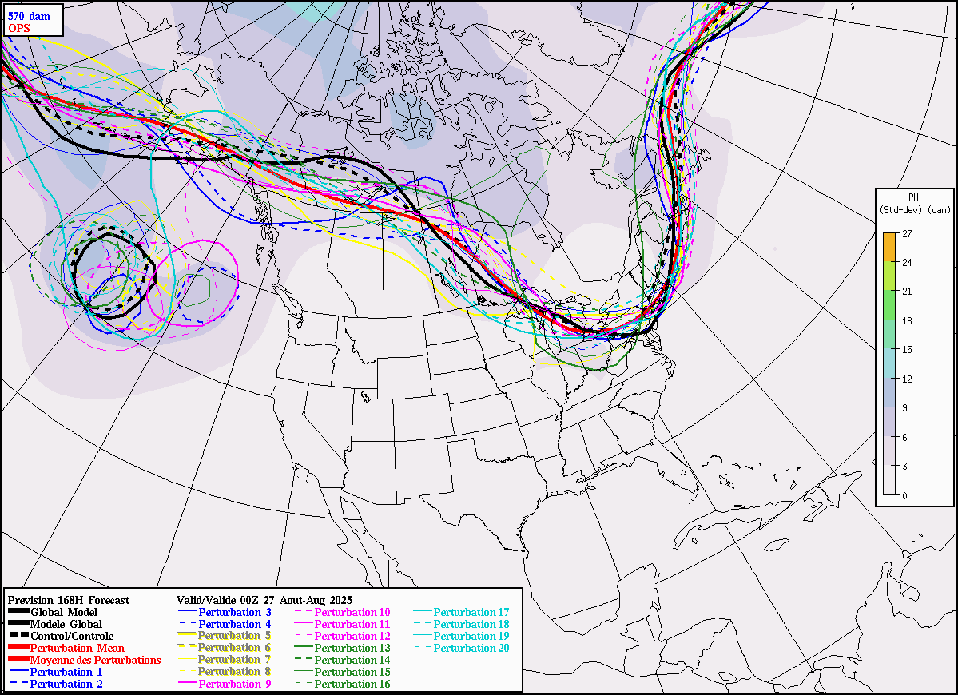
Ensemble 7d (t=168h Tue pm)
http://weather.gc.ca/ensemble/index_e.html#spagat
Local repository: W:\EDM\Fire\CIFFC\WeatherBriefings\Gen_Image_Repo\cef5581.png {5701.png}
L
H
570 dam
L
L
H
14.5H x 20W
Notes:
Updates automatically if downloaded using Markus’ tool. You may have to change the local link between cef5581.png and cef5701.png, depending on the month.
Spaghetti plot of some geopotential height. The 558 dam line is likely good for spring and fall, and the 570 for summer.
Choose the contour line, forecast initialization date and time, and the number of hours into the forecast you wish to feature from the drop-down boxes under “Spaghetti Plots” at the top of this URL-linked web page. You can scroll back and forth between forecast hours within the display. If you choose a different time, be sure to change the hours and valid day in this slide’s title.
Tangled lines indicate uncertainty between ensemble elements, and uncertainty in forecast conditions.
Tightly-bound lines indicate a high degree of certainty of contour line placement and forecast conditions.

Slide 23
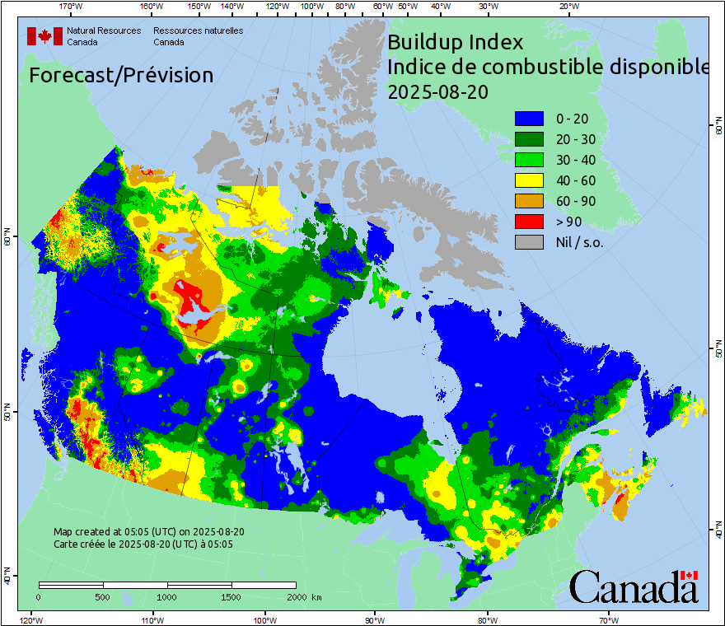
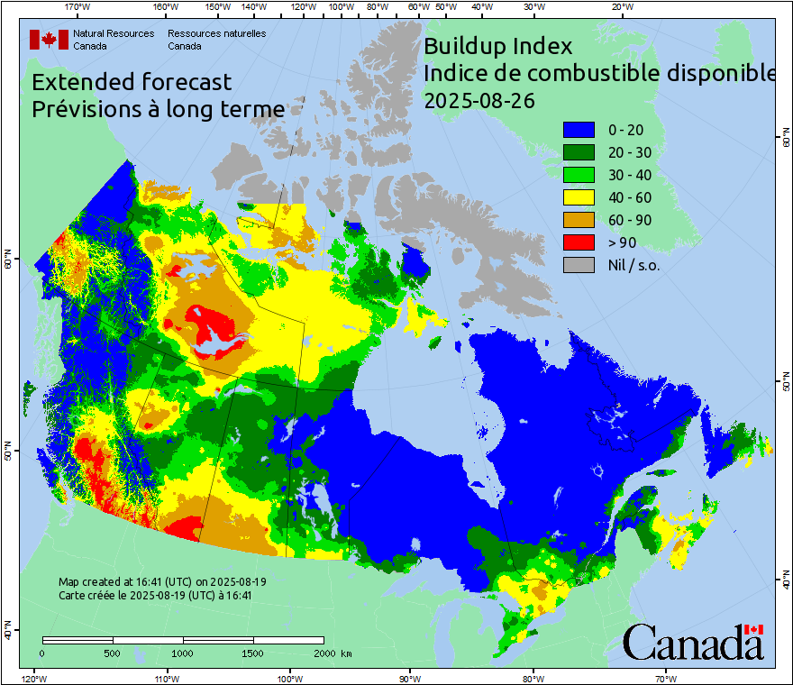
CWFIS -- BUI
11H x 12.75W
Notes:
Update images manually – CWFIS images URLs are date-specific.
CWFIS forecast Fire Weather Index or other themes. Choose the most relevant for the forecast period and uptrend or downtrend of indexes. Discuss rapid or ongoing changes between days.
Composite of Canadian, American, and Mexican fire danger updated at 8, 12, 18, 23 MDT
Canadian: Forecast conditions at 0800 and 1200 runs; observed conditions at 1800 and 2300 runs
American: Observed conditions, run by USFS
Mexican: Observed conditions, run by CFS-WFIS
Watch map text for source of data

Slide 24
Graphic Summary – Week 1
Aug 20-26, 2025
Occasional showers/thundershowers
Drier in south
Rainy then drying
Warm, dry
Showers / thunderstorms
Mostly dry
Watch for Erin winds Fri-Sat
Showers early in week of Aug 24
15.5H x 20.0W
Notes:
Summarize the expected fire weather conditions in the regions of the country indicated.
Use red font for regions of intense activity
Use orange font for regions of moderate activity
Use yellow font for regions of low activity
Use green font for regions of minimal activity
Add specific comments for each region. These may be included in items such as CIFFC SPU call minutes, so be clear and concise as possible
Summarize the expected fire weather conditions in the regions of the country indicated.
Use red font for regions of intense activity or expected high fire weather indexes.
Use blue font for regions expecting substantial rainfall or with low fire weather indexes.
Use shapes to outline regions, and symbols to indicate lightning or other relevant conditions.

Slide 25
Fire weather indexes trends
Summary of national fire weather expectations August 20-26, 2025:
Little or no activity A few small fires
Large fires possible Widespread intense activity
A rather moist pattern this week. Though there are underlying dry conditions. Rain is not enough to change conditions in SK, MB, NWT, and Atlantic Canada.
West (BC/YT/NT/AB):
BC: Rising
YT: Showers in far north, drying in south
NT: Remaining dry in boreal regions. Precipitation to the north.
AB: Drying
Central (SK/MB/NU/ON):
SK: Showers and thundershowers, gradual drying. Drier in far north
MB: Showers and thundershowers, gradual drying. Drier in far north ON: Steady with showers and thunderstorms
East (QC/Atl);
QC: Steady with showers and thunderstorms
Atl: Dry until early in week of Aug 24, showers may be light
mH x nW
Notes:
Summarize the expected fire weather conditions in the regions of the country indicated.
Use red font for regions of intense activity
Use orange font for regions of moderate activity
Use yellow font for regions of low activity
Use green font for regions of minimal activity
Add specific comments for each region. These may be included in items such as CIFFC SPU call minutes, so be clear and concise as possible

Slide 26
Weather Notes: June 4 – June 10, 2025
Updates:
1
Fire Weather This Week [06-03 Buchart] Updated Mon, Weds, Fri
A low sits over southern Nunavut and is giving precipitation to the far north of the prairies and southeastern NWT. This system will weaken over the coming 36 hours. The low-pressure system is bringing a cooler airmass (though relatively dry) to AB, SK, and MB. Westerly winds of ~30km/h will impact over SK and MB through June 4.
A series of weak troughs will bring patchy, yet consistent precipitation to AB and northwest SK June 3-4 that will begin to lower fire weather indices.
Another low-pressure system developing June 4 will drag precipitation through much of eastern ON and QC, then Atlantic Canada by June 6. This will keep fire weather indices relatively low.
A third system is forecast to develop over the southern NWT on June 5. The associated cold front is likely to bring thunderstorms and lightning to northern BC Thursday evening. More intense thunderstorms can be expected to the south of the low as it moves southeast, though rain should minimize lightning ignition potential. As it tracks southeast, the system will strengthen, bringing up to 10-20mm of rain in a band from northern SK into much of MB by Sunday June 8.
Southern BC remains dry and warm with no rain expected in the next week. Fire Indices continue to increase in this region, giving extreme risk.
mH x nW

Slide 27
Questions or suggestions?
Contact:
Richard Carr, Liam Buchart or Mike Smith
Fire Weather Specialists
Richard.Carr@NRCan-RNCan.gc.ca
Liam.Buchart@NRCan-RNCan.gc.ca
Michael.Smith2@NRCan-RNCan.gc.ca
5320 122 Street NW
Edmonton, AB, Canada
T6H 3S5
Richard: 825-510-1265
Liam: 825-510-1211
?
?
?
?
?

