Slide 1
Canadian Fire Weather Situation Presented to the Canadian Interagency Forest Fire Centre (CIFFC)
May 28, 2025
Via Teams
Richard Carr / Liam Buchart
Canadian Forest Service
Wildland Fire Information Systems Group, Northern Forestry Centre

Slide 2
Instructions to developer
Linking Images:
Some images are linked to URLs and update automatically. Linking images can be done by using menu items <Insert> then <Pictures>, and specifying the URL or network location in the <File name> box, and choosing <Insert> then <Insert and link>, for example. The speaker notes on each slide indicate if images update automatically or need manual updates. When you are done this presentation for the current day’s briefing: Copy it to a presentation dated for your next briefing day On the current day’s presentation Go to the <File> menu Under <Related Documents>, go to <Edit Links to File> Select each file and choose <Break link to file> This procedure ensures if you open an old presentation, the chosen images for that date are not overwritten by the automatic updates.
Drawing on images:
Epic Pen is a versatile tool we have used to draw on images. If Epic Pen is not installed, you may try the built-in Powerpoint pen, faintly visible in the lower left corner when in Presenter (full screen) mode. This offers pen and highlighter with color choices, but apparently no choice of line weight. Microsoft’s Snip & Sketch can also be used. It offers more options, including pen thicknesses, but operates on new pop-up windows created after snipping, so is a bit clumsier.
Notes:
2

Slide 3
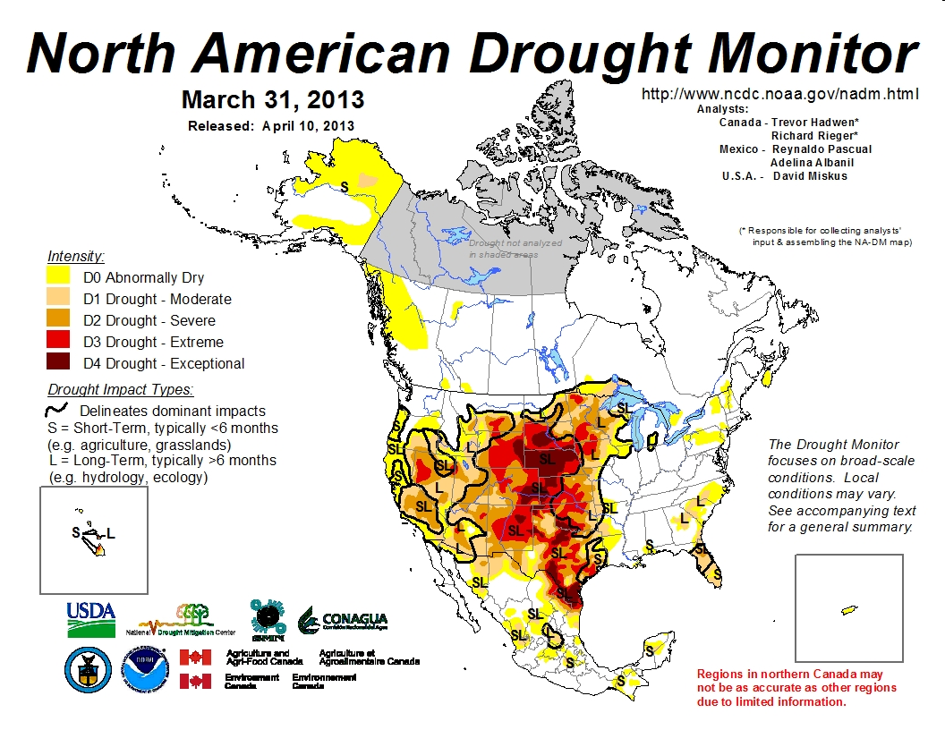
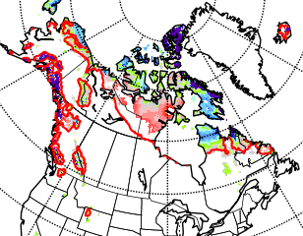
Ice and Snow
https://www.ccin.ca/ccw/snow/current
Local Repository: W:\EDM\Fire\CIFFC\WeatherBriefings\Gen_Image_Repo\ccin1.png
May 28, 2025
14H x 14W
CWFIS: 6.6H x 7.7W
CCN: 10.3H x 9.7W
Notes:
CCIN: Automatic update if downloaded using Markus’ tool.
If needed, update CCIN and CWFIS images manually.
Snow (and sea ice with the NOAA graphic) from a variety of sources:
-- United States Ice Center
-- Canadian Cryospheric Network
-- CWFIS
Snow cover is relevant to start-up and shutdown dates of fire weather index calculations.
Sea ice may influence weather systems in the mid and high latitudes.

Slide 4
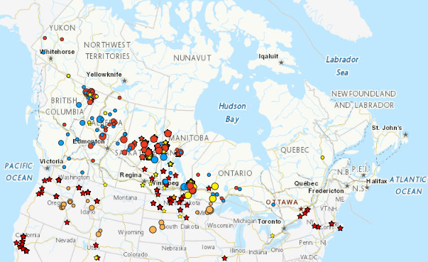
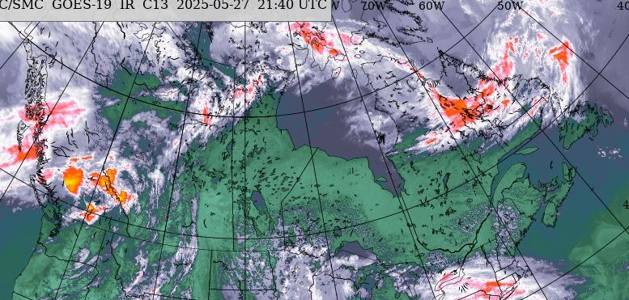
CWFIS Hotspots (Interactive Map)
http://cfsdev.nofc.cfs.nrcan.gc.ca/cwfis-dev/interactive-map
http://weather.gc.ca/data/satellite/goes_nam_1070x_100.jpg
Interactive map : ~14.5H x 22.8W 9Hx11.6W
Notes:
Update images manually. We want to preserve the images from the previous afternoon.
To overlay a semi-transparent satellite image:
-Align the red line from the northern tip of Vancouver Island to the southeast tip of Newfoundland’s Avalon Peninsula.
-Get the CWFIS interactive map image from late afternoon on Tuesday and align with the red line as above
-Choose the late afternoon Tuesday North American GOES composite image. Rotate ~7 degrees, transparency ~50%.
and align with the red line/CWFIS interactive map image.
Previous afternoon’s CWFIS active fire layer with other themes such as hotspots as you see fit. Red circles are fires of > 1000 ha, orange 100-1000 ha, yellow < 100 ha.
Include satellite image from Environment Canada (North American IR & topography) from about the same time as the CWFIS screenshots.
The inset shows fires in Yukon via the Data Integration Project. Red circles indicate uncontrolled fires.
4

Slide 5
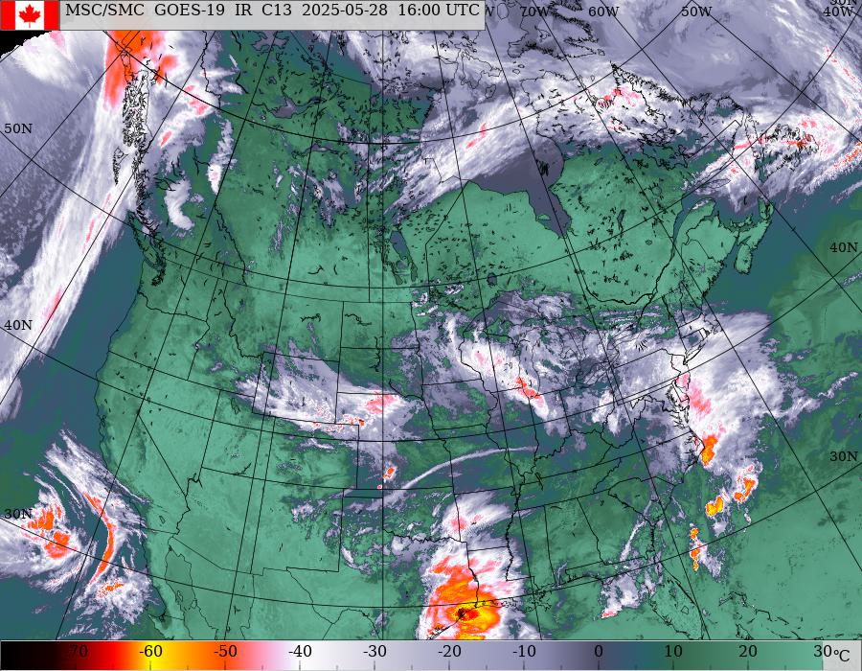
North American IR Composite
http://weather.gc.ca/data/satellite/goes_nam_1070_100.jpg
14H x 18W
Notes:
Image is updated automatically from web.

Slide 6
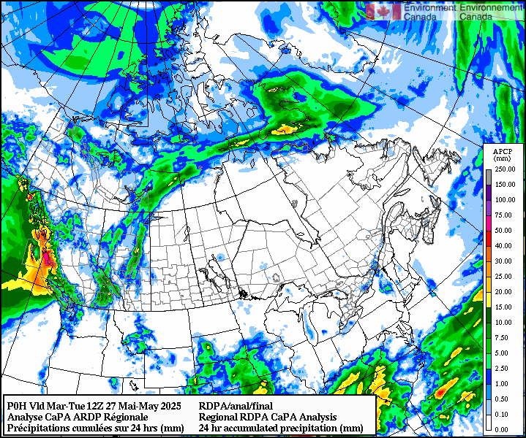
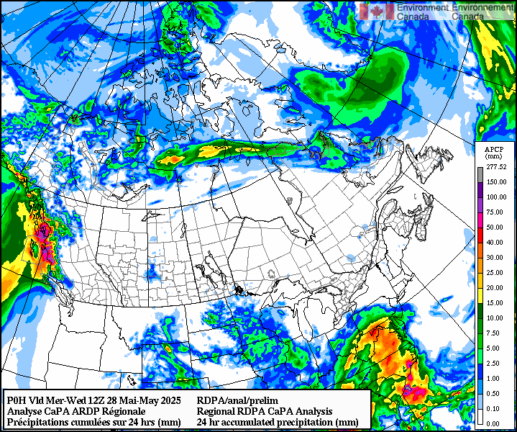
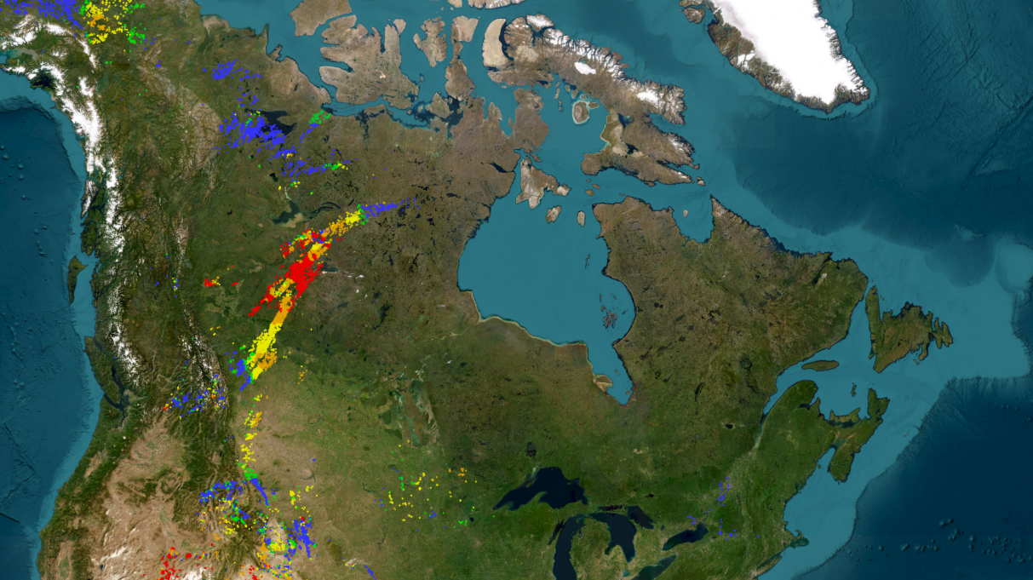
Lightning and CaPA
https://weather.gc.ca/data/analysis/regional/rdpa/2025040312_054_CR_canada_I_RDPA_prelim@pr@024_000.png
Local Repository: W:\EDM\Fire\CIFFC\WeatherBriefings\Gen_Image_Repo\capa_prelim1.png
CLDN past 48 hours
14Hx16.8W 6.9H x 12W
Notes:
Automatic update of CaPA image when downloaded using Markus’ tool.
We likely need to update the Ops Room Viewer image manually as layers have to be chosen. Use https://app-portal-cwfis-sbx.azurewebsites.net/situation-viewer
6

Slide 7
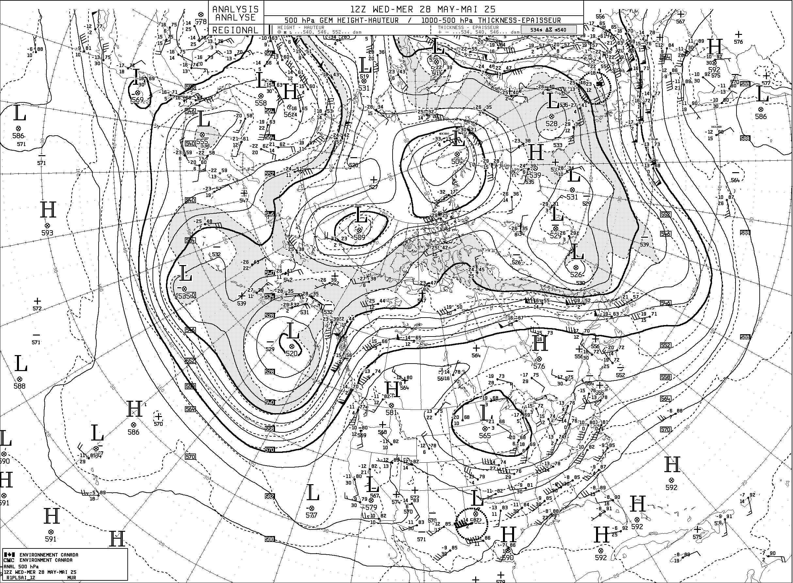
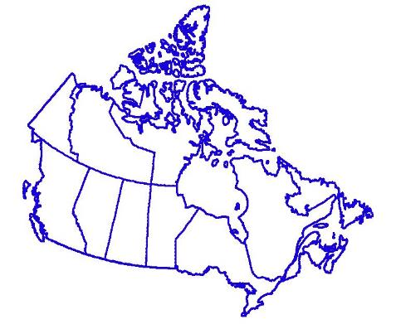
500 hPa Analysis (12 UTC)
250 hPa: https://weather.gc.ca/data/analysis/sah_100.gif
500 hPa: https://weather.gc.ca/data/analysis/sai_100.gif
L
L
L
L
H
H
H
L
L
H
14H x 19W
Notes:
Images are updated automatically from the web.
250 hPa analysis shows jet stream features (or lack thereof)
Point out major troughs and ridges and areas without significant features. The latter are often prone to fire if unchanged over a period of a few days or more.

Slide 8
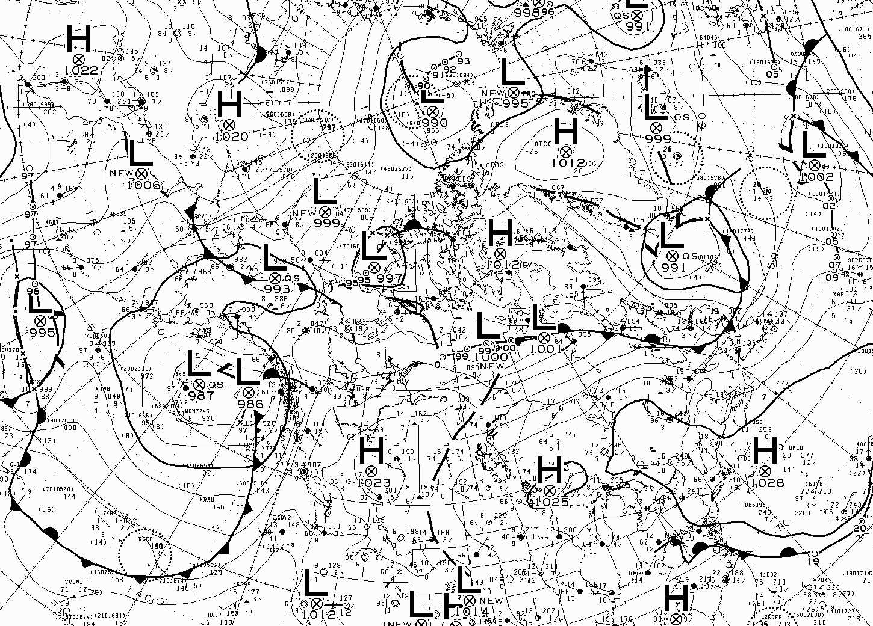
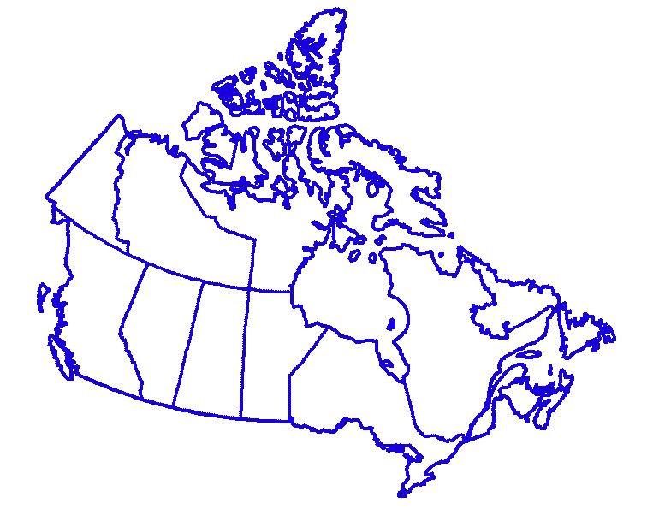
Surface Analysis (12 UTC)
http://weather.gc.ca/data/analysis/935_100.gif
15H x 17.5W
Notes:
Images are updated automatically from the web.
Morning (12Z) surface analysis for Canadian region showing surface pressure pattern (or lack thereof)
Point out major troughs and high pressure areas and areas without significant features.

Slide 9
Forecast conditions

Slide 10
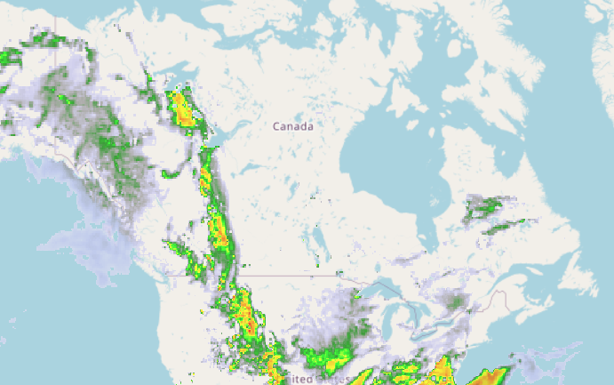
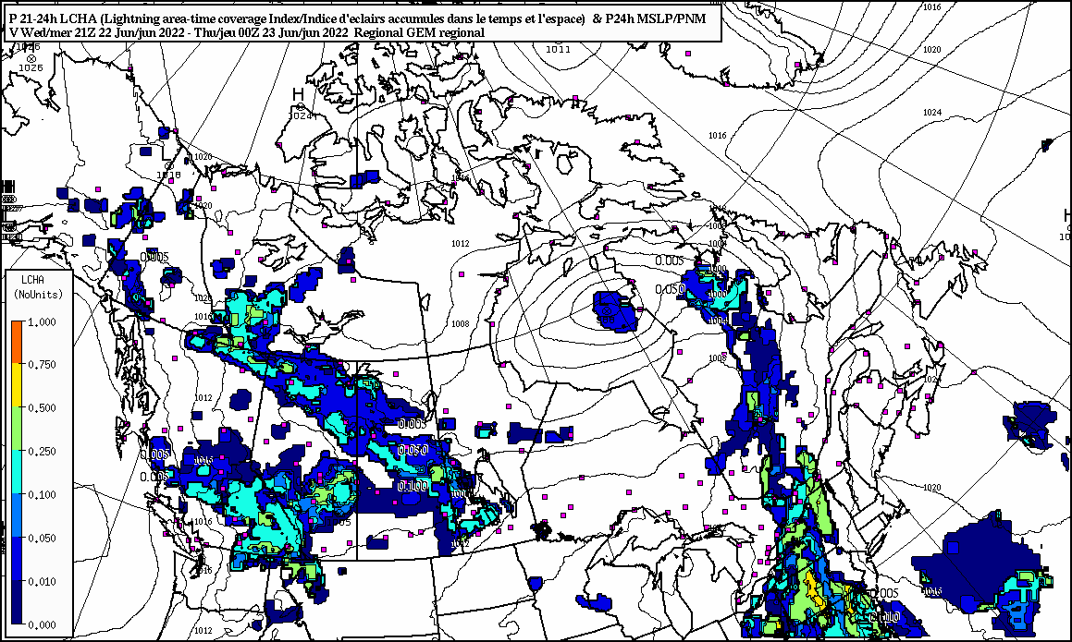
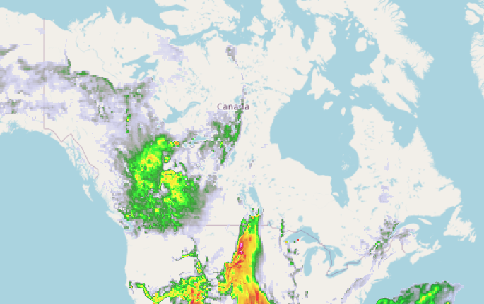
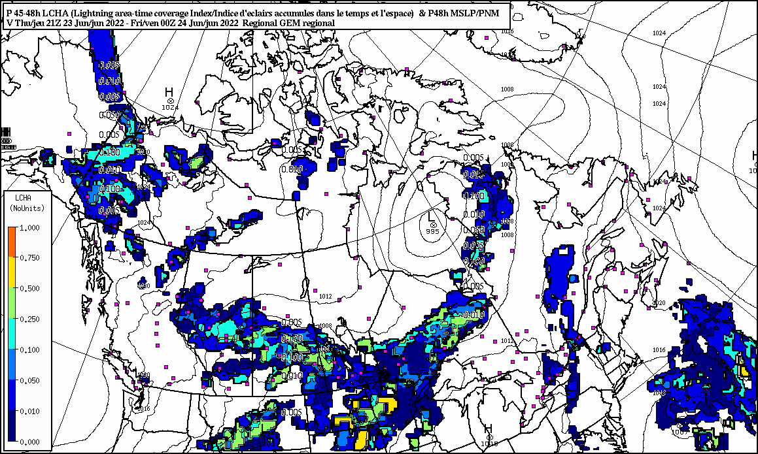
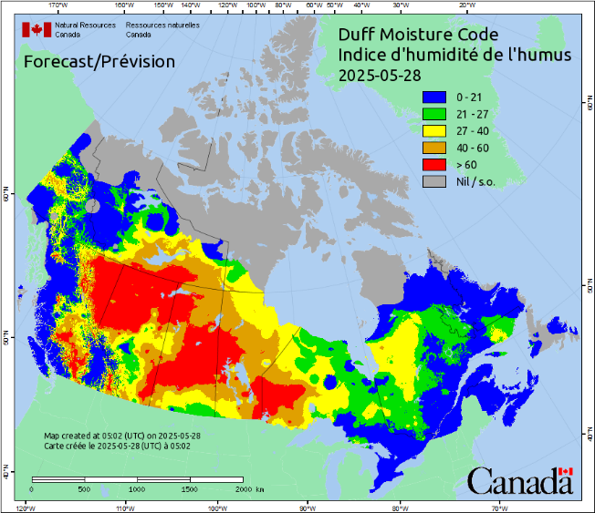
Lightning Forecast
\\s-bsc-uiftprd1.nrn.nrcan.gc.ca\incoming\burrows_ltg
Thur May 29 pm,
Surface-based CAPE
Maps generated by Environment Canada –
Meteorological Service of Canada
Mon June 2 pm, Surface-based CAPE
Thu pm
Wed pm
7.5H x 12.5W
Notes:
Update manually for now – unsure if we can link image from the NRCan ftp site (incoming).
Short-term lightning forecast maps from Bill Burrows at EC-MSC’s Alberta/Arctic weather centre in Edmonton. These are uploaded to daily at about 11:00 am MDT, so we miss the morning update when doing most CIFFC briefings (except SPU, which runs at noon MDT). Normally use the 21 and 45 hour images, valid late afternoon today and tomorrow.

Slide 11
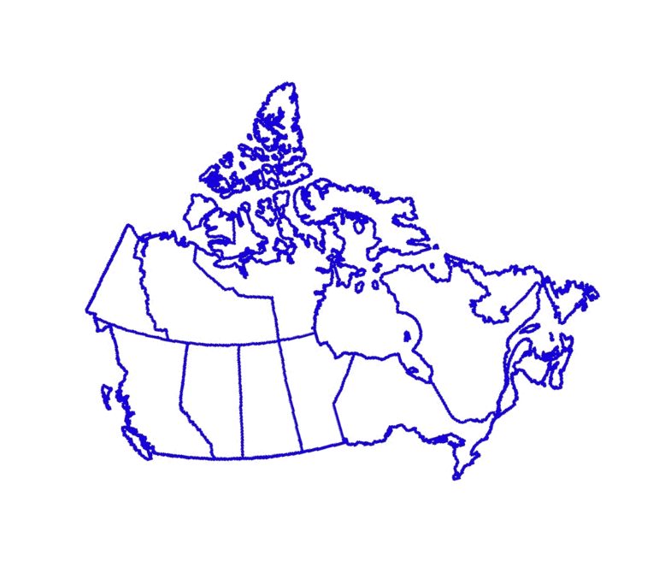
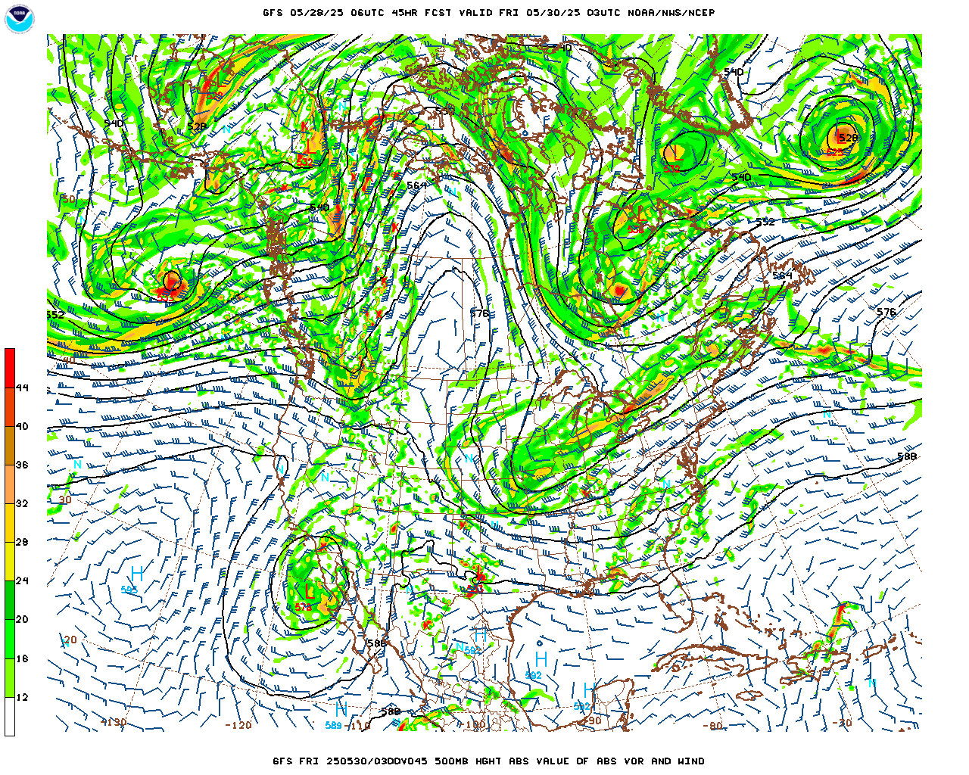
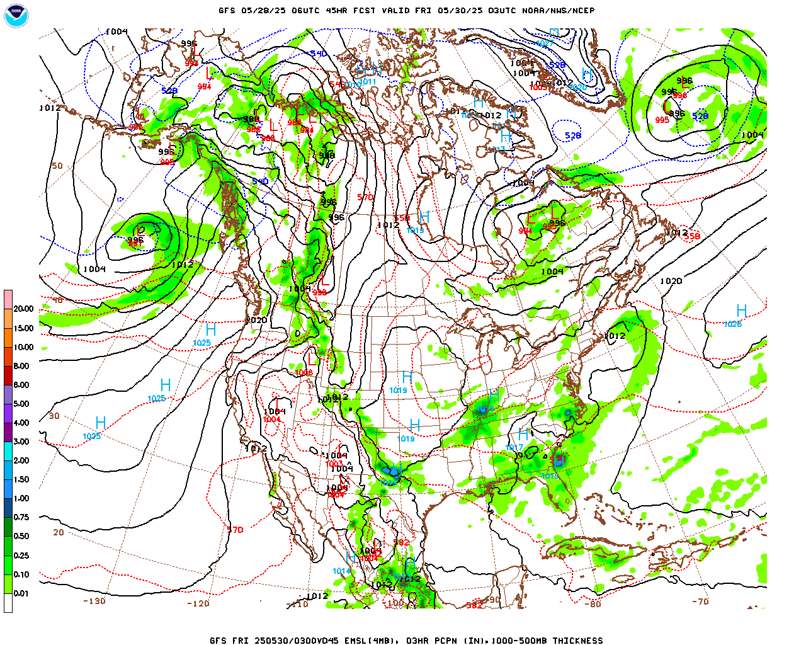
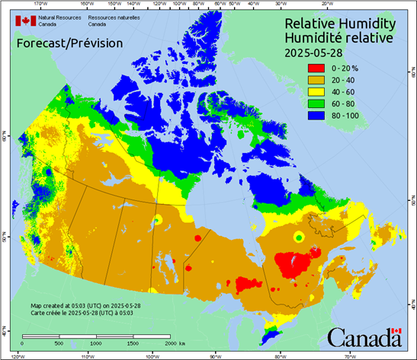
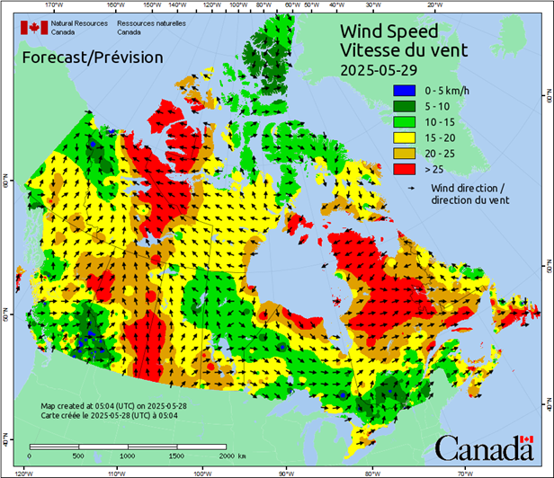
NAM/GFS/NAEFS
http://mag.ncep.noaa.gov/model-guidance-model-area.php
t=45h 2025053003Z Thu May 20 eve
L
L
L
L
L
L
H
L
L
H
L
L
L
L
H
H
H
L
each 10H x 12.4W
Notes:
Update manually for now – Markus’ tool looping may be too slow to be efficient.
NWP maps from NCEP’s NAM/GFS/NAEFS models. From this main page, choose the Model Area and Model Type. On the next page, choose the initialization time from the top row of the table, then choose the parameters you wish to view, and the forecast time (hours from initialization). Note it is difficult to capture individual images when looping through the output, so instead choose the forecast hour you wish to display. Remember to change the date and time in the text box above the charts!
Copy this slide to a new one if you want to show additional forecast times.
Left: 500 hPa level (5-6 km up)
Right: Surface – green/blue areas show forecast precipitation
Highlight ridges and troughs and areas without significant upper air features. The latter are often prone to fire if unchanged over a period of a few days or more. Indicate areas where lightning/heat/dryness/wind may cause problems, and where significant rain is expected.

Slide 12
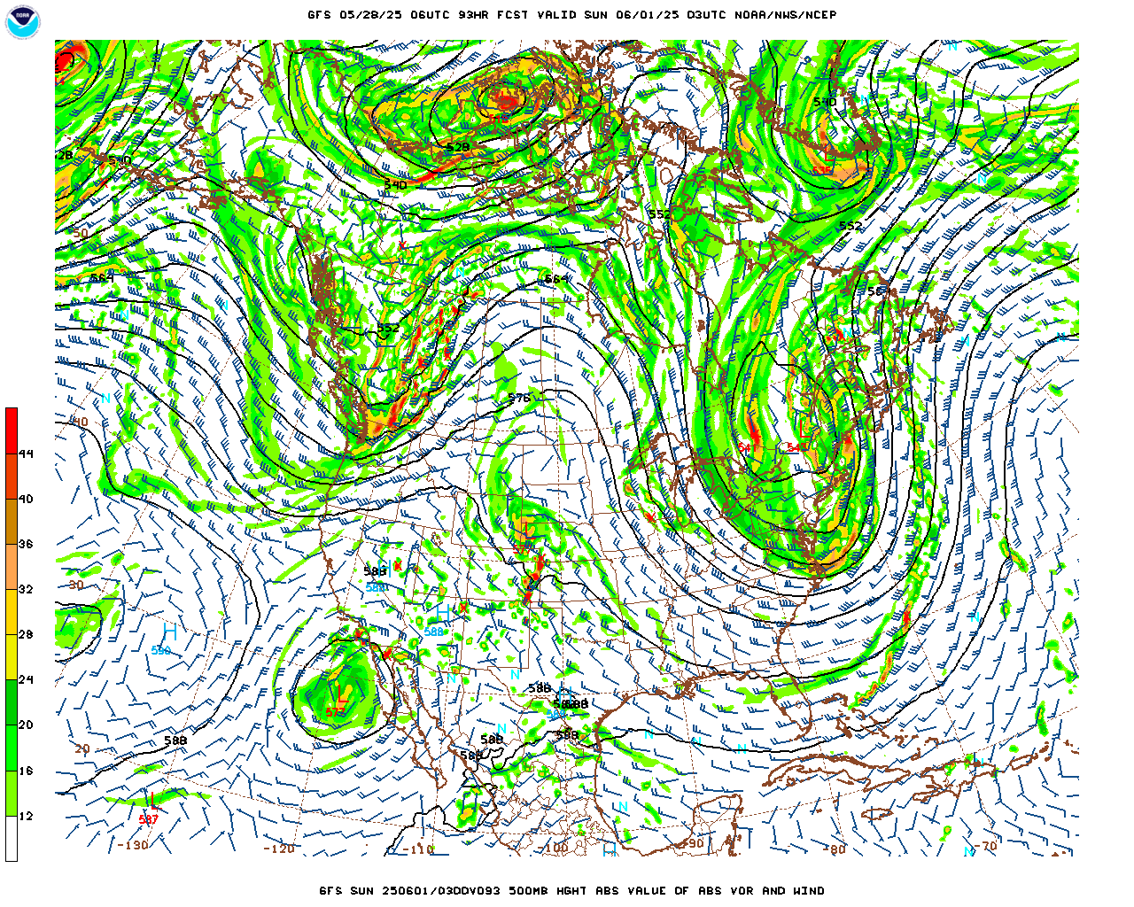
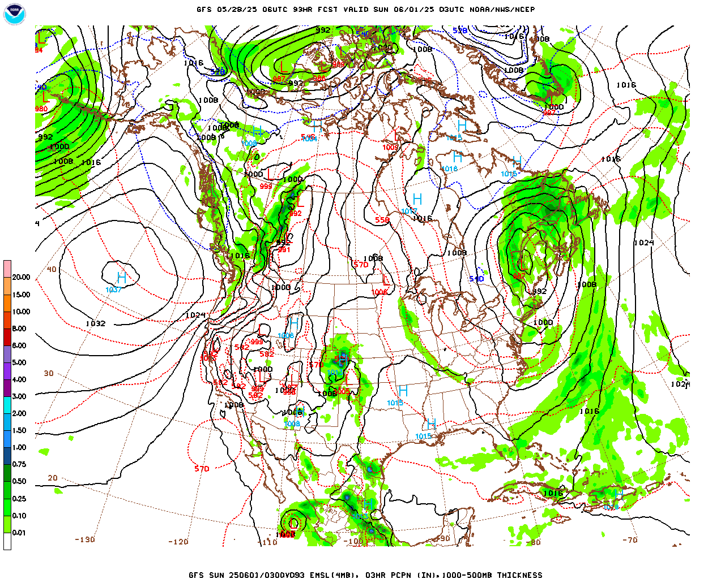
NAM/GFS/NAEFS
http://mag.ncep.noaa.gov/model-guidance-model-area.php
t=93h 2025060103Z Sun Jun 1 eve
L
L
L
L
L
L
L
H
L
H
L
L
H
H
H
L
L
each 10H x 12.4W
Notes:
Update manually for now – Markus’ tool looping may be too slow to be efficient.
NWP maps from NCEP’s NAM/GFS/NAEFS models. From this main page, choose the Model Area and Model Type. On the next page, choose the initialization time from the top row of the table, then choose the parameters you wish to view, and the forecast time (hours from initialization). Note it is difficult to capture individual images when looping through the output, so instead choose the forecast hour you wish to display. Remember to change the date and time in the text box above the charts!
Copy this slide to a new one if you want to show additional forecast times.
Left: 500 hPa level (5-6 km up)
Right: Surface – green/blue areas show forecast precipitation
Highlight ridges and troughs and areas without significant upper air features. The latter are often prone to fire if unchanged over a period of a few days or more. Indicate areas where lightning/heat/dryness/wind may cause problems, and where significant rain is expected.

Slide 13
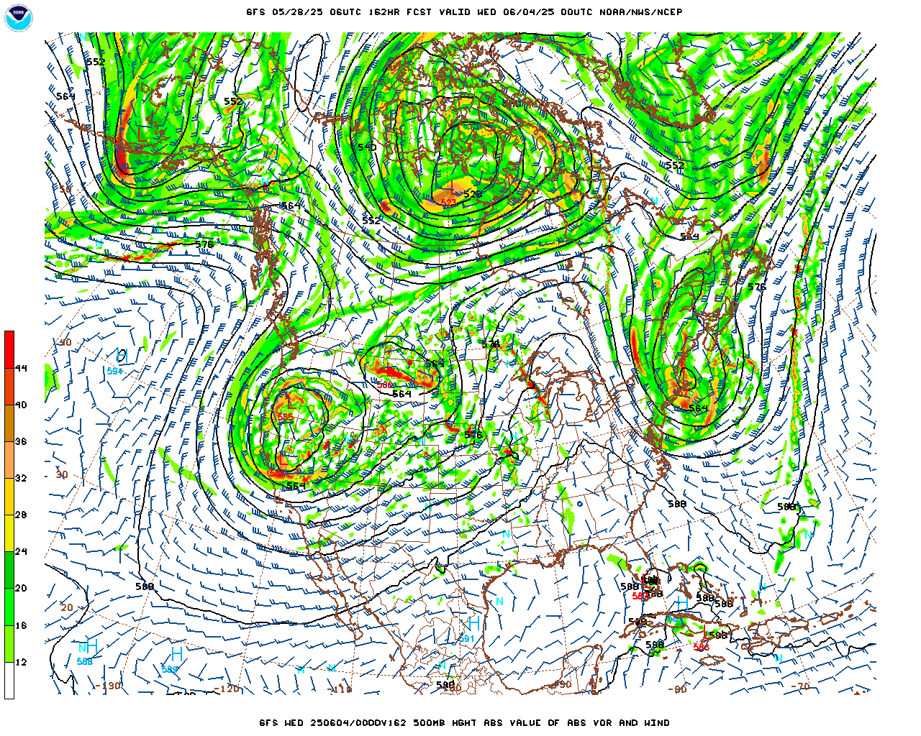
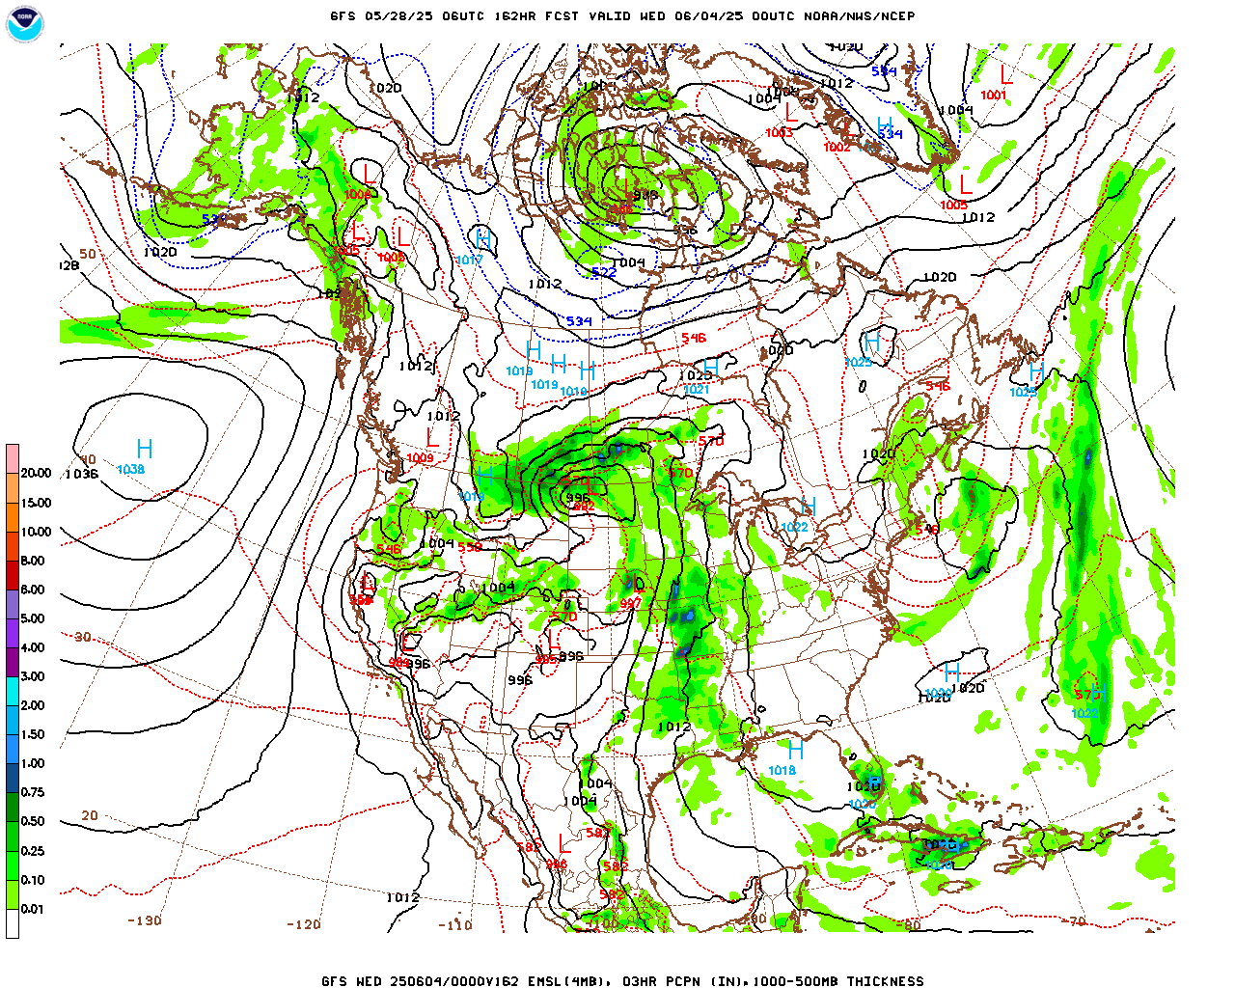
NAM/GFS/NAEFS
http://mag.ncep.noaa.gov/model-guidance-model-area.php
t=162h 2025060400Z Tue Jun 3 eve
L
L
L
L
L
L
H
H
H
H
L
H
L
H
L
L
H
L
each 10H x 12.4W
Notes:
Update manually for now – Markus’ tool looping may be too slow to be efficient.
NWP maps from NCEP’s NAM/GFS/NAEFS models. From this main page, choose the Model Area and Model Type. On the next page, choose the initialization time from the top row of the table, then choose the parameters you wish to view, and the forecast time (hours from initialization). Note it is difficult to capture individual images when looping through the output, so instead choose the forecast hour you wish to display. Remember to change the date and time in the text box above the charts!
Copy this slide to a new one if you want to show additional forecast times.
Left: 500 hPa level (5-6 km up)
Right: Surface – green/blue areas show forecast precipitation
Highlight ridges and troughs and areas without significant upper air features. The latter are often prone to fire if unchanged over a period of a few days or more. Indicate areas where lightning/heat/dryness/wind may cause problems, and where significant rain is expected.

Slide 14
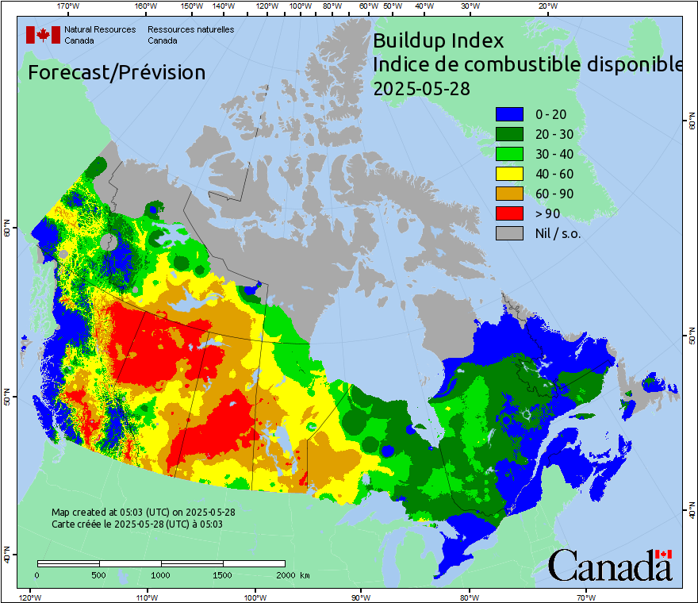
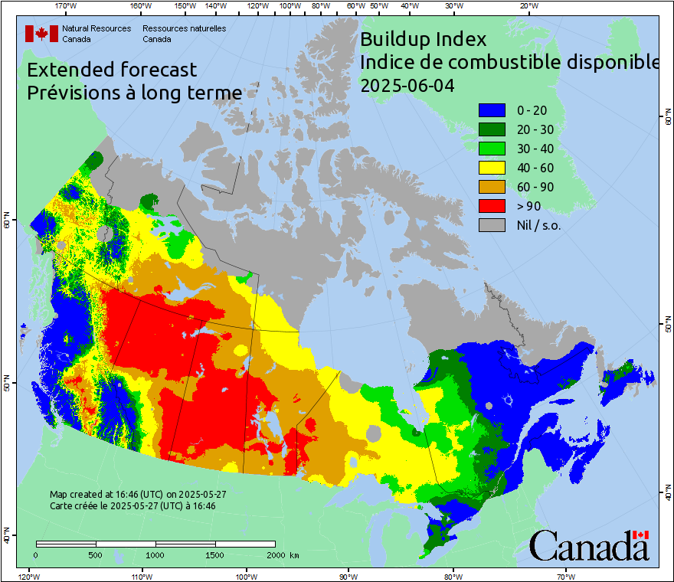
CFFWIS
9H x 8W
9H x 10.4W
Notes:
Update images manually – CWFIS images URLs are date-specific.
CWFIS forecast Fire Weather Index or other themes. Choose the most relevant for the forecast period and uptrend or downtrend of indexes. Discuss rapid or ongoing changes between days.
Composite of Canadian, American, and Mexican fire danger updated at 8, 12, 18, 23 MDT
Canadian: Forecast conditions at 0800 and 1200 runs; observed conditions at 1800 and 2300 runs
American: Observed conditions, run by USFS
Mexican: Observed conditions, run by CFS-WFIS
Watch map text for source of data

Slide 15
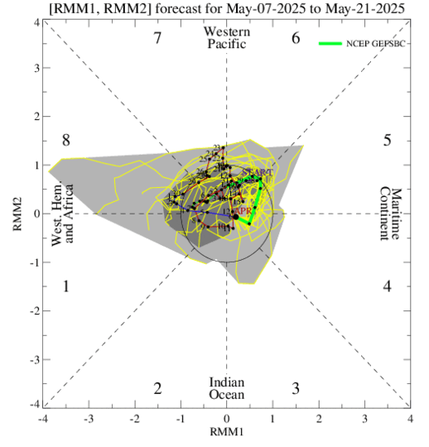
Madden-Julian Oscillation
https://www.cpc.ncep.noaa.gov/products/precip/CWlink/MJO/foregfs.shtml
Local Repository: W:\EDM\Fire\CIFFC\WeatherBriefings\Gen_Image_Repo\MJO1.png
MJO presence is indicated by 2 of 3 of:
200 hPa zonal wind anomaly
850 hPa zonal wind anomaly
OLR anomaly
These are indicated by RMM1 and RMM2 on the phase diagrams.
https://hpfx.science.gc.ca/~lin001/
Temperature
Precipitation
Notes:
MJO phase diagram is updated automatically upon download with Markus’ tool.
Update Hai Lin’s images manually – we have to choose the season and crop to the MJO phase.

Slide 16
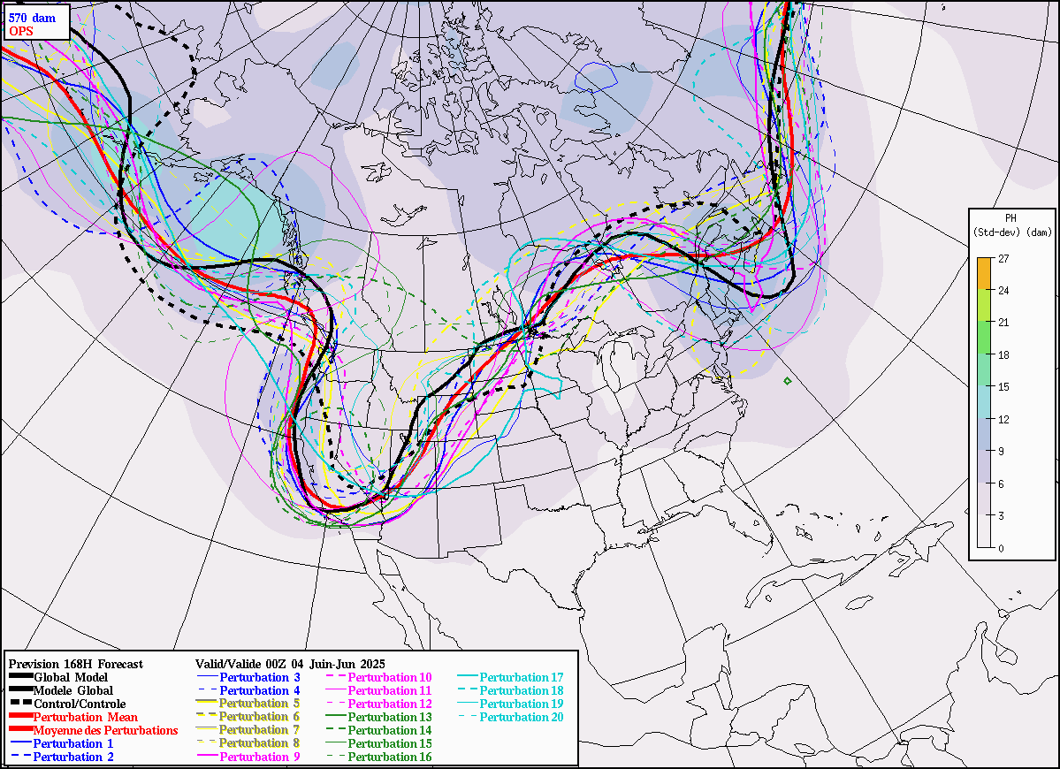
Ensemble 7d (t=168h Tue pm)
http://weather.gc.ca/ensemble/index_e.html#spagat
Local repository: W:\EDM\Fire\CIFFC\WeatherBriefings\Gen_Image_Repo\cef5702.png
L
570 dam
L
H
H
L
14.5H x 20W
Notes:
Updates automatically if downloaded using Markus’ tool. You may have to change the local link between cef5581.png and cef5701.png, depending on the month.
Spaghetti plot of some geopotential height. The 558 dam line is likely good for spring and fall, and the 570 for summer.
Choose the contour line, forecast initialization date and time, and the number of hours into the forecast you wish to feature from the drop-down boxes under “Spaghetti Plots” at the top of this URL-linked web page. You can scroll back and forth between forecast hours within the display. If you choose a different time, be sure to change the hours and valid day in this slide’s title.
Tangled lines indicate uncertainty between ensemble elements, and uncertainty in forecast conditions.
Tightly-bound lines indicate a high degree of certainty of contour line placement and forecast conditions.

Slide 17
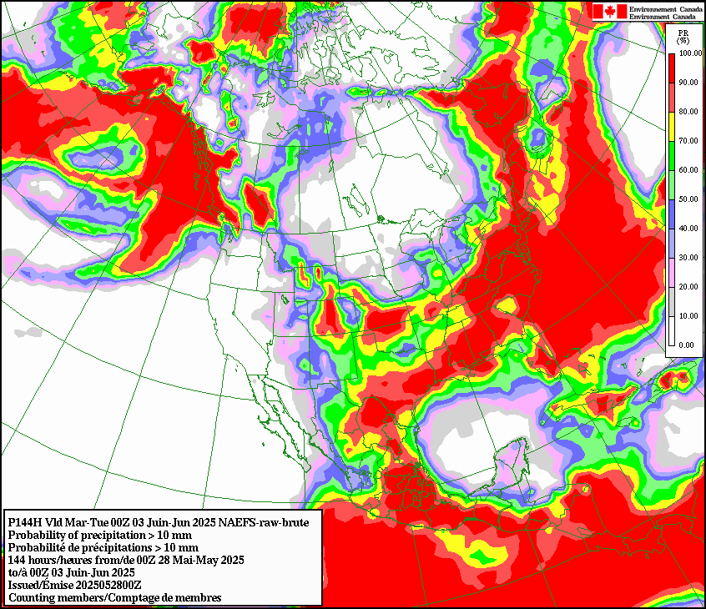
NAEFS
http://weather.gc.ca/ensemble/index_e.html#spagat
Local repository: W:\EDM\Fire\CIFFC\WeatherBriefings\Gen_Image_Repo\naefstotalPcp168h1.png
May 28 – June 3 00z
10 mm total
14.5H x 16.8W Inset 250%
Notes:
Updates automatically from local repository if downloaded using Markus’ tool. If you want a different precipitation threshold or time period then update manually from the web.
Choose the “Precip. accumulation” amount you want to show from the “Product Type” drop-down box. Choose the model initialization time (00 or 12) from the drop-down on the right, then run out the “Forecast End” date for the period you need.

Slide 18
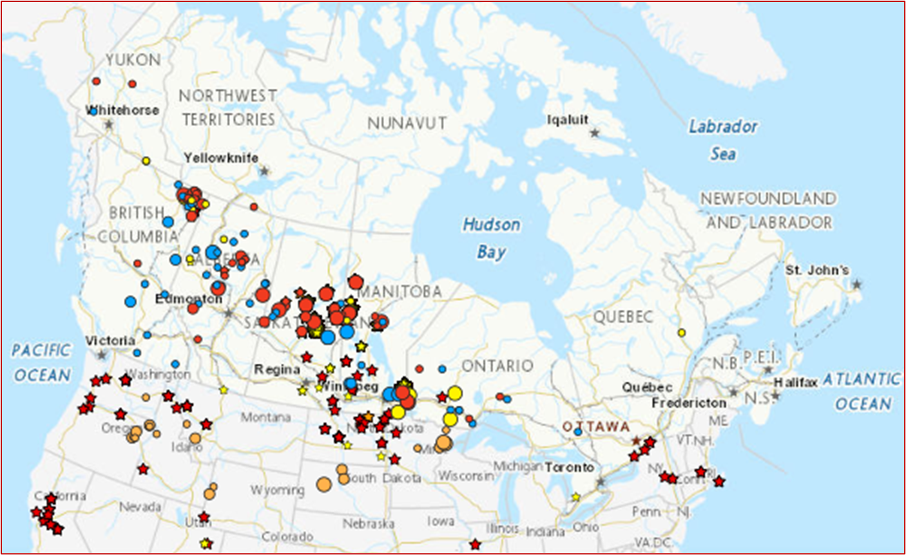
Graphic Summary – Week 1
May 28 – June 3, 2025
Periodic Showers/thundershowers
with windy periods
Continued Drying
Periodic showers on/after weekend
15.5H x 20.0W
Notes:
Summarize the expected fire weather conditions in the regions of the country indicated.
Use red font for regions of intense activity
Use orange font for regions of moderate activity
Use yellow font for regions of low activity
Use green font for regions of minimal activity
Add specific comments for each region. These may be included in items such as CIFFC SPU call minutes, so be clear and concise as possible
Summarize the expected fire weather conditions in the regions of the country indicated.
Use red font for regions of intense activity or expected high fire weather indexes.
Use blue font for regions expecting substantial rainfall or with low fire weather indexes.
Use shapes to outline regions, and symbols to indicate lightning or other relevant conditions.

Slide 19
Fire weather indexes trends
Summary of national fire weather expectations May 28 – June 3, 2025:
Little or no activity A few small fires
Large fires possible Widespread intense activity
Atmospheric features are still moving quickly, providing variable weather in most regions. Wind could be a growth factor in active fire areas with these transitions.
West (BC/YT/NT/AB):
BC: Steady
YT: Steady
NT: Steady
AB: Rising then falling/steady after weekend
Central (SK/MB/NU/ON):
SK: Rising, periodic thundershowers esp in north
MB: Rising
ON: Rising in north/west
East (QC/Atl);
QC: Falling on/after weekend
Atl: Falling on/after weekend
mH x nW
Notes:
Summarize the expected fire weather conditions in the regions of the country indicated.
Use red font for regions of intense activity
Use orange font for regions of moderate activity
Use yellow font for regions of low activity
Use green font for regions of minimal activity
Add specific comments for each region. These may be included in items such as CIFFC SPU call minutes, so be clear and concise as possible

Slide 20
Weather Notes: May 28 -- June 3, 2025
Updates:
1
Fire Weather This Week (Updated Wednesday May 28, 2025, Richard Carr)
Clear and dry weather prevails over most of Canada between Wednesday, May 28, and Friday May 30.
Pacific troughs cross western Canada Thursday, May 29 and Sunday, June 1. These will bring active bands of thundershowers and increase wind as they pass, creating conditions conducive to new fire starts and rapid growth.
Following the May 31- June 1 weekend, a cooler and moister pattern affects western regions, increasing chances of daily shower or thundershower development.
Northern regions of the Prairies and Ontario appear to remain mostly dry, increasing fire weather indexes. Occasional bands of showers or thundershowers may scrape northern regions, raising chances of lightning fires, as showers passing through Alberta are forced northeast towards Nunavut.
Yukon and the Northwest Territories will have spotty showers or thundershowers, although lightning fire potential remains near and south of Great Slave Lake.
Eastern Canada starts the period with warm and dry conditions, but showers become more prevalent after the May 31 – June 1 weekend as low pressure areas from the north and south converge. This will return fire weather indexes to low or moderate.
mH x nW

Slide 21
Questions or suggestions?
Contact:
Richard Carr or Liam Buchart
Wildland Fire Research Analyst
Richard.Carr@NRCan-RNCan.gc.ca
Liam.Buchart@NRCan-RNCan.gc.ca
5320 122 Street NW
Edmonton, AB, Canada
T6H 3S5
Richard: 825-510-1265
Liam: 825-510-1211
?
?
?
?
?

